Slide 1


Non-parametric tests
Anne Segonds-Pichon v2020-09

Slide 2
Comparison between 2 groups
Non-Parametric data

Slide 3
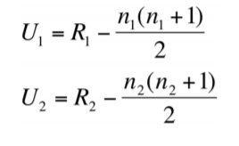
Non-parametric test:
Mann-Whitney = Wilcoxon rank test
Non-parametric equivalent of the t-test (and not).
Not meeting the assumptions for parametric tests is not enough to switch to a non-parametric approach.
  Like always, data exploration is key.
  The outcome is a rank or a score with limited amount of possible values: non-parametric approach.
How does the Mann-Whitney test work?
Real values | Ranks
3 | 1
5 | 2
6 | 3
7 | 4
8 | 5
9 | 6
 | Group 1 | Group 2
 | 2 | 5
 | 4 | 6
 | 1 | 3
Sum | 7 | 14
Group 1 | Group 2
5 | 8
7 | 9
3 | 6
Statistic of the Mann-Whitney test: U (W)
  U₁ = 7-6 = 1 and U₂ = 14-6 = 8
  Smallest of the 2 Us: U₁ + sample size p-value
R: wilcox_test()
Where:
R = sum of ranks
n = sample size.

Slide 4
Non-parametric test:
Wilcoxon’s signed-rank
Non-parametric equivalent of the paired t-test (ish).
How does the test work?
2+3=5/2=2.5: average rank
Before | After | Differences
9 | 3 | -6
7 | 4 | -3
10 | 4 | -6
8 | 5 | -3
5 | 6 | 1
8 | 2 | -6
7 | 7 | 0
9 | 4 | -5
10 | 5 | -5
Abs. Diff. | Ranking | Ranks
0
1 | 1 | 1
3 | 2 | 2.5
3 | 3 | 2.5
5 | 4 | 4.5
5 | 5 | 4.5
6 | 6 | 7
6 | 7 | 7
6 | 8 | 7
 | Negative ranks | Positives ranks
 |  | 1
 | -2.5
 | -2.5
 | -4.5
 | -4.5
 | -7
 | -7
 | -7
Sum | -35 | 1
Statistic of the Wilcoxon’s signed-rank test: Sum of signed ranks = W
  Here: W = -35 + 1 = -34
  Statistic W + sample size p-value
R: wilcox_test(paired = TRUE)

Slide 5

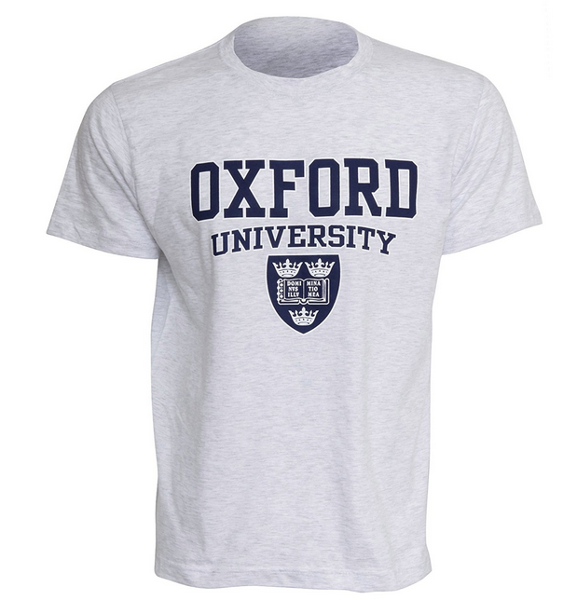
Exercise 13: Independent test
smelly.teeshirt.csv
Hypothesis: Group body odour is less disgusting when associated with an in-group member versus an out-group member. Two groups of Cambridge University students
are presented with one of two smelly, worn t-shirts with university logos.
Question: are Cambridge students more disgusted by worn smelly T-shirts from Oxford or Cambridge? Disgust score: 1 to 7, with 7 the most disgusting
  Load smelly.teeshirt.csv
  Explore the data with an appropriate combination of 2 graphs
  Answer the question with a non-parametric approach

Slide 6
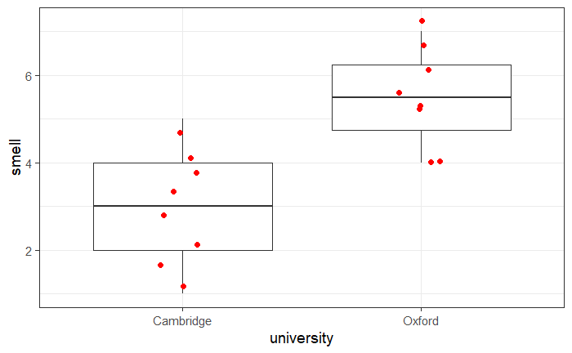

Exercise 13: smelly.teeshirt. csv
Question: are Cambridge students more disgusted
by worn smelly T-shirts from Oxford or Cambridge?
  Disgust score: 1 to 7, with 7 the most disgusting
read_csv("smelly.teeshirt.csv") -> smelly.teeshirt
smelly.teeshirt %>%
ggplot(aes(x=university, y=smell))+
geom_boxplot()+
geom_jitter(height=0, width=0.1, size=2, colour="red")
smelly.teeshirt %>%
wilcox_test(smell~university)
Answer: T-shirts from Oxford are significantly more disgusting than the ones from Cambridge (W=5,p=0.0047).
What do you think of the design??

Slide 7
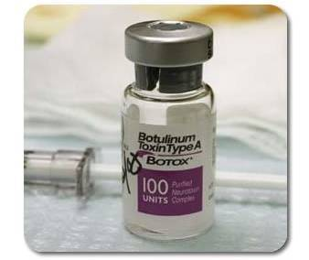
Exercise 14: Dependent test
botulinum.long.csv
A group of 9 disabled children with muscle spasticity (or extreme muscle tightness limiting movement) in their right upper limb underwent a course of injections with botulinum toxin to reduce spasticity levels.
A neurologist (blinded) assessed levels of spasticity pre- and post-treatment for all 9 children using a 10-point ordinal scale.
Higher ratings indicated higher levels of spasticity.
Question: do botulinum toxin injections reduce muscle spasticity levels?
  Score: 1 to 10, with 10 the highest spasticity
  Load botulinum.long.csv
  Plot the data
  Answer the question with a non-parametric approach
  Work out and plot the difference (after – before)

Slide 8
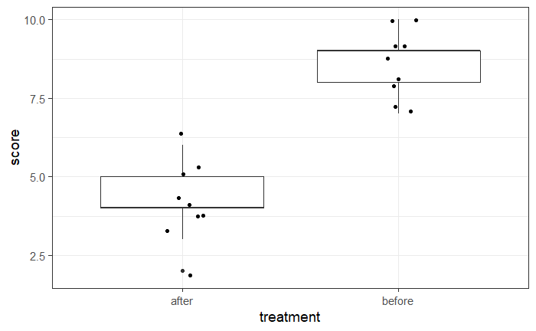
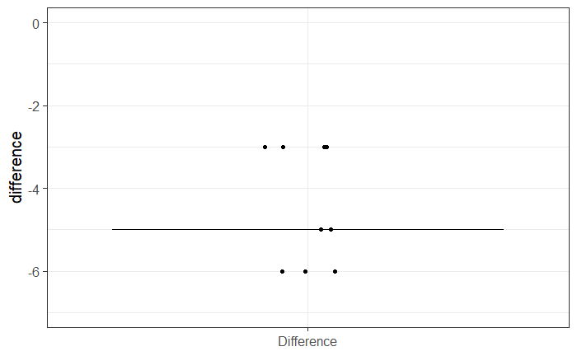

Exercise 14: Dependent test - botulinum.csv
read_csv("botulinum.long.csv") -> botulinum
botulinum %>%
ggplot(aes(x=treatment, y=score))+
geom_boxplot()+
geom_jitter(height=0, width=0.1)
botulinum %>%
mutate(difference = scores - scores[treatment == 'before']) %>%
ggplot(aes("Difference", difference))+
geom_jitter(height = 0, width=0.1)+
stat_summary(geom="errorbar",
fun=median,fun.min=median,fun.max=median)+
ylim(-7, 0)+
xlab(NULL)
botulinum.long %>%
wilcox_test(score~treatment, paired = TRUE)
Answer: There was a significant difference pre- and post- treatment in ratings of muscle spasticity (p=0.008). Note: T=V

Slide 9

Comparison between more than 2 groups
One factor
Non-Parametric data

Slide 10
Kruskal-Wallis and Friedman tests
Non-parametric equivalents of the One-Way ANOVA
  Also based on ranks
  Kruskal-Wallis: independent measures
  Friedman: repeated measures
Statistic associated with Kruskal-Wallis is H
Statistic associated with Friedman is Q or T1 or FM
The statistics have a Chi² distribution
  Kruskal-Wallis H = Friedman statistic = One-Way ANOVA F
Post-hoc test associated with Kruskal-Wallis and Friedman: Dunn’s test
  The Dunn’s test works pretty much like the Mann-Whitney test.

Slide 11
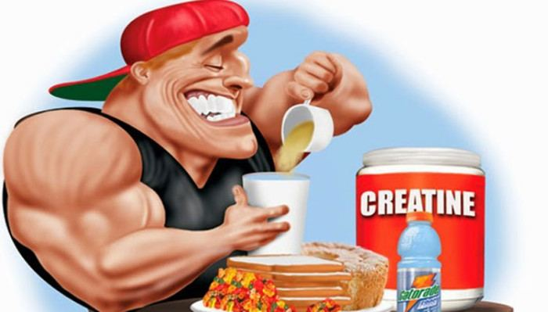
Kruskal-Wallis test: Example
Creatine, a supplement popular among body builders
Three groups: No creatine; Once a day; and Twice a day.
Question: does the average weight gain depend on the creatine group to which people were assigned?

Slide 12
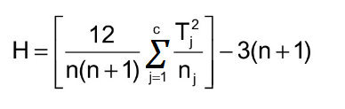
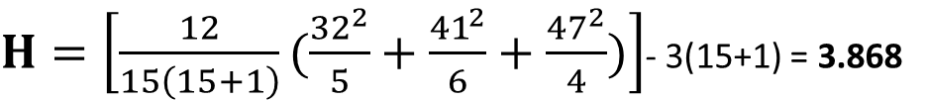
Kruskal-Wallis
Example: creatine.csv
Actual values
Ranks
No | Once | Twice
63 | 0 | 2239
-261 | -652 | 171
-153 | 4724 | 40
-13 | -2 | 1395
965 | 0
 | -86
No | Once | Twice
10 | 7.5 | 14
2 | 1 | 11
3 | 15 | 9
5 | 6 | 13
12 | 7.5
 | 4
32 | 41 | 47
$H=\left[\frac{12}{15\left(15+1\right)}(\frac{{32}^{2}}{5}+\frac{{41}^{2}}{6}+\frac{{47}^{2}}{4})\right]$- 3(15+1) = 3.868
Where:
n = sum of sample sizes for all samples,
c = number of samples,
T_{j} = sum of ranks in the j^{th} sample,
n_{j} = size of the j^{th} sample.

Slide 13

Friedman test: Example
An auction house is putting three violins, A, B, and C, up for bidding. Ten violinists are blindfolded are asked to rate the instruments and each player plays the violins in a randomly determined sequence (BCA, ACB, etc.).
After each violin is played, the violinist rates the instrument on a 10-point scale of overall excellence (1=lowest, 10=highest).
Question: which violin is the best according to the 10 violinists?

Slide 14
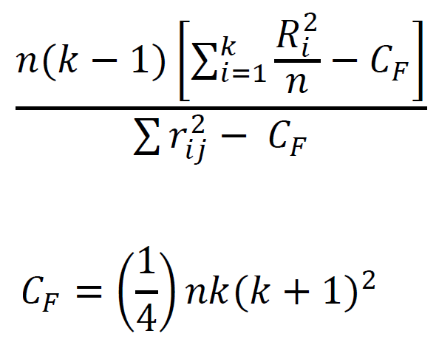
Friedman test
Example: violin.csv
Actual values
Ranks
Violinists | Violin A | Violin B | Violin C
1 | 9 | 7 | 6
2 | 9.5 | 6.5 | 8
3 | 5 | 7 | 4
4 | 7.5 | 7.5 | 6
5 | 9.5 | 5 | 7
6 | 7.5 | 8 | 6.5
7 | 8 | 6 | 6
8 | 7 | 6.5 | 4
9 | 8.5 | 7 | 6.5
10 | 6 | 7 | 3
Violinists | Violin A | Violin B | Violin C
1 | 3 | 2 | 1
2 | 3 | 1 | 2
3 | 2 | 3 | 1
4 | 2.5 | 2.5 | 1
5 | 3 | 1 | 2
6 | 2 | 3 | 1
7 | 3 | 1.5 | 1.5
8 | 3 | 2 | 1
9 | 3 | 2 | 1
10 | 2 | 3 | 1
Sum | 77.5 | 67.5 | 57
Q or T1 or FM =
Where:
n = sum of sample sizes for all samples,
k = number of samples,
R_{j} = sum of ranks in the j^{th} sample,
r_{ij} = rank i of the j^{th} sample.

Slide 15
Kruskal-Wallis and Friedman tests
Exercise 15: creatine.csv
Question: does the average weight gain depend on the creatine group to which people were assigned?
kruskal_test(y~x) produces omnibus part of the analysis
dunn_test(y~x) produces pairwise comparisons results
Exercise 16: violin.csv
Question: which violin is the best according to the 10 violinists?
friedman_test(y~x|id)
wilcox_test(y~x, paired = TRUE, p.adjust.method = "bonferroni")
Have a go !

Slide 16
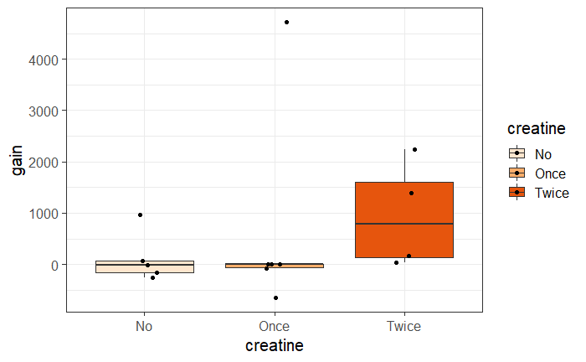

Exercise 15: creatine.csv
Creatine, a supplement popular among body builders
Three groups: No creatine; Once a day; and Twice a day.
Question: does the average weight gain depend on the creatine group to which people were assigned?
read_csv("creatine.csv") -> creatine
creatine %>%
ggplot(aes(creatine, gain, fill=creatine))+
geom_boxplot(outlier.shape = NA)+
geom_jitter(height = 0, width=0.1)+
scale_fill_brewer(palette="Oranges")
creatine %>%
group_by(creatine) %>%
summarise(sd=sd(gain))

Slide 17

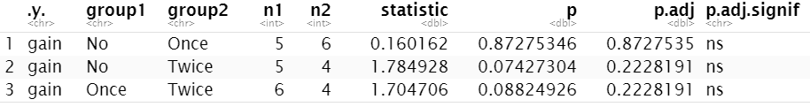
Exercise 15: creatine.csv
creatine %>%
kruskal_test(gain~creatine)
Not needed here
creatine %>%
dunn_test(gain~creatine)
Answer: this study did not demonstrate any effect from creatine (χ² = 3.87, p = 0.14).

Slide 18
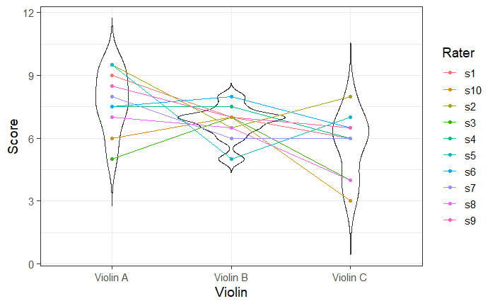
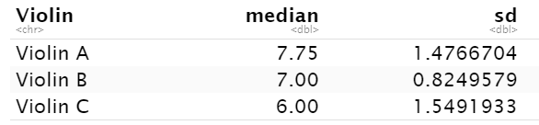
Exercise 16: violin.csv
3 violins, each tested by 10 violinists.
Question: which violin is the best according to the 10 violinists?
read_csv("violin.csv") -> violin
violin %>%
ggplot(aes(Violin, Score)) +
geom_violin(trim=FALSE)+
geom_point(aes(colour=Rater)) +
geom_line(aes(group = Rater, colour=Rater))
violin %>%
group_by(Violin) %>%
summarise(median = median(Score), sd=sd(Score))

Slide 19

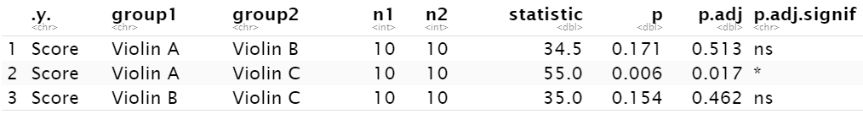
Exercise 16: violin.csv
violin %>%
friedman_test(Score ~ Violin|Rater)
violin %>%
wilcox_test(Score ~ Violin, paired = TRUE, p.adjust.method = "bonferroni")
Answer: Violin A seems to be the best one.

Slide 20
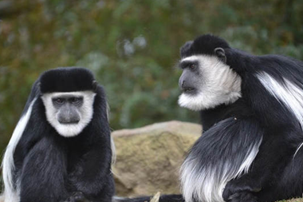
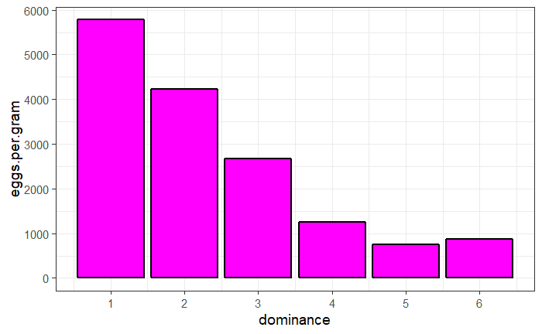
Non-Parametric:
Spearman Correlation Coefficient
Only really useful for ranks (either one or both variables)
ρ (rho) is the equivalent of r and calculated in a similar way
read_csv("dominance.csv") -> dominance
Example: dominance.csv
Six male colobus monkeys ranked for dominance
Question: is social dominance associated with parasitism?
  Eggs of Trichirus nematode per gram of monkey faeces
dominance %>%
ggplot(aes(rank, eggs.per.gram))+
geom_col(fill="Magenta", colour="black", size=1)+
scale_x_continuous(breaks=seq(1:6))+
scale_y_continuous(breaks = seq(0, 6000, 1000))

Slide 21
Non-Parametric:
Spearman Correlation Coefficient
Example: dominance.csv
dominance %>%
cor_test(rank,eggs.per.gram, method = "spearman")
Answer: the relationship between dominance and parasitism is significant (ρ =-0.94, p=0.017) with high ranking males harbouring a heavier burden.

