Slide 1


Research Integrity or How to be a Good Scientist
Anne Segonds-Pichon, Jo Montgomery,
Sarah Inglesfield, Laura Biggins and Simon Andrews v2024-02
Notes:
Not top down.
Facilitating a discussion, guiding us through reflecting and questioning – like good scientists!

Slide 2
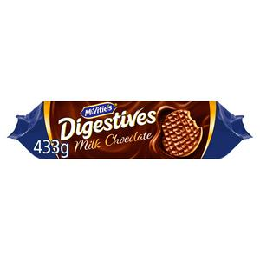

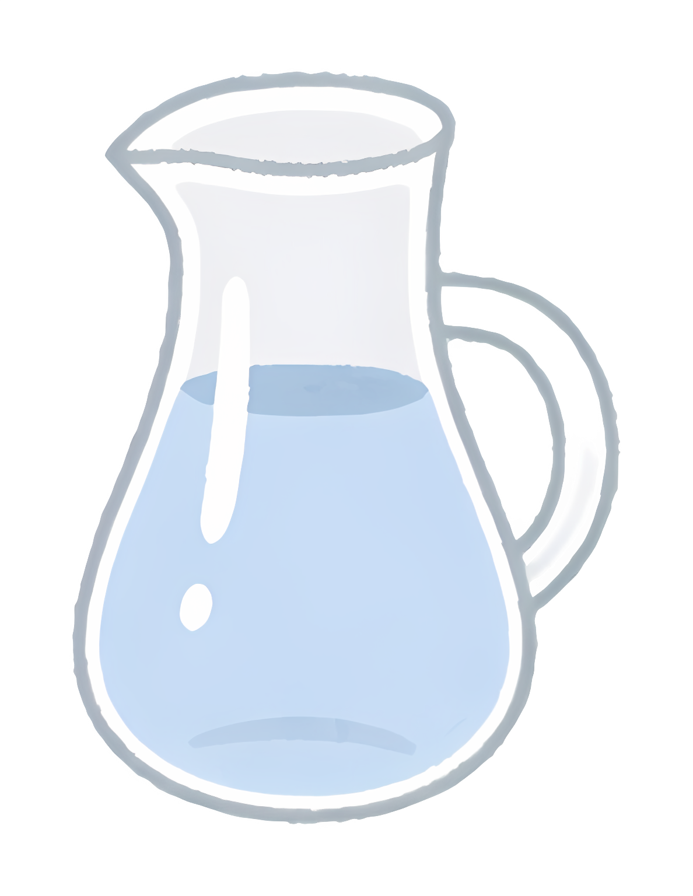
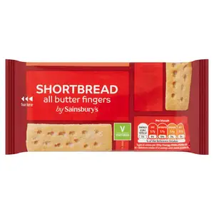
A
B
C
D

Slide 3
An illustration

Slide 4
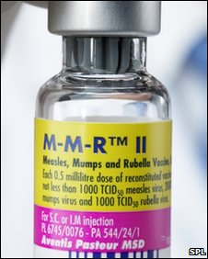
Research Integrity
MMR = Measles, Mumps and Rubella
Autism

Slide 5
2010
Retraction of the Wakefield et al. paper
https://www.ncbi.nlm.nih.gov/pmc/articles/PMC2831678/
2010
Andrew Wakefield found guilty of serious professional misconduct
https://www.bmj.com/content/340/bmj.c593
2002-2005: No link MMR autism
Many more studies
https://pubmed.ncbi.nlm.nih.gov/15366972/
https://pubmed.ncbi.nlm.nih.gov/15877763/
1999 No link MMR autism
Taylor et al.
n=498 children
https://pubmed.ncbi.nlm.nih.gov/10376617
2001: No link MMR autism
Dales et al.
n=600-1900 children each year over 14 years
https://pubmed.ncbi.nlm.nih.gov/11231748/
1998 Link MMR autism
Wakefield et al.
n=12 children
https://pubmed.ncbi.nlm.nih.gov/9500320/
Notes:
The paper in The Lancet was a case series of 12 child patients; it reported a proposed "new syndrome" of enterocolitis and regressive autism and associated this with MMR as an "apparent precipitating event." But in fact:
Three of nine children reported with regressive autism did not have autism diagnosed at all. Only one child clearly had regressive autism; Despite the paper claiming that all 12 children were "previously normal", five had documented pre-existing developmental concerns; Some children were reported to have experienced first behavioural symptoms within days of MMR, but the records documented these as starting some months after vaccination; In nine cases, unremarkable colonic histopathology results—noting no or minimal fluctuations in inflammatory cell populations—were changed after a medical school "research review" to "non-specific colitis"; The parents of eight children were reported as blaming MMR, but 11 families made this allegation at the hospital. The exclusion of three allegations—all giving times to onset of problems in months—helped to create the appearance of a 14-day temporal link; Patients were recruited through anti-MMR campaigners, and the study was commissioned and funded for planned litigation.^{[91]}

Slide 6
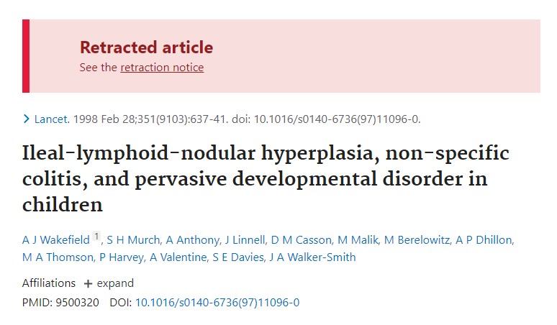
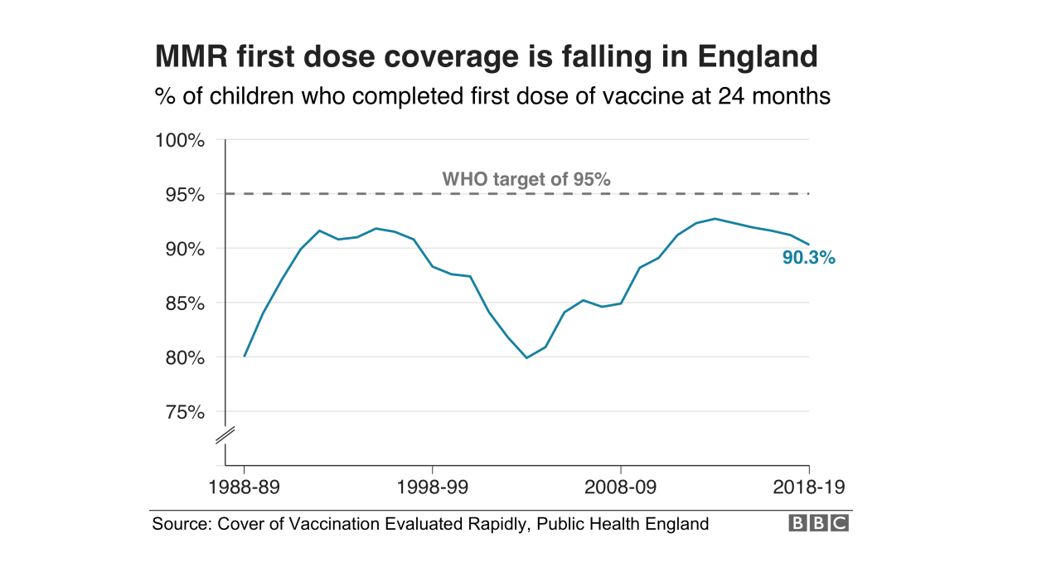
Research Integrity
Scientists and organisations across the world spent a great deal of time and money refuting the results of a minor paper in the Lancet .
MMR vaccination: 1995: 95% to 2002: 81 %
Measles outbreaks in the UK in 2008 and 2009
2020: Uptake of MMR vaccine: 91% (still below herd immunity)
2010
12 years
84%
2022-23
Notes:
Journal responsibility to have retracted earlier? Or other authors??
Not clear cut…
Time
Money
Impact

Slide 7

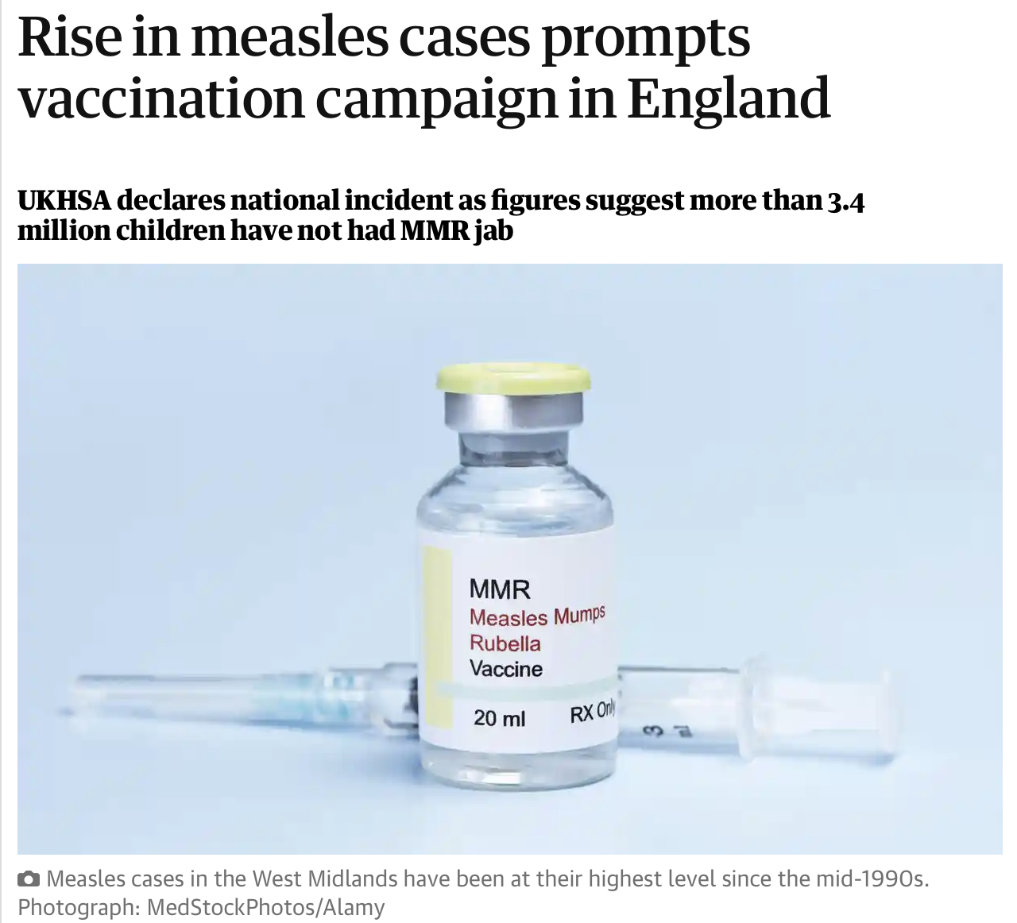
Research Integrity
2016: UK declared measles free
Now lost this status
Increases in number of measles cases
2022-23: : 84% children in England
    (74% in London, vs 90% South West)
Need vaccination rate of 95%
Current decline due to:
            Vaccine misinformation
            Not serious?
            Difficulty accessing appointments
            Impact of covid pandemic
Notes:
In this case, the effects have also been long reaching…
2 doses offer 99% immunity
Lifelong immunity
At 1yr and 3y 4mon but can be given anytime.

Slide 8
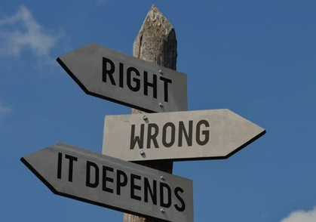
Obvious examples are obvious, but…
Notes:
What about the grey areas?
Obvious examples where it would be wrong to do something, but lots of ways you could be misleading, unconsciously

Slide 9
Outline of the course

Slide 10
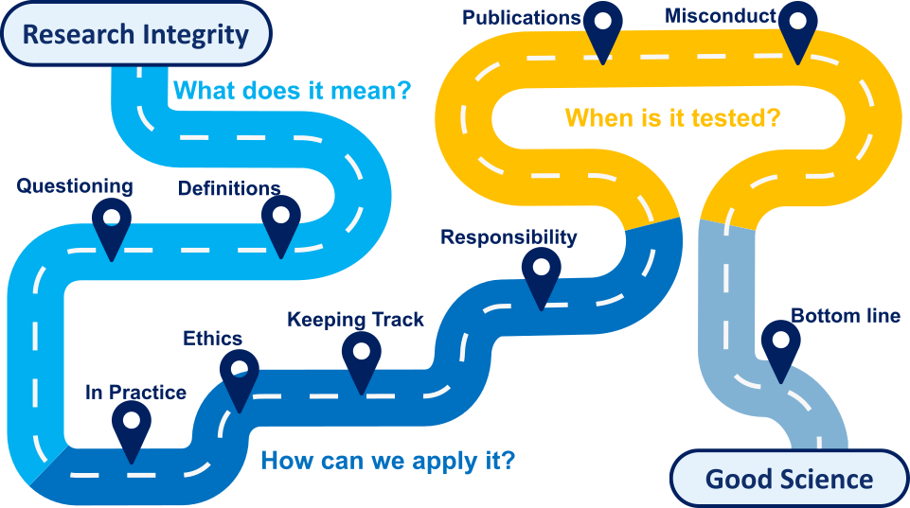

Slide 11
What is Research Integrity?

Slide 12
Research Integrity
a.k.a. Scientific Integrity
Scientific integrity (From Wikipedia):
Scientific integrity deals with ‘best practices’ or rules of professional practice of researchers.
Organisation for Economic Co-operation and
Development (OECD) report, 2007 replication (or reproducibility) crisis and the fight against scientific misconduct.

Slide 13
Research Integrity
a.k.a. Scientific Integrity
    The replication crisis - scientific studies are difficult or impossible to replicate or reproduce.
    Psychology:
    Open Science Collaboration
    (100 papers from 2012)
      36% of the replications yielded significant findings vs 97% in the original studies.
      Cancer Research:
      Reproducibility Project: Cancer Biology (53 papers from 2010 to 2012)
      25% experiments could be reproduced.
      Replication effect sizes were 85% smaller on average than the original findings.
https://osf.io/82fth/
https://www.sciencenews.org/article/cancer-biology-studies-research-replication-reproducibility
Notes:
Could add another example from a proper science!!
Piece in Nature recently (October 23) about ecology studies where could not be reproduced – differences in sample collection etc

Slide 14
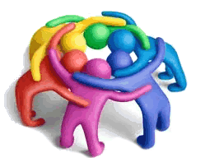
Which words are
most important/synonymous with integrity?
Exercise
Notes:
Rank them/top 3 etc Jamboard https://jamboard.google.com/d/1XrAnPzF5ll-hB-FPeaW5AfwA22eWiJAS-pIMSearEWI/edit?usp=sharing
or card sort Bioinfstore>Training>Research Integrity>Research Integrity Roles and Words card sorts.pdf

Slide 15
Research Integrity
Many words
Responsibility
Accountability
Honesty
Fair
Objectivity
Respect
Scientific integrity
Rigor
Care
Reproducibility
Openness
Ethics
Transparency
Accurate
Reliability
Cooperation
Collegiality
Quality

Slide 16
Research Integrity
More than words
Accountability
Accurate
Care
Collegiality
Cooperation
Ethics
Fair
Honesty
Objectivity
Openness
Quality
Reliability
Reproducibility
Respect
Responsibility
Rigor
Transparency
Scientific integrity
Notes:
We will keep the words on the slides, so you can reflect on which ones might be most pertinent at different stages. We sometimes suggest and highlight some, but its not definitive

Slide 17
Research Integrity in practice

Slide 18
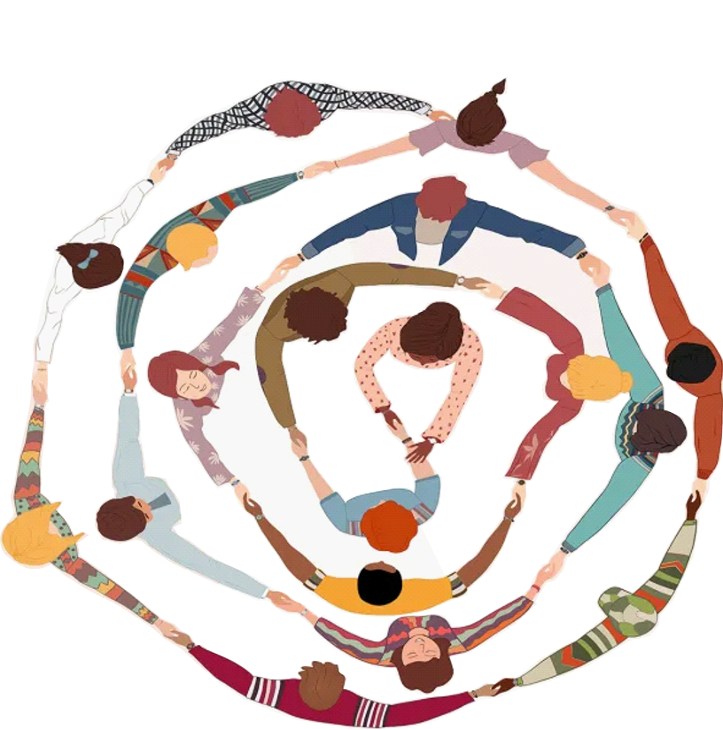
Research Integrity: In Practice
Accountability
Accurate
Care
Collegiality
Cooperation
Ethics
Fair
Honesty
Objectivity
Openness
Quality
Reliability
Reproducibility
Respect
Responsibility
Rigor
Transparency
Question
Results
Experiment
Experimental Design
Data Analysis
Sample Size
Data Exploration
Credit: Getty Images/melitas
Notes:
To do this going to consider this experimental wheel
Question → experiment → results
But it’s a bit more complicated than that!
And these sections where we essentially plan how to answer our question and look to see what our answer are really critical
However it’s also true that this still isn’t the full picture of what does on with our research
In science we do not work in isolation – part of a team, collaborate with others ect
Therefore at every stage of this wheel we also are incorporating these elements for successful research
So with this in mind lets take a closer look at these key sections and think about how research integrity comes into play

Slide 19
Research Integrity in practice
Experimental design

Slide 20
Question
Data Exploration
Data Analysis
Results
Experiment
Experimental Design
Sample Size
Accountability
Accurate
Care
Collegiality
Cooperation
Ethics
Fair
Honesty
Objectivity
Openness
Quality
Reliability
Reproducibility
Respect
Responsibility
Rigor
Transparency
A Practical Translation of the Question
Communicating Ideas
Types of Design
Avoiding Bias
Notes:
So experimental design is our first step
And we’re not going through how to design an experiment here
Rather going to highlight a couple of aspects of experimental design which are particularly key to the integrity of our experiments
And this comes down to what we need from our experimental design –i.e the goal
And how we accomplish this

Slide 21
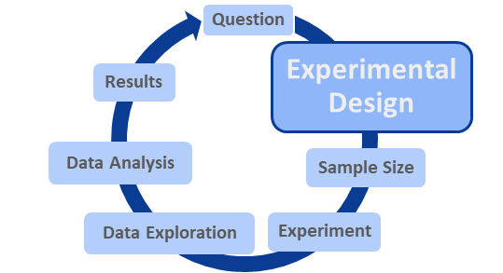

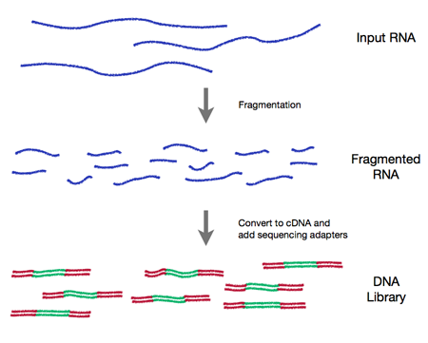
Clear Communication
Library
Accountability
Accurate
Care
Collegiality
Cooperation
Ethics
Fair
Honesty
Objectivity
Openness
Quality
Reliability
Reproducibility
Respect
Responsibility
Rigor
Transparency
Library, Cambridge
RNA seq Library
Notes:
So to start with there is a very fundamental level of experimental design
And that is how we communicate what we are doing
Important for initial stages and when we come to report
Trickier than it sounds… example… What do you mean….
Gonville & Caius College library
All the RNA molecules present in one or a collection of cells
So could argue library meaning is clear as very different contexts

Slide 22
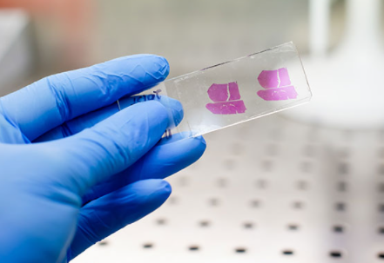
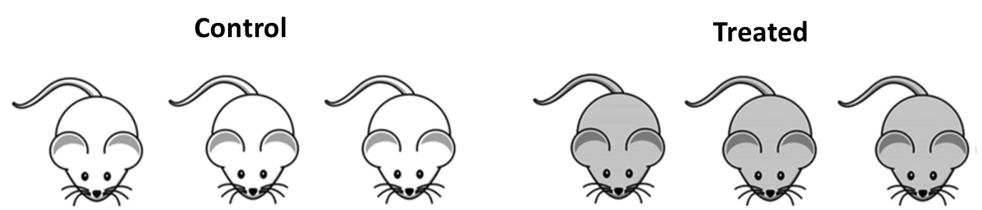
Clear Communication
Sample
Accountability
Accurate
Care
Collegiality
Cooperation
Ethics
Fair
Honesty
Objectivity
Openness
Quality
Reliability
Reproducibility
Respect
Responsibility
Rigor
Transparency
Tissue Sample
Sample of mice
Different words to describe the same data/graphs
Different traditions in different labs, areas of science
Notes:
…. So what about a word we might use in very similar context
Sample – what do you think I mean when I say sample
And it gets worse…
So all about being mindful of how we are communicating so it is clear

Slide 23
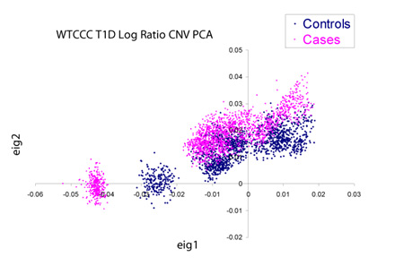
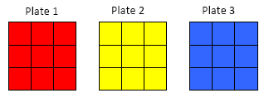

Appropriate Type of Design
Distinguish real differences from experimental artefacts…
…But experiments can be big and complicated
Accountability
Accurate
Care
Collegiality
Cooperation
Ethics
Fair
Honesty
Objectivity
Openness
Quality
Reliability
Reproducibility
Respect
Responsibility
Rigor
Transparency
      Seminal Wellcome Trust GWAS Study:
      14000 cases of 7 diseases & 3000 shared controls
    Each processed at different sites and genotyped on distinct series of plates
Condition 1
Condition 2
Condition 3 etc…
A
Good Design
B
Bad Design
Plate 1
Plate 2
Plate 3
Differences between control and cases are confounded by plate
Notes:
So what else do we need to think about in designing our experiment
Well a fundamental element is what kind of design is appropriate
And what makes it appropriate
And what makes this particularly challenging…
Lets consider with an example Seminal Wellcome Trust GWAS Study
So how they chose to design this experiment was like this – essentially they put one condition per plate
Question – do you think this is a good design – are there any potential issues
Answer – PCA plot – this allows us to visualise variance of samples (each of these dots) – and essentially what we should see is that the control and cases populations sit on top of one another
The reason they don’t is because of plate-to-plate variation – a nuisance variable
So can we address this with design…. Another example

Slide 24
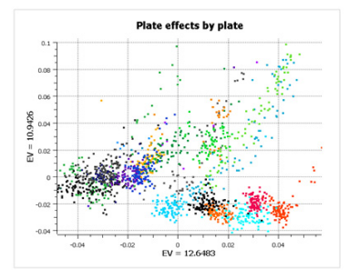
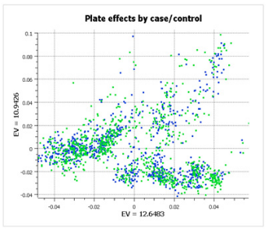
Appropriate Type of Design
GenADA multi-site collaborative study:
Plate 1
Plate 2 etc…
875 Alzheimers patients, 850 controls, 9 sites
Randomised Block Design
Accountability
Accurate
Care
Collegiality
Cooperation
Ethics
Fair
Honesty
Objectivity
Openness
Quality
Reliability
Reproducibility
Respect
Responsibility
Rigor
Transparency
Accountability
Accurate
Care
Collegiality
Cooperation
Ethics
Fair
Honesty
Objectivity
Openness
Quality
Reliability
Reproducibility
Respect
Responsibility
Rigor
Transparency
Still have differences between plates
Doesn’t confound the experiment
https://blog.goldenhelix.com/stop-ignoring-experimental-design-or-my-head-will-explode/
Notes:
Large genome-wide association study – multi-sites -> big confounding factors!
Designed the experiment so that cases and controls were present in equal proportions across the different plates
randomized block design across plates – equal representation
PC analysis showing that plating does cause separation of samples
Each colour is a plate and we see variability between samples
But because our controls/cases are spread across these – this doesn’t result in spread here
Point here is that need to consider our design carefully to prevent confounding issues which could impact on our experiment
Can’t always avoid them but we can plan for them!

Slide 25
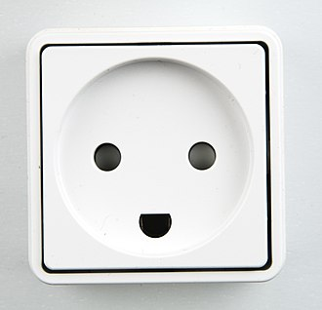
Avoiding Bias
Humans are not always good at remaining objective…
Accountability
Accurate
Care
Collegiality
Cooperation
Ethics
Fair
Honesty
Objectivity
Openness
Quality
Reliability
Reproducibility
Respect
Responsibility
Rigor
Transparency
Cognitive Bias = Pareidolia
Biases can also impact our experiments
Notes:
Now for possibly the hardest part of experimental design – avoiding bias
What makes it challenging - US
To illustrate this lets look at this picture
It’s a plug socket
But perhaps like me, you see a smiley face
And you get a little happy feeling
If so that’s a type of bias! We look for meaning when there isn’t always one –and our brain can reward us for that
And these biases aren’t limited to plug sockets…

Slide 26
Confirmation bias
Exercise

Slide 27
A Quick Exercise on Confirmation Bias and Hypothesis Testing
You will be presented with 3 numbers in a sequence.
You need to guess the rule that governs the sequence.
You can suggest any 3 numbers you like, and we will tell you whether or not your sequence follows the rule.

Slide 28
A Quick Exercise on Confirmation Bias and Hypothesis Testing
2
4
8

Slide 29
A Quick Exercise on Confirmation Bias and Hypothesis Testing
What’s the rule?

Slide 30
Confirmation bias
Objective facts
What confirms your beliefs
What you see

Slide 31
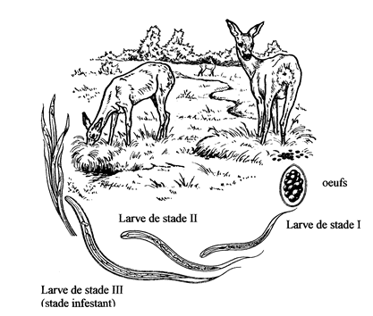
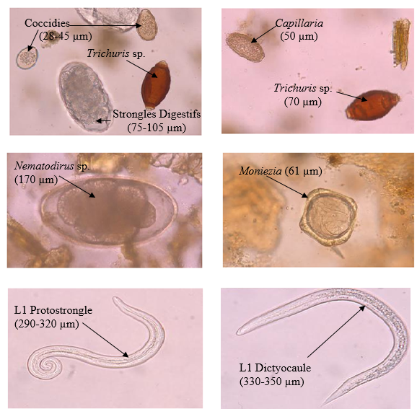
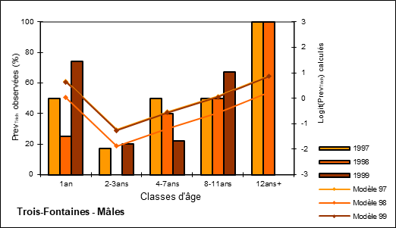
Experimenter Bias
Accountability
Accurate
Care
Collegiality
Cooperation
Ethics
Fair
Honesty
Objectivity
Openness
Quality
Reliability
Reproducibility
Respect
Responsibility
Rigor
Transparency
Scientists should be blind … if they want to be objective!
Wetzer and Rieck, 1960
Notes:
Can see confirmation bias in the lab as experimenter bias
Example from Anne’s PhD
Had to count parasites in deer poo, had her own theories about how parasite load might vary across ages
Found herself looking more closely for parasites in samples were she expected there to be more!
Analogy to flow cytometry – tweaking gates
My experience, tempting to tweak gates to fit expected difference – i.e. a drop in population
What can we do about it?
Anne swapped samples with a bench-mate so neither knew what to expect
Similarly could ask a lab-mate to assign our identities
Either at start of experiment
Or when it comes to later steps/ analysis

Slide 32
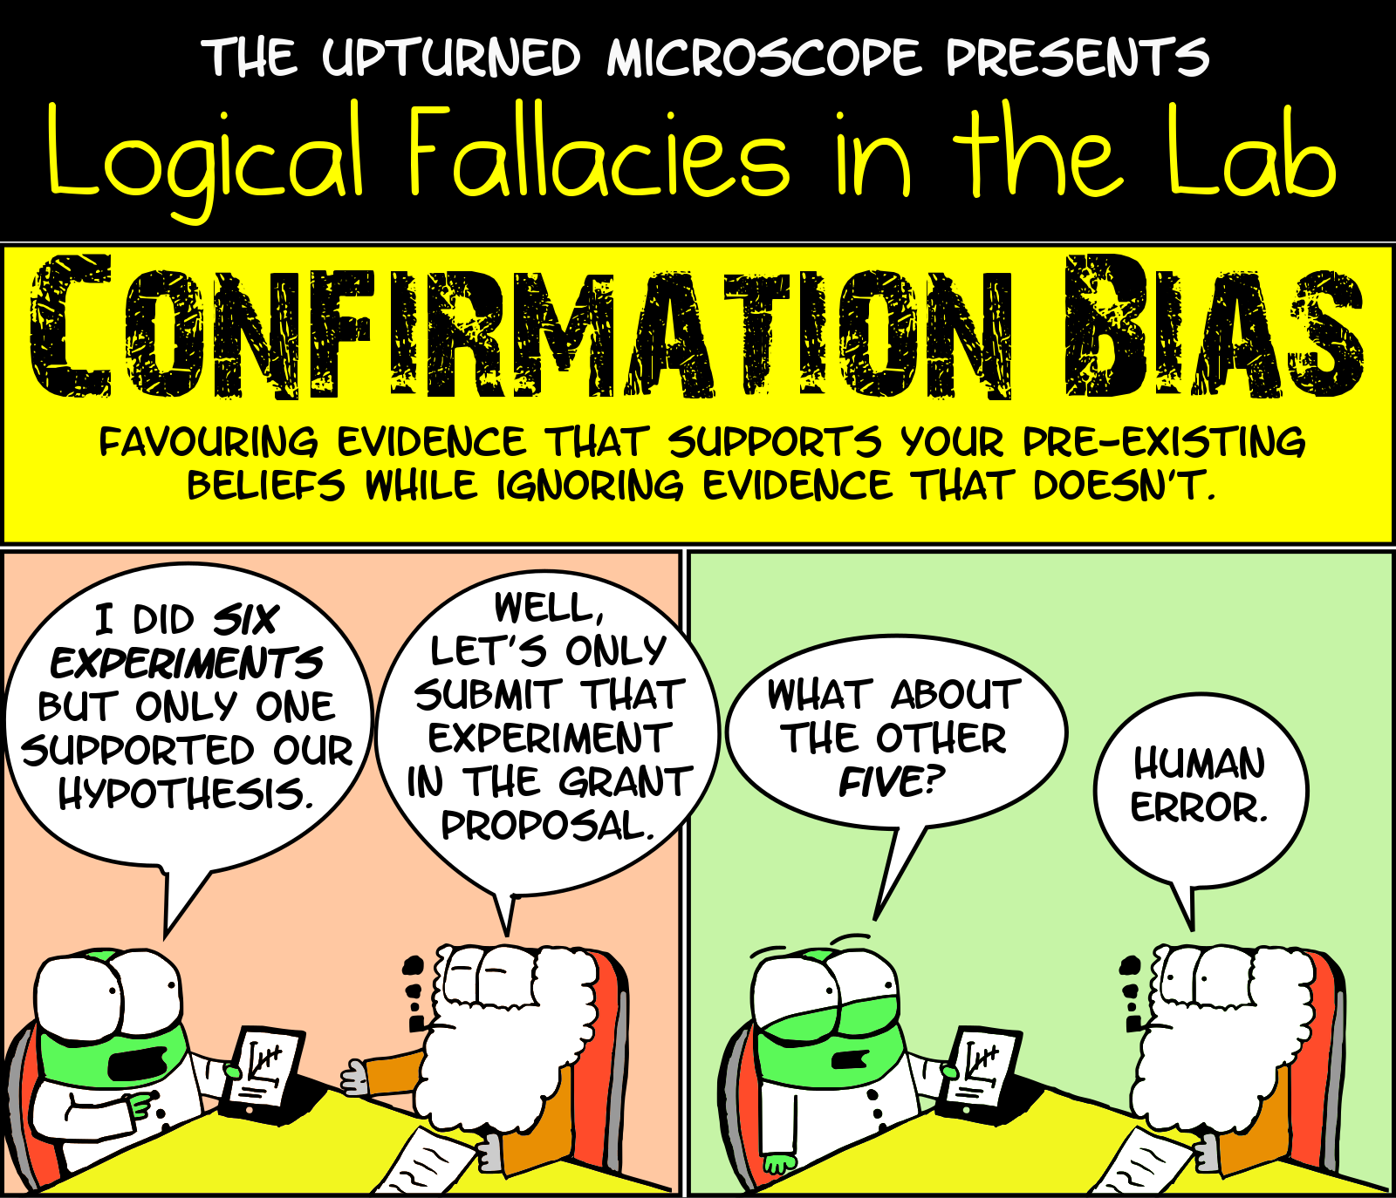
Blinding
is important to avoid
Confirmation bias
Accountability
Accurate
Care
Collegiality
Cooperation
Ethics
Fair
Honesty
Objectivity
Openness
Quality
Reliability
Reproducibility
Respect
Responsibility
Rigor
Transparency
Notes:
Important to be aware of, and to try to take steps to ensure our results are not influenced by confirmation bias

Slide 33
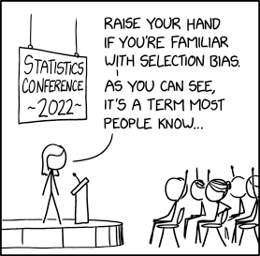
Selection Bias
Accountability
Accurate
Care
Collegiality
Cooperation
Ethics
Fair
Honesty
Objectivity
Openness
Quality
Reliability
Reproducibility
Respect
Responsibility
Rigor
Transparency
Biases in our sample populations can impact on our conclusions too
Notes:
Our experimental/ sample populations also have the potential to introduce bias
Need to ensure we are using a sample population representative of the population intended to be analysed
If we don’t run the risk on introducing selection bias

Slide 34
Randomisation
Control Group
Pooled starting group
Accountability
Accurate
Care
Collegiality
Cooperation
Ethics
Fair
Honesty
Objectivity
Openness
Quality
Reliability
Reproducibility
Respect
Responsibility
Rigor
Transparency
Random Allocation
Treatment Group
Each experimental unit has equal probability of receiving a treatment
Minimises Selection Bias
Reduces systematic differences between groups
Notes:
Combat selection bias using randomisation
Process used to ensure that each experimental unit has an equal probability of receiving a particular treatment.
Means that we aren’t preferencing our populations in any way
Helps to reduce systematic differences in the characteristics of animals/humans

Slide 35
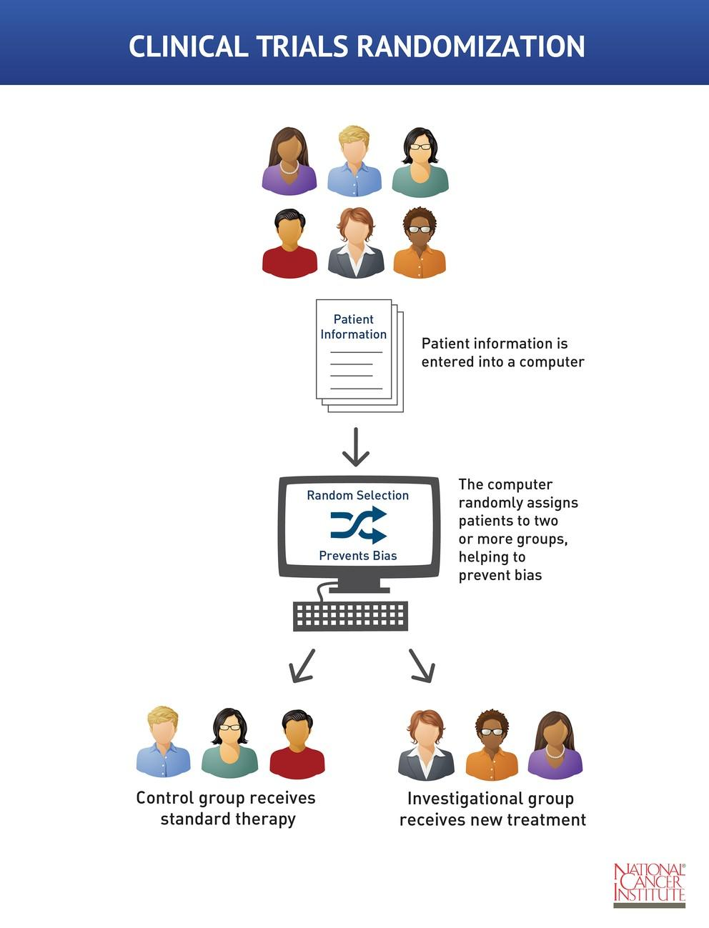
Random Allocation
Accountability
Accurate
Care
Collegiality
Cooperation
Ethics
Fair
Honesty
Objectivity
Openness
Quality
Reliability
Reproducibility
Respect
Responsibility
Rigor
Transparency
Notes:
Most are probably familiar with this idea in context of clinical trials
Also often introduce blinding at this stage

Slide 36
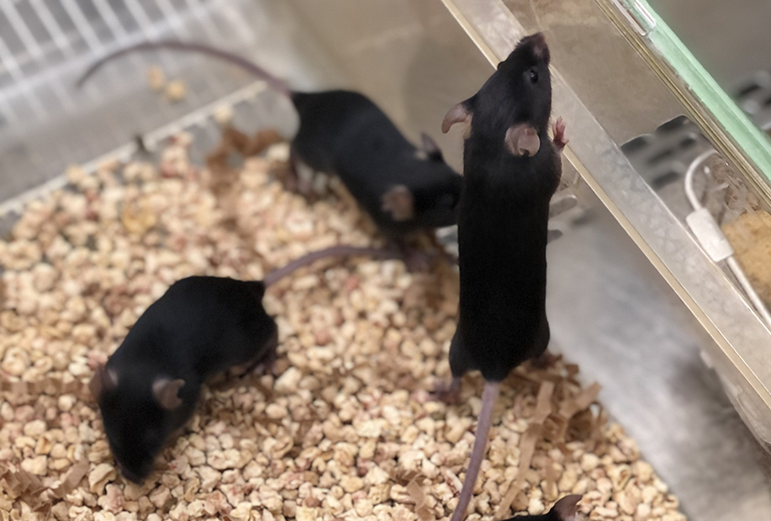
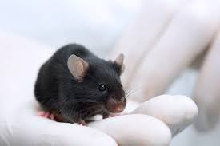
Random Allocation
Accountability
Accurate
Care
Collegiality
Cooperation
Ethics
Fair
Honesty
Objectivity
Openness
Quality
Reliability
Reproducibility
Respect
Responsibility
Rigor
Transparency
Pick out a mouse at random, first 3 get the treatment
Is this random?
Does it have the potential to introduce bias?
A
Biased
B
Not Biased
Notes:
Random allocation is also pertinent to other sample types e.g. mice
Important to think about what we mean by random
Consider this experimental design
There will be bias in how the mice are chosen
This is an example of something that feels random and can be an example of how the word random applies differently in science to everyday

Slide 37
Randomisation More Broadly
Consider Nuisance Factors
Accountability
Accurate
Care
Collegiality
Cooperation
Ethics
Fair
Honesty
Objectivity
Openness
Quality
Reliability
Reproducibility
Respect
Responsibility
Rigor
Transparency
Random Allocation
Also consider randomisation throughout the experiment
https://eda.nc3rs.org.uk/experimental-design-allocation#randomisationstrategy
Notes:
Can also think about what might impact our experimental groups & factor this into randomisation
The cage environment varies = noise
Ensure we distribute experimental groups across cages / litters
Randomised block design = similar to what we talked about before with the plates
Also try to think about randomisation beyond initial allocation
E.g. ideally animal cages should be in a random order on shelves
Do measurements of individuals in a random order etc.
Some things won’t always be in our control but consider carefully what is to try and minimise sources of noise/ bias

Slide 38
In a nutshell
Accountability
Accurate
Care
Collegiality
Cooperation
Ethics
Fair
Honesty
Objectivity
Openness
Quality
Reliability
Reproducibility
Respect
Responsibility
Rigor
Transparency
Good experimental design…
Translates the scientific question into lab work
Prevents subjectivity
Reduces effects of nuisance variables
…Is a fair way to do science
Notes:
Prevents subjectivity and reducing contaminating effects of nuisance variables
Blinding and randomisation
Assuring objectivity, rigor and reproducibility
- It prevents subjective bias and helps reduce the contaminating effects of the remaining nuisance variables (unknown/uncontrollable, lurking).
- Subjective bias (a.k.a. confirmation bias): strong inclination of the mind based on personal opinion (e.g. expecting a difference in a direction)
- Nuisance variables: random, unwanted variable (e.g. experimental variability)

Slide 39
Research Integrity in practice
Sample size

Slide 40
Question
Data Exploration
Data Analysis
Results
Experiment
Experimental Design
Sample Size
Accountability
Accurate
Care
Collegiality
Cooperation
Ethics
Fair
Honesty
Objectivity
Openness
Quality
Reliability
Reproducibility
Respect
Responsibility
Rigor
Transparency
The Right Size to be Confident in Our Results
Statistical Power
Replicates
Notes:
Sample size
This is somewhat tied to our experimental design
But what we’re focusing on here is that in our designed experiment we use a large enough population to confidently answer our questions
This Breaks down too
Statistical power
Replicates

Slide 41


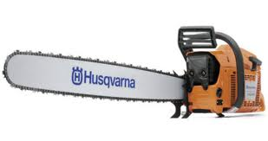
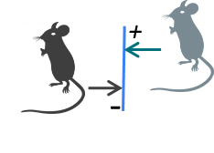
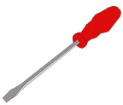
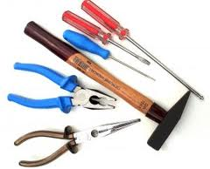
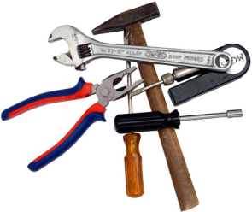


Statistical power: an analogy
Accountability
Accurate
Care
Collegiality
Cooperation
Ethics
Fair
Honesty
Objectivity
Openness
Quality
Reliability
Reproducibility
Respect
Responsibility
Rigor
Transparency
You send your child into the basement to find a tool. The child comes back and says "it isn't there". What do you conclude?
In the house
In the lab
"If the tool really is in the basement, what are the chances that your child would have found it?”
“If there is a difference between 2 conditions, what are the chances that your experiment will pick it up (p<0.05)?”
How long did the child spend looking?
How many mice do you look at? Sample size
How big is the tool?
How big is the difference? The absolute effect
or
How messy is the basement?
How messy the data are? Variability
or
Notes:
So lets start then with statistical power and what I mean by that
Technical definition of Statistical Power = Ability of a test to reach significance when there is an effect
i.e. power = probability of detecting an effect that is really there
(Type I error is the probability of wrongly concluding an effect when non exists (5% of time… p value))
Understanding what this means, think about an analogy
You send your child into the basement to find a tool. The child comes back and says "it isn't there".
What do you conclude? Is the tool there or not? There is no way to be sure.
So power is whether we can trust what our child or what our experiment is telling us i.e. that this is no tool or there is no difference
So how do we know if we can trust this…

Slide 42
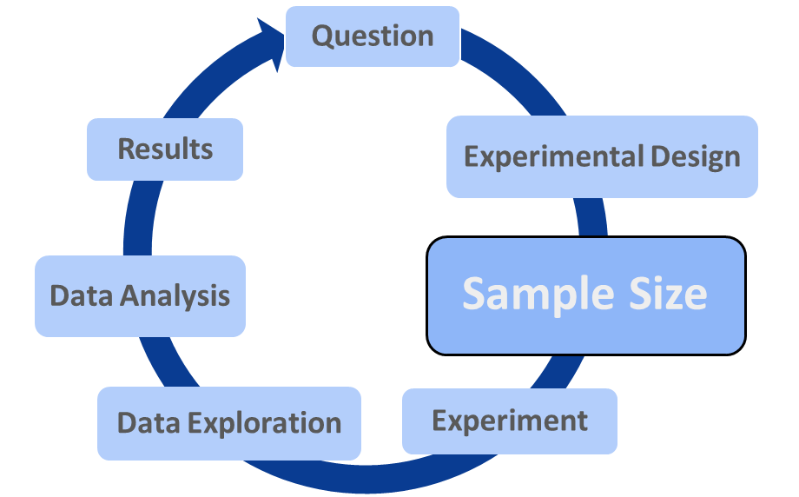
The Importance of Statistical Power
“If there is a difference between 2 conditions, what are the chances that your experiment will pick it up (p<0.05)?”
Accountability
Accurate
Care
Collegiality
Cooperation
Ethics
Fair
Honesty
Objectivity
Openness
Quality
Reliability
Reproducibility
Respect
Responsibility
Rigor
Transparency
Increase Sample size to increase Power
How many mice do you look at? Sample size
How big is the difference? The absolute effect
Little to no control
How messy the data are? Variability
Notes:
So that is why power is so important
It lets us confidently know if we don’t see an effect that it’s a real answer
How to influence power
The difference and the variability → effect size
The sample size → our practical option
Power analysis determines what sample size will ensure a high probability that we correctly reject the Null Hypothesis that there is no difference between two groups

Slide 43
The Importance of Statistical Power
Low Powered Studies have a greater chance of failing to detect a real effect
Accountability
Accurate
Care
Collegiality
Cooperation
Ethics
Fair
Honesty
Objectivity
Openness
Quality
Reliability
Reproducibility
Respect
Responsibility
Rigor
Transparency
BUT that’s all probability…
So some underpowered studies will detect a real effect
Are these results trustworthy?
A
Yes
B
No
https://www.taconic.com/taconic-insights/quality/animal-research-sample-size-calculation.html
Notes:
So as power = probability of detecting an effect that is really there
logically then if we are underpowered then we have a greater chance of not detecting an effect that is real
But that’s all probability, so there will be underpowered studies that do detect an effect
Does this mean these conclusions are fine

Slide 44
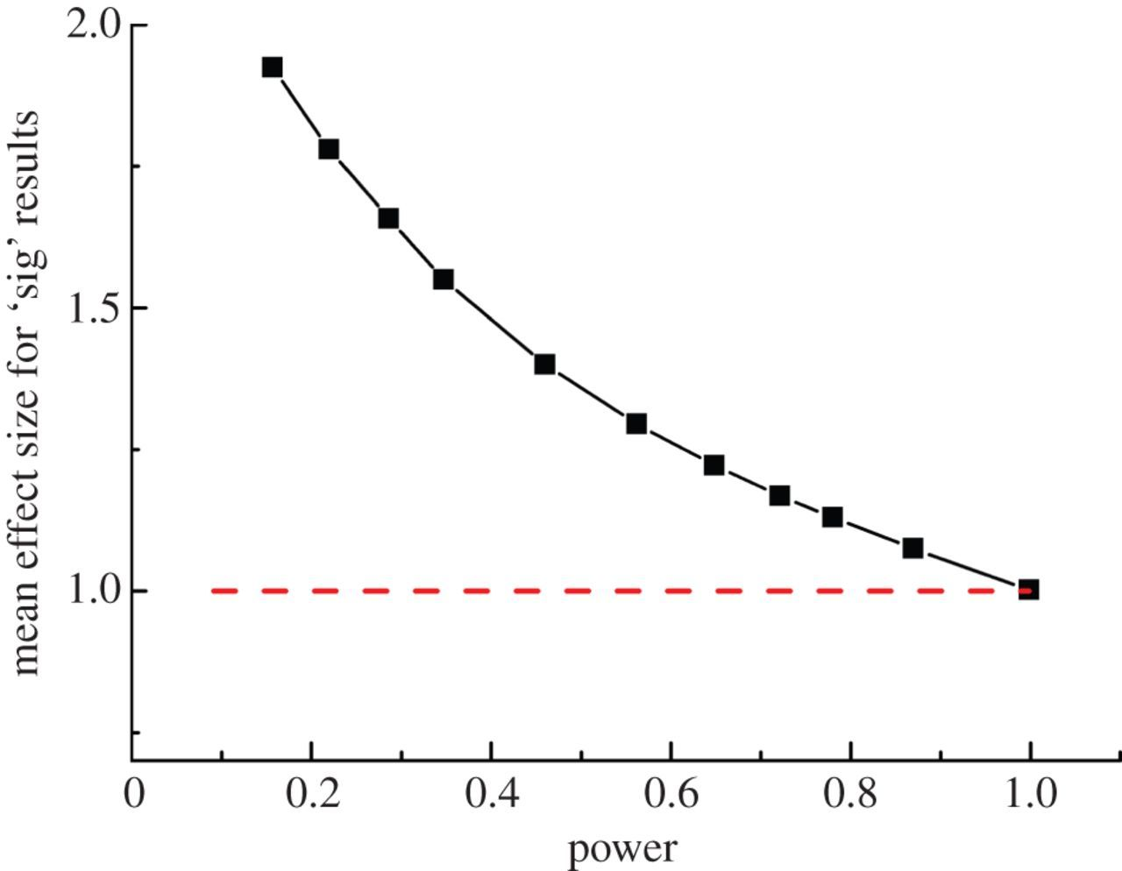
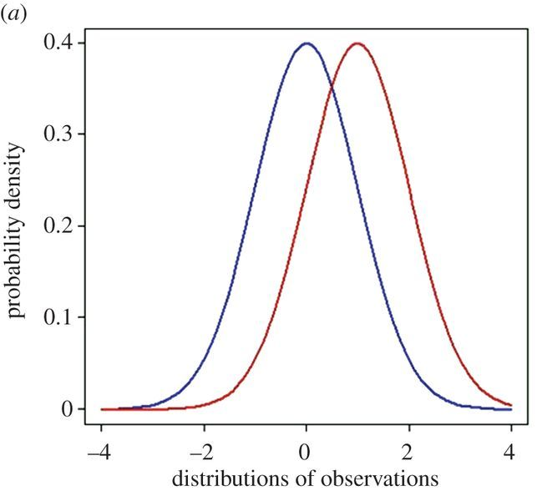
The Importance of Statistical Power
The Problem of the “Inflation Effect”…
Accountability
Accurate
Care
Collegiality
Cooperation
Ethics
Fair
Honesty
Objectivity
Openness
Quality
Reliability
Reproducibility
Respect
Responsibility
Rigor
Transparency
The TRUE effect size = 1
n=3
power = 0.157
n=50
power = 0.999
https://royalsocietypublishing.org/doi/10.1098/rsos.140216
Notes:
Inflation effect:
A significant result when underpowered, is more likely to come from samples that show an above average effect size
Example
2 populations that are different from one another – see distributions
Can then draw points from these distributions
The number of points drawn can be varied to give different sample sizes aka different power
Difference between populations assessed with a T-test
For each different sample size they ran simulation 100,000 times
Then selected those experiments that were statistically significant
Looked at the mean effect size predicted from these
with large sample size very high power predicted effect size = comparable to true
Small sample underpowered, predicted effect size = greater
Because at these lower sample sizes we’re reliant on experiments which include more extreme members of the population to reach a significant result
So risk = underpowered studies can over-estimate the actual effect size

Slide 45
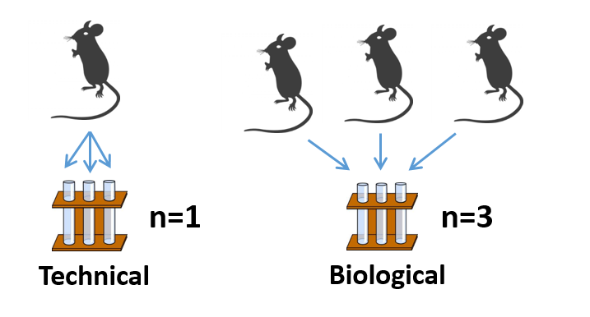
Defining Replicates
By the way: replicates = repeat = sample = library
Technical versus biological replicates
Accountability
Accurate
Care
Collegiality
Cooperation
Ethics
Fair
Honesty
Objectivity
Openness
Quality
Reliability
Reproducibility
Respect
Responsibility
Rigor
Transparency
Notes:
What kind of replicates do we mean
Taken from a single source/individual
Taken from different sources/individuals
Technical replicates can inform on the reproducibility of an assay e.g. can be useful when proving a method
Don’t inform us on the random biological differences between individuals
Key for us to put our results into wider context of population

Slide 46
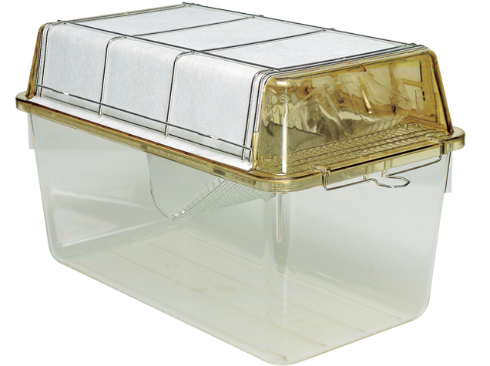

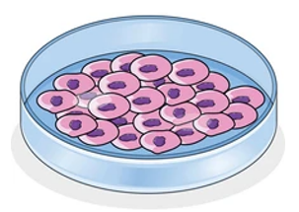
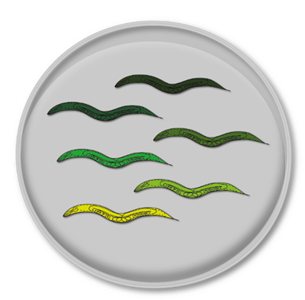

What is a Biological Replicate in Practice?
1 biological replicate:
A
1 mouse
B
1 cage
Accountability
Accurate
Care
Collegiality
Cooperation
Ethics
Fair
Honesty
Objectivity
Openness
Quality
Reliability
Reproducibility
Respect
Responsibility
Rigor
Transparency
1 biological replicate:
A
1 cell
B
1 petri dish
1 biological replicate:
A
1 worm
B
1 petri dish
Notes:
How to then define a biological replicate (voting)
Mouse might be easy example – thinking about an individual
Different genetics, different environment
But then we have cells
Cells → same individual
Finally can have a bit more of a grey area
Worms… asexual reproduction = same genetics,
and if on the same dish = same environment
The point is that it isn’t always clear cut, context is important and we need really to think about this

Slide 47
In a nutshell
Accountability
Accurate
Care
Collegiality
Cooperation
Ethics
Fair
Honesty
Objectivity
Openness
Quality
Reliability
Reproducibility
Respect
Responsibility
Rigor
Transparency
Sample Size & Power are key to confident results
Underpowered Studies are more likely to:
- Fail to detect real effects
  - Overestimate the effect size of detected effects
More biological replicates increase our evidence
How Many?
Formalise with power calculations….
Notes:
Overall because of the relationship between sample size and power
the bigger the sample, the more evidence we have to be confident about what our data tells us.
We can increase power by:
Increasing the number of biological replicates
But of course we need to be sensible about this (resources, ethics)
Power analysis determines what sample size will ensure a high probability that we correctly reject the Null Hypothesis that there is no difference between two groups

Slide 48


Slide 49
Research Integrity in practice
Data Exploration & Data Analysis
Notes:
Okay so now we’re beyond the planning we’ve done the experiment and we’ve got some data
What next – explore and analyse!

Slide 50
Question
Data Exploration
Data Analysis
Results
Experiment
Experimental Design
Sample Size
Accountability
Accurate
Care
Collegiality
Cooperation
Ethics
Fair
Honesty
Objectivity
Openness
Quality
Reliability
Reproducibility
Respect
Responsibility
Rigor
Transparency
A Faithful and Informative View of Our Data
Understanding Our Data
Presenting Our Data Honestly
Notes:
So to start with data exploration – as we’re going to see a really critical step
So what do we want from this step
Information – we want to know what the experiment is actually telling us about the biology
So this is our chance to be informed by our data
Which means we know what's going on
And can then determine how best we can communicate this to others (as ultimately want to disseminate this)

Slide 51

Data Exploration
Accountability
Accurate
Care
Collegiality
Cooperation
Ethics
Fair
Honesty
Objectivity
Openness
Quality
Reliability
Reproducibility
Respect
Responsibility
Rigor
Transparency
Understanding Our Data:
- The Biology
- The Quality
Builds Our Understanding and Confidence
Notes:
So we want to know what’s going on with our data – what does this come down to
Understanding the biology
A good understanding of the patterns and reality the data is telling us
See what the
Helps us build an honest story & informs us on how best to present
Understanding the Quality
This is also the time to do any sanity and quality control check
Want to know if there are any issues or limitations with the dataset
Sensible things we can check for – outliers, validating conditions ect.
If there are problems far better to know sooner
And overall doing this builds our confidence in the quality of our results and hence the interesting biology we’ve found
So overall what we want at this stage is a thorough picture

Slide 52
Data Exploration: Understanding Our Data
Accountability
Accurate
Care
Collegiality
Cooperation
Ethics
Fair
Honesty
Objectivity
Openness
Quality
Reliability
Reproducibility
Respect
Responsibility
Rigor
Transparency
Often we summarise our data to key values
N | 182
X Mean | 54.26
Y Mean | 47.83
X SD | 16.76
Y SD | 26.93
Correlation | -0.06
Can be really useful…
…And also really not!
Notes:
But often we summarise our data to key metrics
Descriptive /summary statistics which give us more of a broad overview of the general trends/ behaviours in our datasets
Can be really useful as more and more we have ever larger datasets and these values can be a way to get key points across concisely
But it can also cause us problems if we’re not careful about it

Slide 53
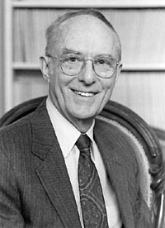
Data Exploration: Anscombe’s Quartet
Accountability
Accurate
Care
Collegiality
Cooperation
Ethics
Fair
Honesty
Objectivity
Openness
Quality
Reliability
Reproducibility
Respect
Responsibility
Rigor
Transparency
“A computer should make both calculations and graphs"
Dataset 1 |  | Dataset 2 |  | Dataset 3 |  | Dataset 4
X1 | Y1 | X2 | Y2 | X3 | Y3 | X4 | Y4
10.00 | 8.04 | 10.00 | 9.14 | 10.00 | 7.46 | 8.00 | 6.58
8.00 | 6.95 | 8.00 | 8.14 | 8.00 | 6.77 | 8.00 | 5.76
13.00 | 7.58 | 13.00 | 8.74 | 13.00 | 12.74 | 8.00 | 7.71
9.00 | 8.81 | 9.00 | 8.77 | 9.00 | 7.11 | 8.00 | 8.84
11.00 | 8.33 | 11.00 | 9.26 | 11.00 | 7.81 | 8.00 | 8.47
14.00 | 9.96 | 14.00 | 8.10 | 14.00 | 8.84 | 8.00 | 7.04
6.00 | 7.24 | 6.00 | 6.13 | 6.00 | 6.08 | 8.00 | 5.25
4.00 | 4.26 | 4.00 | 3.10 | 4.00 | 5.39 | 19.00 | 12.50
12.00 | 10.84 | 12.00 | 9.13 | 12.00 | 8.15 | 8.00 | 5.56
7.00 | 4.82 | 7.00 | 7.26 | 7.00 | 6.42 | 8.00 | 7.91
5.00 | 5.68 | 5.00 | 4.74 | 5.00 | 5.73 | 8.00 | 6.89
Francis Anscombe
4 datasets
Each consisting of X and Y variable
All 4 datasets have the same summary statistics...
Notes:
And this is best illustrated by turning to the Statistician Francis Anscombe who grappled with this issue back in the 70’s
Favoured the visualisation and graphing of data alongside summaries
To illustrate his concerns he generated 4 datasets
Each consisting of X & Y variable
With some interesting behaviour…. Their descriptive statistics all look the same!

Slide 54
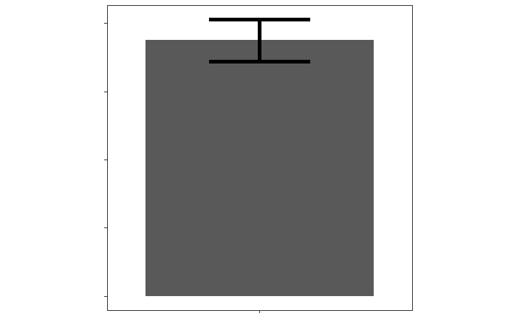
Data Exploration: Anscombe’s Quartet
Accountability
Accurate
Care
Collegiality
Cooperation
Ethics
Fair
Honesty
Objectivity
Openness
Quality
Reliability
Reproducibility
Respect
Responsibility
Rigor
Transparency
The average and spread of the conditions appears the same
 | Dataset 1 |  | Dataset 2 |  | Dataset 3 |  | Dataset 4
 | X1 | Y1 | X2 | Y2 | X3 | Y3 | X4 | Y4
N | 11 | 11 | 11 | 11 | 11 | 11 | 11 | 11
Mean | 9.00 | 7.50 | 9.00 | 7.50 | 9.00 | 7.50 | 9.00 | 7.50
STD | 3.31 | 2.03 | 3.31 | 2.03 | 3.31 | 2.03 | 3.31 | 2.03
SEM | 1.00 | 0.612 | 1.00 | 0.612 | 1.00 | 0.612 | 1.00 | 0.612
The relationship between X & Y can be described the same
 | Correlation (r) | Line of Best Fit
x1 vs. y1 | r = 0.8164 | Y = 0.5001*X + 3.000
x2 vs. y2 | r = 0.8162 | Y = 0.5000*X + 3.001
x3 vs. y3 | r = 0.8163 | Y = 0.4997*X + 3.002
x4 vs. y4 | r = 0.8165 | Y = 0.4999*X + 3.002
Notes:
When we look at the X & Y variables in each dataset
Can see that to quite a few decimal places the average & spread looks the same
So the mean/standard dev/standard error the mean for all the X groups looks the same
And also all the Y groups
Same too when we think about describing the possible relationship between X&Y
So can do this with things like a line of best fit and how well the variables are correlated
Again the descriptive statistics here are the same for all 4 datasets
So our expectation just looking at these summaries for these datasets is that they be all really similar right?
Well lets take a more visual look….

Slide 55
Data Exploration: Anscombe’s Quartet
Accountability
Accurate
Care
Collegiality
Cooperation
Ethics
Fair
Honesty
Objectivity
Openness
Quality
Reliability
Reproducibility
Respect
Responsibility
Rigor
Transparency
How does the data behave within the groups?
We’re still not getting a complete view of the data
What about the relationship between X & Y?
Notes:
Could view this as a simple bar-chart here
All look very similar
Problem with this is it’s not really giving us more than the summary stats – just visualising them
Lets get a bit more granular - A very different story!
Different types of distributions between the y groups – different spreads & behaviour
For the X variable, first 3 look identical – might be concerning if this was real data!
Also can see in a few groups the influence of outliers in defining the “average”
Particularly clear for X4
So maybe there’s a bit more going on, but still can look at this more closely….

Slide 56
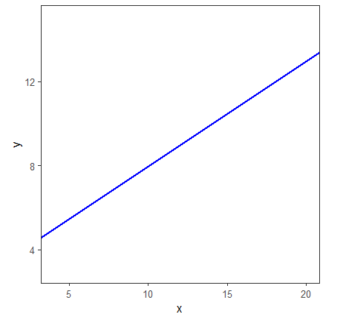
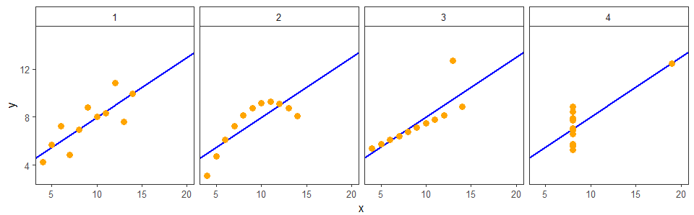
Data Exploration: Anscombe’s Quartet
Accountability
Accurate
Care
Collegiality
Cooperation
Ethics
Fair
Honesty
Objectivity
Openness
Quality
Reliability
Reproducibility
Respect
Responsibility
Rigor
Transparency
What about the relationship between X & Y?
r = 0.816 | Y = 0.500*X + 3.00
Notes:
So again remember the descriptive statistics for this relationship was very similar
Essentially could all be described by this correlation and this line
This line looks like this – still not very informative
Lets look at the data points again
Again despite it being possible to describe all the data in the same way, when plotted they don’t look all that similar
Dataset 1 = linear relationship – probably what we’d expect when we see these stats
Dataset 2 = relationship but not linear – therefore the stat’s we’ve used aren’t really appropriate
Dataset 3 = linear relationship but heavily offset by one outlier – could be modelled better again
Dataset 4 = No relationship but one extreme outlier is enough to suggest that there is one!

Slide 57
Can You Predict The Data Structure?
Accountability
Accurate
Care
Collegiality
Cooperation
Ethics
Fair
Honesty
Objectivity
Openness
Quality
Reliability
Reproducibility
Respect
Responsibility
Rigor
Transparency
We already know what the data will look like…
A
N | 182
X Mean | 54.26
Y Mean | 47.83
X SD | 16.76
Y SD | 26.93
Correlation | -0.06
C
Line
Unstructured
B
D
Circle
I Don’t Know…
A Dinosaur!
Notes:
So overall from that hopefully we can see that summarising our data can be misleading
But equally in my time as a researcher I encountered the phrase “We already know what the data will look like…”
Lets put that to the test
What do you think

Slide 58
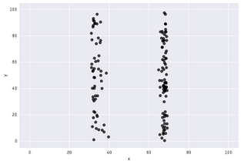
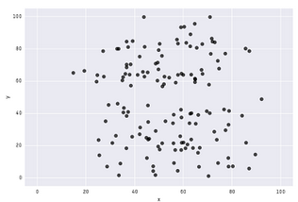
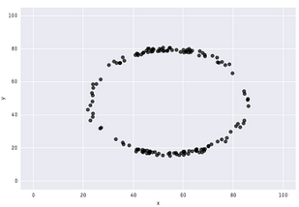
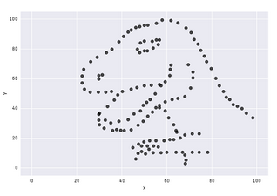
The Datasaurus Dozen
A
N | 182
X Mean | 54.26
Y Mean | 47.83
X SD | 16.76
Y SD | 26.93
Correlation | -0.06
C
B
D
And More!
https://www.research.autodesk.com/publications/same-stats-different-graphs/
Notes:
Comes from a group inspired by Ancombe’s Quartet & Albert Cairo’s “Datasaurus”
All 13 described by the same summary statistics

Slide 59
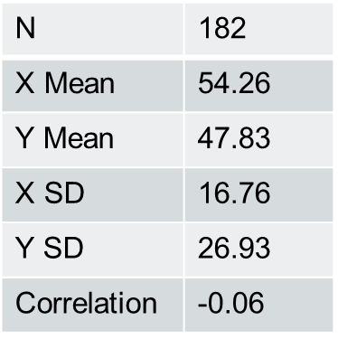
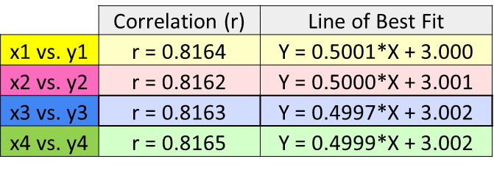

Data Exploration: Seeing is Believing!
Accountability
Accurate
Care
Collegiality
Cooperation
Ethics
Fair
Honesty
Objectivity
Openness
Quality
Reliability
Reproducibility
Respect
Responsibility
Rigor
Transparency
  Beware of statistical or graphical summaries…
…without proper exploration & visualisation!
Notes:
So overall then
While these statistics and summary views can be very useful
This is only true when they reflect the real message of our data
And one of the best ways we can do that is by visualising and exploring our data in appropriate way

Slide 60
Data Exploration
Exercise
Notes:
Which nicely brings us onto doing just that!
So now its over to you to do some of your own data exploration
Going to work on two datasets – look and create different representations and discuss our opinions
The aim of this is to get an informed view of the data

Slide 61
What do you think of this graph?
Values from 3 conditions from one experiment
Notes:
So to start us of
Lets first look at a graph of the data we’ll look at in dataset 1
What do we think of this graph, do you think it’s a informative representation of the dataset?
Is it a good graph for us to explore this dataset?
(summary=mean, sample size, distribution, outliers, error bars)

Slide 62

Representing Dataset 1:
Create the most informative graph
  https://tinyurl.com/RIdataExp
  Make sure you are looking at Dataset 1
Plot for initial exploration of the data?
Plot for presentation/ publication?
Notes:
Create an exploratory graph
Think about what you would do initially to explore the data
Then think about how you might convey your findings to others
Then we’ll discuss what we chose

Slide 63

Representing Dataset 1:
Create the most informative graph
Which plots did we choose and why?
Any differences between initial exploration and presentation?
Notes:
Main point = there are lots of ways we can look at our data and software to help us with this so we can explore to understand
What did everyone come up with?
Benefit of including data points
Adding on summary stats to help with the interpretation
Log10 is an appropriate way to transform this data
Easy to visualise and we’re clear about what has been done
The integrity of removing outliers
Did anyone remove the outlier
When we come to present this data may want to consider if it can be removed
Is there justification e.g. did it come from a sick mouse, is it a technical error in the approach….

Slide 64
What do you think of this graph?
Before
After
Values for before-after treatment from 4 experiments.
Notes:
What do we think of this graph?
Do we think it could be more informative?
Anything about it that seems odd?
Key reaction = p value vs error bar
So want to be confident that we can trust the stats underlying this – data exploration can help

Slide 65

Representing Dataset 2:
Create the most informative graph
  https://tinyurl.com/RIDataExp
  Make sure you are looking at Dataset 2
Create a plot to best represent dataset 2
Think about experimental design and statistics
Notes:
So now create an exploratory graph
Think about what you would do initially to explore the data
Then think about how you might convey your findings to others
Then we’ll discuss what we chose

Slide 66

Representing Dataset 2:
Create the most informative graph
Which plots did we choose and why?
What do you think about the stats now?
Notes:
Which graph did everyone choose/ create?
Overall are the means acceptable summaries for the data?
How did we get such a low p-value
Although small sample we’re seeing a consistent effect

Slide 67



An Aside to Help with Better Figure Design…
Scientific Figure Design
Notes:
Our aims are to develop skills at creating figures that are both reproducible and more effective visual communications of data and results, whilst also providing constructive feedback to authors.
The format is designed to not take up too much of your time, meeting once every 2 weeks and covering 1 paper every 4; with the first session focused on reproducibility and the second on figure design. Participants will split up into groups which will each focus on one figure.
First Meeting: Monday 6th November, 15:30, Alec Bangham room

Slide 68
Data exploration
What can go wrong if we don’t do it?!
Notes:
So we’ve seen the benefits of exploring our data
But what if we don’t….
Some Dangers of if we assume and don’t explore

Slide 69

Risk missing the actual story the data is telling…
Data exploration
Less Exploring more Assuming!
Image from https://link.springer.com/article/10.1007/s00246-017-1742-2
Notes:
Don’t have to explore can likely still build your story
But may be missing the wider picture
What our data is telling us and how much we should trust the story its telling us

Slide 70
…Suspicious Summaries
Data Exploration…
Notes:
To illustrate the risk of not exploring properly….
Going through some real life examples of questionable data exploration practices here at babraham and beyond…
Let start we some summarised datasets (all from babraham)

Slide 71


Example 1
Four experiments: Before-After treatment effect on a variable of interest.
Hypothesis: Treatment will decrease the levels of the variable of interest
Accountability
Accurate
Care
Collegiality
Cooperation
Ethics
Fair
Honesty
Objectivity
Openness
Quality
Reliability
Reproducibility
Respect
Responsibility
Rigor
Transparency
Notes:
So example 1
Setup was…
Summary looked like….
Response: Only one of my experiments worked!
Confirmation bias in action!

Slide 72
Example 2
Accountability
Accurate
Care
Collegiality
Cooperation
Ethics
Fair
Honesty
Objectivity
Openness
Quality
Reliability
Reproducibility
Respect
Responsibility
Rigor
Transparency
Notes:
Another….
Misleading summary condition A
More spread / overlap than suggested

Slide 73
Example 3
Accountability
Accurate
Care
Collegiality
Cooperation
Ethics
Fair
Honesty
Objectivity
Openness
Quality
Reliability
Reproducibility
Respect
Responsibility
Rigor
Transparency
Notes:
Quite big error bars here if we look at CI
Reason for this becomes clear if we explore further
Misleading summaries → hide lack of data

Slide 74
…Dubious Datasets
Data Exploration…
Notes:
Not just an issue of how we present the actual data of interest
Also important that we check and explore our data more broadly
So we can build our confidence in the story we will present
So again have some datasets to illustrate this issue – this time from published papers

Slide 75



Example 1: A Knockout?
Accountability
Accurate
Care
Collegiality
Cooperation
Ethics
Fair
Honesty
Objectivity
Openness
Quality
Reliability
Reproducibility
Respect
Responsibility
Rigor
Transparency
Notes:
SeqMonk: I knocked out a gene (actually 2 genes), or did I?
What we’re looking at, top tracks = genes that should be knocked out
So expect to see reads for these genes in WT but not the KO
Both genes still present in both WT and KO

Slide 76


Example 2: A Case of Mistaken Identity
Accountability
Accurate
Care
Collegiality
Cooperation
Ethics
Fair
Honesty
Objectivity
Openness
Quality
Reliability
Reproducibility
Respect
Responsibility
Rigor
Transparency
WT
KO
Notes:
Again the top is the gene that should be knocked out
Reads expected in WT not KO
WT and KO’s are mislabelled

Slide 77


Example 3: Of Mice and Mycoplasma!
Accountability
Accurate
Care
Collegiality
Cooperation
Ethics
Fair
Honesty
Objectivity
Openness
Quality
Reliability
Reproducibility
Respect
Responsibility
Rigor
Transparency
% Alignment to Mouse
50%
Condition 1
Condition 2
% Alignment to Mycoplasma
Condition 1
Condition 2
50%
Notes:
So here we’re looking at sequencing samples from two conditions that should all be from a mouse cell line
When process data and align it to a mouse genome we’d expect this to be fairly high and consistent
Not what we see:
Initial alignment looks a bit low for condition 1 sample
So followed up with fastq screen check
Low alignment to expected genome
Because those cells are infected with another genome!

Slide 78

…Is it okay if you don’t know there’s a problem?
All highlight the perils of assuming and not exploring….
Accountability
Accurate
Care
Collegiality
Cooperation
Ethics
Fair
Honesty
Objectivity
Openness
Quality
Reliability
Reproducibility
Respect
Responsibility
Rigor
Transparency
Notes:
Would you trust these datasets? Would you want to base follow-up work on it?
Its important for the integrity of research that we do our due diligence
So we should be happy that what we present is as reliable and faithful as possible
I think its what we’d want from others
How can we be the better explorers?

Slide 79







Analytical Tools
  The right tools for the job!
Accountability
Accurate
Care
Collegiality
Cooperation
Ethics
Fair
Honesty
Objectivity
Openness
Quality
Reliability
Reproducibility
Respect
Responsibility
Rigor
Transparency
  - Know what's out there
  - Learn how to use it
Notes:
So really key to this is understanding the tools we use! (some bioinformatics tools as an example)
And that can be harder than it sounds…
There’s lots of different software to use: broad, specialist, ect.
Two major challenges with this
Don’t know they exist
Might not always fully understand how they work
Ensure you do before you start analysing your data
Courses
Guides
Experience
Help assess the best tool for you and what you can / cant do with it!

Slide 80
Help With Analytical Tools
Accountability
Accurate
Care
Collegiality
Cooperation
Ethics
Fair
Honesty
Objectivity
Openness
Quality
Reliability
Reproducibility
Respect
Responsibility
Rigor
Transparency
Application Specific Courses
Core Skills Courses
e.g. R Programming
e.g. NGS Analysis
https://www.bioinformatics.babraham.ac.uk/training.html
Notes:
So if you need help with this where can you get it

Slide 81
In a nutshell
Accountability
Accurate
Care
Collegiality
Cooperation
Ethics
Fair
Honesty
Objectivity
Openness
Quality
Reliability
Reproducibility
Respect
Responsibility
Rigor
Transparency
Data exploration is CRITICAL to:
Understand our data
Be confident in our findings
Ensure our results are quality and reliable
… Good for everyone!
Notes:
Overall data exploration is vital
We explore to understand our results, know how to present them, and know how much to trust them
And that’s better for all of us

Slide 82
Question
Data Exploration
Data Analysis
Results
Experiment
Experimental Design
Sample Size
Accountability
Accurate
Care
Collegiality
Cooperation
Ethics
Fair
Honesty
Objectivity
Openness
Quality
Reliability
Reproducibility
Respect
Responsibility
Rigor
Transparency
Formalise Our Findings with Statistics
Understanding Our Data
Understanding Our Question
Notes:
Finally having done our exploring we’re onto data analysis
And really this is here to ensure that we formalise what we have observed in our exploration appropriately

Slide 83

Statistical Analysis
Translate the hypothesis/question into statistical questions
By choosing the right test!
Accountability
Accurate
Care
Collegiality
Cooperation
Ethics
Fair
Honesty
Objectivity
Openness
Quality
Reliability
Reproducibility
Respect
Responsibility
Rigor
Transparency
Healthy approach:
      “It’s not about knowing the name of the test…
      …It’s knowing what the test should do”
Anne Segonds-Pichon
Notes:
So what we want to do is essentially analogous to what we did in our experimental design
We have to translate our question into a statistical question
Which can feel a bit intimidating – because statistics is a full on field!
But to think about how to approach this I’d like to use a quote our previous bio-statistician Anne
And what she means by this is that the “right test” really comes down to:
Understanding your data
Understanding the question you want to ask

Slide 84

Knowing what the Test should do…
Statistics Decision tree
Accountability
Accurate
Care
Collegiality
Cooperation
Ethics
Fair
Honesty
Objectivity
Openness
Quality
Reliability
Reproducibility
Respect
Responsibility
Rigor
Transparency
Notes:
And if we know that then there are resources that can help us
Decision trees
Discussion with others
Training

Slide 85
Knowing what the Test should do…
Accountability
Accurate
Care
Collegiality
Cooperation
Ethics
Fair
Honesty
Objectivity
Openness
Quality
Reliability
Reproducibility
Respect
Responsibility
Rigor
Transparency
Statistics Using GraphPad Prism
Statistics Using R
https://www.bioinformatics.babraham.ac.uk/training.html
Notes:
So if you need help with this where can you get it

Slide 86
Research Integrity
More than 1 way to Investigate!
Accountability
Accurate
Care
Collegiality
Cooperation
Ethics
Fair
Honesty
Objectivity
Openness
Quality
Reliability
Reproducibility
Respect
Responsibility
Rigor
Transparency
Data Exploration
Data Analysis
Results
Experiment
Experimental Design
Sample Size
Question
Question
Data Analysis
Data Exploration
Exploratory data analysis
Notes:
Before we finish this section I just want to highlight that this wheel isn’t the only way to do science
So far we’ve talked about research with the idea that it is always initiated with a specific question in mind that then informs everything else
Including our stats as discussed
Not the only option
Scientists “dive” into data in search of patterns (or lack there of)
Often creates a foundation for hypotheses
Can lead hypothesis-driven research
But still appropriate to treat the analysis here as before, we still build a hypothesis which we need to translate into statistical formulation

Slide 87
Accountability
Accurate
Care
Collegiality
Cooperation
Ethics
Fair
Honesty
Objectivity
Openness
Quality
Reliability
Reproducibility
Respect
Responsibility
Rigor
Transparency
In a nutshell
Question
Data Exploration
Data Analysis
Data exploration should always be a pivotal step of analysis
Stats helps us formalise our findings
Notes:
Regardless of the research being hypothesis-driven or not,
The key point is that data exploration is vital and will tell us a lot
Then we can use stats to formalise these findings
Enable us to understand what we are doing, what we are looking at and present this fairly and faithfully

Slide 89
Research Integrity
What does Ethics mean?

Slide 90

Research Integrity
Ethics and Animal Welfare
Accountability
Accurate
Care
Collegiality
Cooperation
Ethics
Fair
Honesty
Objectivity
Openness
Quality
Reliability
Reproducibility
Respect
Responsibility
Rigor
Transparency
If we need biological replicates to be confident in our results, why not have as many as we can?
And what does it have to do with integrity?
Time to talk about the Home Office, ASPA and the 3 Rs
Notes:
And what about human studies – informed consent etc

Slide 91


Research Integrity
Home Office
The Home Office (HO) is a ministerial department of the Government of the UK, responsible for immigration, security and law and order.
- But more importantly: animal welfare
By Steph Gray, CC BY-SA 2.0, https://commons.wikimedia.org/w/index.php?curid=31387711

Slide 92
Research Integrity
The 3 Rs
Accountability
Accurate
Care
Collegiality
Cooperation
Ethics
Fair
Honesty
Objectivity
Openness
Quality
Reliability
Reproducibility
Respect
Responsibility
Rigor
Transparency
Replace
Reduce
Refine
https://wellcome.org/sites/default/files/wtp057673_0.pdf
Notes:
The 3 Rs: “The principles of the 3Rs (Replacement, Reduction and Refinement) were developed over 50 years ago providing a framework for performing more humane animal research. Since then they have been embedded in national and international legislation and regulations on the use of animals in scientific procedures, as well as in the policies of organisations that fund or conduct animal research.

Slide 93

Research Integrity
The 3Rs: about animal welfare
Replace
Avoiding or replacing the use of animals in areas where they otherwise would have been used.
Notes:
Accelerating the development and use of predictive and robust models and tools, based on the latest science and technologies, to address important scientific questions without the use of animals.

Slide 94

Research Integrity
The 3Rs: about animal welfare
Reduce
Minimising the number of animals used consistent with scientific aims.
Notes:
The reduction R is pertinent to experimental design and sample size.
Appropriately designed and analysed animal experiments that are robust and reproducible, and truly add to the knowledge base.

Slide 95

Research Integrity
The 3Rs: about animal welfare
Refine
Minimising the pain, suffering, distress or lasting harm that research animals might experience.
3Rs resource library | NC3Rs
Notes:
Refinement is about improvements to animal welfare, and ultimately to our science.
Advancing research animal welfare by exploiting the latest in vivo technologies and by improving understanding of the impact of welfare on scientific outcomes.

Slide 96

Research Integrity
The 3 Rs at Babraham: AWERB
Remit
To provide the campus with independent ethical advice on the balance of harms to benefits within scientific projects using animals. To monitor standards of animal care and welfare, to support and advise named persons and licensees working under the Animals (Scientific Procedures) Act and to advise the Establishment Licence Holder on the suitability of Project Licence applications. To develop initiatives and guidelines leading to the widest possible application of the 3Rs (refinement, reduction and replacement) both on the campus and amongst the wider scientific community. In accordance with our commitments to the Concordat on Openness in animal research, any staff member with a concern that falls within the AWERB remit is encouraged to speak to the AWERB chair or any other committee member.

Slide 97
Good Research in Practice

Slide 98


Good Research in Practice
Accountability
Accurate
Care
Collegiality
Cooperation
Ethics
Fair
Honesty
Objectivity
Openness
Quality
Reliability
Reproducibility
Respect
Responsibility
Rigor
Transparency
The Research Process
Responsibilities
Competence
Project planning
Quality Control
Laboratory Practice
Health and safety
Handling of samples and materials
Facilities and equipment
Documentation of procedures and methods
Research/work records
Notes:
Further information about Good Research in Practice – as part of Research Integrity - relating to H&S can be found on the Hub

Slide 99
Keeping track of the research
How?

Slide 100


Research Integrity
Laboratory Notebooks
Accountability
Accuracy
Care
Collegiality
Cooperation
Ethics
Fair
Honesty
Objectivity
Openness
Quality
Reliability
Reproducibility
Respect
Responsibility
Rigor
Transparency
  Reporting
  Defend data
  Trace
  Find it
  Share it
  Describe
  Protect IP
  Legal protection
  GLP++
  Safe and secure
  Compliant
Notes:
Suppliers of lab book systems and the format in which things are stored.
Some smaller, bespoke systems are small companies – longevity/security
Ownership !!!
Security
Support
Longevity
Trustworthy
Need to maintain access, needs to be around 10+ years or storage needs to be open source so you can still access it even if the platform goes down.
Examples of people losing data! Or who owns it?? Legal
Data needs to be accessible

Slide 101


Research Integrity
Laboratory Notebooks
Accountability
Accuracy
Care
Collegiality
Cooperation
Ethics
Fair
Honesty
Objectivity
Openness
Quality
Reliability
Reproducibility
Respect
Responsibility
Rigor
Transparency
This Photo by Unknown Author is licensed under CC BY
Notes:
Suppliers of lab book systems and the format in which things are stored.
Some smaller, bespoke systems are small companies – longevity/security
Ownership !!!
Security
Support
Longevity
Trustworthy
Need to maintain access, needs to be around 10+ years or storage needs to be open source so you can still access it even if the platform goes down.
Examples of people losing data! Or who owns it?? Legal
Data needs to be accessible

Slide 102

Research Integrity
Laboratory Notebooks
Accountability
Accuracy
Care
Collegiality
Cooperation
Ethics
Fair
Honesty
Objectivity
Openness
Quality
Reliability
Reproducibility
Respect
Responsibility
Rigor
Transparency
This Photo by Unknown Author is licensed under CC BY-ND
This Photo by Unknown Author is licensed under CC BY-ND
Notes:
Suppliers of lab book systems and the format in which things are stored.
Some smaller, bespoke systems are small companies – longevity/security
Ownership !!!
Security
Support
Longevity
Trustworthy
Need to maintain access, needs to be around 10+ years or storage needs to be open source so you can still access it even if the platform goes down.
Examples of people losing data! Or who owns it?? Legal
Data needs to be accessible

Slide 103

Research Data
Data Storage
Accountability
Accuracy
Care
Collegiality
Cooperation
Ethics
Fair
Honesty
Objectivity
Openness
Quality
Reliability
Reproducibility
Respect
Responsibility
Rigor
Transparency
Legal Requirements
Practicalities
Image: cleanpng.com
Notes:
Electronic storage is a known problem, your organisation will have guidelines and mechanisms in place.

Slide 104


Research Data
Data Storage
Accountability
Accuracy
Care
Collegiality
Cooperation
Ethics
Fair
Honesty
Objectivity
Openness
Quality
Reliability
Reproducibility
Respect
Responsibility
Rigor
Transparency
Interruption in the supply of liquid nitrogen leading to the destruction of samples from multiple institutions.
Valued in the millions.
“Those worst affected are those researching leukaemia, they have gathered samples from patients over as much as 30 years,”
Notes:
Physicsl storage too.
Interruption in the supply of liquid nitrogen leading to the destruction of samples from multiple institutions.
Valued in the millions.
“Those worst affected are those researching leukaemia, they have gathered samples from patients over as much as 30 years,”

Slide 105





What should we be doing?
Expectations and Responsibilities
Notes:
Expectations and responsibilities
Document what we are doing
Be able to find results
Timely/traceable/retrievable
Checked
Legal responsibilities

Slide 106
Research Data
OneNote
Accountability
Accuracy
Care
Collegiality
Cooperation
Ethics
Fair
Honesty
Objectivity
Openness
Quality
Reliability
Reproducibility
Respect
Responsibility
Rigor
Transparency
Notes:
ELN/One Note course
And data management policy/guidance coming soon

Slide 107
Responsibility

Slide 108
Research Integrity
Wider Responsibility
Accountability
Accurate
Care
Collegiality
Cooperation
Ethics
Fair
Honesty
Objectivity
Openness
Quality
Reliability
Reproducibility
Respect
Responsibility
Rigor
Transparency
Question
Experimental Design
Results
Data Analysis
Data Exploration
Experiment
Sample Size

Slide 109

Research Integrity
Accountability
Accuracy
Care
Collegiality
Cooperation
Ethics
Fair
Honesty
Objectivity
Openness
Quality
Reliability
Reproducibility
Respect
Responsibility
Rigor
Transparency
Photo by Miguel Henriques Unsplash
Notes:
Wider responsibility as a scientist: tell you a story….
This is a story of a late stage PhD/early postdoc researcher. Let’s call them Alex….
Alex was a talented enzyme biochemist and had an intriguing idea about the structure of a particular enzyme. Alex thought they had discovered a novel aspect that could revolutionize the understanding of these enzymes.
For months, Alex had been diligently working in the laboratory, pouring over data, running experiments, and refining the hypothesis. Excitement grew at the potential impact of this discovery. It seemed to suggest something novel to all that had gone before. Alex worked in a busy lab and everyone was engrossed in their own projects.
Alex got the opportunity to present at a big conference and even got funding to attend! . Renowned scientists from around the world would be in attendance.
The room was filled with distinguished scientists, including Dr. Bennett (not their real name), a well-known figure in the field, who had spent decades studying the same class of enzymes. His reputation was built on his extensive work in this area.
Alex began their presentation, anxious about the delivery but confident in the groundbreaking revelation. As they revealed their findings about the enzyme's structure, the room's collective gaze was upon them. Dr. Bennett listened intently, his face unreadable as the presentation progressed.
When Alex finished the talk, Dr. Bennett, began to ask questions that Alex was not prepared for, couldn’t back up, hadn’t rehearsed and ultimately didn’t have answers for. It was a polite, but pretty humiliating experience.
As the conference went on, Alex had the opportunity to reflect. The value of sharing their work with their lab group and trusted colleagues became apparent. Their feedback, insights, and constructive criticism would have allowed Alex to refine the hypothesis, question the validity, address its shortcomings, and strengthen the argument (or change the direction entirely) before presenting it on a global stage.
It was a hard lesson to learn that it is essential to have a support network to evaluate and strengthen one's ideas before presenting them to the world.
Alex’s journey taught them that the process of science is not just about groundbreaking ideas but also about the collaborative and critical examination of those ideas within a trusted network.

Slide 110

Research Integrity
Questioning
Accountability
Accuracy
Care
Collegiality
Cooperation
Ethics
Fair
Honesty
Objectivity
Openness
Quality
Reliability
Reproducibility
Respect
Responsibility
Rigor
Transparency
Photo by Ana Municio on Unsplash
Notes:
Wider responsibility as a scientist:
Questioning –
You
Your data
Others questioning you
You questioning others
Being open to having your science questioned
about you questioning your data and findings of others and also being open to people questioning your science. Lab meetings. Conferences. Seminars etc. It will help you grow. Your lab group have a vested interest in you not screwing up!
Self-questioning is an essential aspect of the scientific method. Researchers must continually reflect on their hypotheses, methods, and conclusions. This introspective process helps ensure that biases and preconceptions do not interfere with the objective pursuit of knowledge.
By questioning their own work, scientists can identify areas for improvement, leading to more robust experiments, clearer communication of results, and, ultimately, scientific progress. This ongoing self-assessment can lead to the refinement and optimization of research methodologies.
Science is built on a foundation of skepticism and empirical evidence. Researchers must constantly question the validity of their findings. They should strive to verify their results through replication and be open to the possibility of falsification if new evidence contradicts their existing theories.
Scientific rigor relies on peer review processes, where experts in the field question the methodology, interpretation, and significance of a research study. Openness to constructive criticism and willingness to revise one's work in response to peer feedback are essential for maintaining the credibility of scientific research.
Open science encourages transparency and the sharing of research data, methodologies, and findings. Being open to questioning by others in the scientific community promotes accountability, reproducibility, and the exchange of knowledge.
A culture of questioning, both within and beyond one's work, is essential for the advancement of science, as it encourages rigor, innovation, transparency, and collaboration, ultimately leading to a more robust and credible body of knowledge.

Slide 111

Research Integrity
Collaboration and Competition
Accountability
Accuracy
Care
Collegiality
Cooperation
Ethics
Fair
Honesty
Objectivity
Openness
Quality
Reliability
Reproducibility
Respect
Responsibility
Rigor
Transparency
Photo by Natalie Pedigo on Unsplash
Notes:
Wider responsibility as a scientist:
Collaboration and competition – there is competition, but we should also support each other. Group leaders should foster an atmosphere that is helpful and collaborative rather than combative.
both collaboration and competition are integral to the scientific research ecosystem. When properly balanced, they can drive innovation, ensure quality control, and accelerate progress. Researchers and institutions must foster an environment that promotes healthy competition while also encouraging collaboration to maximize the collective impact of scientific research on society

Slide 112

Research Integrity
The Game
Accountability
Accuracy
Care
Collegiality
Cooperation
Ethics
Fair
Honesty
Objectivity
Openness
Quality
Reliability
Reproducibility
Respect
Responsibility
Rigor
Transparency
Photo by Karthik Balakrishnan on Unsplash
Notes:
Wider responsibility as a scientist:
This is a game. We can say this as impartial scientists. Group leaders know this but don’t say it, and PhD students might not know this yet. This is how you play the game.
The world of scientific research is indeed a game, a game of discovery and knowledge-seeking. Researchers must learn to play this game, understanding that it involves collaboration, competition, and unwavering integrity. Like any game, it has its challenges and rewards, and those who navigate it skillfully are more likely to make significant contributions to our understanding of the world. In the scientific game, as in any other, success is determined not just by individual talent but also by the ability to strike a fine balance between these key elements.
Let’s have a look at some other places where integrity might be challenged…

Slide 113

Research Integrity
Wider Responsibility and Scientific Community
Accountability
Accuracy
Care
Collegiality
Cooperation
Ethics
Fair
Honesty
Objectivity
Openness
Quality
Reliability
Reproducibility
Respect
Responsibility
Rigor
Transparency
Notes:
We’re going speed dating to find out more, discuss and question some aspects of the scientific research process

Slide 114
Research Integrity
Notes:
Review:
Your group have a vested interest in you and your science being successful and getting the story right. Listen to them.
NB Further training on the peer review process is available.
FAIR
Ensuring your science is FAIR can maximise the value of your science and your data.
Your data has value above and beyond what you created it for, especially with big datasets
Make your data as useful as possible (make it work for you and others)
Pre prints
The positives and negatives to pre prints are a bit more nuanced.
Open Access
This is a bit of a game.

Slide 115

Research Integrity
In a nutshell
Accountability
Accurate
Care
Collegiality
Cooperation
Ethics
Fair
Honesty
Objectivity
Openness
Quality
Reliability
Reproducibility
Respect
Responsibility
Rigor
Transparency
Applying research integrity principles is our responsibility as scientists
Notes:
when we produce our own data, conduct our own research
when we review other scientists’ research

Slide 116

Research Integrity
In the lab
Accountability
Accurate
Care
Collegiality
Cooperation
Ethics
Fair
Honesty
Objectivity
Openness
Quality
Reliability
Reproducibility
Respect
Responsibility
Rigor
Transparency
https://www.nature.com/articles/nj7593-263a
Notes:
We are part of a bigger whole, in the lab, in the department or ISP, Institute or University and around the world – different cultures and microcultures

Slide 117

Research Integrity
Work culture
Accountability
Accurate
Care
Collegiality
Cooperation
Ethics
Fair
Honesty
Objectivity
Openness
Quality
Reliability
Reproducibility
Respect
Responsibility
Rigor
Transparency
Notes:
Applying principles of integrity is kind of easy in theory or
even when designing an experiment or analysing ones data.
But, in practice, we are not alone: work culture + need to publish
- Work culture
- Different in each lab/institute/country.
- Can be difficult to adapt and/or to apply these principles (peers, PI …)
- As a PhD student or a young post-doc, it can be challenging

Slide 118

Research Integrity
PhD Students
Accountability
Accurate
Care
Collegiality
Cooperation
Ethics
Fair
Honesty
Objectivity
Openness
Quality
Reliability
Reproducibility
Respect
Responsibility
Rigor
Transparency
It doesn’t matter if it ‘doesn’t work’
Notes:
It doesn’t matter if it ‘doesn’t work’
- as in non significant results
- Well, it matters a little but with negative results one can still get a PhD!
- In the UK but perhaps not everywhere …
- Student: learning new techniques, designing new experiments …
Work hard…
Welfare of student is the responsibility of the supervisor
- Scientific integrity is also about that

Slide 119

Research Integrity
Accountability
Accurate
Care
Collegiality
Cooperation
Ethics
Fair
Honesty
Objectivity
Openness
Quality
Reliability
Reproducibility
Respect
Responsibility
Rigor
Transparency
Work hard…
…but what if it is too hard?
Notes:
It doesn’t matter if it ‘doesn’t work’
- as in non significant results
- Well, it matters a little but with negative results one can still get a PhD!
- In the UK but perhaps not everywhere …
- Student: learning new techniques, designing new experiments …
Work hard…
Welfare of student is the responsibility of the supervisor
- Scientific integrity is also about that

Slide 120
Research Integrity
Accountability
Accurate
Care
Collegiality
Cooperation
Ethics
Fair
Honesty
Objectivity
Openness
Quality
Reliability
Reproducibility
Respect
Responsibility
Rigor
Transparency
EAP
Mental Health First Aiders
Graduate Studies
HR
Pastoral Mentors
The Hub
Notes:
Signposting for where to go for support – for ALL

Slide 121

Research Integrity
Accountability
Accurate
Care
Collegiality
Cooperation
Ethics
Fair
Honesty
Objectivity
Openness
Quality
Reliability
Reproducibility
Respect
Responsibility
Rigor
Transparency
https://forbetterscience.com/2020/07/07/science-misconduct/
Notes:
Who are you in this image?
Lab/cultural differences too

Slide 122
Research Integrity
Accountability
Accurate
Care
Collegiality
Cooperation
Ethics
Fair
Honesty
Objectivity
Openness
Quality
Reliability
Reproducibility
Respect
Responsibility
Rigor
Transparency
PhD
PostDoc
Tenure
Group Leader
Notes:
Discussion Question: Where do you think is it most important/ most challenging for research integrity? At which career stage?
Breakout rooms for discussion?
Jamboard card sort at https://jamboard.google.com/d/1vk13Bk3rqFeSZOGwLsSdLAcO6MdXU49wFj796m5ygLA/edit?usp=sharing
or card sort Bioinfstore>Training>Research Integrity>Research Integrity Roles and Words card sorts.pdf

Slide 123


Research Integrity
Accountability
Accurate
Care
Collegiality
Cooperation
Ethics
Fair
Honesty
Objectivity
Openness
Quality
Reliability
Reproducibility
Respect
Responsibility
Rigor
Transparency
Notes:
Discussion Question: Where do you think is it most important/ most challenging for research integrity? At which career stage?
Breakout rooms for discussion?
Jamboard card sort at https://jamboard.google.com/d/1vk13Bk3rqFeSZOGwLsSdLAcO6MdXU49wFj796m5ygLA/edit?usp=sharing
or card sort Bioinfstore>Training>Research Integrity>Research Integrity Roles and Words card sorts.pdf

Slide 124
How our integrity may be tested

Slide 125
Publications
Notes:
The major challenge of which is publication

Slide 126
Publish or Perish?
Notes:
So why our publications so tricky….
The publish or perish model of research
May depend where you are in your career as to how aware of this you are
But as Jo mentioned it is a bit of a game, and in order to progress in this game we need to publish (at least by the current rules)
And that isn’t inherently a bad thing
Publication is pivotal for scientific progress and dissemination
So we also need to publish to move the field forward
So everybody wins right?

Slide 127
Publications: the good
Accountability
Accurate
Care
Collegiality
Cooperation
Ethics
Fair
Honesty
Objectivity
Openness
Quality
Reliability
Reproducibility
Respect
Responsibility
Rigor
Transparency
Paper published
Dissemination of knowledge
Peer review
Need to publish
Career advancement
More jobs in research
Grant, Job
More research, more grants, more papers
More research
Notes:
So first lets think about the good side of the need to publish first
Everybody wins…
But do they…

Slide 128
Publications: the bad
Accountability
Accurate
Care
Collegiality
Cooperation
Ethics
Fair
Honesty
Objectivity
Openness
Quality
Reliability
Reproducibility
Respect
Responsibility
Rigor
Transparency
Random sample of 1,000 Medline abstracts:
96% reported significant p-values
Dissemination of knowledge
Peer review
Need to publish
Career advancement
More jobs in research
Grant, Job
More research, more grants, more papers
More research
Paper published
Dissemination of knowledge
Peer review
Need to publish
Career advancement
More jobs in research
Grant, Job
More research, more grants, more papers
More research
Novel Significant Results
Rules are ignored, bent, broken
Paper published
Amgen attempted to replicate 53 high-impact
cancer research studies: able to replicate only six.
Replication crisis
Notes:
To address that lets think about the not so good side of publications
And that can creep in that’s largely to what gets published….
Publications focus on positive results, on statistical significance
Does that 96% of significant experiments look right
How do we get here… well the pressure for this means these are the results scientists look for the positives
Non significant results can be shelved
Scientific rules are bent (or worse)
And then papers can get published which can be replicated
All of which holds us back as a community

Slide 129






Publications: the ugly
Accountability
Accurate
Care
Collegiality
Cooperation
Ethics
Fair
Honesty
Objectivity
Openness
Quality
Reliability
Reproducibility
Respect
Responsibility
Rigor
Transparency
Paper Mills
Estimated Prevalence
2 – 3%¹
11%²
In 2023 Hindawi closed 4 journals because they were
“heavily compromised by paper mills”
2 – 46%³
1. https://www.nature.com/articles/d41586-023-03464-x
2. https://www.medrxiv.org/content/10.1101/2023.05.06.23289563v2
3. https://publicationethics.org/node/55256
Notes:
And the extreme of this pressure on scientists is seen in the booming paper mill industry
All these estimates should be taken with a bit of a pinch of salt
not always clear on their methods and how they break their numbers down (challenge of openness vs combating mills)
in some cases have been criticised for risk of high false positives
But there is agreement this is a serious problem in research
And to illustrate this… Hindawi which publishes several journals had to close 4 in May 2023
overall the percentage of suspect papers being submitted to journals ranges from 2-46%.
Notes on estimated prevalence
1. is from this 2023 nature article featuring estimates from Adam Day (director of scholarly data-services company Clear Skies in London)
For 2.85 million papers published in 2022 – machine learning software came up with general estimate of approx. 2.2%
but varied by subject – medicine & biology worse – approx. 3%
2. is from a 2023 preprint by neuropsychologist Bernhard Sabel using his fake paper detector to look at range of papers from range of years (2020 = 11%)
3. is from a 2022 report Committee on Publication Ethics, Scientific, Technical and Medical Publishers looking at 53,000 papers over a range of journals
Percentages are how many articles in a given journal were suspect

Slide 130

Publications: the balance
Accountability
Accurate
Care
Collegiality
Cooperation
Ethics
Fair
Honesty
Objectivity
Openness
Quality
Reliability
Reproducibility
Respect
Responsibility
Rigor
Transparency
Notes:
Overall publication is necessary both for our careers and the scientific field
Balance between doing the right thing, and playing the game

Slide 131

Misconduct
Notes:
Okay so publications broadly test our integrity, but what about cases of actual misconduct
Think about what this looks like and why they might happen, so hopefully they don’t happen to us

Slide 132


Research Integrity
Misconduct
Accountability
Accurate
Care
Collegiality
Cooperation
Ethics
Fair
Honesty
Objectivity
Openness
Quality
Reliability
Reproducibility
Respect
Responsibility
Rigor
Transparency
Notes:
Who do we think might do it – scheming scientists who deliberately want to mislead for their own personal gain
Example like Wakefield
But is that really always the case, and is it really always so extreme -

Slide 133


Misconduct: How?
Accountability
Accurate
Care
Collegiality
Cooperation
Ethics
Fair
Honesty
Objectivity
Openness
Quality
Reliability
Reproducibility
Respect
Responsibility
Rigor
Transparency
There are many ways to misbehave when it comes to research
    Plagiarism
Fabrication and falsification
Inappropriate image manipulation
Non-publication of data
Faulty data-gathering procedures
Poor data storage and retention
Misleading authorship
Sneaky publication practices
https://undsci.berkeley.edu/article/socialsideofscience_06
Notes:
First lets think about the many ways that misconduct might appear in research
They all largely relate to this later end of the research wheel
Go through them
So some might be obviously bad – fabrication/ falsification of data
Some might seem more harmless – does it matter if you put someone on a paper if they didn’t really contribute?
- Might do it for a reason – promotion, prominence
Also P hacking
It is mostly about the publishing ethics

Slide 134









Misconduct: Why?
Accountability
Accurate
Care
Collegiality
Cooperation
Ethics
Fair
Honesty
Objectivity
Openness
Quality
Reliability
Reproducibility
Respect
Responsibility
Rigor
Transparency
Temptation
Rationalization
Ambition
Tina Gunsalus
Group and authority pressure
Entitlement
Deception
Incrementalism
Embarrassment
Stupid systems
https://www.nature.com/articles/d41586-018-05145-6
Notes:
Brings us onto why people do this
To consider this we’re going to use a mnemonic device developed by Tina Gunsalus
Who is Tina: On her role leading investigations at her University as a Research Integrity Officer
TRAGEDIES which she uses to summarise the feelings and factors that can lead to bad decisions in a research career
Go through each in turn
Temptation: “Getting my name on this article would look really good on my CV.”
Rationalization: “It’s only a few data points, and those runs were flawed anyway.”
Ambition: “The better the story we can tell, the better a journal we can go for.”
Group and authority pressure: “The PI’s told me to use the test that gives me the most stars”
Entitlement: “I’ve worked so hard on this, and I know this works, and I need to get this publication.”
Deception: “I’m sure it would have turned out this way (if I had done it).”
Incrementalism: “It’s only a single data point I’m excluding, and just this once.”
Embarrassment: “I don’t want to look foolish for not knowing how to do this.”
Stupid systems: “It counts more if we divide this manuscript into three submissions instead of just one.”
So now lets try to recognise how the tragedies might apply to some real life scenarios

Slide 135

Misconduct: Spot the TRAGEDIES
Group and authority pressure
Entitlement
Deception
Ambition
Incrementalism
A Simple Request from their Professor
Verify the numbers in a figure matched the spreadsheet
Rationalisation
A Questionable Outcome
Embarrassment
Paper published with the new student as a co-author
They accept the credit
Temptation
Stupid systems
Why?
A real case from Tina Gunsalus
https://www.nature.com/articles/d41586-018-05145-6
The New Student
The Professor
Notes:
Consider this real case study from Tina experience leading investigations at her University as a Research Integrity Officer
The exercise
In pairs think about why the student decided to take the publication credit – consider which of the tragedies apply and why
Review
Ask each group for one word they came up with and why
So we can understand lots of feelings and reasons that might have lead the student to this decision
And might think its fairly harmless – what’s one more name on a paper….
But the wider picture - the professors actions:
Why add the student
Papers publication initially rejected – reviewers questioned whether a single researcher could have done the work
Subsequent investigation found that professor had orchestrated the paper’s publication with “falsifying intent” to suggest that a different publication had been independently confirmed

Slide 136


Misconduct: Spot the TRAGEDIES
Group and authority pressure
Embarrassment
Deception
Rationalization
Entitlement
Stupid systems
Temptation
Incrementalism
Ambition
Why?
Elisabeth Bik
The Authors
https://www.nature.com/articles/d41586-020-01363-z
The retracted paper:https://journals.plos.org/plosone/article?id=10.1371/journal.pone.0091566
Notes:
Another example – this time lets play spot the difference
Elisabeth Bik is very good at this game – she’s a Science Integrity Consultant and specialises in spotting image manipulation
(she’s also very good at spotting fake data spewed out by those paper mills!)
This is a figure she found issues with
It’s only part of the figure (there were more problems in another panel)
If you want to check it out with some more before and after’s you can see it here
You can also see the original paper here – spoilers it’s retracted due to the issues that Elisabeth found
What we have are duplicated images, and images which look to come from different sections of the same slide when they should be different conditions
So that’s the what
But what I want you all to think about is why the authors published this data
We’re going to assume that this wasn’t an innocent mistake
Think about how the tragedies apply here – are there the same words, same logic behind them – discuss
Again review – one word from each group
Particular focus on new words or new logic

Slide 137
Misconduct: In a nutshell
Accountability
Accurate
Care
Collegiality
Cooperation
Ethics
Fair
Honesty
Objectivity
Openness
Quality
Reliability
Reproducibility
Respect
Responsibility
Rigor
Transparency
“I never met anyone who said, yeah, you know, that was the day I woke up and decided to you know, put my career at risk, potentially go to jail, embarrass my family, lose my job.”
Tina Gunsalus
We need to be aware of our feelings and circumstances
And acknowledge how they might influence us
Notes:
So we started this section with our scheming scientist but hopefully we can see that not everyone who gets embroiled in scientific misconduct fits this mould
We don’t think the reason that the previous people did what they did was because they were evil or that was their starting goal
The new student in the first example probably didn’t join that lab with the goal of taking credit for other peoples work
Summed up by Tina here
So generally its important for us to understand the pitfalls in research and how we might fall into them
Being honest with ourselves will help us avoid tragedy

Slide 138

The Only Acceptable Tragedy!*
https://www.youtube.com/watch?v=OiwDHHcHPh0
*To be fully transparent we should note the Bee Gees did it first!

Slide 139
The bottom line

Slide 140

Research Integrity
It’s about being a good scientist
Research integrity
is about owning every step of our research, and
benefits everyone.
https://penntoday.upenn.edu/news/pursuit-scientific-truth-adversarial-collaboration-Tetlock-Clark
Notes:
We need to learn…
Not only the theory but also how to use the tools to quantify/analyse/present our work/data to others but also ourselves.
Owning every step if our research from the formulation of the question to the publication of the paper.

Slide 142
What do you think now?
Which words are
most important/synonymous with integrity?
Notes:
Rank them/top 3 etc Jamboard https://jamboard.google.com/d/1XrAnPzF5ll-hB-FPeaW5AfwA22eWiJAS-pIMSearEWI/edit?usp=sharing
or card sort Bioinfstore>Training>Research Integrity>Research Integrity Roles and Words card sorts.pdf

Slide 143
Research Integrity
More than words
Responsibility
Accountability
Honesty
Fair
Objectivity
Respect
Scientific integrity
Rigor
Care
Reproducibility
Openness
Ethics
Transparency
Accurate
Reliability
Cooperation
Collegiality
Quality
Notes:
Top 3 etc or new words?

Slide 144


Research Integrity
Useful resources

Slide 145

Research Integrity
Useful resources
MS Teams channel and mailing list. Contact Richard.Acton@babraham.ac.uk
www.bioinformatics.babraham.ac.uk

Slide 146




Research Integrity
Useful resources
Notes:
Not an easy link to research integrity collection in nature, but links have been present as go along & several news articles/ comment pieces on this theme
UKRI resources etc
PubPeer
Retraction watch

