Slide 1
Analysis of Quantitative data Student’s t-test Anne Segonds-Pichon v2020-12

Slide 2
Comparison between 2 groups

Slide 3
Comparison between 2 groups: Student’s t-test
Basic idea:
When we are looking at the differences between scores for 2 groups, we have to judge the difference between their means relative to the spread or variability of their scores.
Eg: comparison of 2 groups: control and treatment

Slide 4
Variability does matter
Absolute difference
Absolute difference
Scatter plot
Bar chart
Notes:
Smaller variability more likely that the difference is significant case b it’s going to be difficult you nee A LOT of data

Slide 5
Student’s t-test
Notes:
Smaller variability more likely that the difference is significant case b it’s going to be difficult you nee A LOT of data

Slide 6
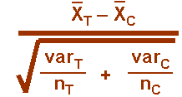
Student’s t-test

Slide 7
~ 4.5 x SEM: p~0.01
~ 2 x SEM: p~0.05
n = 3
~ 2 x SEM: p~0.01
~ 1 x SEM: p~0.05
n = 10

Slide 8
Student’s t-test
Independent t-test
Difference between 2 means of one variable for two independent groups
Example: difference in weight between WT and KO mice
Paired t-test
Difference between two measures of one variable for one group:
Example: before-after measurements
the second ‘sample’ of values comes from the same subjects (mouse, petri dish …).
Importance of experimental design!
One-Sample t-test
Difference between the mean of a single variable and a specified constant.
Notes:
WT vs mutant, totally independent
Time 0 then treatment and look at time 1: look difference in one group in difference condition

Slide 9
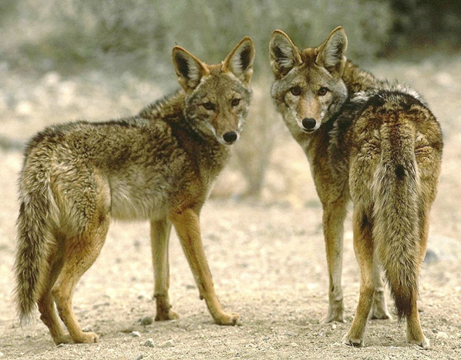
Example: coyotes
Question: do male and female coyotes differ in size?
Sample size
Data exploration
Check the assumptions for parametric test
Statistical analysis: Independent t-test

Slide 10
Exercise 3: Power analysis
Example case:
No data from a pilot study but we have found some information in the literature.
In a study run in similar conditions as in the one we intend to run, male coyotes were found to measure: 92cm +/- 7cm (SD).
We expect a 5% difference between genders.
smallest biologically meaningful difference
power.t.test(n = NULL, delta = NULL, sd = 1, sig.level = NULL,
power = NULL, type = c("two.sample", "one.sample", "paired"),
alternative = c("two.sided", "one.sided"))

Slide 11
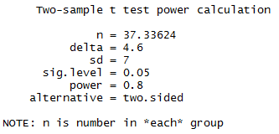
Exercise 3: Power analysis - Answers
Example case:
We don’t have data from a pilot study but we have found some information in the literature.
In a study run in similar conditions as in the one we intend to run, male coyotes were found to measure:
92cm+/- 7cm (SD)
We expect a 5% difference between genders with a similar variability in the female sample.
Mean 1 = 92
Mean 2 = 87.4 (5% less than 92cm)
delta = 92 – 87.4
sd = 7
power.t.test(delta=92-87.4, sd=7, sig.level=0.05, power=0.8)
We need a sample size of n~76 (2*38)

Slide 12
Data exploration $≠$ plotting data

Slide 13
Exercise 4: Data exploration coyote.csv
The file contains individual body length of male and female coyotes.
Question: do male and female coyotes differ in size?
Load coyote.csv
Plot the data as boxplot, histogram, violinplot and stripchart
Data exploration $≠$ plotting data

Slide 14
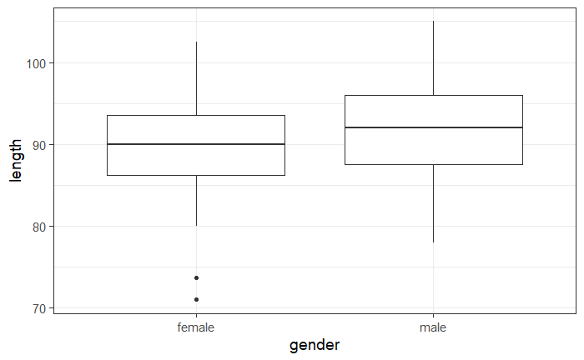
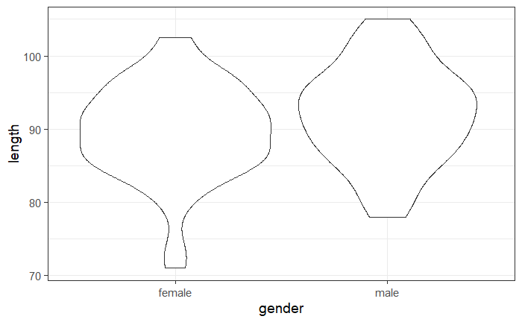
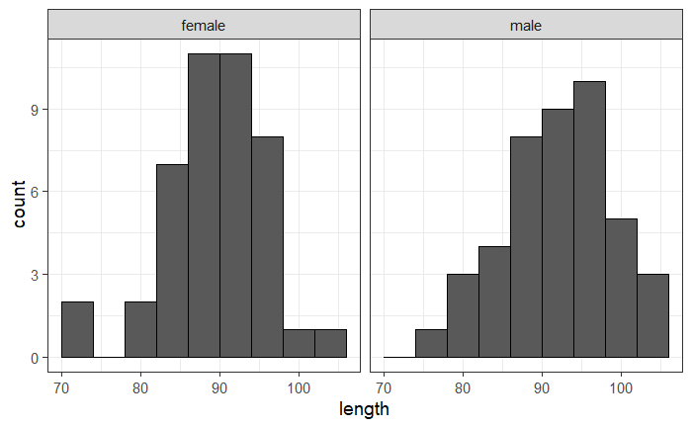
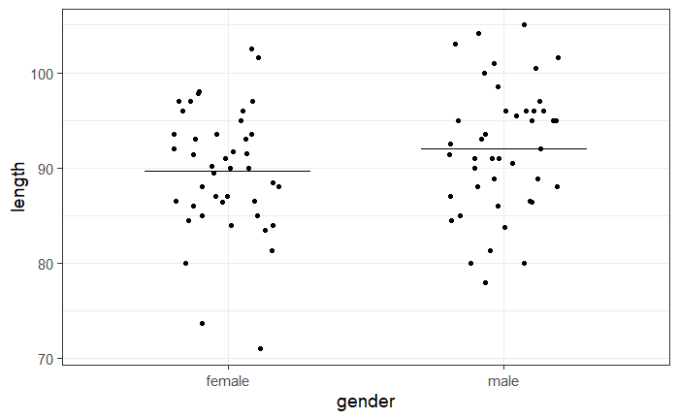
Exercise 4: Data exploration
Explore data using 4 different representations:

Slide 15
Exercise 4: facet_grid(rows=vars(row),cols=vars(column))
facet_grid(cols=vars(gender))
2 columns: one per gender
One row

Slide 16
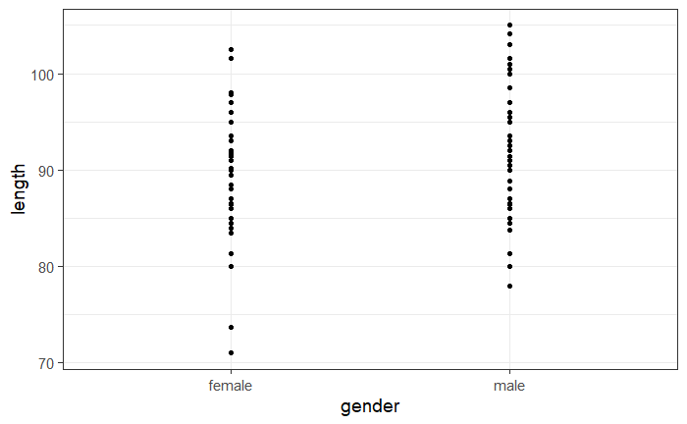
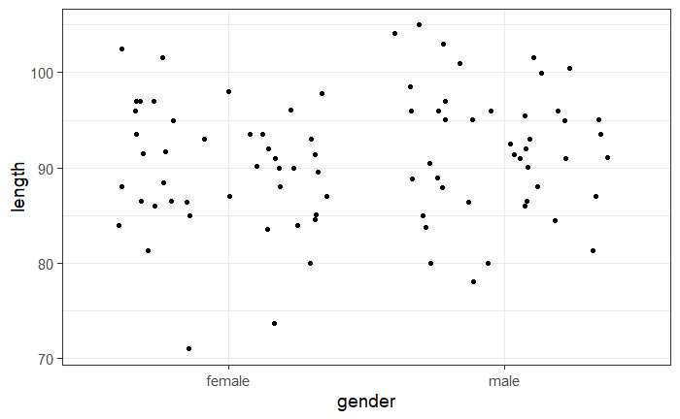
Exercise 4: geom_jitter()
Stripchart
Variation of geom_point(): geom_jitter()
coyote %>%
ggplot(aes(x=gender,y=length)) +
geom_point()
coyote %>%
ggplot(aes(x=gender,y=length)) +
geom_jitter(height=0, width=0.3)

Slide 17
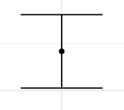
Exercise 4: stat_summary()
Stripchart
stat_summary()
What statistical summary: mean: fun = "mean"
What geom(): choice of graphical representation: a line: geom_errorbar()
stat_summary(geom="errorbar", fun="mean",fun.min="mean",fun.max="mean")
mean=minimum=max
coyote %>%
ggplot(aes(gender,length)) +
geom_jitter(height=0, width=0.2)+
stat_summary(geom= "errorbar", fun="mean", fun.min="mean", fun.max="mean")

Slide 18
Exercise 4: Data exploration
coyote %>%
ggplot(aes(x=gender, y=length))+
geom_...()
Explore data using 4 different representations:
geom_boxplot()
geom_violin()
facet_grid(rows=vars(row),cols=vars(column))
geom_histogram
geom_jitter()
stat_summary()
Have a go!

Slide 19
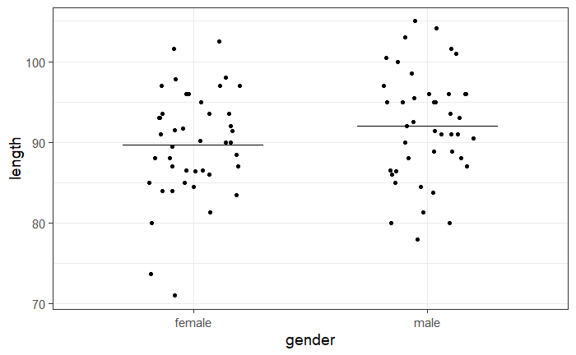
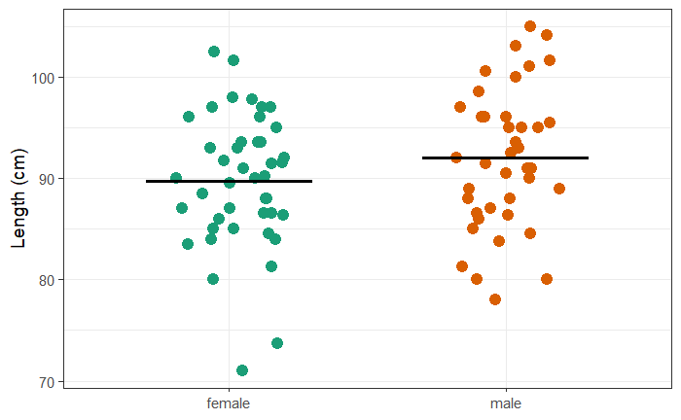
Exercise 4: Exploring data - Stripchart
coyote %>%
ggplot(aes(gender,length)) +
geom_jitter(height=0, width=0.2)+
stat_summary(geom= "errorbar", fun="mean", fun.min="mean", fun.max="mean")
coyote %>%
ggplot(aes(gender,length, colour=gender)) +
geom_jitter(height=0, size=4, width=0.2, show.legend = FALSE) +
ylab("Length (cm)")+
scale_colour_brewer(palette="Dark2")+
xlab(NULL)+
stat_summary(geom="errorbar", fun=mean, fun.min=mean, fun.max=mean, colour="black", size=1.2, width=0.6)

Slide 20
Exercise 4: Exploring data - Boxplots and beanplots
coyote %>%
ggplot(aes(x=gender, y=length)) +
geom_boxplot()
coyote %>%
ggplot(aes(x=gender, y=length)) +
geom_violin()

Slide 21
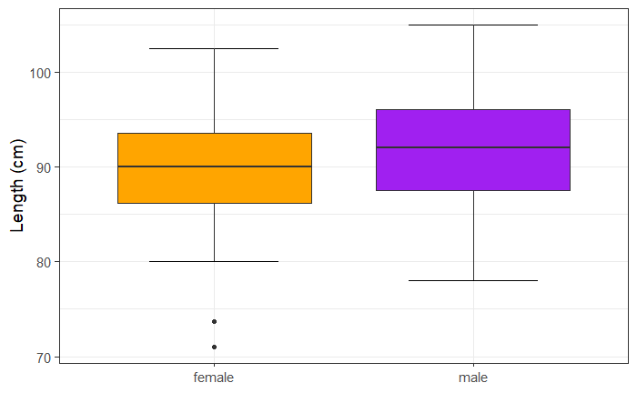
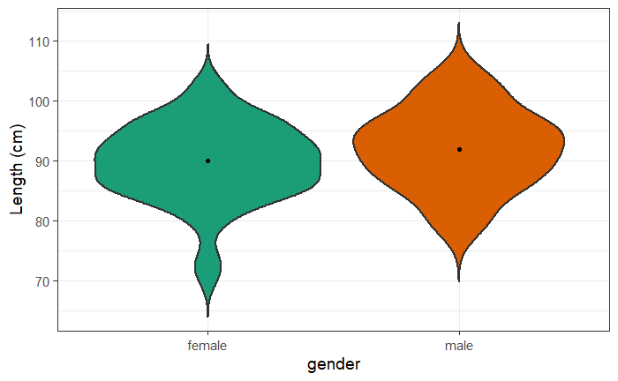
Exercise 4: Exploring data - Boxplots and beanplots
coyote %>%
ggplot(aes(x=gender, y=length, fill=gender)) +
stat_boxplot(geom="errorbar",width=0.5) +
geom_boxplot(show.legend=FALSE)+
ylab("Length (cm)")+
xlab(NULL)+
scale_fill_manual(values = c("orange","purple"))
coyote %>%
ggplot(aes(gender, length, fill=gender)) +
geom_violin(trim=FALSE, size=1, show.legend=FALSE)+
ylab("Length (cm)")+
scale_fill_brewer(palette="Dark2")+
stat_summary(geom = "point", fun = "median",show.legend=FALSE)

Slide 22
Exercise 4: Exploring data - Histograms
also works
facet_wrap(vars(gender))
coyote %>%
ggplot(aes(length))+
geom_histogram(binwidth = 4, colour="black") +
facet_grid(cols=vars(gender))

Slide 23
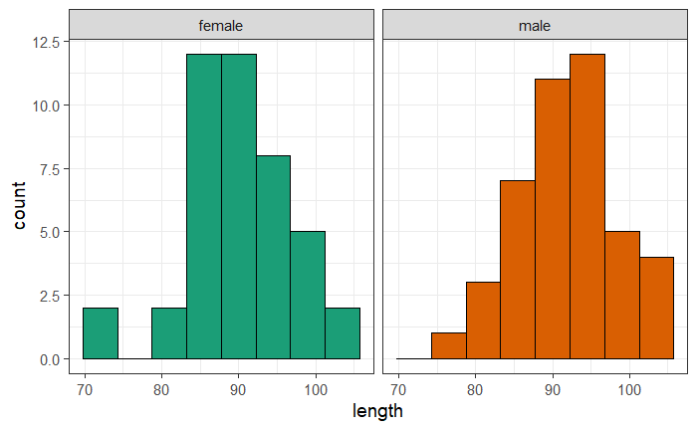
Exercise 4: Exploring data - Histograms
coyote %>%
ggplot(aes(length, fill=gender))+
geom_histogram(binwidth = 4.5, colour="black", show.legend = FALSE) +
scale_fill_brewer(palette="Dark2")+
facet_grid(cols=vars (gender))

Slide 24
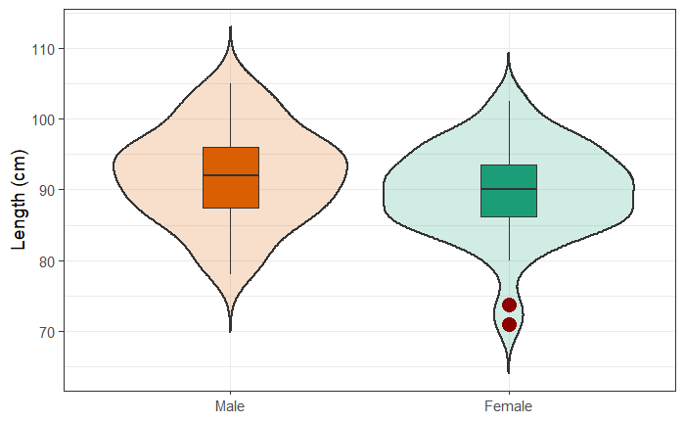
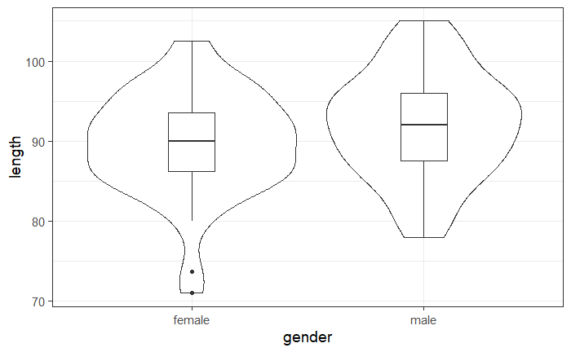
Exercise 4 extra: Exploring data - Graph combinations
coyote %>%
ggplot(aes(gender, length)) +
geom_boxplot(width=0.2)+
geom_violin()
coyote %>%
ggplot(aes(gender,length, fill=gender)) +
geom_violin(size=1, trim = FALSE, alpha=0.2, show.legend=FALSE) +
geom_boxplot(width=0.2, outlier.size=5, outlier.colour = "darkred", show.legend=FALSE)+
scale_fill_brewer(palette="Dark2")+
ylab("Length (cm)")+
xlab(NULL)+
scale_x_discrete(labels=c("female"="Female", "male"="Male"), limits =c("male", "female"))

Slide 25
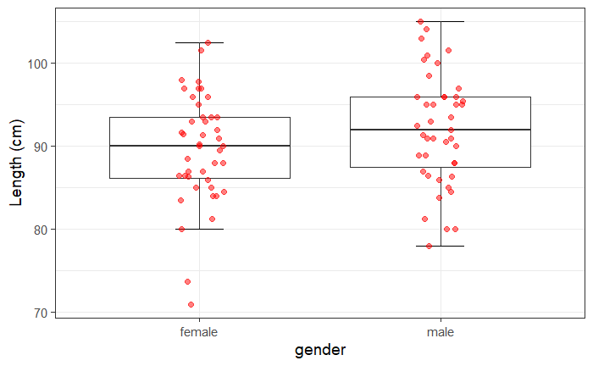
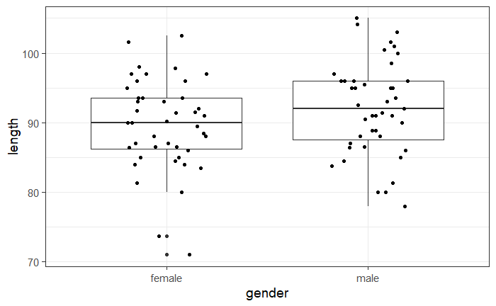
Exercise 4 extra: Exploring data - Graph combinations
coyote %>%
ggplot(aes(gender, length)) +
geom_boxplot()+
geom_jitter(height=0, width=0.2)
coyote %>%
ggplot(aes(gender, length)) +
geom_boxplot(outlier.shape=NA)+
stat_boxplot(geom="errorbar", width=0.2)+
geom_jitter(height=0, width=0.1, size=2, alpha=0.5, colour="red")+
ylab("Length (cm)")

Slide 26
Checking the assumptions

Slide 27
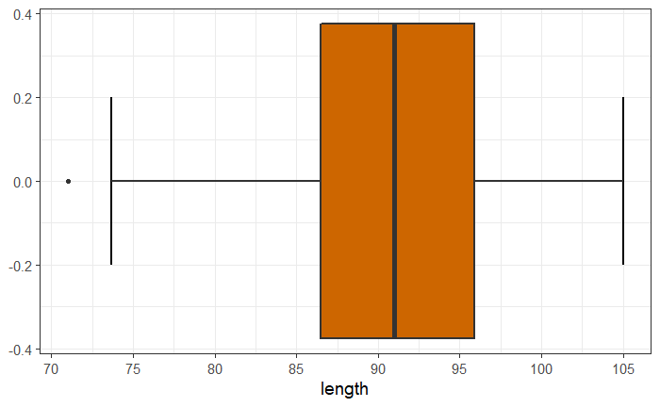
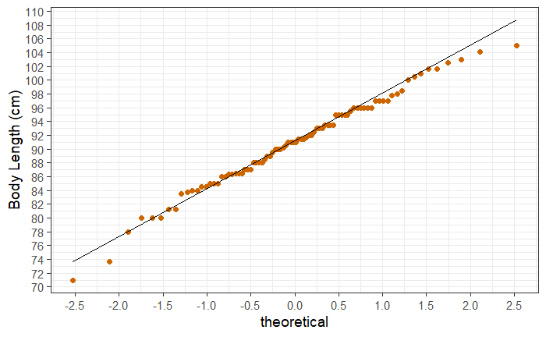
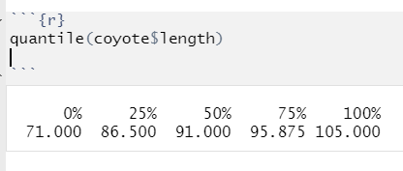
Normality assumption: QQ Plot
QQ plot= Quantile – Quantile plot
Quantiles:
Upper quartile
Lower quartile
Normality ☑ (ish)
Our coyotes
A little bit off
Quantiles:
Mean = 0
SD = 1
Same sample size
Perfectly normal distribution
Notes:
The values in our data are ranked and sorted, and each value is then compared to the expected value that the score should have in a normal distribution. If our data are normally distributed, the values in our data should have approximately the same values as those from a normal distribution, which would result in a straight diagonal line.

Slide 28
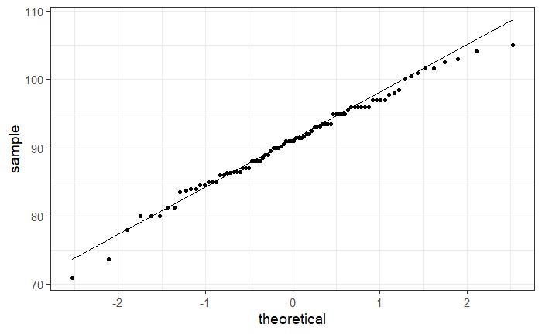
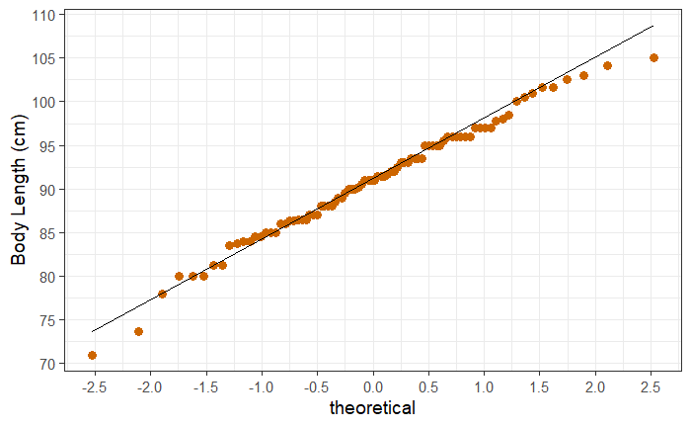
Normality assumption: QQ plot
coyote %>%
ggplot(aes(sample = length)) +
stat_qq()+
stat_qq_line()
coyote %>%
ggplot(aes(sample = length)) +
stat_qq(size=2, colour="darkorange3")+
stat_qq_line()+
ylab("Body Length (cm)")+
scale_y_continuous(breaks=seq(from=70, by=5, to=110))+
scale_x_continuous(breaks=seq(from=-3, by=0.5, to=3))

Slide 29
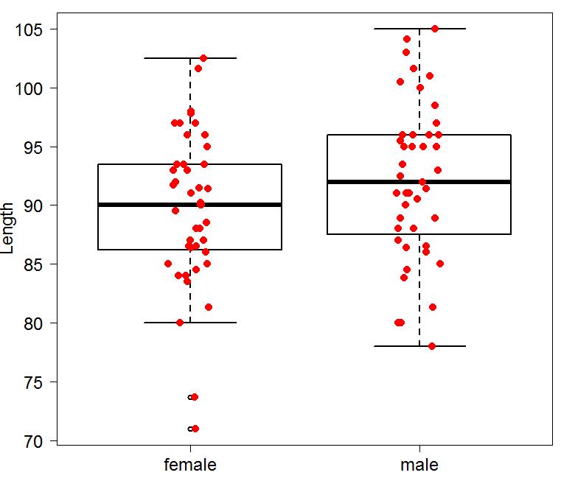
Assumptions of Parametric Data
First assumption: Normality
Shapiro-Wilk test shapiro_test() # rstatix package #
It is based on the correlation between the data and the corresponding normal scores.
Second assumption: Homoscedasticity
Levene test levene_test()
coyote %>%
group_by(gender) %>%
shapiro_test(length)%>%
ungroup()
Normality
Other classic: D’Agostino-Pearson test
# fBasic package #
dagoTest()
Normality ☑
Homoscedasticity
coyote %>%
levene_test(length ~ gender)
More robust: Brown-Forsythe test
# onewaytests package #, bf()
Other classic: Bartlett test
bartlett.test()
Homogeneity in variance ☑

Slide 30
Independent t-test: results (tidyverse) coyote.csv
coyote %>%
t_test(length~gender)
coyote %>%
group_by(gender) %>%
get_summary_stats(length, type = "mean_sd") %>%
ungroup()
Answer: Males tend to be longer than females but not significantly so (p=0.1045).
Power : How many more coyotes to reach significance?
Re-run the power analysis with mean=89.7 for females: n~250
But does it make sense?

Slide 31
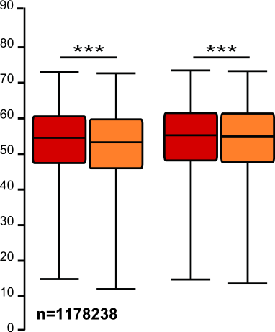
Sample size: the bigger the better?
It takes huge samples to detect tiny differences but tiny samples to detect huge differences.
What if the tiny difference is meaningless?
Beware of overpower
Nothing wrong with the stats: it is all about interpretation of the results of the test.
Remember the important first step of power analysis
What is the effect size of biological interest?

Slide 32
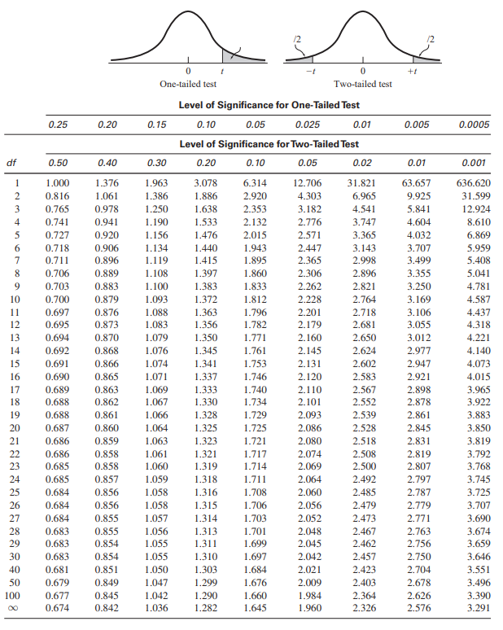
Independent t-test: results
The old-fashion way
t = 1.641 < 1.984: not significant
Critical value

Slide 33
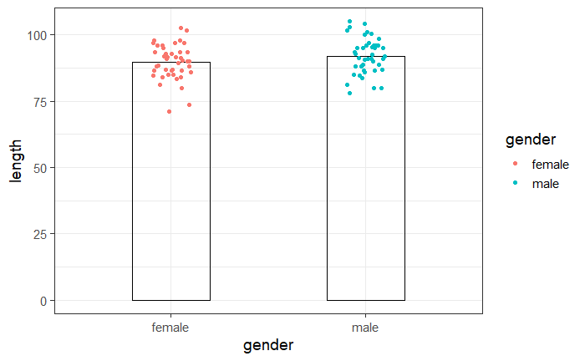
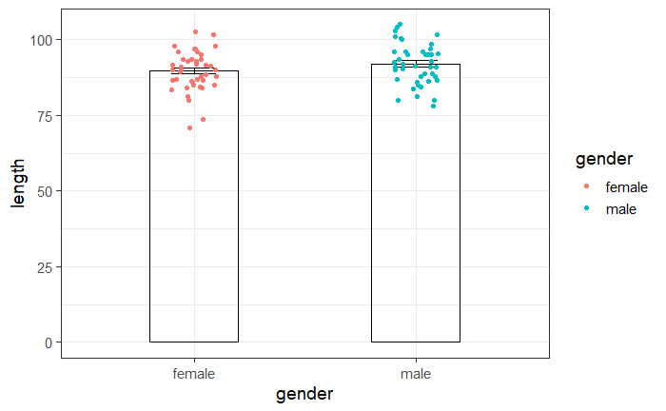
Plot ‘coyote.csv’ data: Plotting data
coyote %>%
ggplot(aes(gender,length, colour=gender)) +
geom_bar(stat = "summary", fun="mean", width=0.4, alpha=0, colour="black")+
geom_jitter(height=0, width=0.1)
Add error bars
coyote %>%
ggplot(aes(gender,length, colour=gender)) +
geom_bar(stat = "summary", fun="mean", width=0.4, alpha=0, colour="black")+
geom_jitter(height=0, width=0.1)+
stat_summary(geom="errorbar", colour="black", width=0.2)

Slide 34
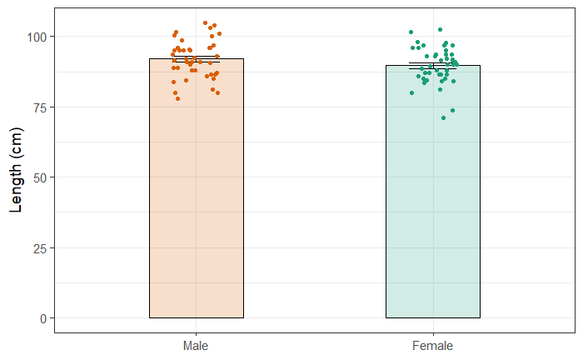
Plot ‘coyote.csv’ data: Plotting data
Prettier version
coyote %>%
ggplot(aes(gender,length, colour=gender, fill=gender)) +
geom_bar(stat="summary", fun="mean", width=0.4, alpha=0.2, colour="black", show.legend=FALSE)+
stat_summary(geom="errorbar", colour="black", width=0.2)+
geom_jitter(height=0, width=0.1, show.legend=FALSE)+
scale_colour_brewer(palette="Dark2")+
scale_fill_brewer(palette="Dark2")+
theme(legend.position = "none")+
scale_x_discrete(limits = c("male", "female"), labels = c("male"="Male", "female"="Female"))+
xlab(NULL)+
ylab("Length (cm)")

Slide 35
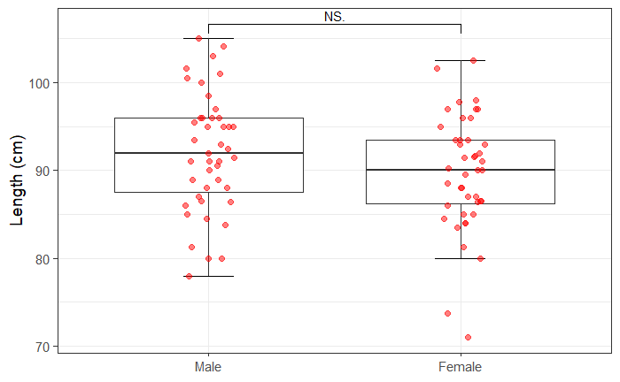
Plot ‘coyote.csv’ data: Plotting data
Work in progress # ggsignif package #
coyote %>%
ggplot(aes(gender, length)) +
stat_boxplot(geom="errorbar", width=0.2)+
geom_boxplot(outlier.shape = NA)+
geom_jitter(height=0, width=0.1, size = 2, alpha = 0.5, colour="red")+
scale_x_discrete(limits = c("male", "female"), labels = c("male"="Male", "female"="Female"))+
ylab("Length (cm)")+
xlab(NULL)+
geom_signif(comparisons = list(c("female", "male")), map_signif_level=T, test = "t.test")

Slide 36
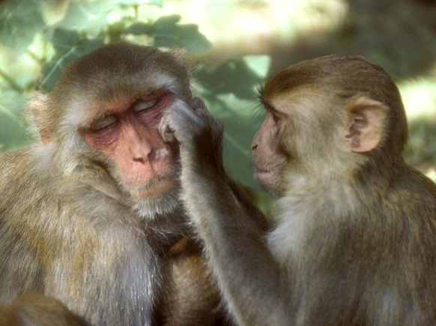
Exercise 5: Dependent or Paired t-test working.memory.csv
A researcher is studying the effects of dopamine depletion on working memory in rhesus monkeys.
A group of rhesus monkeys (n=15) performs a task involving memory after having received a placebo. Their performance is graded on a scale from 0 to 100. They are then asked to perform the same task after having received a dopamine depleting agent.
Question: does dopamine affect working memory in rhesus monkeys?
Load working.memory.csv and check out the structure of the data.
Work out the difference: DA.depletion – placebo and
assign the difference to a column: working.memory$difference
Plot the difference as a stripchart with a mean
Add confidence intervals as error bars
Clue: stat_summary(…, fun.data=mean_cl_normal)
# Hmisc package #
Run the paired t-test. t_test(var ~ 1, mu=0)

Slide 37
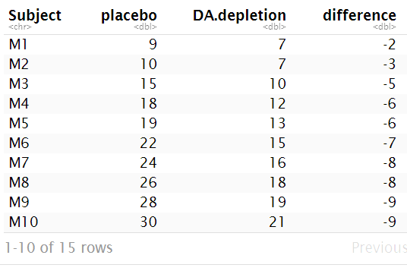
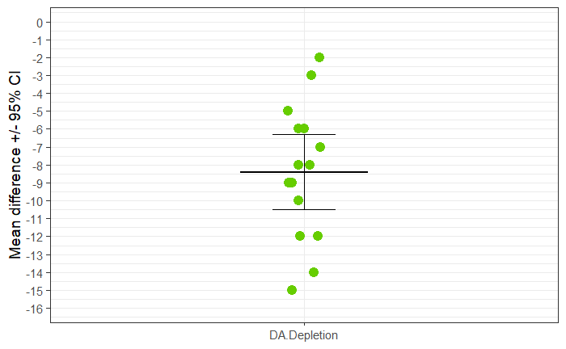
Exercise 5: Dependent or Paired t-test - Answers
working.memory %>%
mutate(difference = DA.depletion - placebo) -> working.memory
# Hmisc package #
working.memory %>%
ggplot(aes("DA.Depletion", difference))+
geom_jitter(height=0, width=0.05, size=4, colour="chartreuse3")+
stat_summary(geom="errorbar",fun="mean", fun.min="mean", fun.max="mean", width=0.3, size=1)+
stat_summary(geom="errorbar", fun.data=mean_cl_normal, width=0.15)+
scale_y_continuous(breaks=-16:0, limits=c(-16, 0))+
xlab(NULL)+
ylab("Mean difference +/- 95% CI")

Slide 38
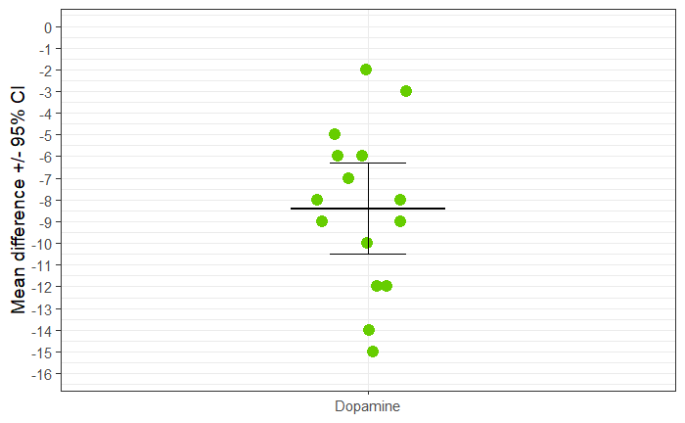
Exercise 5: Dependent or Paired t-test (tidyverse)
Question: does dopamine affect working memory in rhesus monkeys?
working.memory %>%
shapiro_test(difference)
working.memory %>%
t_test(difference ~ 1, mu=0)
Answer: the injection of a dopamine-depleting agent significantly affects working memory in rhesus monkeys (t=-8.62, df=14, p=5.715e-7).

Slide 39
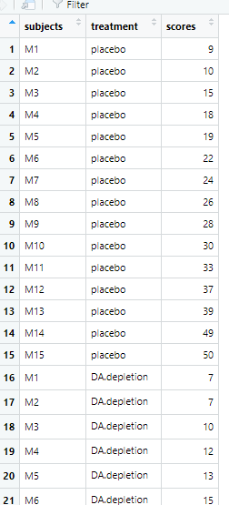
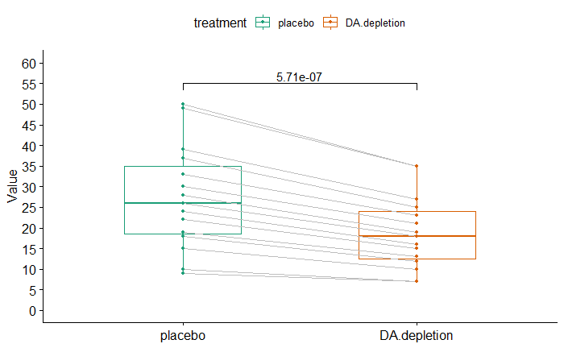
Dependent or Paired t-test
Work in progress # ggpubr package #
working.memory.long %>%
t_test(scores ~ treatment, paired = TRUE) -> stat.test
working.memory.long %>%
ggpaired(x = "treatment", y = "scores", color = "treatment",
palette = "Dark2", line.color = "gray", line.size = 0.4)+
scale_y_continuous(breaks=seq(from =0, by=5, to=60),
limits = c(0,60))+
stat_pvalue_manual(stat.test, label = "p", y.position = 55)
working.memory.long

