Slide 1


Analysis of Quantitative data
Linear regression
Anne Segonds-Pichon v2020-12

Slide 2
Association between 2 continuous variables
One variable X and One variable Y
One predictor
Correlation

Slide 3

Signal-to-noise ratio
Signal
Similarity
=
Noise
Variability
Signal
= statistical significance
Noise
Signal
= no statistical significance
Noise

Slide 4
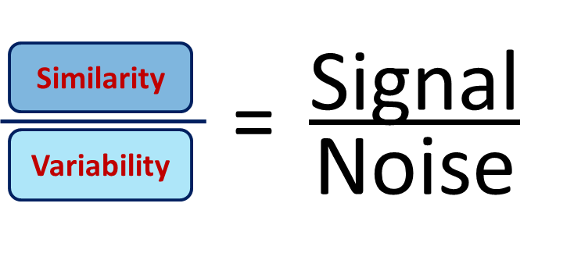
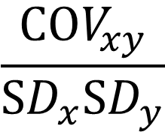
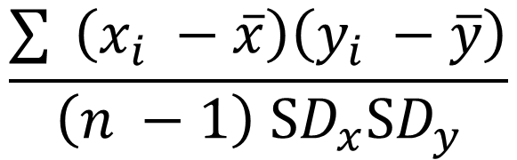
Signal-to-noise ratio and Correlation
Signal is similarity of behaviour between variable x and variable y.
similarity
Signal
Coefficient of correlation: r =
=
variability
Noise
covariance
$$\frac{COV_{xy}}{SD_{x}SD_{y}}$$
$$\frac{\sum{ }\left(x_{i} −\overline{x}\right)\left(y_{i} −\overline{y}\right)}{\left(n −1\right) SD_{x}SD_{y}}$$
r
similarity
variability
Standard Deviation

Slide 5
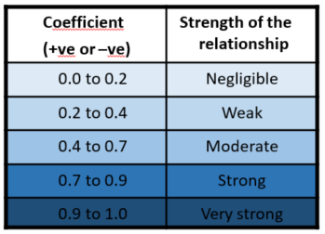
Correlation
Most widely-used correlation coefficient:
  Pearson product-moment correlation coefficient “r”
    The magnitude and the direction of the relation between 2 variables
    It is designed to range in value between -1 and +1
    -0.6 < r > +0.6 : exciting
  Coefficient of determination “r²”
    It gives the proportion of variance in Y that can be explained by X (in percentage).
      It helps with the interpretation of r
      It’s basically the effect size

Slide 6




Correlation
p = 0.0002
p = 0.04
r = - 0.34
r = - 0.83
r² = 0.12
r² = 0.68
Power!!

Slide 7
Correlation
Assumptions
Assumptions for correlation
  Regression and linear Model (lm)
Linearity: The relationship between X and the mean of Y is linear.
Homoscedasticity: The variance of residual is the same for any value of X.
Independence: Observations are independent of each other.
Normality: For any fixed value of X, Y is normally distributed.

Slide 8
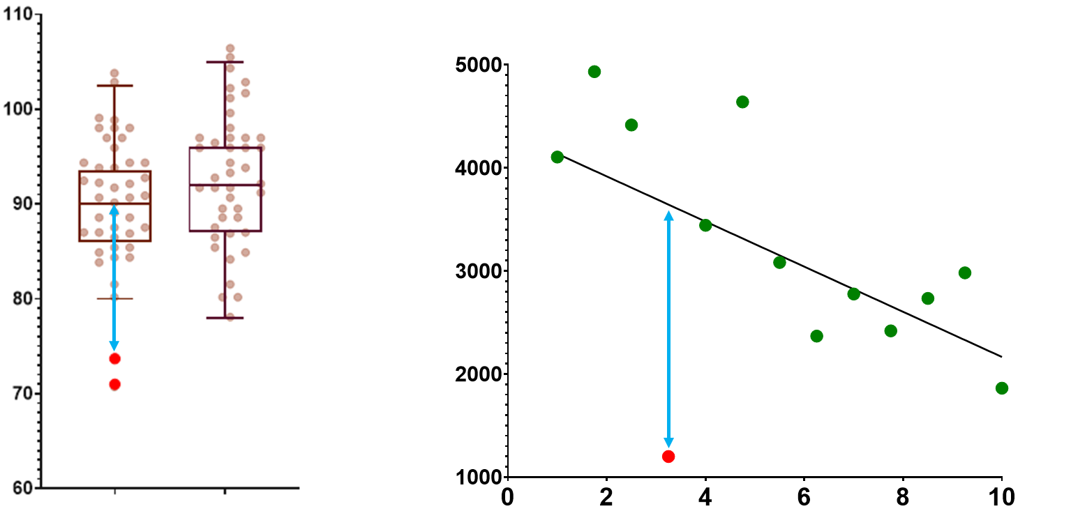
Correlation
Outliers and High leverage points
Outliers: the observed value for the point is very different from that predicted by the regression model.

Slide 9
Correlation
Outliers and High leverage points
Leverage points: A leverage point is defined as an observation that has a value of x that is far away from the mean of x.
Outliers and leverage points have the potential to be Influential observations:
  Change the slope of the line. Thus, have a large influence on the fit of the model.
One method to find influential points is to compare the fit of the model with and without the dodgy observation.

Slide 10
Correlation
Outliers and High leverage points
All good

Slide 11
Correlation
Outliers and High leverage points
Outlier but not influential value

Slide 12
Correlation
Outliers and High leverage points
High leverage but not influential value

Slide 13
Correlation
Outliers and High leverage points
Outlier and High leverage: Influential value

Slide 14
Correlation: Two more things
Thing 1: Pearson correlation is a parametric test
First assumption for parametric test: Normality
Correlation: bivariate Gaussian distribution
Symmetry-ish of the values on either side of the line of best fit.

Slide 15
Correlation: Two more things
Thing 2: Line of best fit comes from a regression
Correlation: nature and strength of the association
Regression: nature and strength of the association and prediction
Y
x
Correlation = Association
Regression = Prediction
Y = A + B*X

Slide 16
Correlation: correlation.csv
Questions:
  What is the nature and the strength of the relationship between X and Y?
  Are there any dodgy points?

Slide 17
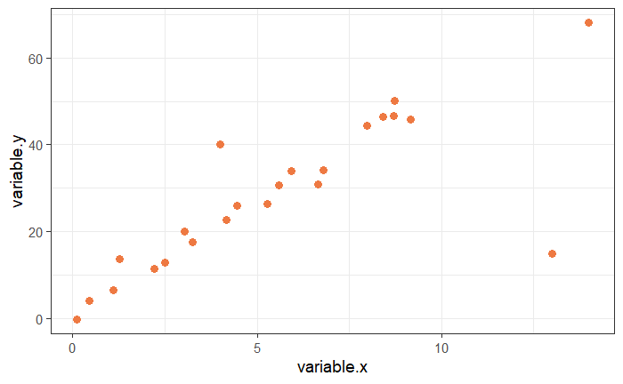
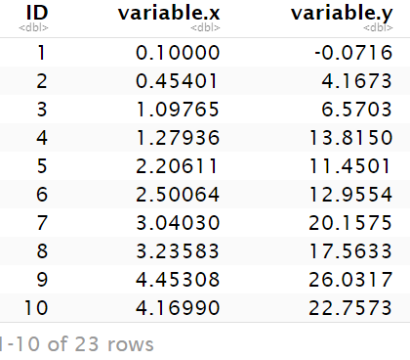
Correlation: correlation.csv
Question: are there any dodgy points?
read_csv("correlation.csv") -> correlation
correlation %>%
ggplot(aes(variable.x, variable.y, colour=Gender)) +
geom_point(size=3, colour="sienna2")

Slide 18

Correlation: correlation.csv
For the lines of best-fit: 3 new functions:
lm(y~x, data=) -> fit
coefficients(fit) -> cf.fit (vector of 2 values)
geom_abline(intercept=cf.fit[1], slope=cf.fit[2])
lm(variable.y ~ variable.x, data=correlation)-> fit.correlation
coefficients(fit.correlation) -> coef.correlation
coef.correlation
intercept slope

Slide 19
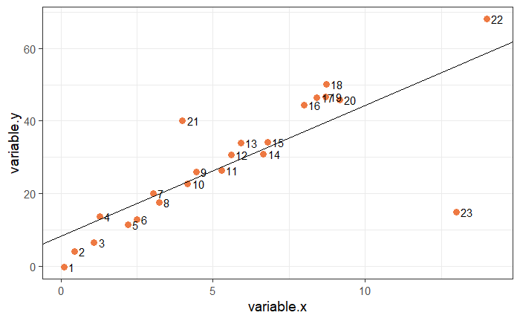
Correlation: correlation.csv
correlation %>%
ggplot(aes(variable.x, variable.y, label = ID)) +
geom_point(size=3, colour="sienna2") +
geom_abline(intercept = coef.correlation[1], slope = coef.correlation[2])+
geom_text(hjust = 0, nudge_x = 0.15)

Slide 20
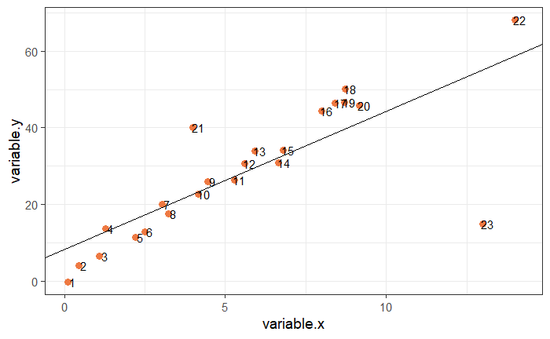
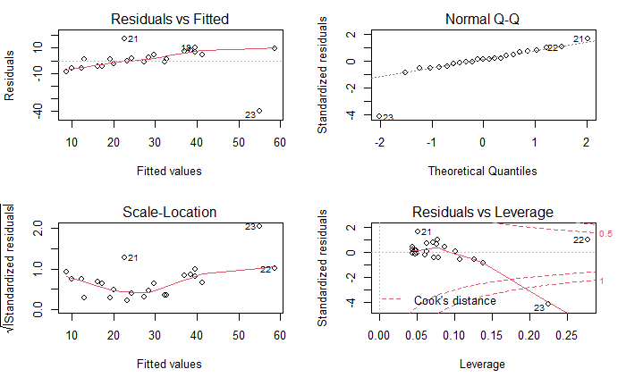
Correlation: correlation.csv
Assumptions, outliers and influential cases
par(mfrow=c(2,2))
plot(fit.correlation)
Linearity, homoscedasticity and outlier
Normality and outlier
cooks.distance()
The Cook’s distance is a combination of each observation’s leverage and residual values ; the higher the leverage and residuals, the higher the Cook’s distance (influential observation).
It summarizes how much all the values in the regression model change when the ith observation is removed.
Consensus: cut-off point =1 (0.5).
Homoscedasticity
Influential cases

Slide 21
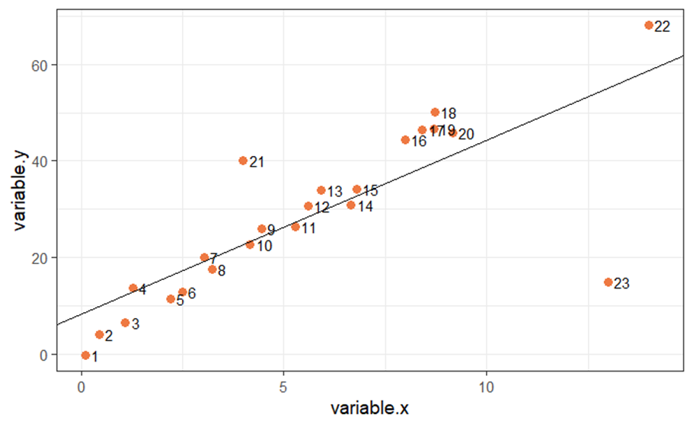
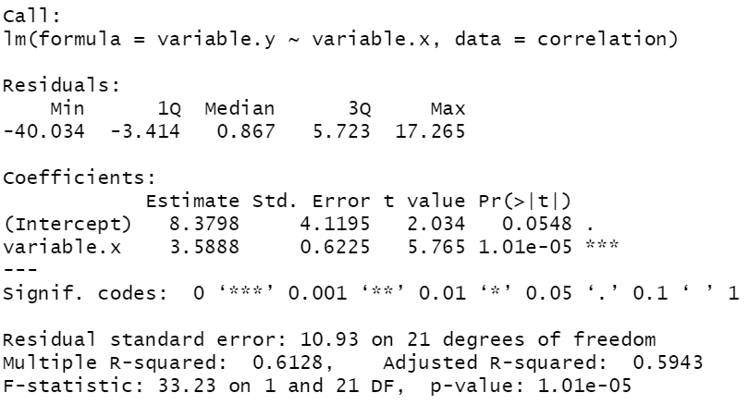
Correlation: correlation.csv
summary(fit.correlation)
Line of best fit: Y=8.38 + 3.59*X
correlation %>%
cor_test(variable.x, variable.y)

Slide 22
Correlation: correlation.csv
Have a go: Remove ID 23, then re-run the model and plot the graph again.
Then decide what you want to do with ID 21 and 22.
correlation %>%
filter(ID != 23) -> correlation.23

Slide 23
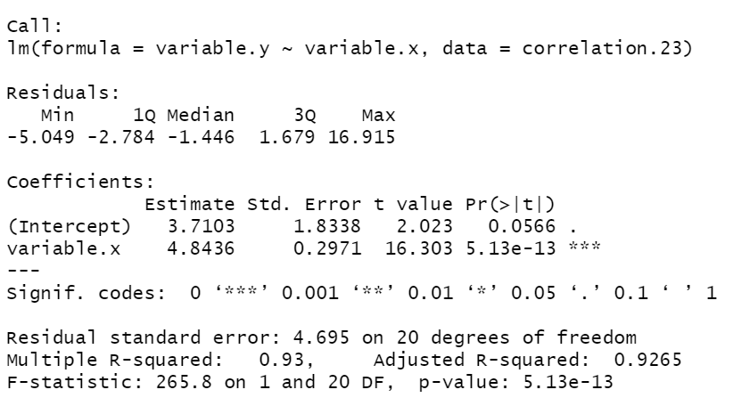
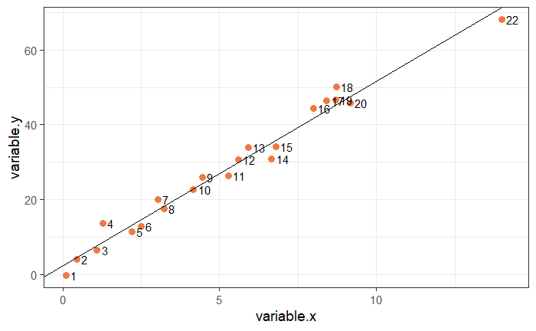
Correlation: correlation.csv
correlation %>%
filter(ID != 23) -> correlation.23
lm(variable.y ~ variable.x, correlation.23) -> fit.correlation.23
summary(fit.correlation.23)

Slide 24
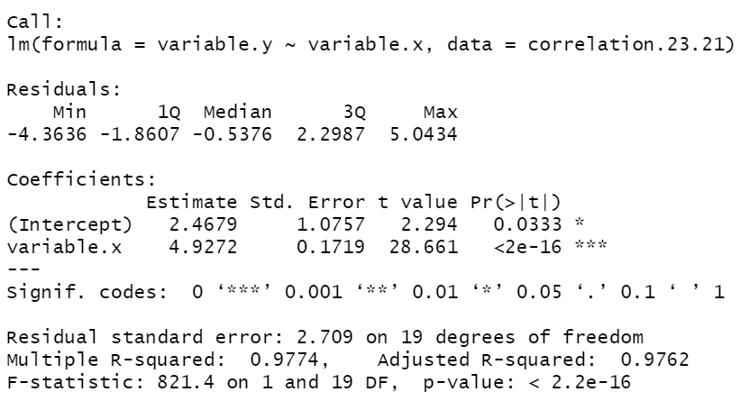
Correlation: correlation.csv
correlation.23 %>%
filter(ID != 21) -> correlation.23.21
lm(variable.y ~ variable.x, correlation.23.21) -> fit.correlation.23.21
summary(fit.correlation.23.21)
Correlation.23.21 %>%
cor_test(variable.x, variable.y)

Slide 25
Extra exercise
Correlation: exam.anxiety.csv
Question: Is there a relationship between time spent revising and exam anxiety?
And, if yes, are boys and girls different?
Build a fit for the boys and a fit for the girls
  data %>% filter() lm(y~x, data=)
Plot the 2 lines of best fit on the same graph
  coefficients() geom_abline()
Check the assumptions visually from the data and with the output for models
  par(mfrow=c(2,2)) plot(fit.male)
Filter out misbehaving values based on the standardised residuals
  rstandard() add_column()
Plot the final (improved!) model
  bind_rows()

Slide 26
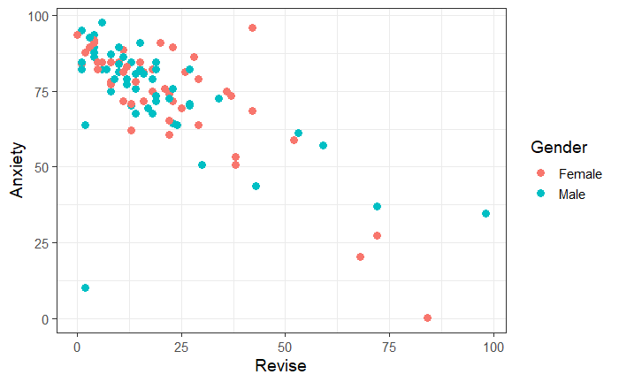
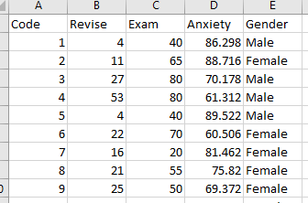
Correlation: exam.anxiety.csv
Question: Is there a relationship between time spent revising and exam anxiety?
And, if yes, are boys and girls different?
read_csv("exam.anxiety.csv") -> exam.anxiety
exam.anxiety %>%
ggplot(aes(x=Revise, y=Anxiety, colour=Gender)) + geom_point(size=3)

Slide 27
Correlation: exam anxiety.csv
Is there a relationship between time spent revising and exam anxiety?
exam.anxiety %>%
filter(Gender=="Female") -> exam.anxiety.female
lm(Anxiety~Revise, data=exam.anxiety.female) -> fit.female
coefficients(fit.female) -> cf.fit.female
Fit for the females
exam.anxiety %>%
filter(Gender=="Male") -> exam.anxiety.male
lm(Anxiety~Revise, data=exam.anxiety.male) -> fit.male
coefficients(fit.male) -> cf.fit.male
Fit for the males

Slide 28

Correlation: exam anxiety.csv
Is there a relationship between time spent revising and exam anxiety?
exam.anxiety %>%
ggplot(aes(x=Revise, y=Anxiety, colour=Gender))+
geom_point(size=3)+
geom_abline(intercept=cf.fit.male[1], slope=cf.fit.male[2])+
geom_abline(intercept=cf.fit.female[1], slope=cf.fit.female[2])

Slide 29
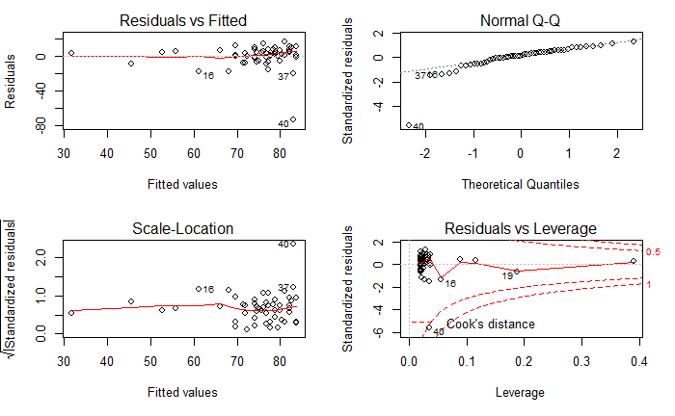
Correlation: exam anxiety.csv
Assumptions, outliers and influential cases
par(mfrow=c(2,2))
plot(fit.male)

Slide 30
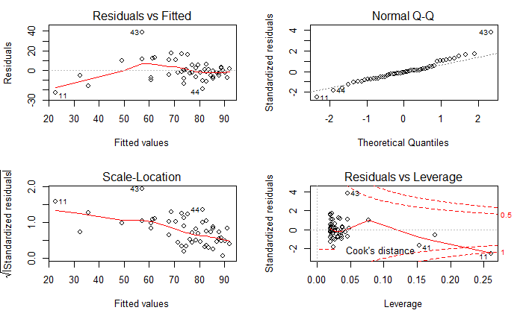
Correlation: exam anxiety.csv
Assumptions, outliers and influential cases
plot(fit.female)

Slide 31
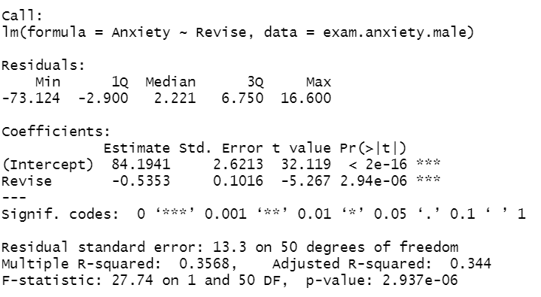
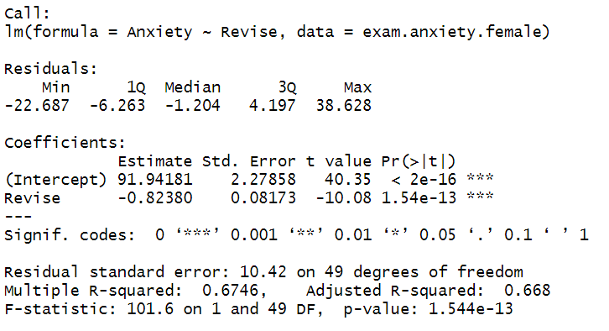
Correlation: exam anxiety.csv
summary(fit.male)
Anxiety=84.19 - 0.53*Revise
summary(fit.female)
Anxiety=91.94 - 0.82*Revise
exam.anxiety %>%
group_by(Gender) %>%
cor_test(Revise, Anxiety) %>%
ungroup()

Slide 32
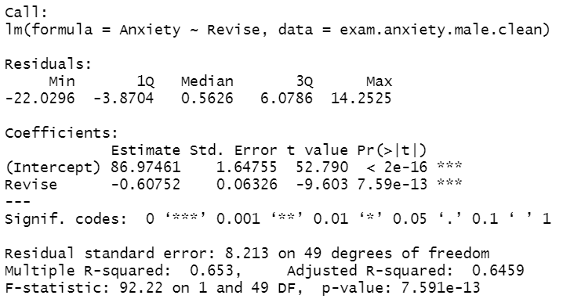
Correlation: exam.anxiety.csv
Influential outliers: Boys
rstandard(fit.male) -> st.resid.m
exam.anxiety.male %>%
add_column(st.resid.m) %>%
filter(abs(st.resid.m)<3) -> exam.anxiety.male.clean
lm(Anxiety~Revise, data=exam.anxiety.male.clean) -> fit.male2
summary(fit.male2)
exam.anxiety.male.clean %>%
cor_test(Revise, Anxiety)

Slide 33
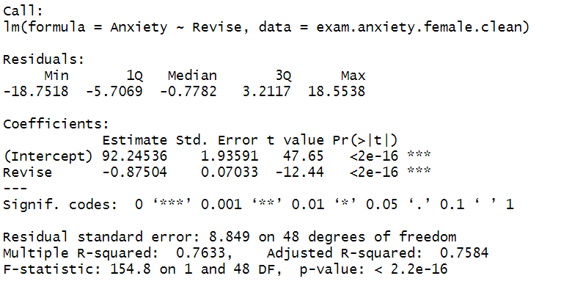
Correlation: exam.anxiety.csv
Influential outliers: Girls
rstandard(fit.female) -> st.resid.f
exam.anxiety.female %>%
add_column(st.resid.f) %>%
filter(abs(st.resid.f) < 3) -> exam.anxiety.female.clean
lm(Anxiety~Revise, data=exam.anxiety.female.clean) -> fit.female2
summary(fit.female2)
exam.anxiety.female.clean %>%
cor_test(Revise, Anxiety)

Slide 34
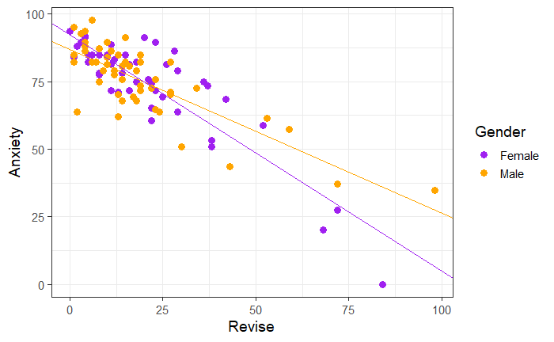
Correlation: exam.anxiety.csv
Question: Is there a relationship between time spent revising and exam anxiety? Yes!
bind_rows(exam.anxiety.female.clean, exam.anxiety.male.clean) -> exam.anxiety.clean
coefficients(fit.male2) -> cf.fit.male2
coefficients(fit.female2) -> cf.fit.female2
exam.anxiety.clean %>%
ggplot(aes(Revise, Anxiety, colour=Gender))+geom_point(size=3)+
geom_abline(aes(intercept=cf.fit.male2[1], slope=cf.fit.male2[2]), colour="orange")+
geom_abline(aes(intercept=cf.fit.female2[1], slope=cf.fit.female2[2]), colour="purple")+
scale_colour_manual(values = c("purple", "orange"))

Slide 35




Correlation: exam.anxiety
Influential outliers: Another check
exam.anxiety.male %>%
shapiro_test(st.resid.m)
exam.anxiety.female %>%
shapiro_test(st.resid.f)
exam.anxiety.male.clean %>%
shapiro_test(st.resid.m)
exam.anxiety.female.clean %>%
shapiro_test(st.resid.f)

Slide 36
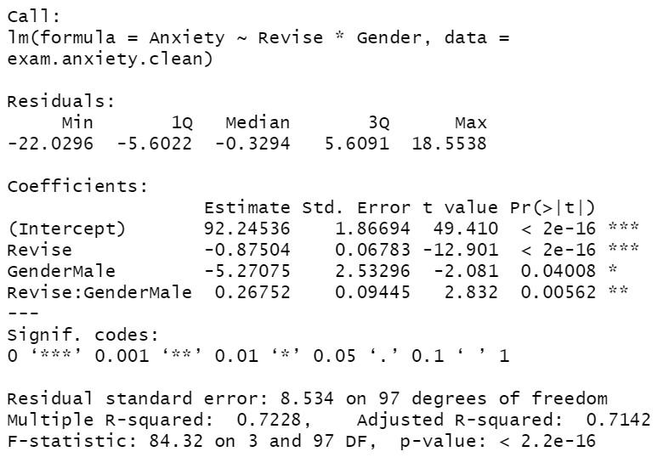
Correlation: exam anxiety.csv
Difference between boys and girls?
lm(Anxiety~Revise*Gender, data=exam.anxiety.clean) -> fit.genders
summary(fit.genders)

