Slide 1
Introducing version control using Git, GitHub and Rstudio v2020 11

Slide 2
Version Control
Friends, Romans, countrymen, lend me your ears;
Friends, Romans, countrymen, lend me your ears;
I come to bury Caesar, not to praise him.
Bring me a shovel, and a bucket
Friends, Romans, countrymen, lend me your ears;
I come to bury Caesar, not to praise him.
The evil that men do lives after them;
The good is oft interred with their bones;

Slide 3
Progressive Saving Options
Save and overwrite
Only have the latest version
Can’t backtrack
Save to new files
Full history
Lots of duplication
No partial backtracking
caesar.txt
caesar_1.txt
caesar_2.txt
caesar_3.txt

Slide 4
Version Control
Store differences to the last version
Version 1
+ Friends, Romans, countrymen, lend me your ears;
+ I come to bury Caesar, not to praise him.
+ Bring me a shovel, and a bucket
Version 2
- Bring me a shovel, and a bucket
+ The evil that men do lives after them;
+ The good is oft interred with their bones;
Version 3

Slide 5
Managing a project is difficult and requires version control
Version 1
Version 2
Version 3
File A
File B
File A*
File A**
File D
File C
File C
File C*
Files edited
Files added
Files removed
How to best manage this?
Version control records each version of the project
Previous versions can be accessed as and when required

Slide 6
Version control is also useful because…
It is a great way to keep track of how and why scripts were modified
Back-up capabilities
Collaboration
Sharing

Slide 7
Distributed version control
Working copy
Computer 1

Slide 8
Distributed version control
Repository
update
commit
Working copy
Computer 1

Slide 9
Distributed version control
Main server
Repository
pull
push
Repository
update
commit
Working copy
Computer 1

Slide 10
Distributed version control
Main server
Repository
pull
push
pull
push
push
pull
Repository
Repository
Repository
update
update
update
commit
commit
commit
Working copy
Working copy
Working copy
Computer 1
Computer 2
Computer 3

Slide 11
Introducing GitHub
GitHub
Main server
Repository
pull
push
pull
push
push
pull
Repository
Repository
Repository
update
update
update
commit
commit
commit
Working copy
Working copy
Working copy
Computer 1
Computer 2
Computer 3

Slide 12
GitHub

Slide 13
Committing files to a Git repository
Repository
Staging
Area
update
commit
Working copy

Slide 14
Committing files to a Git repository
Repository
commit
Staging
Area
update
File
add
Working copy

Slide 15
Branches
Master branch
Commit
1

Slide 16
Branches
Master branch
Commit
1
Commit
2

Slide 17
Branches
New feature branch
Master branch
Commit
1
Commit
2
Commit
3

Slide 18
Branches
New feature branch
Master branch
Commit
1
Commit
2
Commit
3

Slide 19
Branches
New feature branch
Master branch
Commit
1
Commit
2
Commit
3
Commit
4

Slide 20
Branches
New feature branch
Master branch
Commit
1
Commit
2
Commit
3
Commit
4
Commit
5

Slide 21
Checking out a previous version
Requires use of the terminal in RStudio
git checkout [revision] .
where [revision] is the commit hash, for example:
git checkout 668c6a44383e7381d0417143da12804f1ae8fb66 .
The . at the end means that all the files will be checked out.
To only checkout one file from a previous version:
git checkout [revision] [file_name]
e.g.
git checkout 668c6a44383e7381d0417143da12804f1ae8fb66 scatterplot.R

Slide 22
Other resources
https://happygitwithr.com/
https://rstudio.com/resources/webinars/managing-part-2-github-and-rstudio/
https://support.rstudio.com/hc/en-us/articles/200532077-Version-Control-with-Git-and-SVN

Slide 23
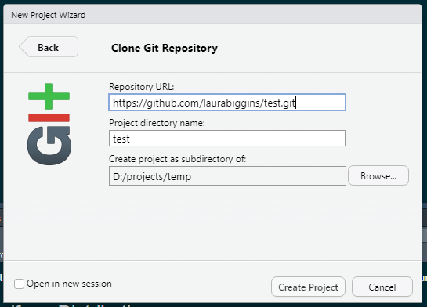
Cloning/Importing repository from GitHub into RStudio
New project -> Version Control -> Git
Paste in URL from GitHub

Slide 24
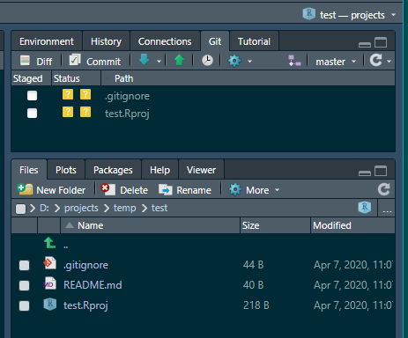
In creating the new Rproject, a test.Rproj file was created, along with a .gitignore file.

Slide 25
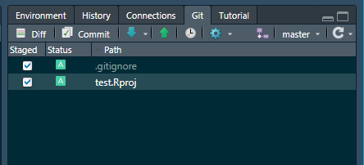
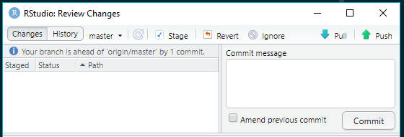
2
To stage the files – select the tick boxes under Staged
Click on Commit
1
Always a good idea to do a Git pull
Should see an information message saying that it’s already up to date

Slide 26
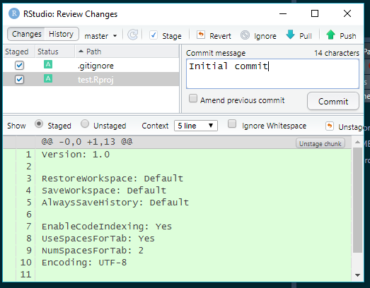
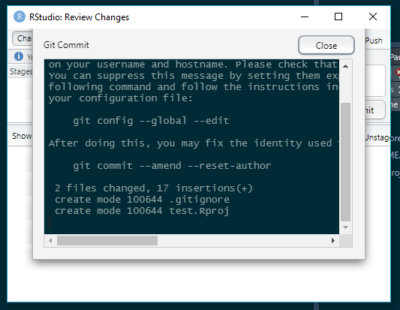
Add a commit message and select commit
Should get confirmation – select Close

Slide 27
Should see an information message saying your branch is ahead of origin/master by 1 commit.
The changes – the creation of the new files - test.Rproj file and .gitignore, have been committed to the local git repo, but they haven’t been pushed to the remote repository.
The push button can now be clicked
This should then push the changes to the remote repository.

Slide 28
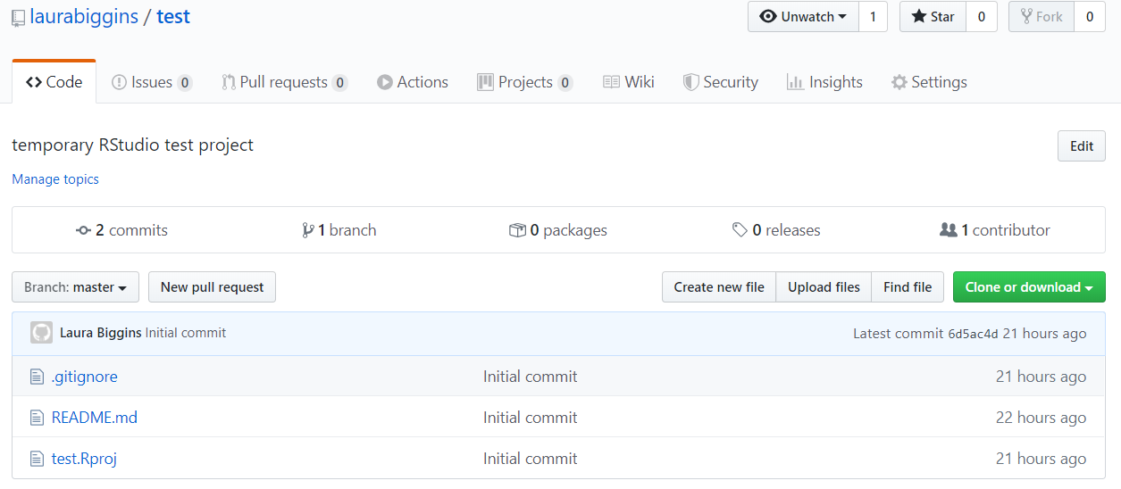
Back to GitHub
This should then push the changes to the remote repository and if the GitHub web page is refreshed, the new files should appear.

Slide 29
Existing R project not in GitHub
Export an R project to GitHub

Slide 30
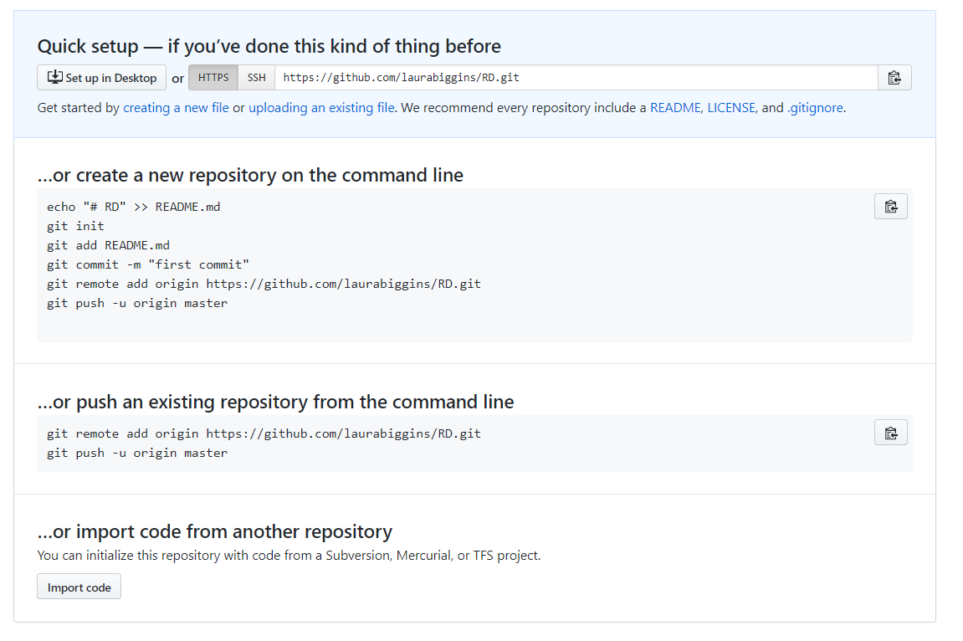
Copy the 2 lines of code

Slide 31
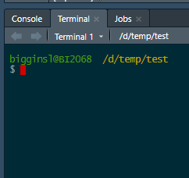
Using the terminal in RStudio

Slide 32
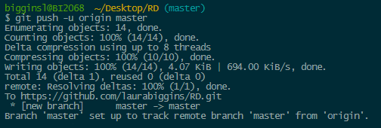
Using the terminal in RStudio

