Slide 1
SeqMonk tools for methylation analysis
Simon Andrews
simon.andrews@babraham.ac.uk
@simon_Andrews
2016-11

Slide 2
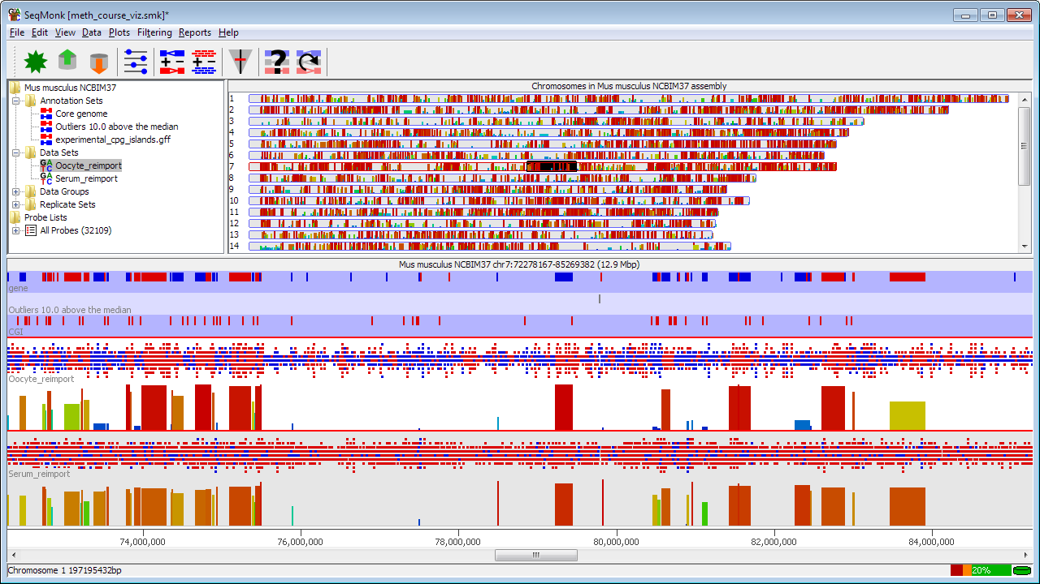
SeqMonk

Slide 3
SeqMonk Data Model
Conventional data (ChIP-Seq, RNA-Seq etc)
  Data is reads (BAM files etc)
  Strand indicates genomic strand
BS-Seq and related data
  Data is methylation calls
  All ‘reads’ are 1bp in length
  Strand indicates meth state (+=meth -=unmeth)
  Original strand comes from the imported file

Slide 4
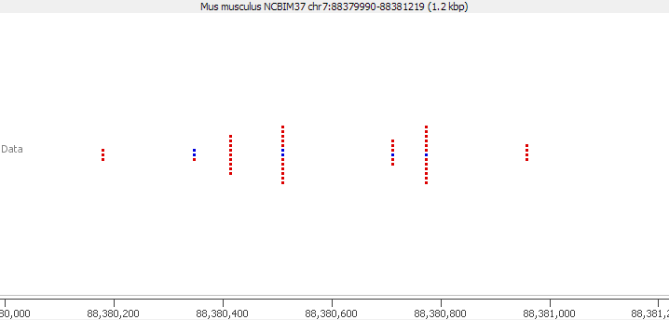
Raw Data
Red = Meth
Blue = Unmeth

Slide 5
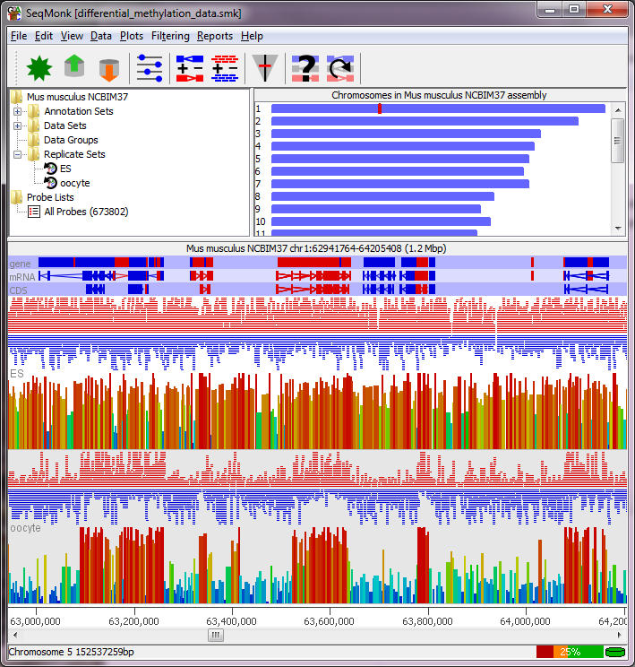
Basic Movement Controls
Move left right
  Drag bottom scrollbar
  Mouse scroll wheel
  Left/Right arrows
Zoom In
  Drag a box and release
  Up arrow
Zoom Out
  Right mouse button
  Down arrow
Find a feature
  Edit > Find Feature
  Control+F
Change chromosome
  Edit > Goto Position
  Drag a box in the genome view
Data View
Genome View
Annotation
Reads / Calls
Quantitations
Chromosome View

Slide 6

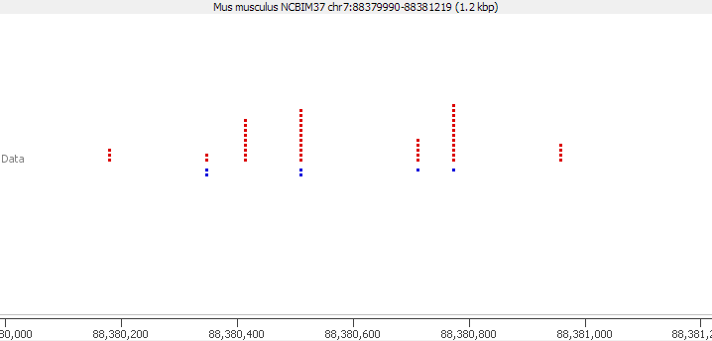
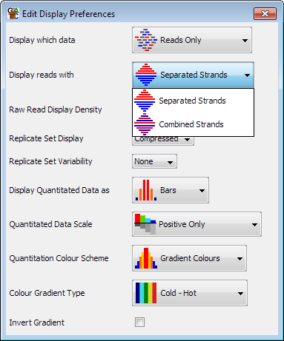
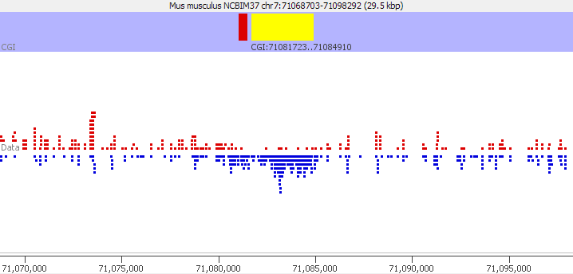
Raw Data Display
View > Data Track Display

Slide 7
Quantitation Model
Probe = Location to make a measurement
ProbeSet = Collection of probes
Quantitation associates a value with each probe for each data set.
Define Probes > Quantitate Probes > Visualise

Slide 8
Probe Generation

Slide 9
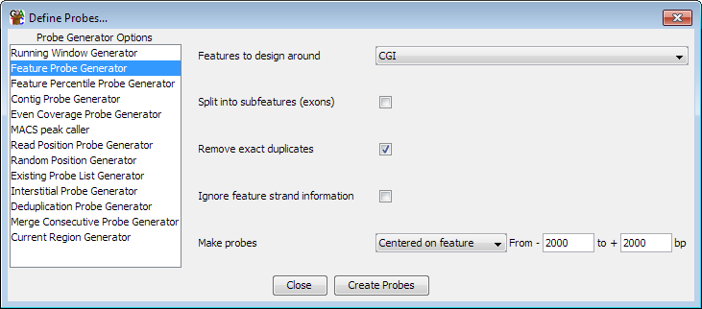
Targeting Measurement
Features
Data > Define Probes > Feature Probe Generator

Slide 10
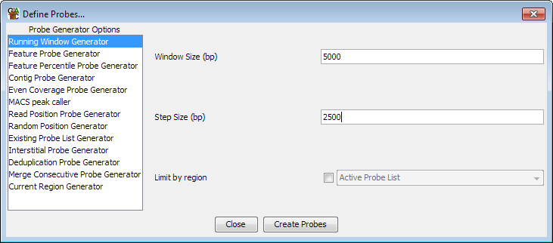
Targeting Measurement
Fixed Windows
Data > Define Probes > Running Window Generator

Slide 11
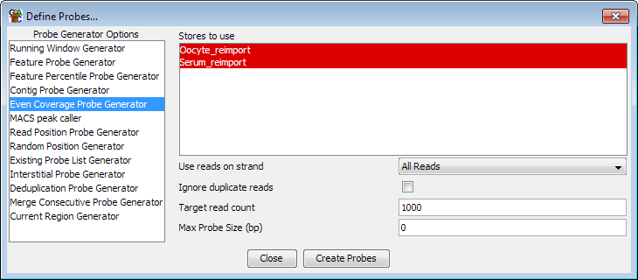
Targeting Measurement
Fixed number of calls
Data > Define Probes > Even Coverage Probe Generator

Slide 12
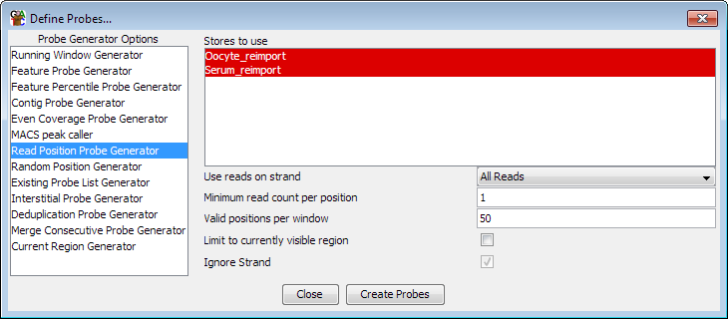
Targeting Measurement
Fixed number of call positions
Data > Define Probes > Read Position Probe Generator

Slide 13
Quantitation

Slide 14
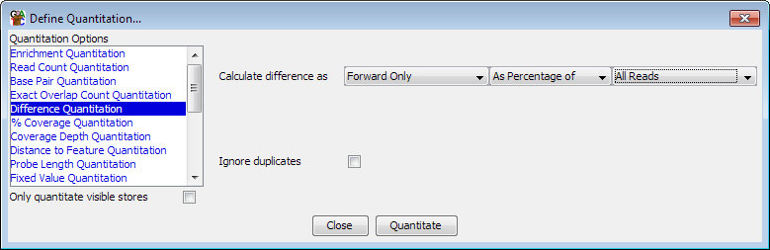
Methylation Measurement
Simple percentage of all calls
Data > Quantitate Existing Probes > Difference Quantitation

Slide 15
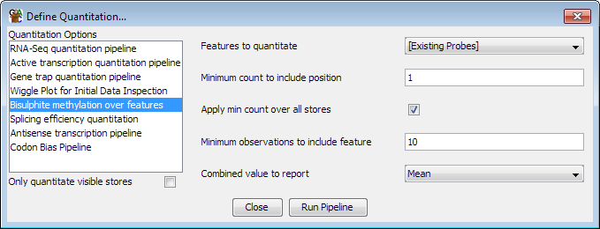
Methylation Measurement
More complex corrected measure
Data > Quantitation Pipelines > Bisulphite methylation over features

Slide 16
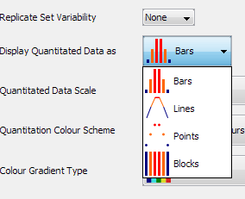
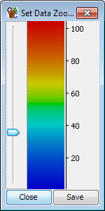
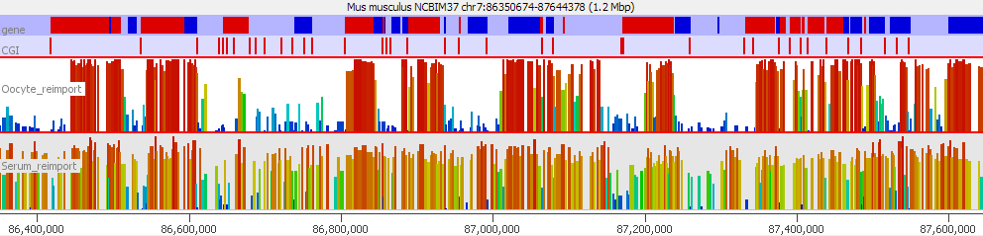
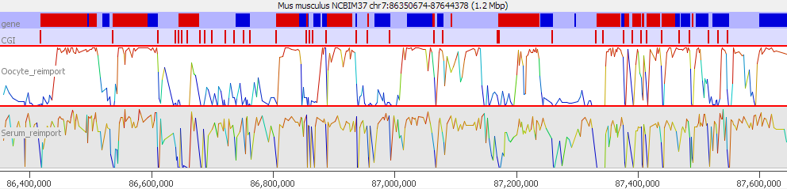
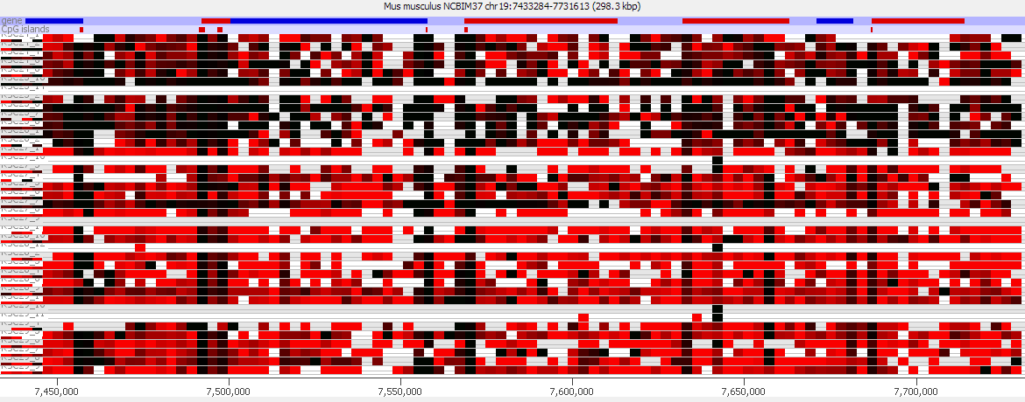
Visualisation of quantitated methylation
View > Data Track Display
View > Set Data Zoom Level

Slide 17
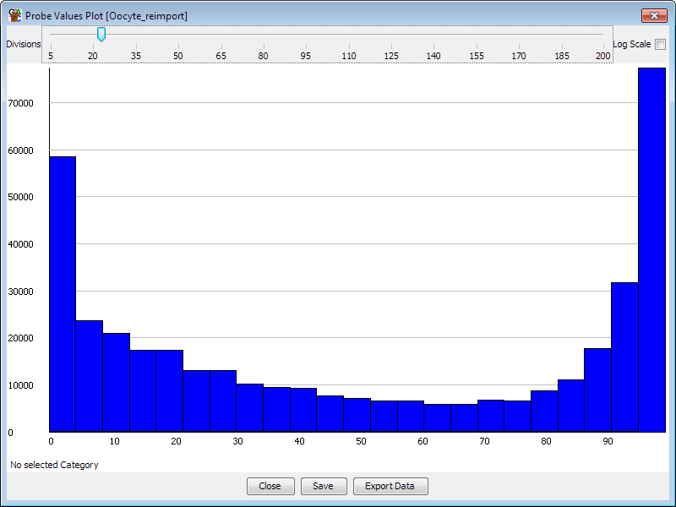
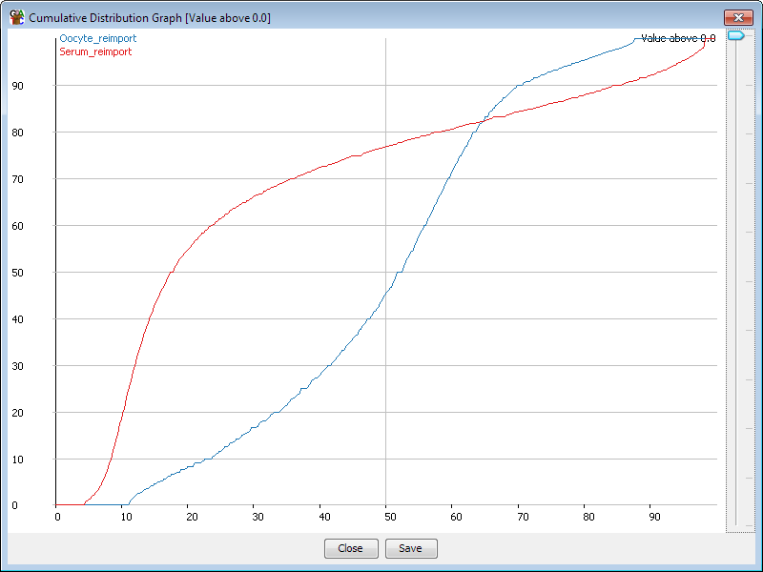
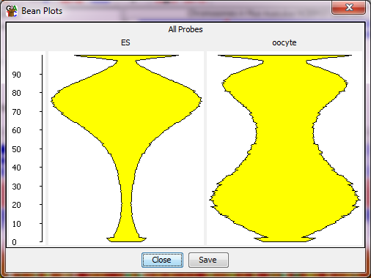
Distributions
Plots > Probe value histogram
Plots > Cumulative Distribution Plot
Plots > Beanplot

Slide 18
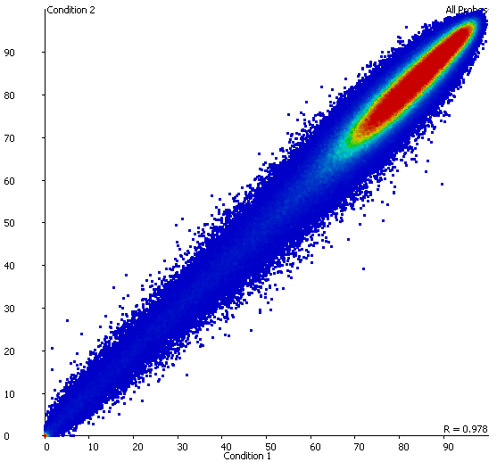
Comparisons
Plots > Scatter plot
Plot is interactive – mouse over a point for information
Double click on a point to move there in the chromosome view

Slide 19
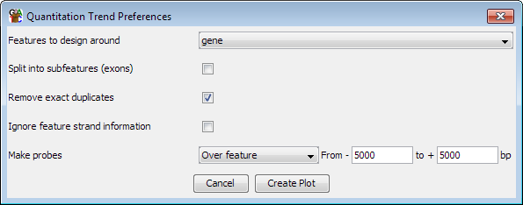
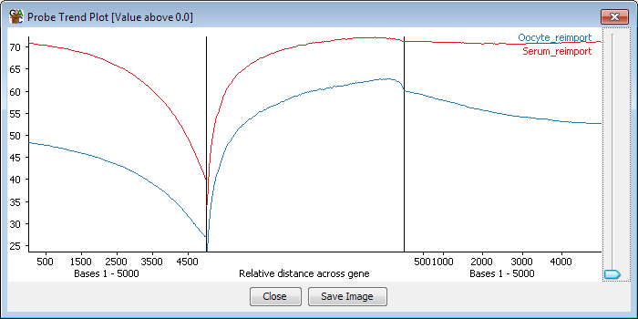
Trend Plots
Plots > Quantitation Trend Plot

Slide 20
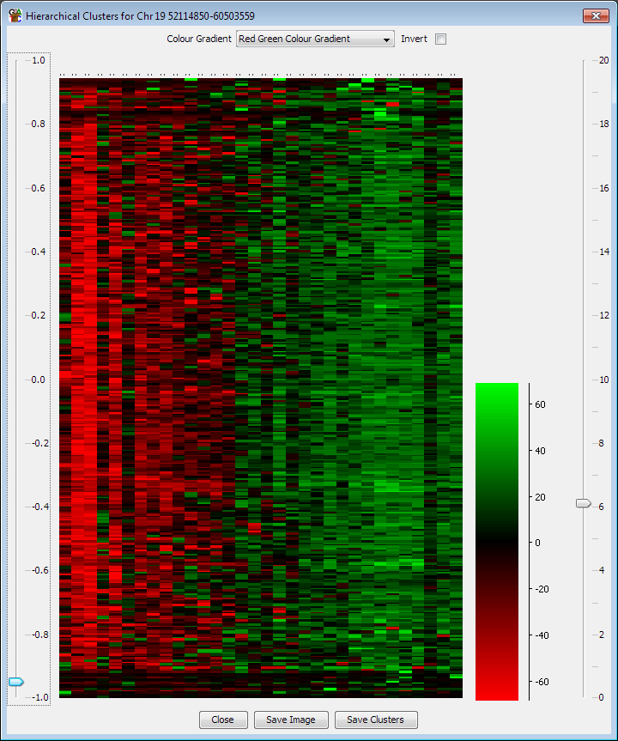
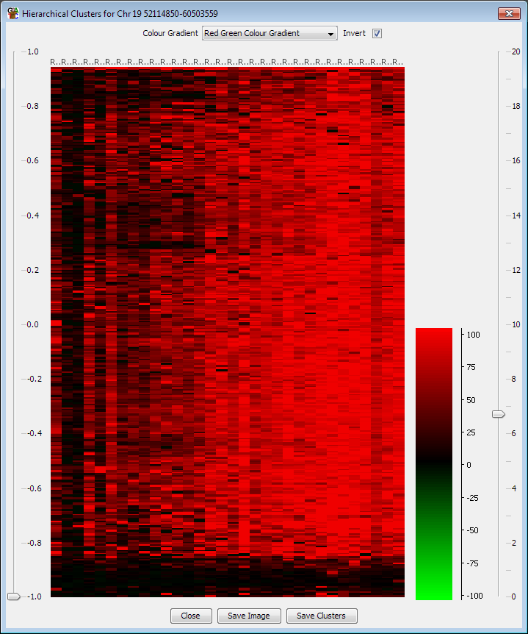
Clustering
Correlation based (per probe normalised)
Euclidean
Plots > Hierarchical Clusters

