Slide 1

Bisulfite-Sequencing Theory and Quality Control
Felix Krueger, Simon Andrews
felix.krueger@babraham.ac.uk
simon.andrews@babraham.ac.uk
v2022-04

Slide 2
Bisulfite-Seq theory and Quality Control
coffee
  Mapping and QC practical
  Visualising and Exploring talk
Lunch
Visualising and Exploring practical
coffee
Differential methylation talk & practical
a.m.
p.m.

Slide 3
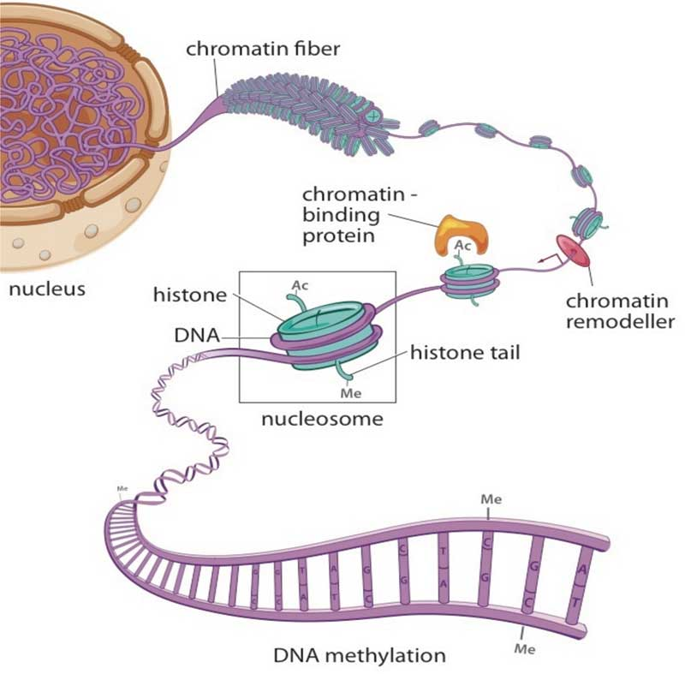
Epigenetics
Studies changes in gene expression which are not encoded by the underlying DNA sequence
Chromatin
histone modification
non-coding RNAs
higher order structure (accessibility/compaction)
DNA cytosine methylation
From The Cell Biology of Stem Cells (2010)

Slide 4
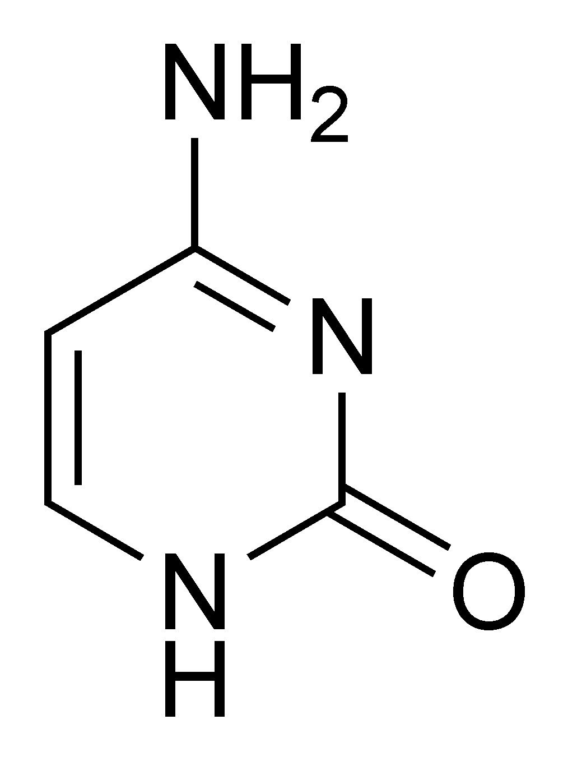
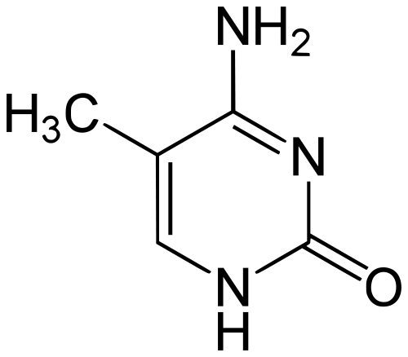
DNA Methylation
DNA methyl-transferases
DNA-demethylase(s)
TET enymes
Passive demethylation
Cytosine
5-methyl Cytosine

Slide 5
Context of DNA methylation
CG context
non-CG context
me
me
T
C
G
T
A
T
C
A
T
A
5’
5’
5’
5’
3’
A
G
C
A
T
3’
3’
A
G
T
A
T
3’
me
 | Mammals | Plants
CG | present | present
CHG | (mostly) absent | present
CHH | (mostly) absent | present
H = T/A/C

Slide 6
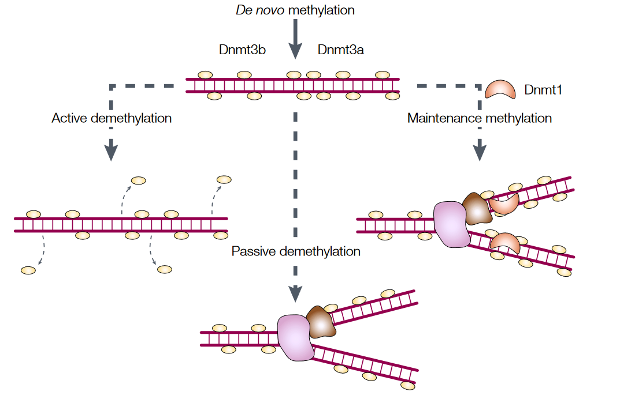
DNA methylation is maintained through cell division
from W. Reik & J. Walter, Nat. Rev. Genet. 2001

Slide 7
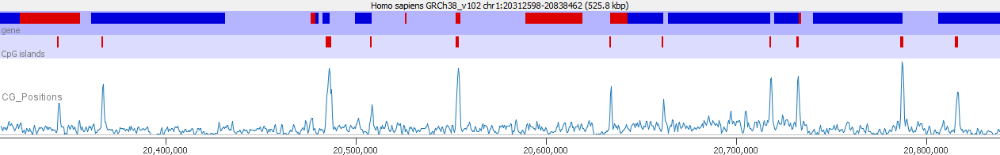
Distribution of CG
CpG dinucleotides are not evenly distributed
Most occur within high density regions called CpG Islands
Most of the genome contains methylated CpGs
CpGs in CpG islands are largely unmethylated

Slide 8
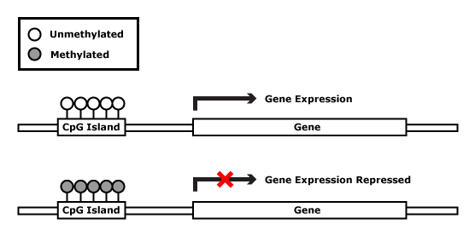
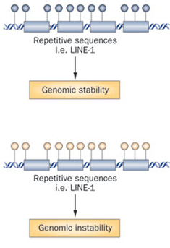
Regulation by DNA methylation
Silencing of gene expression
Tissue differentiation and embryonic development
Faults in correct DNA methylation may result in
early development failure
epigenetic syndromes
cancer
Repeat activity
Genomic stability

Slide 9
Genomic Imprinting: mono-allelic expression
Differential allelic
DNA methylation
CGI (CpG island)
X
methylated CpG
unmethylated CpG
Imprinted Genes: Mono-allelic expression with parent-of-origin specificity. Have key roles in energy metabolism, placenta functions.

Slide 10
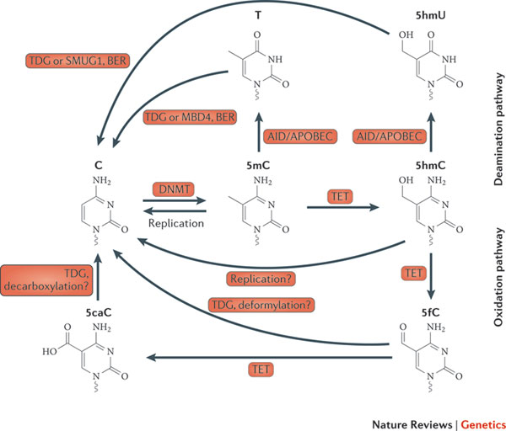
Cytosine Modifications
Miguel R. Branco, Gabriella Ficz & Wolf Reik
Nature Reviews Genetics 13, 7-13 (January 2012)

Slide 11
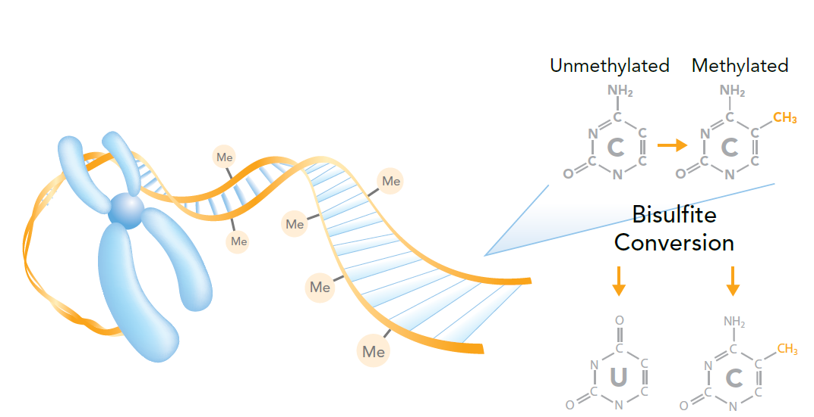
Measuring DNA methylation by Bisulfite-sequencing
Image by Illumina

Slide 12
Bisulfite Sequencing
me
me
CCAGTCGCTATAGCGCGATATCGTA
Convert
TTAGTTGCTATAGTGCGATATTGTA
Map
TTAGTTGCTATAGTGCGATATTGTA
|||||||||||||||||||||||||
...CCAGTCGCTATAGCGCGATATCGTA...

Slide 13
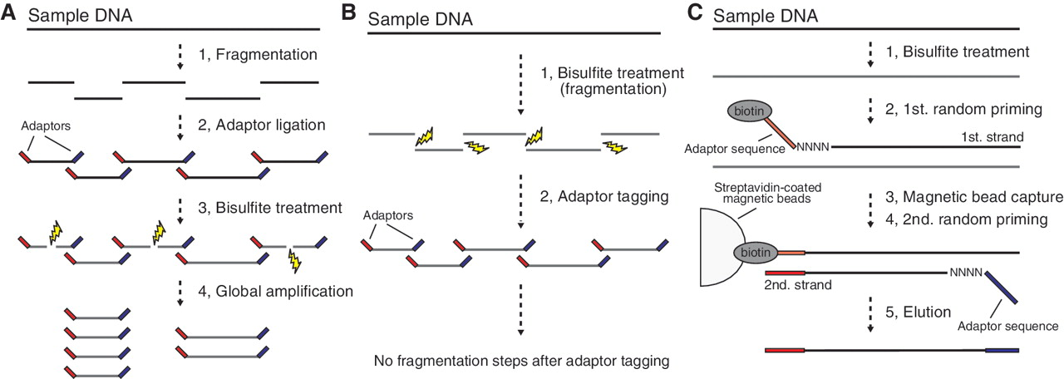
Bisulphite Library Preparation
Whole Genome Bisulphite Sequencing
(WGBS)
Post Bisulphite Adapter Tagging
(PBAT)
Notes:
WGBS and PBAT. (A) Schematic of the conventional WGBS protocols. Bisulfite treatment follows adaptor tagging, thereby leading to bisulfite-induced fragmentation of adaptor-tagged template DNAs. (B) Schematic of PBAT strategy. Bisulfite treatment precedes adaptor tagging, thereby circumventing bisulfite-induced fragmentation of adaptor-tagged template DNAs. (C) Random priming-mediated PBAT method. Two rounds of random priming on bisulfite-treated DNA generate directionally adaptor-tagged template DNAs.

Slide 14
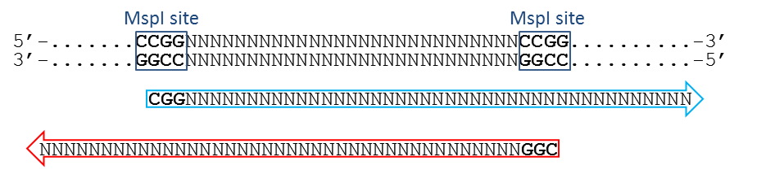
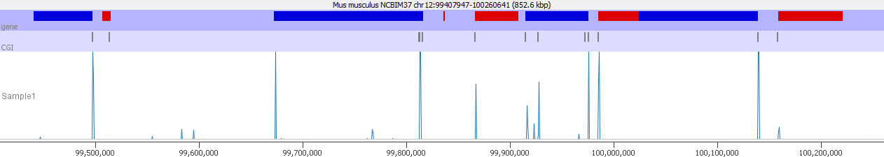
Enriched Bisulphite Sequencing
Reduced Representation (RRBS)
Enrichment Kits
Oligonucleotide hybridisation pull down systems
Can enrich for anything, special kits for methylation
CpG Islands and 'shores'
Relevant promoters and enhancers
Cut with a restriction enzyme (MspI) whose recognition site contains a CpG
Size select for short fragments to enrich for CpG dense regions

Slide 15
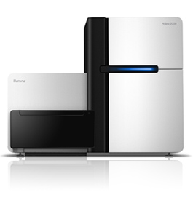
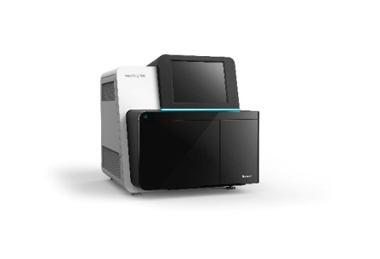
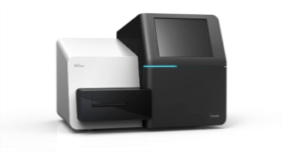
BS-Seq Analysis Workflow
Explore and understand
your data
Sequencing
Processing pipeline
Methylation
Analysis

Slide 16
Bisulfite conversion of a genomic locus
mC
|
mC
|
>>CCGGCATGTTTAAACGCT>>
<<GGCCGTACAAATTTGCGA<<
|
mC
|
hmC
|
mC
Top strand
Bisulfite conversion
Bottom strand
>>UCGGUATGTTTAAACGUT>>
<<GGUCGTACAAATTTGCGA<<
PCR amplification
OT
>>TCGGTATGTTTAAACGTT>>
>>CCAGCATGTTTAAACGCT>>
CTOB
CTOT
<<AGCCATACAAATTTGCAA<<
<<GGTCGTACAAATTTGCGA<<
OB
2 different PCR products and 4 possible different sequence strands from one genomic locus
- each of these 4 sequence strands can theoretically exist in any possible conversion state

Slide 17

3-letter alignment of Bisulfite-Seq reads
sequence of interest
TTGGCATGTTTAAACGTT
Fully bisulfite convert read
(as both forward and reverse strand)
5’…TTGGTATGTTTAAATGTT…3’
5’…TTAACATATTTAAACATT…3’
(1)
(2)
Align to bisulfite converted genomes
(3)
(4)
…TTGGTATGTTTAAATGTT…
…CCAACATATTTAAACACT…
…AACCATACAAATTTACAA…
…GGTTGTATAAATTTGTGA…
forward strand C -> T converted genome
forward strand G -> A converted genome
(equals reverse strand C -> T conversion)
(1)
(2)
(3)
(4)
Read all 4 alignment outputs and extract
the unmodified genomic sequence if the
sequence could be mapped uniquely
5’…CCGGCATGTTTAAACGCT…3’
Methylation Call
h unmethylated C in CHH context
H methylated C in CHH context
x unmethylated C in CHG context
X methylated C in CHG context
z unmethylated C in CpG context
Z methylated C in CpG context
read sequence
TTGGCATGTTTAAACGTTA
genomic sequence
CCGGCATGTTTAAACGCTA
methylation call
xz..H.........Z.h..
Bismark

Slide 18
Common sequencing protocols
mC
|
mC
|
>>CCGGCATGTTTAAACGCT>>
<<GGCCGTACAAATTTGCGA<<
|
mC
|
hmC
|
mC
Top strand
Bottom strand
>>UCGGUATGTTTAAACGUT>>
<<GGUCGTACAAATTTGCGA<<
Directional libraries
(vast majority of kits, also EpiGnome/Truseq)
OT
>>TCGGTATGTTTAAACGTT>>
<<GGTCGTACAAATTTGCGA<<
OB
2) PBAT libraries
CTOT
<<AGCCATACAAATTTGCAA<<
>>CCAGCATGTTTAAACGCT>>
CTOB
3) Non-directional libraries
(e.g. single-cell BS-Seq, Zymo Pico Methyl-Seq)
OT
>>TCGGTATGTTTAAACGTT>>
CTOT
<<AGCCATACAAATTTGCAA<<
>>CCAGCATGTTTAAACGCT>>
CTOB
<<GGTCGTACAAATTTGCGA<<
OB

Slide 19
Validation

Slide 20
BS-Seq Analysis Workflow
QC
Trimming
Mapping
Analysis
Mapped QC
Methylation extraction

Slide 21
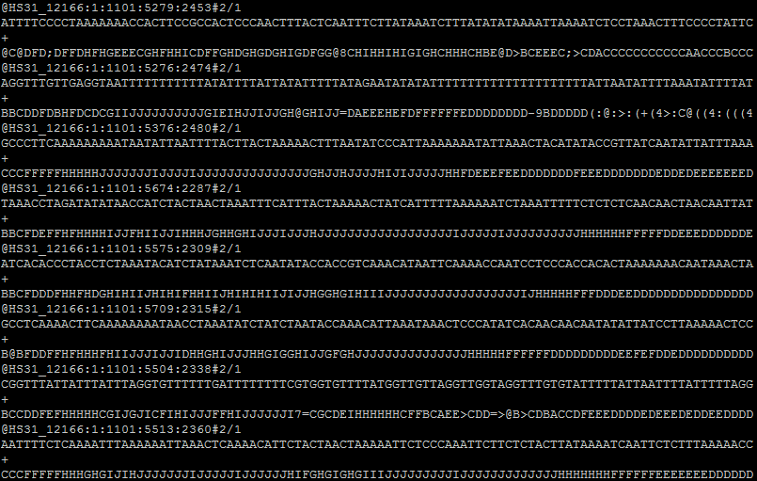
Raw Sequence Data (FastQ file)
...
up to 1,000,000,000 lines per lane

Slide 22
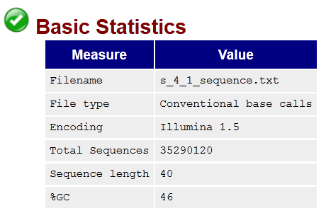
Part I: Initial QC -
What does QC tell you about your library?
# of sequences
Basecall qualities
Base composition
Potential contaminants
Expected duplication rate

Slide 23
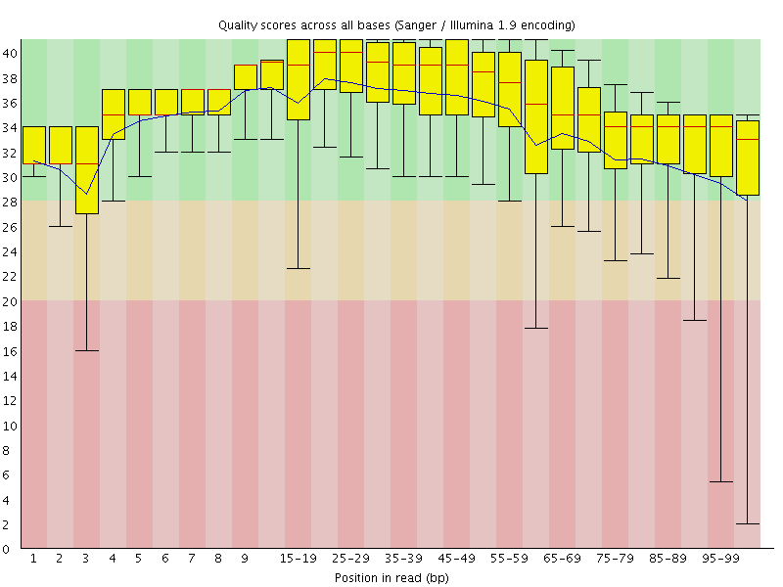
QC Raw data: Sequence Quality
Error rate
0.1%
1%
10%

Slide 24
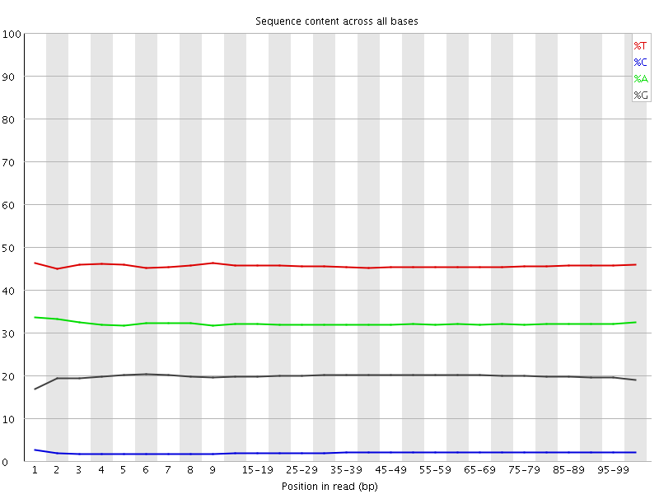
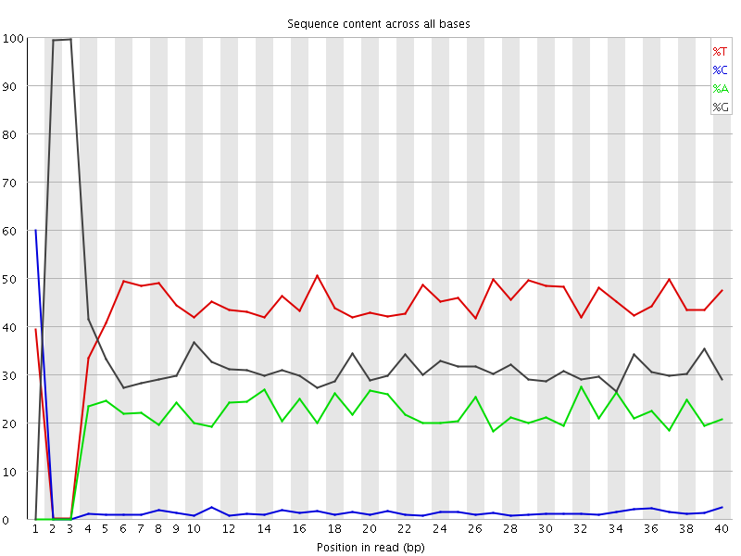
QC: Base Composition
WGSBS
RRBS

Slide 25
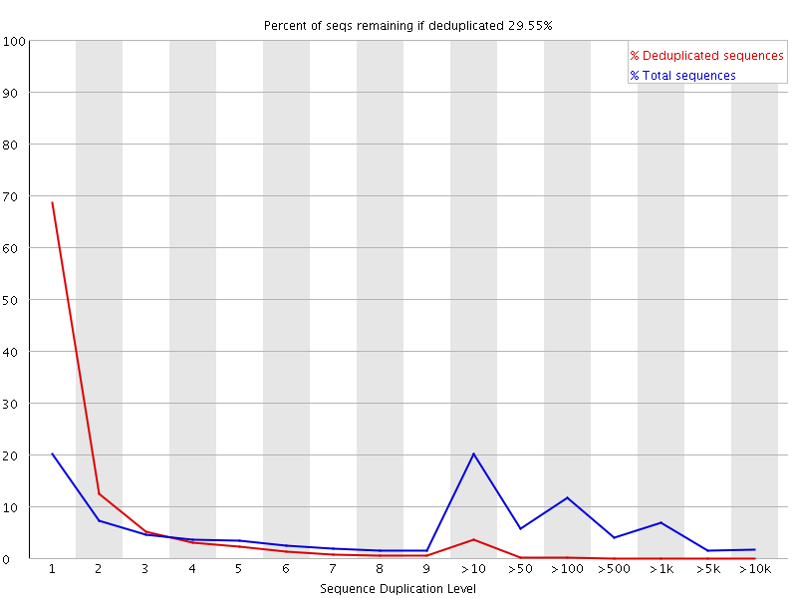
QC: Duplication rate

Slide 26
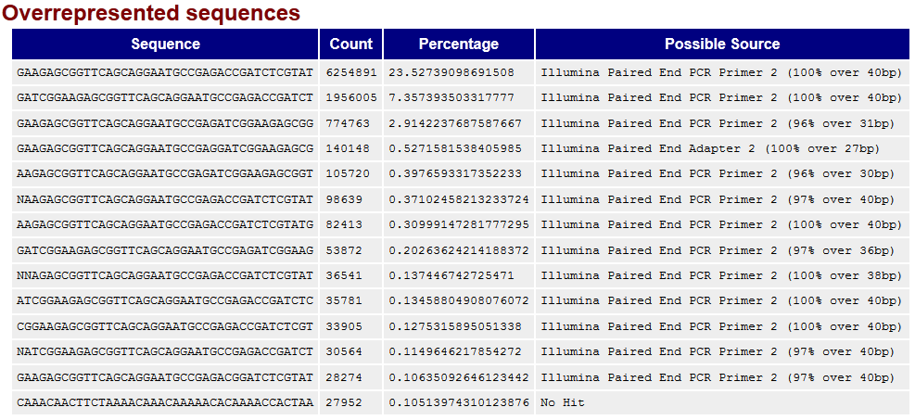
QC: Overrepresented sequences

Slide 27
Common problems in BS-Seq
Not observed
in ‘normal’ libraries,
e.g. ChIP or RNA-Seq

Slide 28
Removing poor quality basecalls

Slide 29
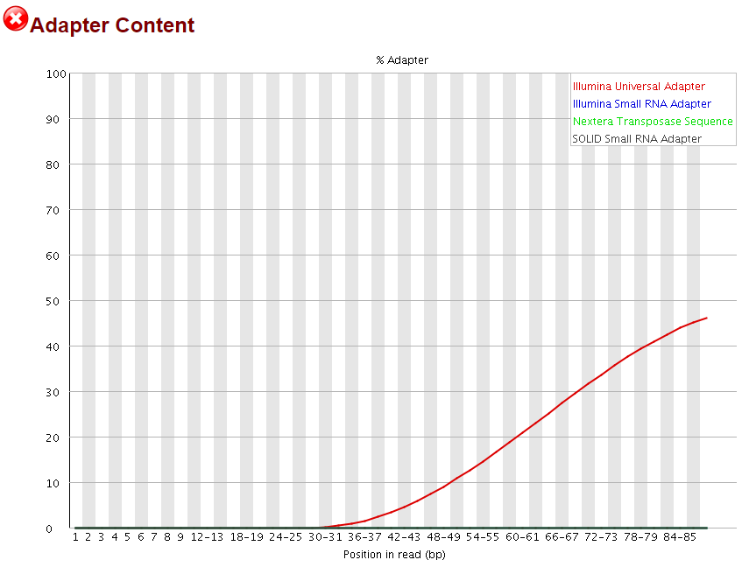
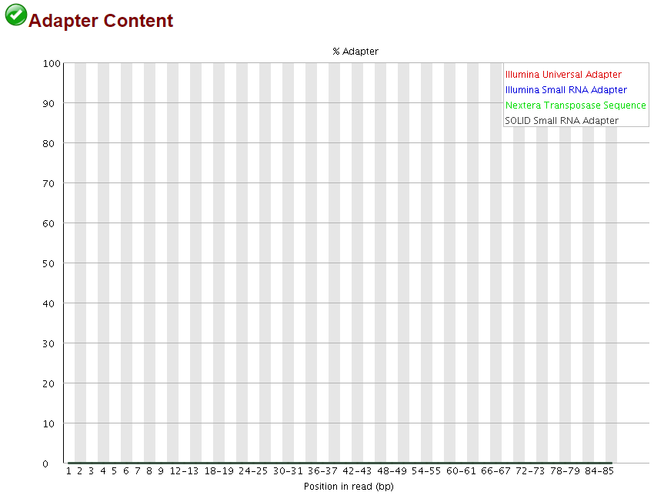
Removing adapter contamination

Slide 30
Summary Adapter/Quality Trimming
Important to trim because failure to do so might result in:
Low mapping efficiency
Mis-alignments
Errors in methylation calls since adapters are methylated
Basecall errors tend toward 50% (C:mC)

Slide 31
Part II: Sequence alignment –
Bismark primary alignment output (BAM file)
chromosome
position
Read 1
HISEQ2000-06:366:C3G4NACXX:3:1101:1316:2067_1:N:0: 99 16 71322125 255 100M = 71322232 207 NTTATTTAGTTTTTTAGGGTTTGTGTGTAGGAGTGTGGGAATTATGTTTTTTATGGTTGATATTTATTTAAAAGTGAGTATAAATTATATATATTTTTTT #1=DDDDDAAFFHIIIA:<FGHCCEFGHD?CFFBBBGEHHGHIII<FEHIIIII==DE??EHHFHEEEEEEEC>;>66;@CDEEEDCEEEEEEEDDDCBB
NM:i:14 XX:Z:G8C2C7C21C13C6CC1C17CC3C4CC4 XM:Z:.........h..h.......x.....................h.............x......hh.h.................hh...h....hh.... XR:Z:CT XG:Z:CT XA:Z:1
HISEQ2000-06:366:C3G4NACXX:3:1101:1316:2067_1:N:0: 147 16 71322232 255 100M = 71322125 -207 GGTTATTTTATTTAGGGTTATTGTTTTAGAGTTTTATTGTTGTGAACAGATATATGATTAAGGTAATTTTTATAAGGATAATATTTAATTGGAGTTGGTT
CCCEEECADCFFFFHHGHGHIIGIHFIJJIJIHFGHGGGEHIJIIJGIGFJJJJJJJJJJIGJJJJGJJJJIIIJJIJIJJJJJJIJHHHHHFFFFFCCC
NM:i:21 XX:Z:2G2CC1C1C1C11C11C2C10C1C4CC4C2C1C3C5C2C12C3C1 XM:Z:.....hh.h.h.x...........h...........x..x......X...h.h....hh....h..h.h...h.....h..h............x...h. XR:Z:GA XG:Z:CT XB:Z:1
sequence
quality
Read 2
methylation call

Slide 32
Sequence duplication
Complex/diverse library:
Duplicated library:
percent methylation
55
17
100
100
71
100
100
deduplication
percent methylation
33
50
100
100
50
100
100

Slide 33
Deduplication - considerations
Advisable for large genomes and moderate coverage
Unlikely to sequence several genuine copies of the same fragment by chance
Could limit coverage in high coverage studies, but would need to be very deep
RRBS
CCGG
CCGG
NOT advisable for RRBS or target enrichment methods
Non-random start positions (restriction sites)
Higher local density means random collisions are likely
deduplication

Slide 34
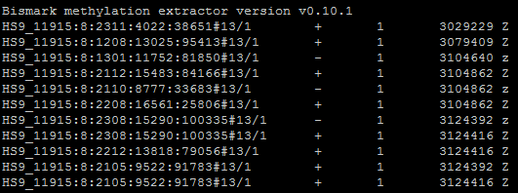
Methylation extraction
Read 1
....Z.....h..h.......x.....Z.........x......hh.h.............z....hx...h....hh.Z...
....x......hh.h.............z....hx...h....hh.Z...hh....x.....Z.h.....h..h......x...h........
redundant methylation calls
Read 2
Read 1
....Z.....h..h.......x.....Z.........x......hh.h.............z....hx...h....hh.Z...
hh....x.....Z.h.....h..h......x...h........
Read 2
CpG methylation
output
read ID
meth
state
chr
pos
context

Slide 35
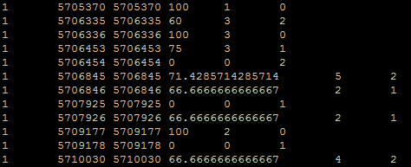
Methylation extraction
CpG methylation output
bismark2bedGraph
bedGraph/coverage output
chr
pos
methylation
percentage
meth
unmeth

Slide 36
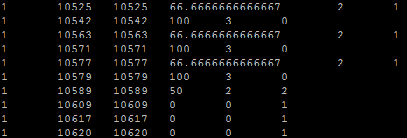
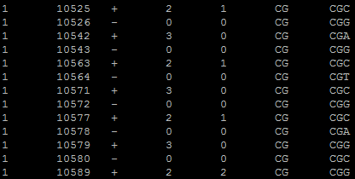
Methylation extraction
coverage output
coverage2cytosine
Optional: merge into CpG dinucleotide entities
Genome wide CpG report
chr
pos
strand
meth
unmeth
di-nuc
tri-nuc

Slide 37
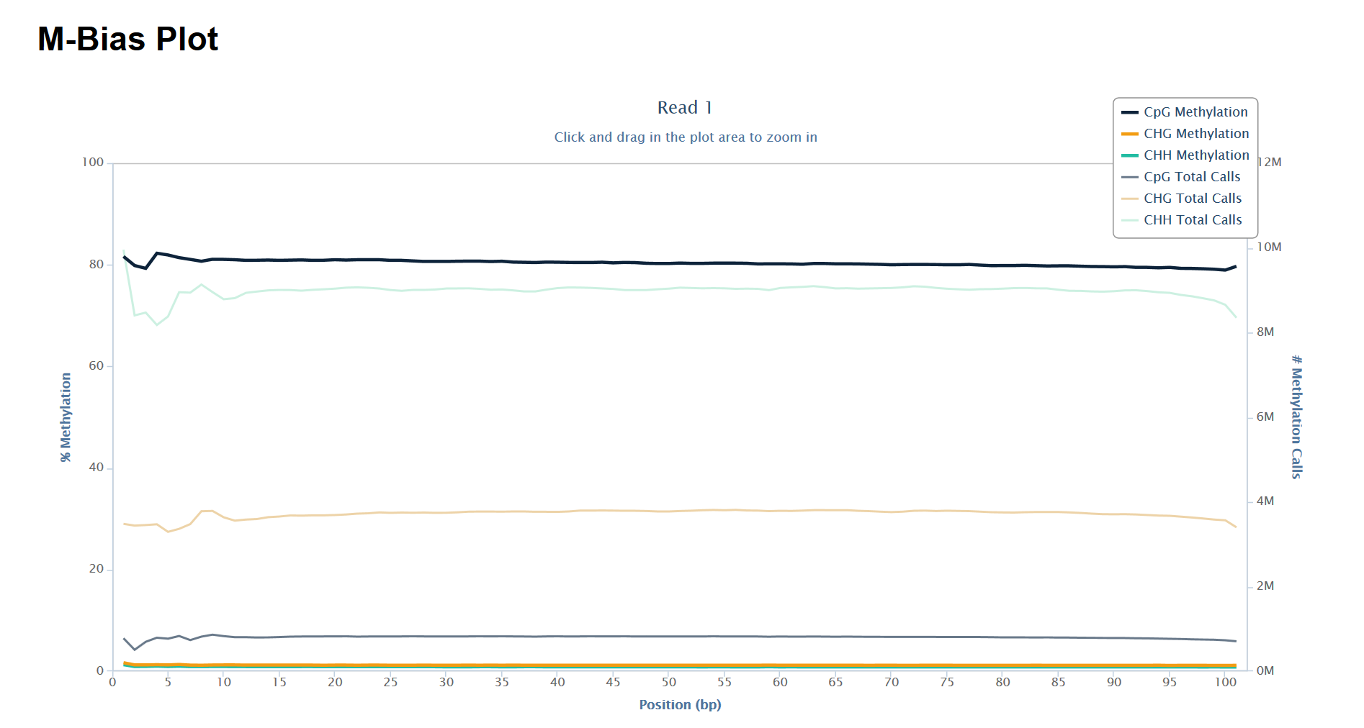
Part III: Mapped QC -
Methylation bias
good opportunity to look at conversion efficiency

Slide 38
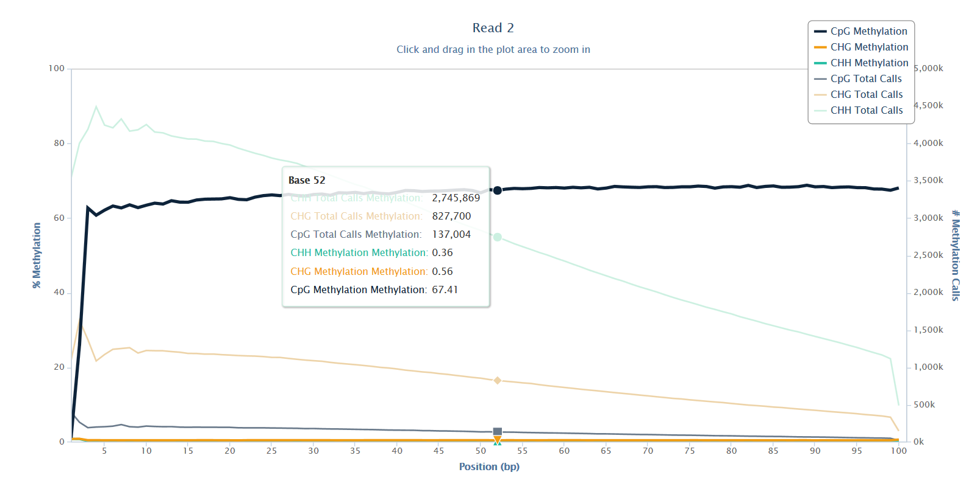
Artificial methylation calls in paired-end libraries
end repair + A-tailing
5’- GGGNNNNNNNNNNNNNNNNNNNNNNNNNNNCCCA -3’
3’- ACCCNNNNNNNNNNNNNNNNNNNNNNNNNNNGGG -5’

Slide 39
Specialist applications
(e)RRBS
WGBS
PBAT
NOMe-seq
target
enrichment
amplicon
single-cell
NMT-seq
non-directional
+ different library kit protocols

Slide 40
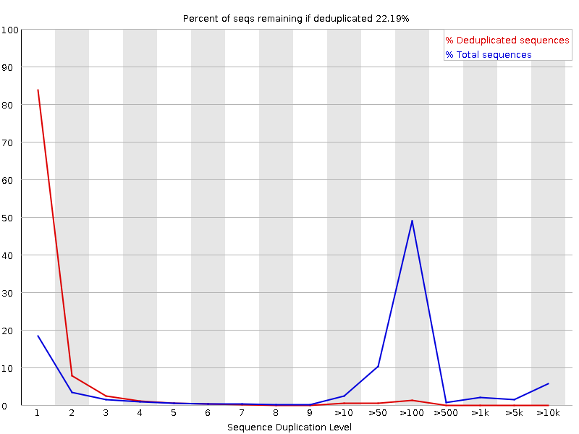
Reduced representation BS-Seq (RRBS)
Sequence composition bias
High duplication rate

Slide 41
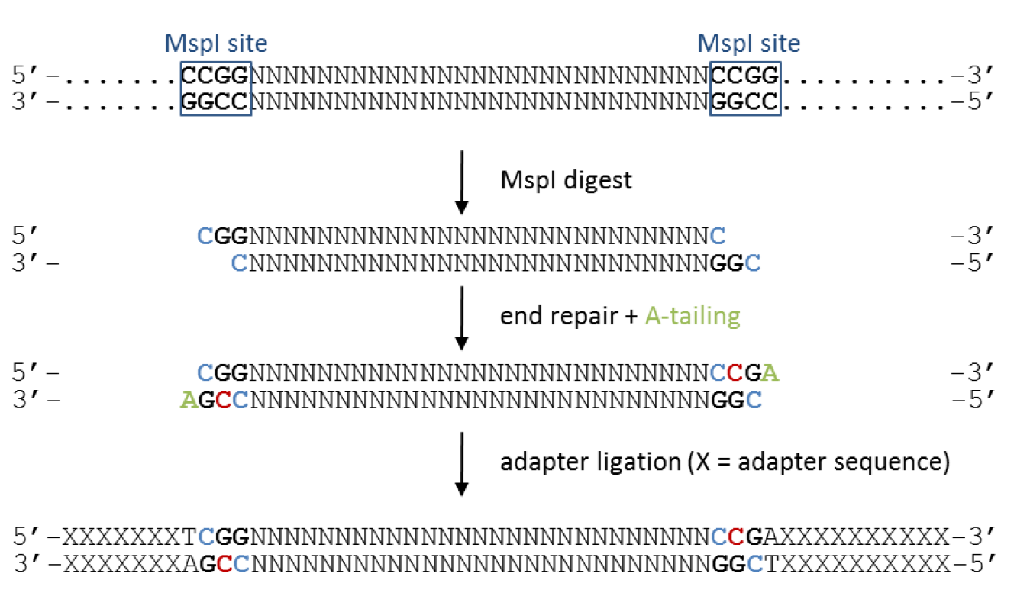
Artificial methylation calls in RRBS libraries
C genomic cytosine
C unmethylated cytosine
Use appropriate trimming (trim_galore --rrbs)

Slide 42
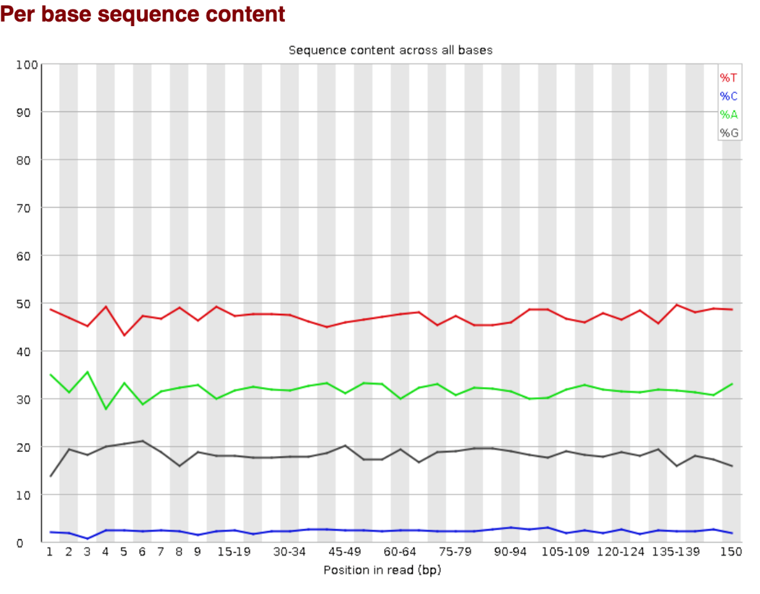
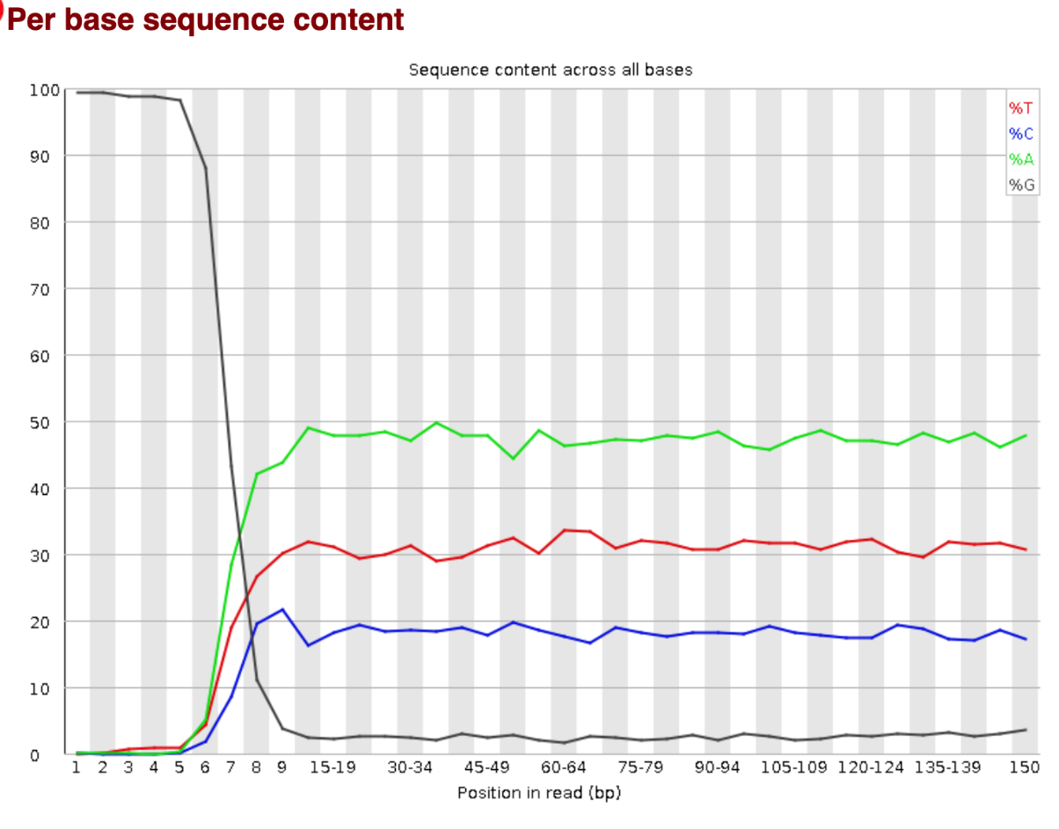
Accel Swift kit
Read 1
Read 2
Use appropriate trimming (trim_galore --clip_r1 10 --clip_r2 15)

Slide 43
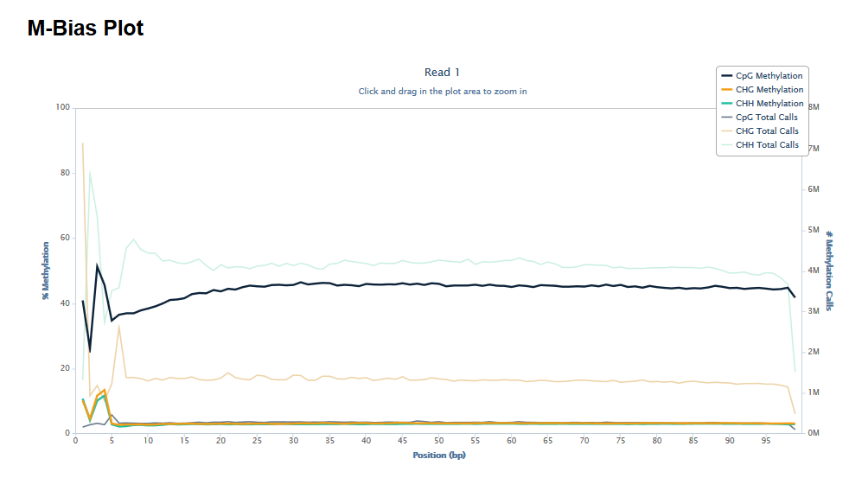
PBAT-Seq
trim off first few basepairs before alignment

Slide 44
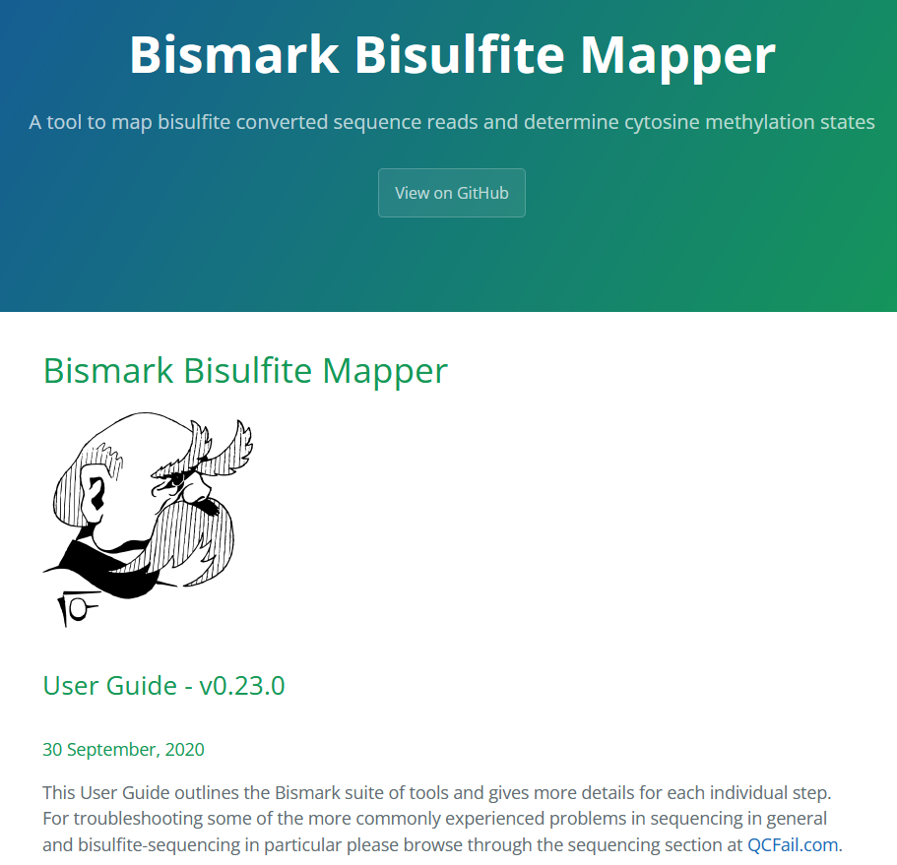
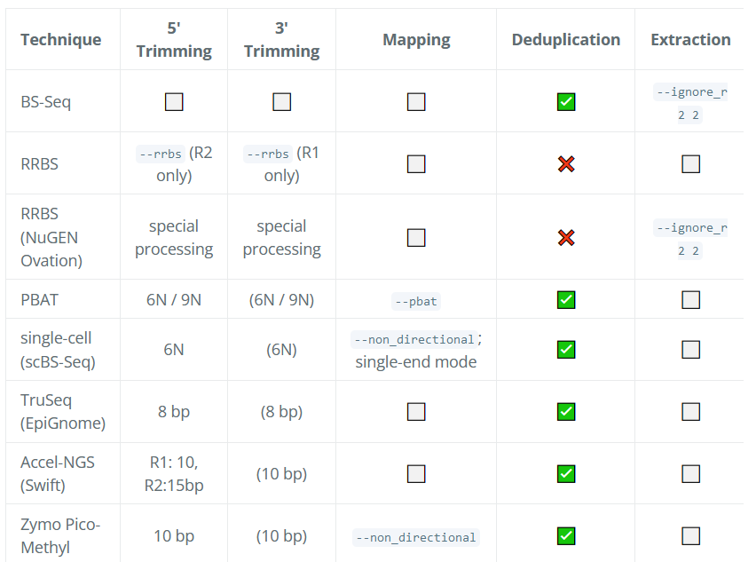
http://felixkrueger.github.io/Bismark/Docs/

Slide 45

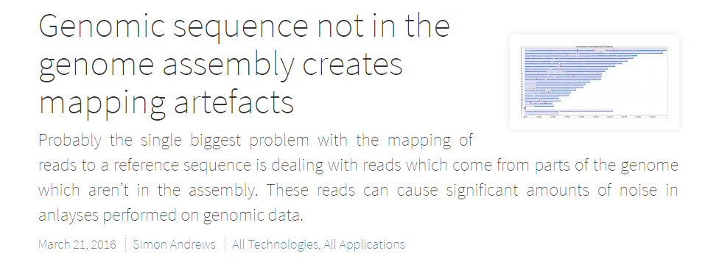
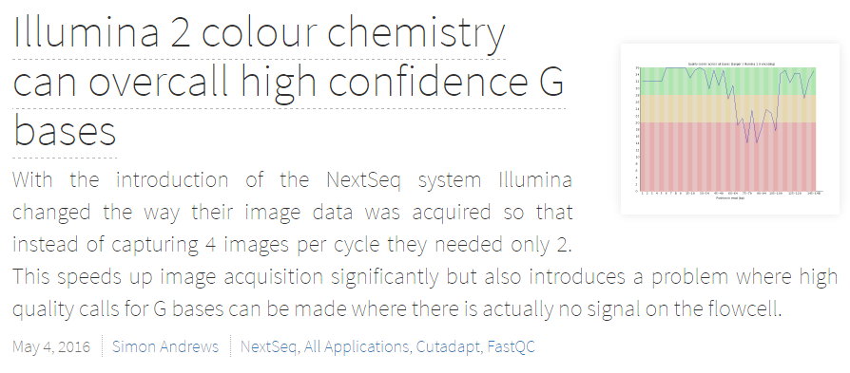
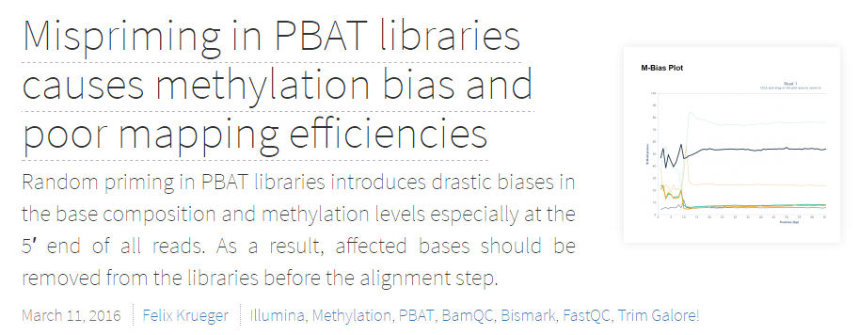
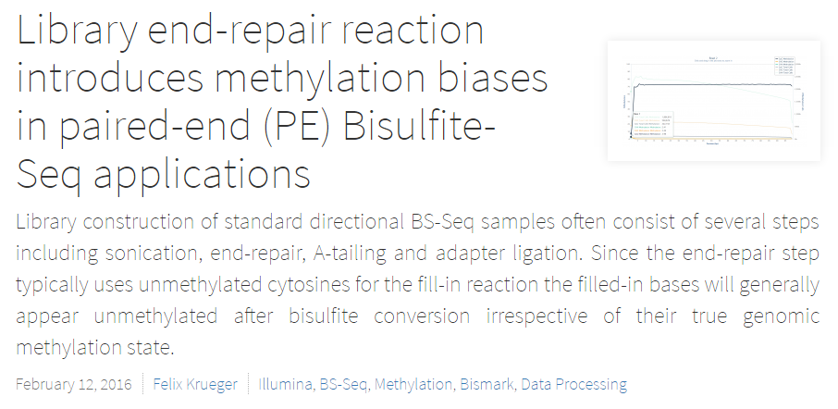
https://sequencing.qcfail.com/

Slide 46

Bismark workflow
Pre Alignment
FastQC Initial quality control
Trim Galore Adapter/quality trimming using Cutadapt; handles RRBS and paired-end reads; Trim Galore and RRBS User guide
Alignment
Bismark Output BAM
Post Alignment
Deduplication optional
Methylation extractor Output individual cytosine methylation calls; optionally bedGraph or genome-wide cytosine report
M-bias analysis
bismark2report Graphical HTML report generation
Example: http://www.bioinformatics.babraham.ac.uk/projects/bismark/PE_report.html
protocol: Quality Control, trimming and alignment of Bisulfite-Seq data

Slide 47
Bismark workflow using a workflow manager
nf_bisulfite_WGBS
FastQC
Trim Galore
FastQ Screen
--bisulfite
FastQC
Bismark
Bismark dedup
Bismark methXtract
Bismark reports
Bismark summary
MultiQC
https://github.com/s-andrews/nextflow_pipelines

Slide 48

Useful links
FastQC www.bioinformatics.babraham.ac.uk/projects/fastqc/
Trim Galore https://github.com/FelixKrueger/TrimGalore
Cutadapt https://code.google.com/p/cutadapt/
Bismark https://github.com/FelixKrueger/Bismark
Bowtie 2 http://bowtie-bio.sourceforge.net/bowtie2/
SeqMonk www.bioinformatics.babraham.ac.uk/projects/seqmonk/
https://sequencing.qcfail.com/

Slide 49






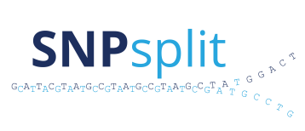

Sierra: A web-based LIMS system
for small sequencing facilities
reStrainingOrder
SeqMonk: Genome browser,
quantitation and data analysis
Trim Galore! Quality and adapter
trimming for (RRBS) sequencing libraries
FastQ Screen: organism and
contamination detection
Bismark: Bisulfite-sequencing
alignments and methylation calls
Hi-C mapping
ASAP: Allele-specific alignments
FastQC: quality control for
high throughput sequencing
  https://www.bioinformatics.babraham.ac.uk

Slide 51
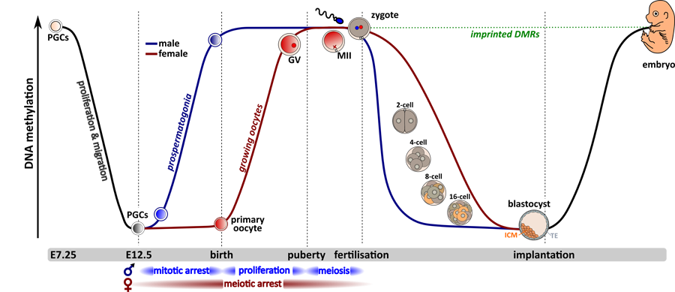
DNA methylation is reset during reprogramming

Slide 52
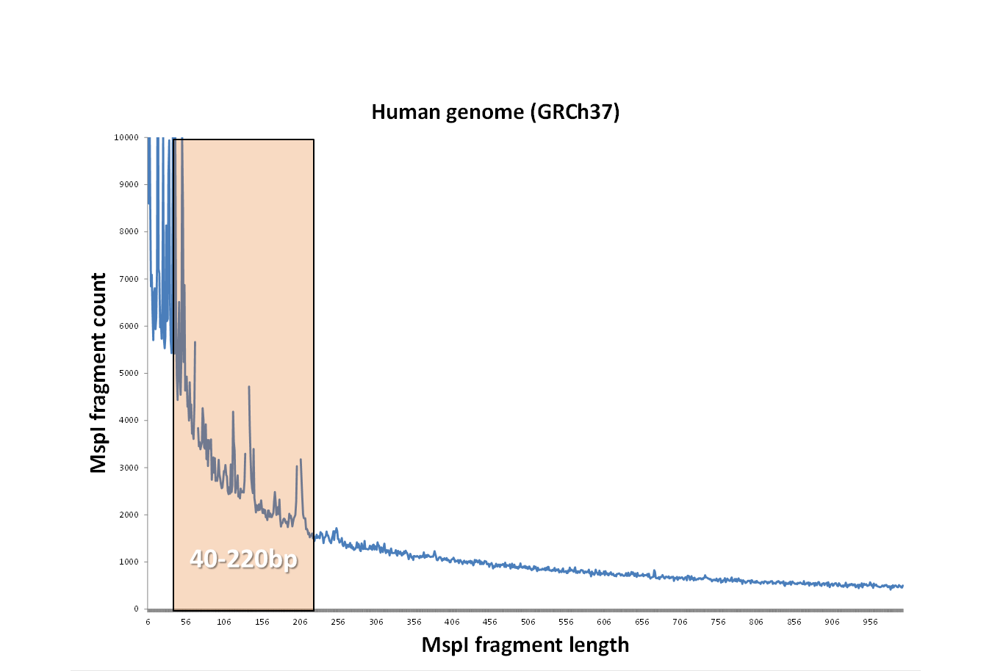
Fragment size distribution in RRBS
identical (redundant) methylation calls

