Slide 1
Linux Bootcamp
An introduction to the Linux environment
v2018-11

Slide 2
Programme
Linux Basics
What is Linux
Using the BASH shell to run and automate programs
Installing and managing software
Understanding the file system
Installing operating system packages
Installing external software
Installing packages for other languages (R, Python, Perl)
Other Useful Stuff
Using containers
Remote connections through SSH
Installing operating systems on hardware or virtual machines
Using Linux in a cloud environment

Slide 3
Learning Outcomes
By the end of the course you should be able to:
Install a Linux operating system on your machine, either directly or through a virtual machine
Be able to run and customise installed applications using the BASH shell
Be able to perform simple automation, linking programs together and iterating the processing of large numbers of files.
Be able to install and configure new software packages
Understand how to use Linux in a variety of environments from personal computers to cloud infrastructure.

Slide 5
Linux Basics
Understanding Linux and the BASH shell
v2018-11

Slide 6
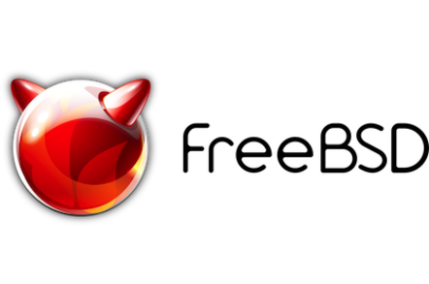
What (exactly) is Linux?

Slide 7
Unix, Posix and Linux
Unix was a set of concepts which defined a number of early operating systems developed in the 1970s.
These concepts allowed for interoperability of software written based on them.
The original Unix concepts developed into POSIX, a more formal standard defining
The way that devices, configuration, memory and libraries are handled
A standardised development environment based on C and make
A core set of commands and a command interpreter (shell) in which to run them
A standard set of documentation

Slide 9
Linux - what most people now use (apart from OSX!)
Linux is more correctly called GNU/Linux
Linux is the kernel
GNU is a collection of applications and libraries
POSIX
The way that devices, configuration, memory and libraries are handled
A standardised development environment based on C and make
A core set of commands and a shell in which to run them
A standard set of documentation

Slide 10
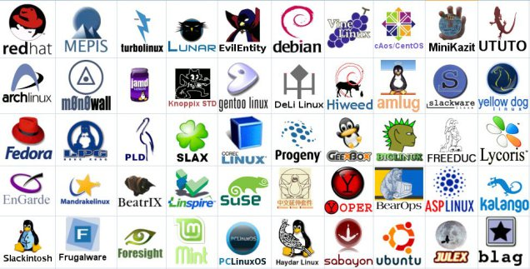
Linux comes in different distributions
They vary in
Their choice of (non-core) software
Their support packages (the way software is installed for example)
How much non-core software they provide
Their frequency of update and length of support

Slide 11
Most Popular Distributions
Ubuntu
Mostly aimed at desktop users
Friendly and well supported
Regular updates (some with long term support)
Based on Debian
Other offshoots such as Mint
CentOS
Free version of the RedHat commercial distro
Mostly aimed at servers
Stable software and long term support
Used in many large environments

Slide 12
Specialised Distributions
Bio Linux
Many pre-built scientific programs
Based on Ubuntu
ROCKS
Linux distribution to run on clusters
Includes automated building and management
Based on CentOS

Slide 14
Running programs in the BASH shell
v2018-11

Slide 15
Running programs in Linux
Two major methods
Graphical
Command line
Graphical launches only work for graphical programs accessed through a graphical environment
Most data processing will be command line based, as will most remote access
Graphical programs can still be launched from the command line

Slide 16
Shells
A shell is a command line interpreter, used to launch software in Linux
There are many different shells available:
BASH
CSH
ZSH etc.
Most software will work the same in all shells
Some functions and automation are different between shells
We will use the most popular shell, BASH

Slide 17
What does a shell provide
Command line editing and construction tools (eg auto complete)
History
Job control
Configuration management (startup scripts)
Aliases
Automation
Scripting language
Variables, functions etc

Slide 18
Running programs in BASH
We will be using a graphical terminal running BASH
Right click and select "Open terminal"
..or, from Applications menu find Terminal
Once running, right click on icon and select "Add to favourites"

Slide 19
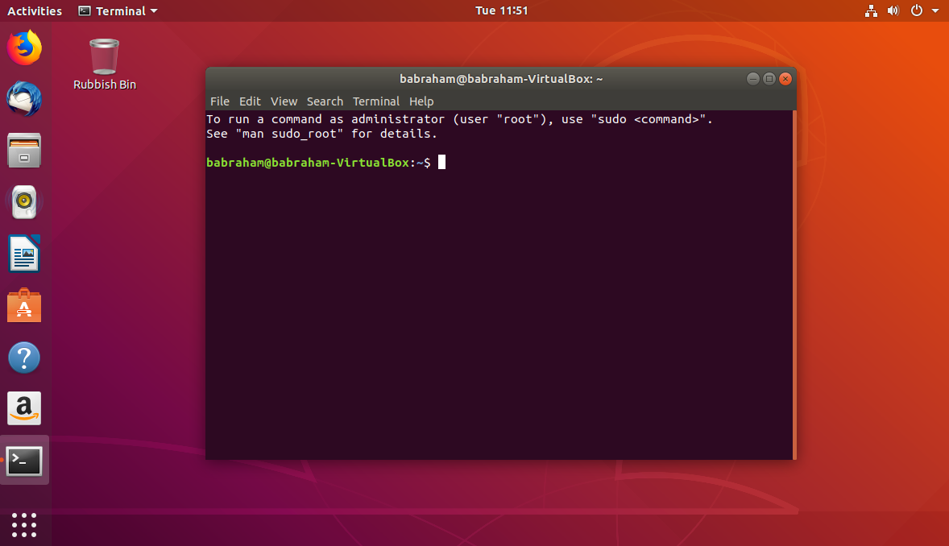

Slide 20
Running programs
Type the name of the program you want to run
Add on any options the program needs
Press return - the program will run
When the program ends control will return to the shell
Run the next program!

Slide 21
Running programs
babraham@babraham-VirtualBox:~$ ls
Desktop Documents Downloads examples.desktop Music Pictures Public Templates Videos
babraham@babraham-VirtualBox:~$
Command prompt - you can't enter a command unless you can see this
The command we're going to run (ls in this case, to list files)
The output of the command - just text in this case

Slide 22
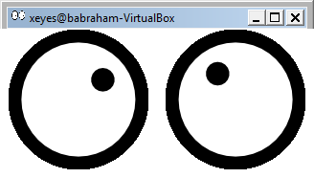
Running graphical programs
babraham@babraham-VirtualBox:~$ xeyes
babraham@babraham-VirtualBox:~$
Note that you can't enter another command
until you close the program you launched

Slide 23
The structure of a unix command
ls -ltd --reverse Downloads/ Desktop/ Documents/
Program
name
Switches
Data
(normally files)
Each option or section is separated by spaces. Options or files with spaces in must be put in quotes.

Slide 24
Command line switches
Change the behaviour of the program
Come in two flavours (each option usually has both types available)
Minus plus single letter (eg -x -c -z)
Can be combined (eg -xcz)
Two minuses plus a word (eg --extract --gzip)
Can't be combined
Some take an additional value, this can be an additional option, or use an = to separate (it's up to the program)
-f somfile.txt (specify a filename)
--width=30 (specify a value)

Slide 25
Manual pages
All core programs will have a manual page to document the options for the command
Manual pages are accessible using the man program followed by the program name you want to look up.
All manual pages have a common structure

Slide 26
Manual Pages (man cat)
CAT(1) User Commands CAT(1)
NAME
cat - concatenate files and print on the standard output
SYNOPSIS
cat [OPTION]... [FILE]...
DESCRIPTION
Concatenate FILE(s) to standard output.
With no FILE, or when FILE is -, read standard input.
-A, --show-all
equivalent to -vET
-n, --number
number all output lines
-T, --show-tabs
display TAB characters as ^I
--help display this help and exit
EXAMPLES
cat f - g
Output f's contents, then standard input, then g's contents.
cat Copy standard input to standard output.

Slide 27
Exercise 1

Slide 28
Understanding Unix File Systems

Slide 29
Unix File Systems
Consists of a hierarchical set of directories (folders)
Each directory can contain files
No drive letters (drives can appear at arbitrary points in the file system)
No file extensions (you can add them, but they're not required)

Slide 30
A simple unix filesystem
/ (Always the top of the file system)
home/ (Directory containing all home directories)
anne/
simon/
Documents/ (All names are case sensitive)
test.txt (A file we want to work with)
/home/simon/Documents/test.txt
media/
myusb/ (A USB stick added to the system)

Slide 31
Drives in a Linux file system
$ mount
/dev/sda1 on / type ext4 (rw)
/dev/sda5 on /state/partition1 type ext4 (rw)
/dev/sda2 on /var type ext4 (rw)
Private-Cluster.local:/ifs/homes on /bi/home type nfs (rw,addr=10.99.101.5)
Private-Cluster.local:/ifs/Scratch/Scratch on /bi/scratch type nfs (rw, addr=10.99.101.5)
Private-Cluster.local:/ifs/Group on /bi/group type nfs (rw, addr=10.99.101.4)
Private-Cluster.local:/ifs/apps-nfs on /bi/apps type nfs (rw, addr=10.99.101.5)
central-cluster.local:/ifs/bioinformatics/pubcache on /bi/pubcache type nfs (rw, addr=10.99.102.7)
central-cluster.local:/ifs/bioinformatics/seqfac on /bi/seqfac/seqfac type nfs (ro, addr=10.99.102.6)
/dev/fuse on /bi/sequencing type fuse (ro,nosuid,nodev,allow_other)

Slide 32
Specifying file paths
Some shortcuts
~ (tilde, just left of the return key) - the current user's home directory
. (single dot) - the current directory
.. (double dot) - the directory immediately above the current directory

Slide 33
Specifying file paths
Absolute paths from the top of the file system
/home/simon/Documents/Course/some_file.txt
Relative paths from whichever directory you are currently in
If I'm in /home/simon/Documents/Course/
../../Data/big_data.csv
is the same as /home/simon/Data/big_data.csv
Paths using the home shortcut
~/Documents/Course/some_file.txt will work for user simon anywhere on the system

Slide 34
Command line completion
Most errors in commands are typing errors in either program names or file paths
Shells (ie BASH) can help with this by offering to complete path names for you
Command line completion is achieved by typing a partial path and then pressing the TAB key (to the left of Q)

Slide 35
Command line completion
Actual files in a folder:
Desktop
Documents
Downloads
examples.desktop
Music
Pictures
Public
Templates
Videos
If I type the following and press tab:
De [TAB] will complete to Desktop as it is the only option
T [TAB] will complete to Templates as it is the only option
Do [TAB] will no nothing (just beep) as it is ambiguous
Do [TAB] [TAB] will show Documents and Downloads since
those are the only options
Do [TAB] [TAB] c [TAB] will complete to Documents
You should ALWAYS use TAB completion to fill in paths for
locations which exist so you can't make typing mistakes
(it obviously won't work for output files though)

Slide 36
Wildcards
Another function provided by your shell (not your application)
A quick way to be able to specify multiple related file paths in a single operation
There are two main wildcards
* = Any number of any characters
? = One of any character
You can include them at any point in a file path and the shell will expand them before passing them on to the program
Multiple wildcards can be in the same path.
Command line completion won't work after the first wildcard

Slide 37
Wildcard examples
$ ls Monday/*txt
Monday/mon_1.txt Monday/mon_2.txt Monday/mon_3.txt Monday/mon_500.txt
$ ls Monday/mon_?.txt
Monday/mon_1.txt Monday/mon_2.txt Monday/mon_3.txt
$ ls */*txt
Friday/fri_1.txt Monday/mon_1.txt Monday/mon_3.txt Tuesday/tue_1.txt
Friday/fri_2.txt Monday/mon_2.txt Monday/mon_500.txt Tuesday/tue_2.txt
$ ls */*1.txt
Friday/fri_1.txt Monday/mon_1.txt Tuesday/tue_1.txt

Slide 38
The structure of a Unix command
D*
ls -ltd --reverse Downloads/ Desktop/ Documents/
Program
name
Switches
Data
(normally files)
Each option or section is separated by spaces. Options or files with spaces in must be put in quotes.

Slide 39
Programs for manipulating files

Slide 40
Manipulating files
You will spend a lot of time managing files on a Linux system.
Viewing files (normally text files)
Editing text files
Moving or renaming files
Copying files
Deleting files
Finding files

Slide 41
Viewing Files
Simplest solution
cat Sends the entire contents of a file (or multiple files) to the screen.
Quick look
head or tail will look at the start/end of a file
head -10 [file]
tail -20 [file]
More scalable solution
less is a 'pager' program, sends output to the screen one page at a time
Return / j = move down one line
k = move up one line
Space = move down one page
b = go back one page
/[term] = search for [term] in the file
q = quit back to the command prompt
less -S (no wrapping)

Slide 42
Editing files
Lots of text editors exist, both graphical and command line
Many have special functionality for specific content (C, HTML etc)
Technically, only the vi editor is required to be present in POSIX
nano is a simple command line editor which is nearly always present
You can try several until you find one you like

Slide 43
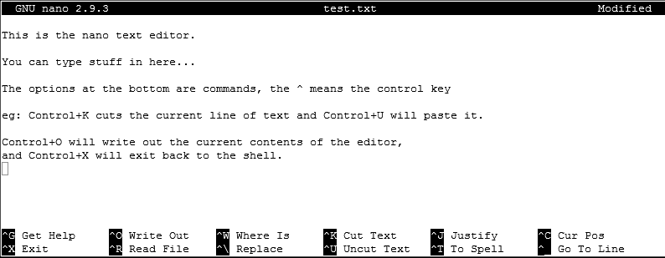
Using nano to edit text files
nano [filename] (edits if file exists, creates if it doesn't)

Slide 44
Moving / Renaming files
Uses the mv command for both (renaming is just moving from one name to another)
mv [file or directory] [new name/location]
If new name is a directory then the file is moved there with its existing name
Moving a directory moves all of its contents as well
Examples
mv old.txt new.txt
mv old.txt ../Saved/
mv old.txt ../Saved/new.txt
mv ../Saved/old.txt .

Slide 45
Copying files
Uses the cp command
cp [file] [new file]
Operates on a single file
Can copy directories using recursive copy (cp -r)
Examples
cp old.txt new.txt
cp old.txt ../Saved/
cp old.txt ../Saved/new.txt
cp ../Saved/old.txt .
cp -R ../Saved ./NewDir
cp -R ../Saved ./ExistingDir/ (only if ExistingDir exists)

Slide 46
Linking rather than copying
Copy duplicates the data in a file
Can be a problem with big data files
Can be a problem if you want edits to propagate
Links are a way to do 'virtual' copies. You can make the same file appear in more than one place.
Two types of link
Hard link - completely indistinguishable from a copied file
Only works on the same disk (can't span file systems)
Only works for files (not directories)
Symbolic (or soft) link
Is visible as a link, but can still be used as if it is a file
Can work across file systems
Can be used for directories as well as files
Normally the safe option to use

Slide 47
Creating symbolic links
Use the ln command with the -s modifier
Usage ln -s [from] [to]
Exactly the same structure as mv
When you list a link you can see where it points, but you can use it like a file
$ cat test.txt
This is a test file
$ ln -s test.txt test2.txt
$ ls -l test2.txt
lrwxrwxrwx 1 babraham babraham 8 Sep 11 16:27 test2.txt -> test.txt
$ cat test2.txt
This is a test file

Slide 48
Deleting files
Linux has no undo.
Deleting files has no recycle bin.
Linux will not ask you "are you sure"
Files can be deleted with the rm command
Directories (and all of their contents) can be deleted with rm -r
Examples
rm test_file.txt test_file2.txt
rm *.txt (be VERY careful using wildcards. Always run ls first to see what will go)
rm -r Old_directory/

Slide 49
Finding files
From the command line there are two main mechanisms
Using locate
Uses a pre-built index, so is *VERY* quick
Needs to be installed and configured (isn't on all distributions)
Only works on local drives - not network shares
Using find
Searches fresh each time
Can be slow if you're searching large numbers of files
Requires no pre-processing

Slide 50
Using find
find [options/filters] [place to start] [action]
Options / Filters
-name thisfile.txt
-name *txt
-type f -empty
Action
-print
-exec (any command - include {} for filename - need to finish with \;)

Slide 51
Find examples
find ~ -name *fastq.gz -print
find /etc/ -name *conf -exec wc -l '{}' \;
find ~ -type l -print

Slide 52
Exercise 2

Slide 53
Finding programs to run
ls -ltd --reverse Downloads/ Desktop/ Documents/
Program
name
Switches
Data
(normally files)
How does the system know which executable file to run when you just supply a name (like ls in this example) rather than a file path?
What happens when you have two different programs with the same name?

Slide 54
The PATH environment variable
Two new concepts which will be reused a lot:
A search path is a list of directories which the shell will iterate over to try to find something (a program in this case). It is an ordered list and the first hit will be returned.
Shells use "environment variables" as a small scale storage and configuration system. They are a set of key/value pairs which provide named pieces of data which influence the behaviour of the shell or programs which it runs. Some environment variables are created by default, but you can modify these, or add your own.

Slide 55
The PATH environment variable
You can see the current PATH contents by running:
echo $PATH
/usr/local/sbin:/usr/local/bin:/usr/sbin:/usr/bin:/sbin:/bin:/usr/games:/usr/local/games:/snap/bin
These are the directories which are trusted to contain good programs which you can launch just using their name
Other programs can be launched using their location (rather than name)
You can find the location of a named program using which
which ls (produces /bin/ls which is where the ls program is)

Slide 56
Setting the PATH
PATH is an environment variable, you can set it the same as any other variable, using the export function
export PATH=/one/folder:/another/folder
Normally you want to just add to the existing PATH, so you can include the current $PATH in the definition
export PATH=/new/folder/:$PATH
You can write this into ~/.bashrc to make the change permanent.

Slide 57
Exercise 3

Slide 59
More advanced BASH usage
v2018-11

Slide 60
What we know already
How to run existing programs
Those which are in the PATH
Those which are somewhere else
How to modify the options for a program using switches
How to supply data to programs using file paths and wildcards

Slide 61
What else can we do
Record the output of programs
Check for errors in programs which are running
Link programs together into small pipelines
Automate the running of programs over batches of files
All of these are possible with some simple BASH scripting

Slide 62
Recording the output of programs
One of the aspects of POSIX is a standard system for sending data to and from programs.
Three data streams exist for all Linux programs (though they don't have to use them all)
STDIN (Standard Input - a way to send data into the program)
STDOUT (Standard Output - a way to send expected data out of the program)
STDERR (Standard Error - a way to send errors or warnings out of the program)
By default STDOUT and STDERR are connected to your shell, so when you see text coming from a program, it's coming from these streams.

Slide 63
Recording the output of programs
STDOUT
STDIN
program
STDERR
Rather than leaving these streams connected to the screen, you can link them to either files, or other programs to either create logs, or to build small pipelines

Slide 64
Redirecting standard streams
You can redirect using arrows at the end of your command
> [file] Redirects STDOUT
< [file] Redirects STDIN
2> [file] Redirects STDERR
2>&1 Sends STDERR to STDOUT so you only have one output stream
$ find . -print > file_list.txt 2> errors.txt
$ ls
Data Desktop Documents Downloads errors.txt examples.desktop file_list.txt Music Pictures Public Templates Videos
$ head file_list.txt
.
./Downloads
./Pictures
./Public
./Music
./.bash_logout
./.local
./.local/share
./.local/share/icc
./.local/share/icc/edid-33d524c378824a7b78c6c679234da6b1.icc

Slide 65
Throwing stuff away
Sometimes you want to be able to hide output
STDOUT - I just want to test whether something worked
STDERR - I want to hide progress / error messages
Linux defines a special file /dev/null which you can write to but just discards all data sent to it
might_fail > /dev/null
chatty_app 2> /dev/null

Slide 66
Linking programs together
Part of the original UNIX design was to have lots of small programs doing specific jobs, and then to link them together to perform more advanced tasks.
There are a couple of mechanisms to do this
Pipes
Backticks

Slide 67
Linking programs together using pipes
Pipes are a mechanism to connect the STDOUT of one program to the STDIN of another. You can use them to build small pipelines
To create a pipe just use a pipe character | between programs
pr1 | pr2 is the equivalent to pr1 > temp; pr2 < temp
$ ls | head -2
Data
Desktop

Slide 68
Useful programs for pipes
Whilst you can theoretically use pipes to link any programs, there are some which are particularly useful, these are things like:
wc - to do word and line counting
grep - to do pattern searching
sort - to sort things
uniq - to deduplicate things
less - to read large amounts of output
zcat/gunzip/gzip - to do decompression or compression

Slide 69
Small example pipeline
Take a compressed fastq sequence file, extract from it all of the entries containing the telomere repeat sequence (TTAGGG) and count them
zcat file.fq.gz | grep TTAGGGTTAGGG | wc -l
$ zcat file.fq.gz | wc -l
179536960
$ zcat file.fq.gz | grep TTAGGGTTAGGG | wc -l
3925

Slide 70
Using backticks to capture output
Pipes are great to link streams of data together, but they need to be supported by both programs
In some cases you want to use the output of one program as an argument to another one.
You can do this using backticks - these are like quotes, but their contents are executed, and the contents are replaced with the STDOUT of the executed code

Slide 71
Backticks example
I want to find out where a program (fastqc) is installed, and I want to find out whether that location is a real file, or a symlink to somewhere else.
I can do this in 2 separate steps, but this involves copy/paste
which fastqc
ls -l [whatever came out of step 1]
Backticks let you do this in a single step.
$ ls -l `which fastqc`
-rwxr-xr-x 1 andrewss bioinf 14400 Dec 21 2017 /bi/apps/fastqc/0.11.7/fastqc

Slide 72
Iterating over files
When processing data it is common to need to re-run the same command multiple times for different input/output files.
Some programs will support being provided with multiple input files, but many will not.
You can use the automation features of the BASH shell to automate the running of these types of programs

Slide 73
The BASH for loop
Simple looping construct
Loop over a set of files
Loop over a set of values
Creates a temporary environment variable which you can use when creating commands

Slide 74
Examples of for loops
for value in {5,10,20,50}
do
run_simulation --iterations=$value > ${value}_iterations.log 2>&1
done
for value in {10..100}
do
run_simulation --iterations=$value > ${value}_iterations.log 2>&1
done
for file in *txt
do
echo $file
grep .sam $file | wc -l
done

Slide 75
Job Control
By default you run one job at at time in a shell
Shells support multiple running jobs
States of job
Running - foreground (shell has the attention of the job)
Running - background (output goes to the shell but other jobs can run)
Suspended - background (job exists but is paused, consumes no CPU)
Running - disconnected (output is no longer attached to the shell)

Slide 76
Job Control
prog_to_run (starts in foreground)
prog_to_run & (starts in background)
Control of running jobs
jobs (lists the jobs in this shell)
Control + Z (suspends the current job)
bg (puts the current suspended job into the background
fg [number] (puts the selected job back in the foreground)

Slide 77
Job Control - nohup
nohup prog_to_run
Merges STDOUT and STDERR
Disconnects from the terminal
Can't be killed when the terminal exits
Output appended to nohup.out
Can redirect with > logfile.txt

Slide 78
Job Control - listing and killing processes
ps (list my processes associated with this shell)
ps -fu [username] (list all processes for user [username])
ps -ef (list all processes on the system)
$ ps -fu andrewss
UID PID PPID C STIME TTY TIME CMD
andrewss 14510 1 0 Sep26 ? 00:00:02 ls --color=auto
andrewss 15496 15494 0 10:21 ? 00:00:00 sshd: andrewss@pts/36
andrewss 15497 15496 0 10:21 pts/36 00:00:00 -bash
andrewss 17195 1 0 Sep26 ? 00:00:11 /usr/libexec/openssh/sftp-server
andrewss 17955 1 0 Sep26 ? 00:00:11 ls --color=auto
andrewss 20618 15497 0 11:03 pts/36 00:00:00 ps -fu andrewss

Slide 79
Job Control - listing and killing processes
You can only kill your own processes
kill [PID] (Nicely ask this process to stop)
kill -9 [PID] (Force this process to abruptly stop)

Slide 80
Exercise 4

Slide 82
Installing and Managing Software
v2018-11

Slide 83
Different types of software
Software comes in different types
Interpreted scripts
Pre-compiled binary software
Source code requiring compilation
Software comes from different sources
Distributed with your operating system
Distributed by some other software management system
Downloaded from a specific site on the internet

Slide 84
Users, roles and permissions
Software can be installed just for an individual user
Most software is installed in a way which allows all users to run it
You need to understand users, roles and permissions to install software

Slide 85
Users and Roles
For security and privacy most users run with restricted privileges most of the time
They can only read some parts of the file system (eg: not other users data for)
They can only write to some parts of the file system (eg: can’t overwrite important programs)
The ‘root’ user is an account which has full privileges on the system and is used for administrative purposes

Slide 86
Using the root account
Log in as root – requires knowledge of the root account password. Quite dangerous as everything runs with full privileges.
Use su to move from a user account to the root account. Can be done within a session, but still requires the root account password.
Use sudo to selectively run some commands as root. Can restrict which commands can be run and log them. Can use the users own password to authenticate
Running programs with the suid or sgid permissions set on them

Slide 87
File / Directory Permissions
Every file and directory has a number of permissions. There are 3 types
Read permission
Write permission
Execute permission (list permission on directory)
The permissions apply to 3 classes of user
The owner of the file/directory
The members of the file/directories group
Everyone else

Slide 88
File / Directory Permissions
$ ls -l
total 128
-rw-r--r-- 1 root root 10266 Nov 13 2017 Changelog.md
drwxr-xr-x 3 root root 4096 Nov 13 2017 Docs
-rw-r--r-- 1 root root 35141 Nov 13 2017 LICENSE
-rw-r--r-- 1 root root 1720 Nov 13 2017 README.md
drwxr-xr-x 2 root root 4096 Nov 13 2017 test_files
-rwxr-xr-x 1 root root 68054 Nov 13 2017 trim_galore
Permissions
Owner
Group

Slide 89
File / Directory Permissions
r = read
w = write
x = execute/list
Directory
or
not
drwxr-xr-x
Permissions
for
owner
Permissions
for
group
Permissions
for
everyone else

Slide 90
Changing permissions / ownership
chmod
u (user) / g (group) / a (all)
+ / - (add or remove permission)
r (read) / w (write) / x (execute/list)
File/directory list
Can add -R to change permissions for a directory and all of its contents
chmod g+wx my.file
chmod ga-x my.file
chmod -R u-w my.dir

Slide 91
Special permission bits
User level special bit (SUID)
Applies to executable files
Will execute as root, even for a normal user
Group level special bit (SGID)
Can apply to executables or directories
On executables executes as the group of the file
On directories it forces any newly created files to inherit the group of the parent
chmod u+s [file]
chmod g+s [file]

Slide 92
Where to install software
In theory you can install software anywhere on the system, but there are places where software is expected to be installed.
If you don't have admin access, or you are installing just for yourself you can install into your home directory.
For site-wide packages you should follow the rules set out by the File Hierarchy Standard (FHS), which defines the expected locations of software on a POSIX system

Slide 93
FHS Locations
There are two types of application
Those which follow a standard structure for dividing the files they use between a set of related directories. These will be all system software and some add in packages
bin - executable files - things you'd actually run
lib - library files - code which is shared between programs and doesn't run directly
share - other data files used by applications
Those which bundle all of their code and data under a single directory and don't split it up
These will be the majority of scientific applications and other non-core software

Slide 94
FHS Installation Locations
If software follows the FHS division of sub-folders then it can go in a few places
/bin and /sbin are only for vital software packaged by the operating system, software in /sbin is to be used only by admins
/usr/bin and /usr/sbin are similar, but are for non-vital software
/usr/local (with executables in /usr/local/bin) is for software installed outside the operating systems package manager, but for software which follows the FHS standard
Non-FHS packages are generally recommended to be installed under /opt

Slide 95
Installing operating system packages
Nearly all Linux distributions come with a set of optional software packages for a wide range of applications
They use a package manager program to allow you to add and remove packages
Package managers handle installation of the required software as well as any dependencies. They also handle updates.
There are two main package managers
Apt (advanced packaging tool) - Ubuntu, Debian, Mint
Yum (Yum updater modified) - RedHat, CentOS, Fedora

Slide 96
Using a package manager (command line) All operations (except searches) need to run under sudo
APT
YUM
apt install [package name]
apt search [search term]
apt upgrade
apt purge [package name]
yum install [package name]
yum search [search term]
yum update
yum remove [package name]

Slide 97
The good and bad of OS packages
Good
Bad
Very easy to install
Will resolve dependencies and install them
Guaranteed compatible with the rest of your system
Limited software availability
Only one version of any package
Sometimes not up to date
More difficult to get support from authors

Slide 98
OS Package Example - JRE (Java)
# apt install default-jre
Reading package lists... Done
The following additional packages will be installed:
ca-certificates-java default-jre-headless fonts-dejavu-extra java-common libatk-wrapper-java libatk-wrapper-java-jni libgif7 openjdk-11-jre openjdk-11-jre-headless
Suggested packages:
default-java-plugin fonts-ipafont-gothic fonts-ipafont-mincho fonts-wqy-microhei | fonts-wqy-zenhei
The following NEW packages will be installed
ca-certificates-java default-jre default-jre-headless fonts-dejavu-extra java-common libatk-wrapper-java libatk-wrapper-java-jni libgif7 openjdk-11-jre
openjdk-11-jre-headless
0 to upgrade, 10 to newly install, 0 to remove and 0 not to upgrade.
Need to get 41.6 MB of archives.
After this operation, 191 MB of additional disk space will be used.
Do you want to continue? [Y/n] y
Get:1 http://gb.archive.ubuntu.com/ubuntu bionic/main amd64 java-common all 0.63ubuntu1~02 [7,032 B]
Unpacking java-common (0.63ubuntu1~02) ...
Setting up default-jre (2:1.10-63ubuntu1~02) ...
Processing triggers for libc-bin (2.27-3ubuntu1) ...
Processing triggers for ca-certificates (20180409) ...
0 added, 0 removed; done.
Running hooks in /etc/ca-certificates/update.d...
done.

Slide 99
Exercise 5

Slide 100
Installing pre-compiled binaries
These are the easiest type of installation to perform
You need to make sure that you have the correct download for your operating system and architecture (32bit vs 64bit)
Installation is normally just extracting the files from the archive
You can add the new directory to the PATH, or link the executables to a location already in $PATH to make them easier to work with
You might need to check for library compatibility

Slide 101
Some useful related functions
Downloading files from the internet via command line
Compression systems and archive files

Slide 102
Downloading via command line
The first stage in most installations is to download the packaged software from the project web site.
To do this from the command line you can use the wget program which simply takes the URL you want to download as an argument
$ wget https://www.bioinformatics.babraham.ac.uk/projects/fastqc/fastqc_v0.11.7.zip
--2018-09-12 13:15:32-- https://www.bioinformatics.babraham.ac.uk/projects/fastqc/fastqc_v0.11.7.zip
Resolving www.bioinformatics.babraham.ac.uk (www.bioinformatics.babraham.ac.uk)... 149.155.144.82
Connecting to www.bioinformatics.babraham.ac.uk (www.bioinformatics.babraham.ac.uk)|149.155.144.82|:443... connected.
HTTP request sent, awaiting response... 200 OK
Length: 10254666 (9.8M) [application/zip]
Saving to: ‘fastqc_v0.11.7.zip’
fastqc_v0.11.7.zip 100%[===========================================================>] 9.78M 21.3MB/s in 0.5s
2018-09-12 13:15:33 (21.3 MB/s) - ‘fastqc_v0.11.7.zip’ saved [10254666/10254666]

Slide 103
Extracting from archive files
Most software is distributed as a single archive file to make it simpler, and to allow it to be compressed
The two major formats used are:
Zip - a container which is compressed by default
Tar - a container which can optionally be compressed
tar.gz = gzip compression
tar.bz2 = bzip compression
The first step in most software installations is to extract from the archive

Slide 104
Extracting from zip files
Use the unzip program. Very simple. Don't normally supply options.
$ unzip fastqc_v0.11.7.zip
Archive: fastqc_v0.11.7.zip
creating: FastQC/
inflating: FastQC/cisd-jhdf5.jar
creating: FastQC/Configuration/
inflating: FastQC/Configuration/adapter_list.txt
inflating: FastQC/Configuration/contaminant_list.txt
inflating: FastQC/Configuration/limits.txt
inflating: FastQC/fastqc
inflating: FastQC/fastqc_icon.ico
creating: FastQC/Help/
etc…

Slide 105
Extracting from tar files
Uses the tar program with the following options
-x (extract data)
-v (be verbose - show what you're extracting - optional)
-z (decompress gzipped archive - for tar.gz files)
-j (decompress bzipped argive - for tar.bz files)
-f [file] (the tar file to extract from)
$ tar -xzvf bismark_v0.20.0.tar.gz
Bismark_v0.20.0/
Bismark_v0.20.0/bismark
Bismark_v0.20.0/coverage2cytosine
Bismark_v0.20.0/bismark2report
Bismark_v0.20.0/bismark_genome_preparation
Bismark_v0.20.0/deduplicate_bismark
Bismark_v0.20.0/bismark2summary
Bismark_v0.20.0/bismark2bedGraph
Bismark_v0.20.0/Docs/
Bismark_v0.20.0/Docs/Bismark_User_Guide.html
Bismark_v0.20.0/plotly/
Bismark_v0.20.0/plotly/plot.ly
Bismark_v0.20.0/bismark_methylation_extractor

Slide 106
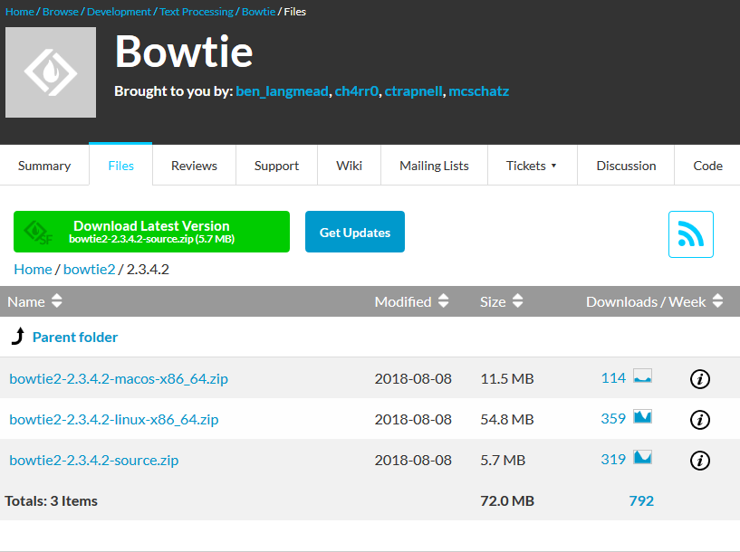
Binary install example - bowtie2
This is a short read aligner, distributed as a binary zip file
!
Be careful which download link you select
The main (green) link here is for the source code, not the Linux binaries

Slide 107
Binary install example - bowtie2
We need to be root as we're installing outside our home
$ sudo su
# cd /opt/
# wget https://kent.dl.sourceforge.net/project/bowtie-bio/bowtie2/2.3.4.2/bowtie2-2.3.4.2-linux-x86_64.zip
2018-09-12 14:22:14 (3.00 MB/s) - ‘bowtie2-2.3.4.2-linux-x86_64.zip’ saved [54761153/54761153]
# unzip bowtie2-2.3.4.2-linux-x86_64.zip
Archive: bowtie2-2.3.4.2-linux-x86_64.zip
creating: bowtie2-2.3.4.2-linux-x86_64/
inflating: bowtie2-2.3.4.2-linux-x86_64/bowtie2-align-l
inflating: bowtie2-2.3.4.2-linux-x86_64/bowtie2-align-l-debug
# cd bowtie2-2.3.4.2-linux-x86_64
# ls
AUTHORS bowtie2-align-s bowtie2-build-l-debug bowtie2-inspect-l doc MANUAL.markdown VERSION
bowtie2 bowtie2-align-s-debug bowtie2-build-s bowtie2-inspect-l-debug example NEWS
bowtie2-align-l bowtie2-build bowtie2-build-s-debug bowtie2-inspect-s LICENSE scripts
bowtie2-align-l-debug bowtie2-build-l bowtie2-inspect bowtie2-inspect-s-debug MANUAL TUTORIAL
# ./bowtie2 --help
Bowtie 2 version 2.3.4.2 by Ben Langmead (langmea@cs.jhu.edu, www.cs.jhu.edu/~langmea)
Usage:
bowtie2 [options]* -x <bt2-idx> {-1 <m1> -2 <m2> | -U <r> | --interleaved <i>} [-S <sam>]
# ln -s /opt/bowtie2-2.3.4.2-linux-x86_64/bowtie2 /usr/local/bin/
It's a self-contained app, so goes in /opt
It's not in PATH, so we need to use ./bowtie2 to launch it
We can link the executable into a directory in PATH

Slide 108
Libraries
Most binary applications make use of dynamic linking
Some functionality is not in the application but is taken from 'library' files
Come with the operating system
Distributed with the application
Libraries allow for
Updating without rebuilding the application
Removal of duplicate code

Slide 109
Checking library compatibility
Most binaries are dynamically linked
Additional functionality pulled from system libraries at runtime
If the libraries are missing / wrong versions then the application won’t work
Installing the missing libraries will usually fix things.
You can see the requirements with ldd

Slide 110
Example of ldd usage
$ ldd `which ssh`
linux-vdso.so.1 (0x00007ffef7598000)
libselinux.so.1 => /lib/x86_64-linux-gnu/libselinux.so.1 (0x00007f68e7899000)
libcrypto.so.1.0.0 => /usr/lib/x86_64-linux-gnu/libcrypto.so.1.0.0 (0x00007f68e7456000)
libdl.so.2 => /lib/x86_64-linux-gnu/libdl.so.2 (0x00007f68e7252000)
libz.so.1 => /lib/x86_64-linux-gnu/libz.so.1 (0x00007f68e7035000)
libresolv.so.2 => /lib/x86_64-linux-gnu/libresolv.so.2 (0x00007f68e6e1a000)
libgssapi_krb5.so.2 => /usr/lib/x86_64-linux-gnu/libgssapi_krb5.so.2 (0x00007f68e6bcf000)
libc.so.6 => /lib/x86_64-linux-gnu/libc.so.6 (0x00007f68e67de000)
libpcre.so.3 => /lib/x86_64-linux-gnu/libpcre.so.3 (0x00007f68e656c000)
/lib64/ld-linux-x86-64.so.2 (0x00007f68e7d77000)
libkrb5.so.3 => /usr/lib/x86_64-linux-gnu/libkrb5.so.3 (0x00007f68e6296000)
libk5crypto.so.3 => /usr/lib/x86_64-linux-gnu/libk5crypto.so.3 (0x00007f68e6064000)
libcom_err.so.2 => /lib/x86_64-linux-gnu/libcom_err.so.2 (0x00007f68e5e60000)
libkrb5support.so.0 => /usr/lib/x86_64-linux-gnu/libkrb5support.so.0 (0x00007f68e5c55000)
libpthread.so.0 => /lib/x86_64-linux-gnu/libpthread.so.0 (0x00007f68e5a36000)
libkeyutils.so.1 => /lib/x86_64-linux-gnu/libkeyutils.so.1 (0x00007f68e5832000)

Slide 111
Library search path
Libraries are identified by using a search path
Some hard-coded components
Some components added by the application
Some components can be configured by the user
System library directories (/lib /usr/lib)
Application library directories (usually relative to the application itself)
User components (via the LD_LIBRARY_PATH environment variable)

Slide 112
Library search path
$ ldd jellyfish
Linux-vdso.so.1 => (0x00007ffd4a352000)
libpthread.so.0 => /lib64/libpthread.so.0 (0x000000376b400000)
libjellyfish-2.0.so.2 => not found
libstdc++.so.6 => /usr/lib64/libstdc++.so.6 (0x0000003770400000)
libm.so.6 => /lib64/libm.so.6 (0x000000376ac00000)
libgcc_s.so.1 => /lib64/libgcc_s.so.1 (0x000000376f000000)
libc.so.6 => /lib64/libc.so.6 (0x000000376a800000)
/lib64/ld-Linux-x86-64.so.2 (0x000000376a400000)

Slide 113
Installing script files
Some software is written as cross-platform scripts.
These are distributed as source code, but do not need to be compiled to run. They are written in interpreted languages such as perl, python, ruby etc.
Installation is similar to that for binary executables

Slide 114
Script install example - bismark
$ sudo su
# cd /opt
# wget http://www.bioinformatics.babraham.ac.uk/projects/bismark/bismark_v0.20.0.tar.gz
2018-09-12 14:49:19 (60.6 MB/s) - ‘bismark_v0.20.0.tar.gz’ saved [1411124/1411124]
# tar -xzvf bismark_v0.20.0.tar.gz
Bismark_v0.20.0/
Bismark_v0.20.0/bismark
Bismark_v0.20.0/coverage2cytosine
Bismark_v0.20.0/bismark2report
# cd Bismark_v0.20.0/
# ./bismark --help
DESCRIPTION
The following is a brief description of command line options and arguments to control the Bismark
bisulfite mapper and methylation caller. Bismark takes in FastA or FastQ files and aligns the
reads to a specified bisulfite genome. Sequence reads are transformed into a bisulfite converted
# export PATH=/opt/Bismark_v0.20.0/:$PATH

Slide 115
Running script based programs
Two methods:
Call the interpreter and pass the script
Execute the script directly - interpreter taken from the first line
# perl bismark --version
Bismark - Bisulfite Mapper and Methylation Caller.
Bismark Version: v0.20.0
# bismark --version
Bismark - Bisulfite Mapper and Methylation Caller.
Bismark Version: v0.20.0

Slide 116
Script 'shebang' lines
The first line of a script file starts with #![interpreter]
If your interpreter is in a different location you can edit the first line
You can also use the env program to take the first instance from your PATH
#!/usr/bin/perl
#!/opt/perl_5.28.0/bin/perl
#!/usr/bin/env perl

Slide 117
Exercise 6

Slide 118
Installing from source code
Most software distributed as source code is written in C or C++
Should come with a BUILD.txt or INSTALL.txt file
Most programs will use a build system to manage compilation
make
cmake
Many will use the autotools system to manage differences in configuration
Compilation will require various accessory packages to work

Slide 119
Anatomy of C/C++ compilation
Compilation
Running
Source code files
Final Binary
Library Header Files
Binary Libraries
Make system
Compiler

Slide 120
Libraries and headers
We mentioned libraries earlier, as a way to include common code in several applications without duplicating it
At runtime a "dynamically linked" application needs the binary libraries to be available
During compilation, code which uses libraries will also need the library "header" file - a text file describing the capabilities of the library. These will not normally be installed, but will be available from the OS
For each library package there will be a corresponding 'dev' package containing the headers. These will be needed for compilation.

Slide 121
Setting up a build environment
Get all of the basic tools in one go
Ubuntu/Debian etc
sudo apt install build-essential
CentOS/Redhat etc.
sudo yum groupinstall "Development tools"

Slide 122
Standard autotools / make compilation
Four steps
configure Checks library dependencies and the capabilities of your system. Writes out a custom 'makefile' which should work for you. Allows for some customisation
make Does the actual compilation
make test Runs a test suite to make sure the binaries work (not always present)
make install Moves the compiled binaries to their final location
All of the steps involving make (but particularly the compilation) can be parallelised over multiple CPUs

Slide 123
Options for autotools
Configure
Some programs will offer custom options. Try ./configure --help
Main option here is to set the location for the installed files. By default these will go into the directories under /usr/local/. If you want to put them somewhere else you specify the --prefix option. Other options might be described in BUILD.txt
./configure --prefix=/opt/custom/
Make
You can set the number of CPU cores to split the compilation over using the -j parameter
make -j 10

Slide 124
Installing EMBOSS
$ wget -q ftp://emboss.open-bio.org/pub/EMBOSS/EMBOSS-6.6.0.tar.gz
$ tar -xzf EMBOSS-6.6.0.tar.gz
$ cd EMBOSS-6.6.0/
$ ./configure --prefix=/opt/EMBOSS/ > configure.log 2>&1
checking for X11/Xlib.h... no
X11 graphics have been selected but no X11 header files
have been found.
$ sudo apt install libx11-dev
$ ./configure --prefix=/opt/EMBOSS/ > configure.log 2>&1
checking for X11/Xlib.h... yes
$ make -j 4 > make.log 2>&1 &
$ tail -f make.log
$ make test
make: Nothing to be done for 'test'.
$ sudo make install
$ ls /opt/EMBOSS/
bin include lib share
$ /opt/EMBOSS/bin/embossversion
Report the current EMBOSS version number
6.6.0.0
1. Configure
2. Make
3. Make test
4. Make install

Slide 125
Standard cmake installation
Slightly simpler than autotools
Create a build directory inside the source directory
Move into the build directory
Run cmake with the target being the directory above (cmake ..)
Add -DCMAKE_INSTALL_PREFIX=/my/custom/dir if wanted
Run make, the same as for autotools

Slide 126
Installing BamTools
$ wget https://github.com/pezmaster31/bamtools/archive/v2.5.1.tar.gz
$ tar -xzf v2.5.1.tar.gz
$ cd bamtools-2.5.1/
$ mkdir build
$ cd build
$ sudo apt install cmake
$ cmake -DCMAKE_INSTALL_PREFIX=/opt/bamtools/ .. > cmake.log 2>&1
Could NOT find ZLIB (missing: ZLIB_LIBRARY ZLIB_INCLUDE_DIR)
$ sudo apt install zlib1g-dev
$ cmake -DCMAKE_INSTALL_PREFIX=/opt/bamtools/ .. > cmake.log 2>&1
Found ZLIB: /usr/lib/x86_64-linux-gnu/libz.so (found version "1.2.11")
$ make -j 4 > make.log 2>&1 &
$ make test
make: *** No rule to make target 'test'. Stop.
$ sudo make install
$ /opt/bamtools/bin/bamtools --version
bamtools 2.5.1
Part of BamTools API and toolkit
Primary authors: Derek Barnett, Erik Garrison, Michael Stromberg
(c) 2009-2012 Marth Lab, Biology Dept., Boston College

Slide 127
Exercise 7

Slide 129
Extending Languages
v2018-11

Slide 130
Extending Languages
Most commonly used languages will have extensions which can be installed to provide new functionality
The extensions may not be written in the same language
C or C++ extensions to scripted languages are very common
We will look at how to extend different languages
R
Perl
Python

Slide 131
R packages

Slide 132
Installing R packages
Standard locations are either in site-wide R package folder, eg /usr/lib/R or in ~/R/
Installation through a package repository
CRAN
BioConductor
Manual installation from any source
Project site
Github etc.

Slide 133
R Library Paths
.libPaths() (R function to show the current search path)
Controlled by environment variables
R_LIBS
R_LIBS_USER
Set the root of a R library tree
Default personal directory is
~/R/R.[version]$[platform]-library/

Slide 134
Installing R packages through CRAN
Installer and dependency resolution built into the language
Can install both binary and source packages
Source packages my have OS dependencies which will need to be fixed
From within R
install.packages(“packagename”)
Use sudo to launch R if you want to install for all users

Slide 135
Installing R packages from BioConductor
Independent, bioinformatics oriented package repository
Has its own installer which you need to load
Different processes for different R versions
Older R (<3.5.0)
source("https://bioconductor.org/biocLite.R")
biocLite()
Newer R (>=3.5.0)
install.packages("BiocManager")
BiocManager::install()

Slide 136
Installing R packages from BioConductor
Additional packages can be installed with
Old system
biocLite("packagename")
New system
BiocManager::install("packagename")
Will handle dependency resolution both within Bioconductor and to CRAN repositories.

Slide 137
Installing R packages from other sources
Download the tar.gz file for the package
Run:
R CMD INSTALL package.tar.gz
Direct installation from github
Install the devtools package
library(devtools)
install_github(“user/repository”)

Slide 138
Exercise 8

Slide 139
Perl Modules

Slide 140
Installing Perl modules
Install from your OS repository
Structured naming format, Example::Module would be perl-example-module
Won't be pulled from here any other way
May end up with duplicates
Automated install using CPAN.pm
Use a module to install modules.
Ships alongside Perl
Manual installation
Follows a standard recipe

Slide 141
Perl module search path
Searches through directories in @INC
Can see these with perl -V
Can add locations using PERL5LIB environment variable
@INC:
/bi/apps/perl_modules/lib/perl5/x86_64-linux-thread-multi
/bi/apps/perl_modules/lib/perl5
/bi/apps/perl_modules/share/perl5/
/bi/apps/perl_modules/lib/perl5/x86_64-linux-thread-multi
/bi/apps/perl_modules/lib64/perl5
/usr/local/lib64/perl5
/usr/local/share/perl5
/usr/lib64/perl5/vendor_perl
/usr/share/perl5/vendor_perl
/usr/lib64/perl5
/usr/share/perl5
.

Slide 142
Installing Perl modules - Using cpan
Run cpan install Example::Module
Automated download, configuration and installation
Does the same steps as a manual install
Can resolve dependencies
Configuration on first use
To install modules, you need to configure a local Perl library directory or
escalate your privileges. CPAN can help you by bootstrapping the local::lib
module or by configuring itself to use 'sudo' (if available). You may also
resolve this problem manually if you need to customize your setup.
What approach do you want? (Choose 'local::lib', 'sudo' or 'manual')
[local::lib]

Slide 143
Manual Perl Module installation (after download and un-tarring)
MakeMaker
Build
perl Makefile.PL
make
make test
make install (with sudo?)
perl Build.PL
./Build
./Build test
./Build install (with sudo?)

Slide 144
Installing in non-standard locations
perl -V (look at @INC)
@INC:
/usr/local/share/perl/5.26.1
/usr/share/perl/5.26
/usr/local/lib/site_perl
Add folders to PERL5LIB environment variable
perl Makefile.PL INSTALL_BASE=/my/dir
perl Build.PL --install_base=/my/dir

Slide 145
Exercise 9

Slide 146
Python packages

Slide 147
Installing python packages
Several options
OS system packages
Automated install with pip
Manual install
Install from source code repository

Slide 148
Python package locations
Searches in directories in sys.path
Can add directories by modifying PYTHONPATH
$ python
Python 2.7.3 (default, Feb 15 2013, 11:09:45)
[GCC 4.4.6 20110731 (Red Hat 4.4.6-3)] on linux2
Type "help", "copyright", "credits" or "license" for more information.
>>> import sys
>>> print ("\n".join(sys.path))
/bi/apps/python/2.7.3/lib/python27.zip
/bi/apps/python/2.7.3/lib/python2.7
/bi/apps/python/2.7.3/lib/python2.7/plat-linux2
/bi/apps/python/2.7.3/lib/python2.7/lib-tk
/bi/apps/python/2.7.3/lib/python2.7/lib-old
/bi/apps/python/2.7.3/lib/python2.7/lib-dynload
/bi/apps/python/2.7.3/lib/python2.7/site-packages
/bi/apps/python/2.7.3/lib/python2.7/site-packages/ipython-0.13.1-py2.7.egg
/bi/apps/python/2.7.3/lib/python2.7/site-packages/ply-3.4-py2.7.egg
/bi/apps/cellprofiler/CellProfiler-2.2.0
/bi/apps/python/2.7.3/lib/python2.7/site-packages/gtk-2.0
/bi/apps/python/2.7.3/lib/python2.7/site-packages

Slide 149
Installing python packages with pip
apt/yum install python-pip
pip install numpy
pip install --user numpy
pip install --upgrade numpy
Check pip vs pip3

Slide 150
Manual python package installation (after download and un-tarring)
python setup.py install
python3 setup.py install --prefix=/my/folder
Will fail initially as final destination isn't in PYTHONPATH
Will tell you what folder to add
Rerun install after fixing PYTHONPATH
If the custom location is outside your home directory then you'll need to modify the global PYTHONPATH by editing /etc/bashrc (or one of the other global shell config files)

Slide 151
Exercise 10

Slide 153
Automated installers and Containers
v2018-11

Slide 154
Automated Installers
Like a package manager, but independent of Operating System
Some will operate from source, distributing recipes
Some will distribute pre-compiled binaries
Most common examples
Conda (https://conda.io)
Easy Build (https://easybuild.readthedocs.io)

Slide 155
Conda
Package management system
Originally for python packages, but now covers all types of software
Several Implementations
Anaconda (original distribution, with a full python environment)
Miniconda (small distribution, just for running conda)
Add-in repositories for more packages
BioConda (https://bioconda.github.io/)

Slide 156
Using conda
Install a conda providing environment (probably miniconda)
Set up some channels (bioconda)
Install some packages
Use the packages

Slide 157
Installing miniconda
Go to https://conda.io/miniconda.html
Download the shell script for your platform
Run it
Will install into your home directory - each user gets a separate install
Will offer to modify your PATH to include the miniconda bin directory*
*Be careful about this!!

Slide 158
Adding bioconda channels
conda config --add channels bioconda
conda config --add channels conda-forge
Bioconda will now be searched for new installs

Slide 159
Installing packages with conda
Simple installs [but don't do this]
conda install bwa
conda install bwa=0.7.4
Custom environments
conda create -n aligners
source activate aligners
conda install bwa bowtie2 hisat2
source deactivate

Slide 160
Problems with conda?
Only software available in the repositories
Pretty comprehensive these days
Closed environment
Can't mix and match with things from the base OS (well you can, but stuff will break!)
Duplication
Every user (and every environment) gets their own copy of everything
Duplication (again)
Will install its own R / perl / python etc and will put it first in the path
Can break non-conda applications in odd ways
Always use a named environment

Slide 161
Exercise 11

Slide 162
Containers

Slide 163
Containers
A method for bundling software and data together into a single item which can be ported easily between users/computers
Can provide an isolated environment - similar to a VM or a conda environment, or make a suite of programs/data look like an application
Main systems
Docker* (https://www.docker.com/)
Singularity* (https://www.sylabs.io/singularity/)
*They play nicely together

Slide 164
Finding a container
DockerHub (https://hub.docker.com)
SingularityHub (https://singularity-hub.org)
Search for the application / user / container you want
Find the address (user/name) eg vsoch/hello-world

Slide 165
Installing singularity
Available from apt in Debian/Ubuntu
sudo apt install singularity-container
Note that just "singularity" is a game!
Compile from source (https://github.com/sylabs/singularity/releases)
v2.6.0 is autotools based - similar install to previous apps
v3.0.0 is re-written in GOLang so has a custom install procedure

Slide 166
Installing a container
Download from a repository and install onto your machine
singularity pull shub://dleehr/qiime2-singularity
singularity pull docker://qiime2/core
File names can get a bit long, so:
singularity pull --name qiime.simg docker://qiime2/core
Produces a .simg file on your machine

Slide 167
Using a container
Different options. You can start a shell in the environment of the container
singularity shell qiime.simg
You can run a script which the image provides
singularity run qiime.simg
./qiime.simg

Slide 168
Exercise 12

Slide 170
Different types of Linux installation
v2018-11

Slide 171
Types of Linux installation
Bare metal
Physical hardware
CD / DVD / USB / Network installation
Virtual Machine
Runs within another operating system
Portable / disposable
Install from ISO / Network
Cloud
Virtual machine on someone else's hardware
Amazon / Google are the main providers
Range of available hardware and OS images available

Slide 172
Installing bare metal or in a VM
Essentially the same process
Uses an installer provided by the Linux distribution
Two main types
Live image
Boot into a working OS from a CD/DVD/USB
Copy the image to a hard drive and boot from there
Little to no configuration options - need to modify post install
Real installer
Guided installation process in a custom installer
Many options (software, networking, disk partitioning etc.)
More flexibility, but more hassle

Slide 173
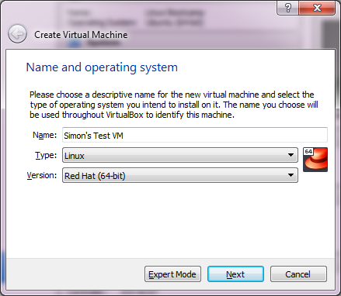
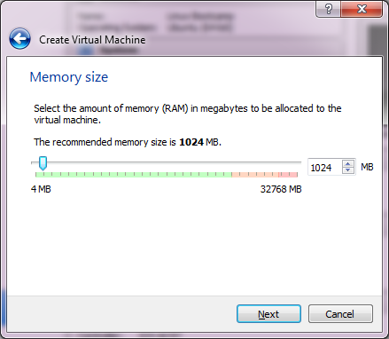
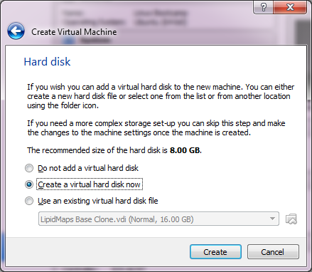
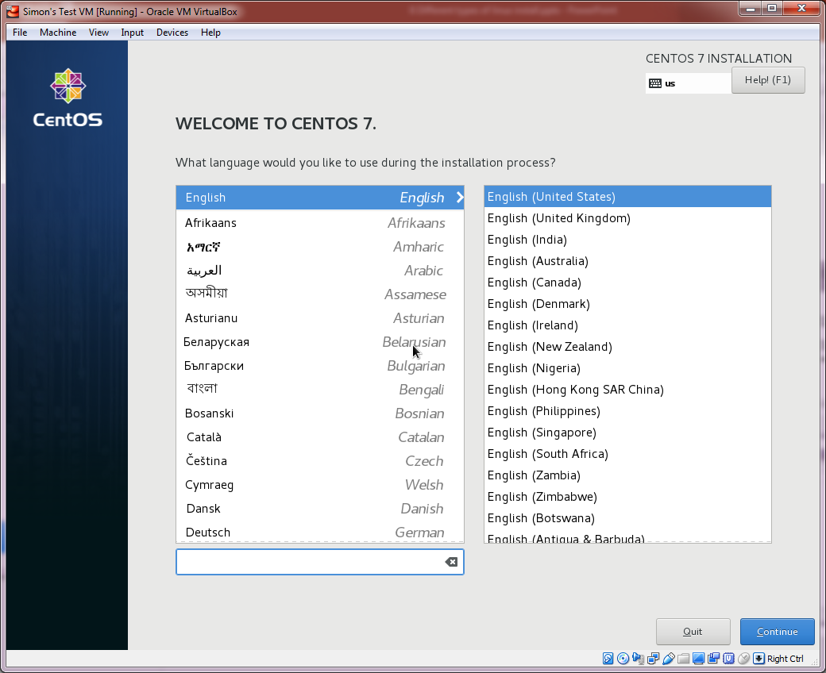
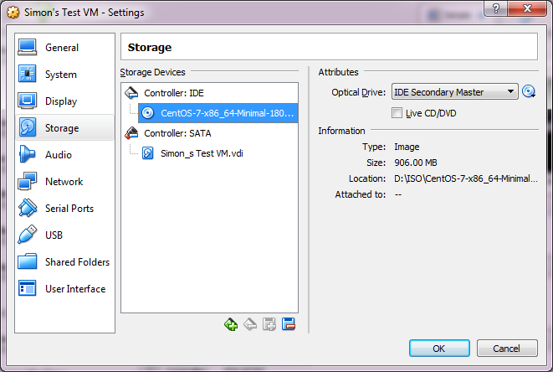
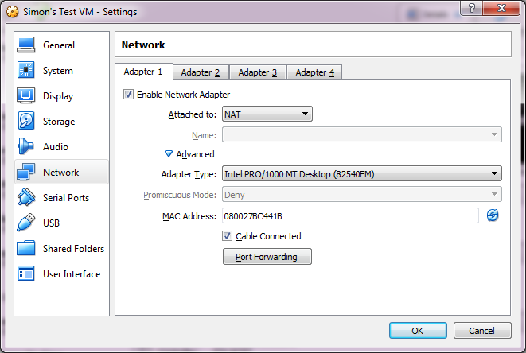
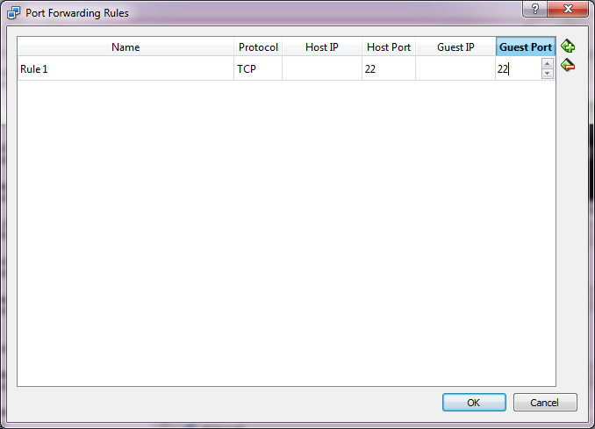
Installing into a VirtualBox VM

Slide 174
Exercise 14

Slide 175
Creating an Amazon EC2 server
Create an AWS account (will require a credit card, but test servers can be run for free)
https://aws.amazon.com
Create a key pair
Create an EC2 instance
Connect to the image using the key
Do what you want
Shut it down (so you stop being charged!)

Slide 176
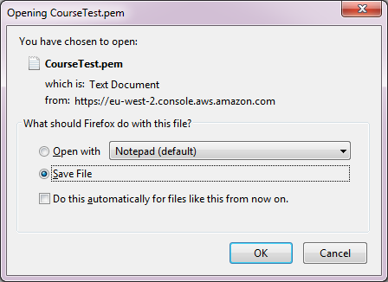
Create a key pair
Key Pairs > Create Key Pair
Give it a name
Download the .pem file which it creates

Slide 177
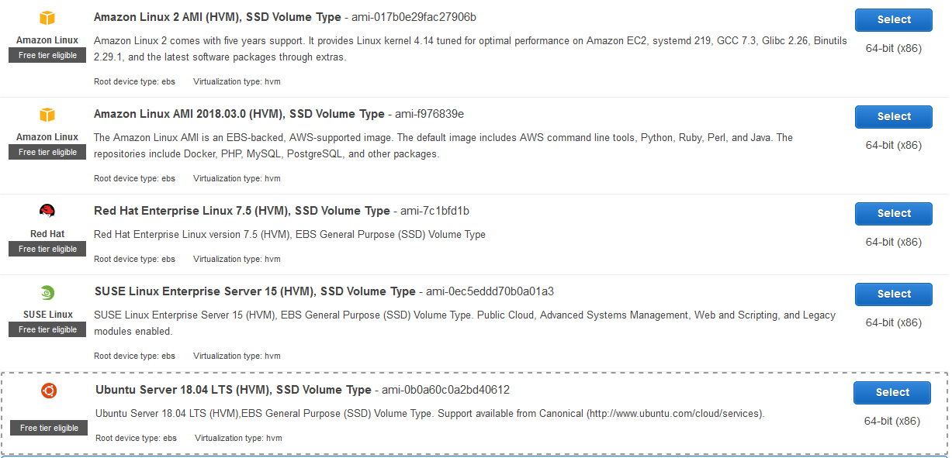
Create an EC2 instance
Instances > Launch Instance
Select hardware and base OS

Slide 178
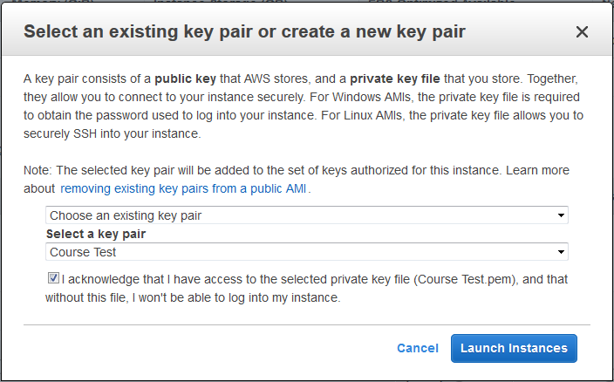
Launch instance and set keys

Slide 179
Find instance details
Under instances
Find username
For Amazon Linux 2 or the Amazon Linux AMI, the user name is ec2-user.
For a Centos AMI, the user name is centos.
For a Debian AMI, the user name is admin or root.
For a Fedora AMI, the user name is ec2-user or fedora.
For a RHEL AMI, the user name is ec2-user or root.
For a SUSE AMI, the user name is ec2-user or root.
For an Ubuntu AMI, the user name is ubuntu.

Slide 180
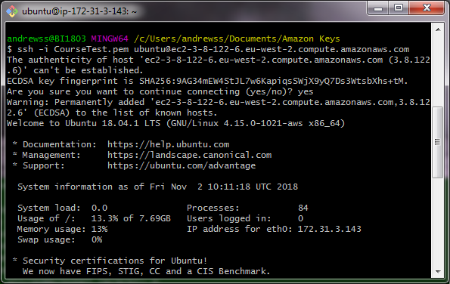
Connect to the instance via SSH using your key
ssh -i [key_file.pem] username@address.from.ec2

Slide 181
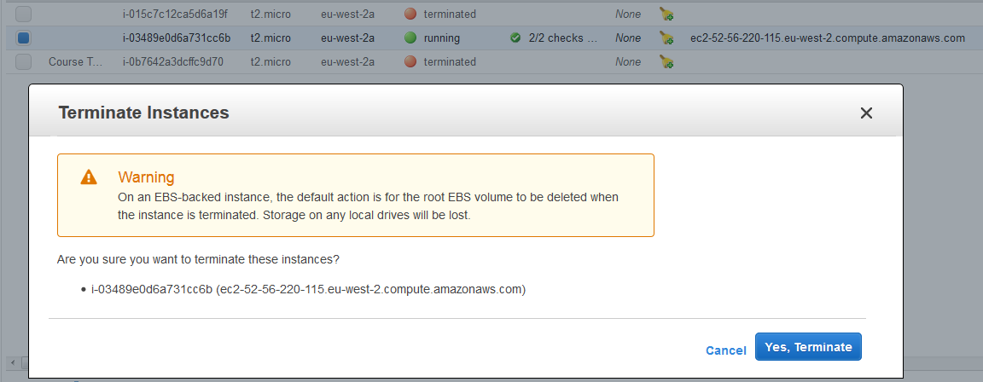
Terminate your instance
Instances > Right click > Terminate
Will be warned about deleting the underlying storage

Slide 182
Storage
Simple instances come with limited, temporary storage
For serious work you want additional storage
Configure storage bins
Add them to one (or more) images
Add data to them
Storage bins exist independently of the compute instances
Simple stores for applications or databases Elastic Block Store (EBS) $$$
File system storage for concurrent access Elastic File System (EFS) $$$$$$
Large data storage and processing/archiving Simple Storage Service (S3) $$
Long term archiving Glacier $

Slide 183
Exercise 15

