Slide 1

Introduction to R
(with Tidyverse)
Simon Andrews, Laura Biggins
v2024-03

Slide 2
R can just be a calculator
> 3+2
[1] 5
> 2/7
[1] 0.2857143
> 5^10
[1] 9765625

Slide 3
Storing numerical data in variables
X <- 10
20 -> y
x
[1] 10
x+y
[1] 30
z <- x+y

Slide 4
Variable names
The rules
  Can't start with a number
  Made up of letters, numbers dots and underscores
The guidelines
  Make the name mean something (x = bad, weight = good)
  Keep variables all lower case
  Separate words with dots or underscores
    gene_name or gene.name are the preferred options

Slide 5
Storing text in variables
height <- 167
my_name <- "laura"
my_other_name <- 'biggins'

Slide 6
Running a simple function
sqrt(10)
[1] 3.162278

Slide 7
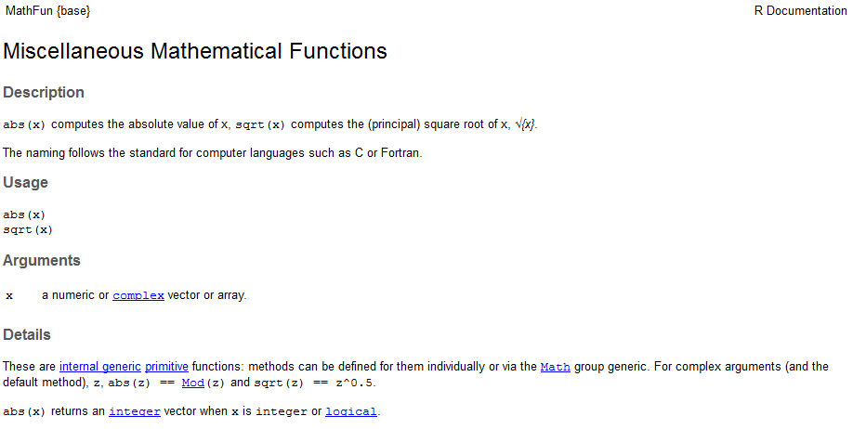
Looking up help
?sqrt

Slide 8
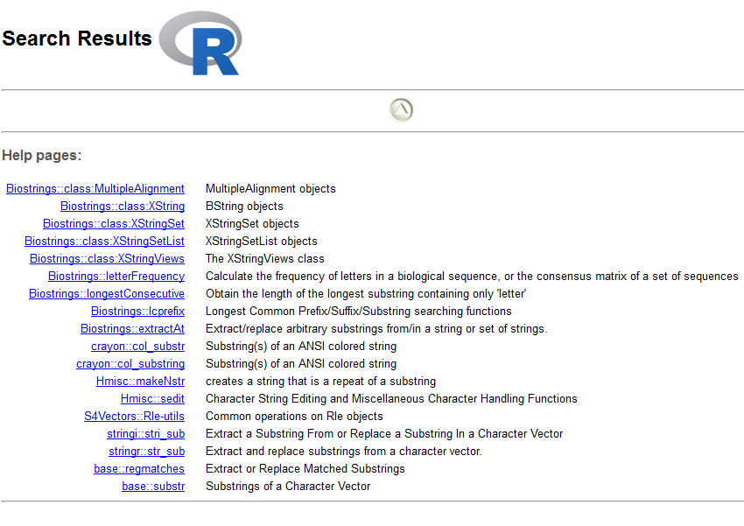
Searching Help
??substring

Slide 9
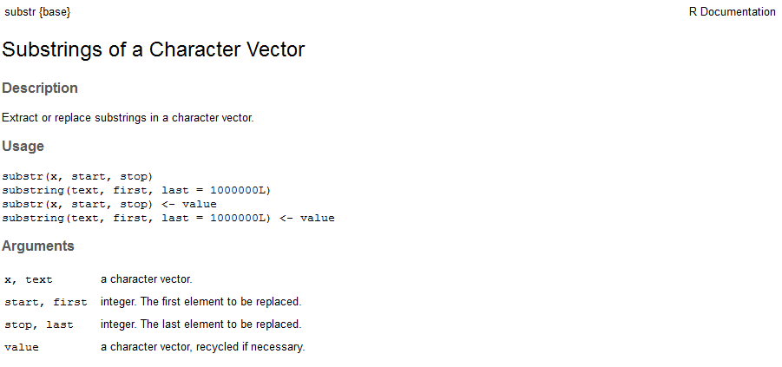
Searching Help

Slide 10
Passing arguments to functions
my.name <- "simon"
substr(my.name, 2, 4)
[1] "imo"
substr(x=my.name, start=2, stop=4)
[1] "imo"
substr(
start = 2,
stop = 4,
x = my.name
)
[1] "imo"

Slide 11
Exercise 1

Slide 12
Everything is a vector
Vectors are the most basic unit of storage in R
Vectors are ordered sets of values of the same type
  Numeric
  Character (text)
  Factor (repeated text values)
  Logical (TRUE or FALSE)
  Date etc…
X <- 10
x is a vector of length 1 with 10 as its first value

Slide 13
Creating vectors manually
Use the c (combine) function
Data must be of the same type
simple_vector <- c(1,2,4,6,3)
some_names <- c("simon","laura",“hayley","jo",“sarah")
c(1,2,3,"fred")
[1] "1" "2" "3" "fred"

Slide 14
Functions for creating vectors
rep - repeat values
rep(2,times=10)
[1] 2 2 2 2 2 2 2 2 2 2
rep("hello",times=5)
[1] "hello" "hello" "hello" "hello" "hello"
rep(c("dog","cat"),times=3)
[1] "dog" "cat" "dog" "cat" "dog" "cat"
rep(c("dog","cat"),each=3)
[1] "dog" "dog" "dog" "cat" "cat" "cat"

Slide 15
Functions for creating vectors
seq - create numerical sequences
  No required arguments!
    from
    to
    by
    length.out
  Specify enough that the series is unique

Slide 16
Functions for creating vectors
seq - create numerical sequences
seq(from=2,by=3,to=14)
[1] 2 5 8 11 14
seq(from=3,by=10,to=40)
[1] 3 13 23 33
seq(from=5,by=3.6,length.out=5)
[1] 5.0 8.6 12.2 15.8 19.4

Slide 17
Functions for creating vectors
Sampling from statistical distributions
  rnorm
  runif
  rpois
  rbeta
  rbinom
  rnorm(10000)
Statistically testing vectors
  t.test
  lm
  cor.test
  aov
  t.test(
  c(1,5,3),
  c(10,15,30)
  )

Slide 18
Language shortcuts for vector creation
Single elements
  c("simon")
  "simon"
Integer series
  seq(from=4,to=20,by=1)
  4:20
  [1] 4 5 6 7 8 9 10 11 12 13 14 15 16 17 18 19 20

Slide 19
Vectorised Operations
2+3
[1] 5
c(2,4) + c(3,5)
[1] 5 9
simple_vector
1 2 4 6 3
simple_vector * 100
100 200 400 600 300

Slide 20
Rules for vectorised operations
Equivalent positions are matched
Vector 1
3
4
5
6
7
8
9
10
+
Vector 2
11
12
13
14
15
16
17
18
14
16
18
20
22
24
26
28

Slide 21
Rules for vectorised operations
Shorter vectors are recycled
Vector 1
3
4
5
6
7
8
9
10
+
Vector 2
11
12
13
14
14
16
18
20
18
20
22
24

Slide 22
Rules for vectorised operations
Incomplete vectors generate a warning
Vector 1
3
4
5
6
7
8
9
10
+
Warning message:
In 3:10 + 11:13 :
longer object length is not a multiple of shorter object length
Vector 2
11
12
13
14
16
18
17
19
21
20
22

Slide 23
Vectorised Operations
c(2,4) + c(3,5)
[1] 5 9
simple_vector
1 2 4 6 3
simple_vector * 100
100 200 400 600 300

Slide 24
Exercise 2

Slide 25
R Data Structures

Slide 26
Vector
1D Data Structure of fixed type
scores
1
0.8
mean(scores)
sd(scores)
1.2
2
3.3
3
1.8
4
2.7
5

Slide 27
List
Collection of vectors
results
“ratios”
“counts”
results$counts
mean(results$counts)
1
2
1
0.8
1
100
1.2
300
2
2
3.3
200
3
3
1.8
4
2.7
5

Slide 28
Data Frame
Collection of vectors with same lengths
Gain the concept of 'rows'
all.results
all.results$mon
mean(all.results$mon)
“mon”
“tue”
“wed”
“pass”
1
2
3
4
1
0.8
0.9
0.8
T
0.6
0.7
0.5
F
2
0.2
0.3
0.3
F
3
0.8
0.8
0.9
T
4
0.6
1.0
0.9
T
5

Slide 29
Tibble
Collection of vectors with same lengths
Gain the concept of 'rows'
all.results
all.results$mon
mean(all.results$mon)
“mon”
“tue”
“wed”
“pass”
1
2
3
4
1
0.8
0.9
0.8
T
0.6
0.7
0.5
F
2
0.2
0.3
0.3
F
3
0.8
0.8
0.9
T
4
0.6
1.0
0.9
T
5

Slide 30
Tibbles are nicer dataframes
> head(as.data.frame(data))
Probe Chromosome Start End Probe Strand Feature
1 AL645608.2 1 911435 914948 + AL645608.2
2 LINC02593 1 916865 921016 - LINC02593
3 SAMD11 1 923928 944581 + SAMD11
4 TMEM51-AS1 1 15111815 15153618 - TMEM51-AS1
5 TMEM51 1 15152532 15220478 + TMEM51
6 FHAD1 1 15247272 15400283 + FHAD1
Description
1 novel transcript
2 long intergenic non-protein coding RNA 2593 [Source:HGNC Symbol;Acc:HGNC:53933]
3 sterile alpha motif domain containing 11 [Source:HGNC Symbol;Acc:HGNC:28706]
4 TMEM51 antisense RNA 1 [Source:HGNC Symbol;Acc:HGNC:26301]
5 transmembrane protein 51 [Source:HGNC Symbol;Acc:HGNC:25488]
6 forkhead associated phosphopeptide binding domain 1 [Source:HGNC Symbol;Acc:HGN

Slide 31
Tibbles are nicer dataframes
> head(as_tibble(data))
# A tibble: 6 x 12
Probe Chromosome Start End `Probe Strand` Feature ID Description
<chr> <dbl> <dbl> <dbl> <chr> <chr> <chr> <chr>
1 AL64~ 1 9.11e5 9.15e5 + AL6456~ ENSG~ novel tran~
2 LINC~ 1 9.17e5 9.21e5 - LINC02~ ENSG~ long inter~
3 SAMD~ 1 9.24e5 9.45e5 + SAMD11 ENSG~ sterile al~
4 TMEM~ 1 1.51e7 1.52e7 - TMEM51~ ENSG~ TMEM51 ant~
5 TMEM~ 1 1.52e7 1.52e7 + TMEM51 ENSG~ transmembr~
6 FHAD1 1 1.52e7 1.54e7 + FHAD1 ENSG~ forkhead a~
# ... with 4 more variables: `Feature Strand` <chr>, Type <chr>, `Feature
# Orientation` <chr>, Distance <dbl>

Slide 32


Tidyverse
https://www.tidyverse.org/
Collection of R packages
  Aims to fix many of core R's structural problems
  Common design and data philosophy
  Designed to work together, but integrate seamlessly with other parts of R

Slide 33




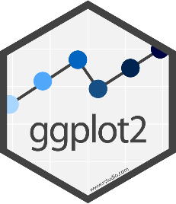
Tidyverse Packages
Tibble - data storage
ReadR - reading data from files
TidyR - Model data correctly
DplyR - Manipulate and filter data
Ggplot2 - Draw figures and graphs

Slide 34
Installation and calling
Once per machine (don’t include in script)
  install.packages("tidyverse")
Once per R session (DO include in script)
  library(tidyverse)
-- Attaching packages ------- tidyverse 1.3.1 --
v ggplot2 3.3.3 v purrr 0.3.4
v tibble 3.1.2 v dplyr 1.0.6
v tidyr 1.1.3 v stringr 1.4.0
v readr 2.0.0 v forcats 0.5.1
-- Conflicts ------------- tidyverse_conflicts()
x dplyr::filter() masks stats::filter()
x dplyr::lag() masks stats::lag()

Slide 35
Reading and Writing Files with readr
Provides functions to read from text files into tibbles or write from tibbles to text files
  data <- read_delim("file.txt")
    data <- read_csv("file.csv")
  data <- read_tsv("file.tsv")
  write_csv(data,"file.csv")
  write_tsv(data,"file.tsv")

Slide 36
Specifying file paths
You can use full file paths, but it's a pain
Just set the 'working directory' and then just provide a file name
  setwd(path)
  Session > Set Working Directory > Choose Directory
Use [Tab] to fill in file paths in the editor
  read_delim("") – put the cursor in the quotes and press tab
read_delim("O:/Training/R_tidyverse_intro_data/neutrophils.csv")

Slide 37
Reading files with readr
> trumpton <- read_delim("trumpton.txt")
Rows: 7 Columns: 5
-- Column specification ------------------------------
Delimiter: "\t"
chr (2): LastName, FirstName
dbl (3): Age, Weight, Height
> trumpton
  # A tibble: 7 x 5
  LastName FirstName Age Weight Height
  <chr> <chr> <dbl> <dbl> <dbl>
  1 Hugh Chris 26 90 175
  2 Pew Adam 32 102 183
  3 Barney Daniel 18 88 168
  4 McGrew Chris 48 97 155
  5 Cuthbert Carl 28 91 188
  6 Dibble Liam 35 94 145
  7 Grub Doug 31 89 164

Slide 38
Exercise 3

Slide 39
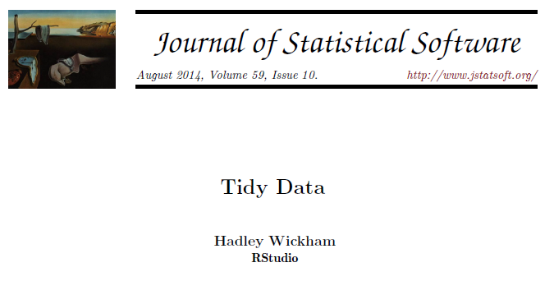
'Tidy' Data Format
Tibbles give you a 2D data structure where each column must be of a fixed data type
Often data can be put into this sort of structure in more than one way
Is there a right / wrong way to structure your data?
Tidyverse has an opinion!

Slide 40
Long vs Wide Data Modelling
Consider a simple experiment:
Two genes tested (ABC1 and DEF1)
Two conditions (WT and KO)
Three replicates for each condition

Slide 41
Wide Format
Gene | WT_1 | WT_2 | WT_3 | KO_1 | KO_2 | KO_3
ABC1 | 8.86 | 4.18 | 8.90 | 4.00 | 14.52 | 13.39
DEF1 | 29.60 | 41.22 | 36.15 | 11.18 | 16.68 | 1.64
Compact
Easy to read
Shows linkage for genes
No explicit genotype or replicate
Values spread out over multiple rows and columns
Not extensible to more metadata

Slide 42

Long Format
Gene | Genotype | Replicate | Value
ABC1 | WT | 1 | 8.86
ABC1 | WT | 2 | 4.18
ABC1 | WT | 3 | 8.90
ABC1 | KO | 1 | 4.00
ABC1 | KO | 2 | 14.52
ABC1 | KO | 3 | 13.39
DEF1 | WT | 1 | 29.60
DEF1 | WT | 2 | 41.22
DEF1 | WT | 3 | 36.15
DEF1 | KO | 1 | 11.18
DEF1 | KO | 2 | 16.68
DEF1 | KO | 3 | 1.64
More verbose (repeated values)
Explicit genotype and replicate
All values in a single column
Extensible to more metadata

Slide 43
Filtering and subsetting
Tidyverse (specifically dplyr) comes with functions to manipulate your data.
All functions take a tibble as their first argument
All functions return a modified tibble
  Selecting columns
  Logical subsetting

Slide 44
The data we're starting with
> trumpton
  # A tibble: 7 x 5
  LastName FirstName Age Weight Height
  <chr> <chr> <dbl> <dbl> <dbl>
  1 Hugh Chris 26 90 175
  2 Pew Adam 32 102 183
  3 Barney Daniel 18 88 168
  4 McGrew Chris 48 97 155
  5 Cuthbert Carl 28 91 188
  6 Dibble Liam 35 94 145
  7 Grub Doug 31 89 164

Slide 45
Using select to pick columns
> select(trumpton,FirstName,LastName, Weight)
# A tibble: 7 x 3
FirstName LastName Weight
<chr> <chr> <dbl>
1 Chris Hugh 90
2 Adam Pew 102
3 Daniel Barney 88
4 Chris McGrew 97
5 Carl Cuthbert 91
6 Liam Dibble 94
7 Doug Grub 89

Slide 46
You can use positions instead of names
> select(trumpton, 2,4)
# A tibble: 7 x 2
FirstName Weight
<chr> <dbl>
1 Chris 90
2 Adam 102
3 Daniel 88
4 Chris 97
5 Carl 91
6 Liam 94
7 Doug 89

Slide 47
You can use negative selections
> select(trumpton, -LastName)
# A tibble: 7 x 4
FirstName Age Weight Height
<chr> <dbl> <dbl> <dbl>
1 Chris 26 90 175
2 Adam 32 102 183
3 Daniel 18 88 168
4 Chris 48 97 155
5 Carl 28 91 188
6 Liam 35 94 145
7 Doug 31 89 164

Slide 48
Functional selections using filter
> filter(trumpton, Height>=170)
# A tibble: 3 x 5
LastName FirstName Age Weight Height
<chr> <chr> <dbl> <dbl> <dbl>
1 Hugh Chris 26 90 175
2 Pew Adam 32 102 183
3 Cuthbert Carl 28 91 188

Slide 49
Types of filter you can use
Greater than
  weight > 20
  weight >= 30
Less than
  height < 170
  height <= 180
Equal to (or not)
  value == 5
  name == "simon"
  name != "simon"
> filter(trumpton, FirstName == "Chris")
# A tibble: 2 x 5
LastName FirstName Age Weight Height
<chr> <chr> <dbl> <dbl> <dbl>
1 Hugh Chris 26 90 175
2 McGrew Chris 48 97 155

Slide 50
You can transform data in a filter
Select rows where the difference (in either direction) is more than 5
> filter(transform.data, difference > 5)
# A tibble: 1 x 3
WT KO difference
<dbl> <dbl> <dbl>
1 -8.69 -2.38 6.31
> filter(transform.data, difference < -5)
# A tibble: 1 x 3
WT KO difference
<dbl> <dbl> <dbl>
1 -1.93 -10.0 -8.10
> transform.data
# A tibble: 10 x 3
WT KO difference
<dbl> <dbl> <dbl>
1 -5.11 -3.29 1.81
2 1.12 -1.85 -2.97
3 -3.99 -3.77 0.222
4 -4.18 -2.46 1.72
5 -1.93 -10.0 -8.10
6 -8.69 -2.38 6.31
7 -0.670 2.73 3.40
8 -1.15 -2.59 -1.43
9 -1.98 1.83 3.80
10 -1.06 0.372 1.43
> filter(transform.data, abs(difference) > 5)
# A tibble: 2 x 3
WT KO difference
<dbl> <dbl> <dbl>
1 -1.93 -10.0 -8.10
2 -8.69 -2.38 6.31

Slide 51
Exercise 4

Slide 52
Combining Multiple Operations
Find people who are:
  Taller than 170cm
  Called Chris
Then report only their age and weight

Slide 53
Combining multiple operations
The long winded way…
Three separate operations with two intermediate variables
Works, but is ugly!
> filter(trumpton, Height >= 170) -> answer1
> filter(answer1, FirstName == "Chris") -> answer2
> select(answer2, Age, Weight)
# A tibble: 1 x 2
Age Weight
<dbl> <dbl>
1 26 90

Slide 54
Pipes to the rescue
All tidyverse functions take a tibble as their first argument
All tidyverse functions return a tibble
You can therefore chain operations together, passing the output of one function as the first input to another
Data → Filter 1 → Filter 2 → Selection

Slide 55
The pipe operator: %>%
Takes the data on its left and makes it the first argument to a function on its right.
> select(trumpton,-LastName)
# A tibble: 7 x 4
FirstName Age Weight Height
<chr> <dbl> <dbl> <dbl>
1 Chris 26 90 175
2 Adam 32 102 183
3 Daniel 18 88 168
4 Chris 48 97 155
5 Carl 28 91 188
6 Liam 35 94 145
7 Doug 31 89 164
> trumpton %>% select(-LastName)
# A tibble: 7 x 4
FirstName Age Weight Height
<chr> <dbl> <dbl> <dbl>
1 Chris 26 90 175
2 Adam 32 102 183
3 Daniel 18 88 168
4 Chris 48 97 155
5 Carl 28 91 188
6 Liam 35 94 145
7 Doug 31 89 164

Slide 56
Combining Multiple Operations with Pipes
Give the age and weight for people who are taller than 170cm and called Chris
trumpton %>% filter(Height>=170) %>% filter(FirstName=="Chris") %>% select(Age,Weight)
trumpton
filter(Height>=170)
filter(FirstName=="Chris")
select(Age,Weight)
# A tibble: 1 x 2
Age Weight
<dbl> <dbl>
1 26 90
%>%
%>%
%>%

Slide 57
Exercise 5

Slide 58
Plotting figures and graphs with ggplot
ggplot is the plotting library for tidyverse
  Powerful
  Flexible
Follows the same conventions as the rest of tidyverse
  Data stored in tibbles
  Data is arranged in 'tidy' format
  Tibble is the first argument to each function

Slide 59
Code structure of a ggplot graph
Start with a call to ggplot()
  Pass the tibble of data
  Say which columns you want to use
Say which graphical representation you want to use
  Points, lines, barplots etc
Customise labels, colours annotations etc.

Slide 60
Geometries and Aesthetics
Geometries are types of plot
  geom_point() Point geometry, (x/y plots, stripcharts etc)
  geom_line() Line graphs
  geom_boxplot() Box plots
  geom_bar() Barplots
  geom_histogram() Histogram plots
Aesthetics are graphical parameters which can be adjusted in a given geometry

Slide 61
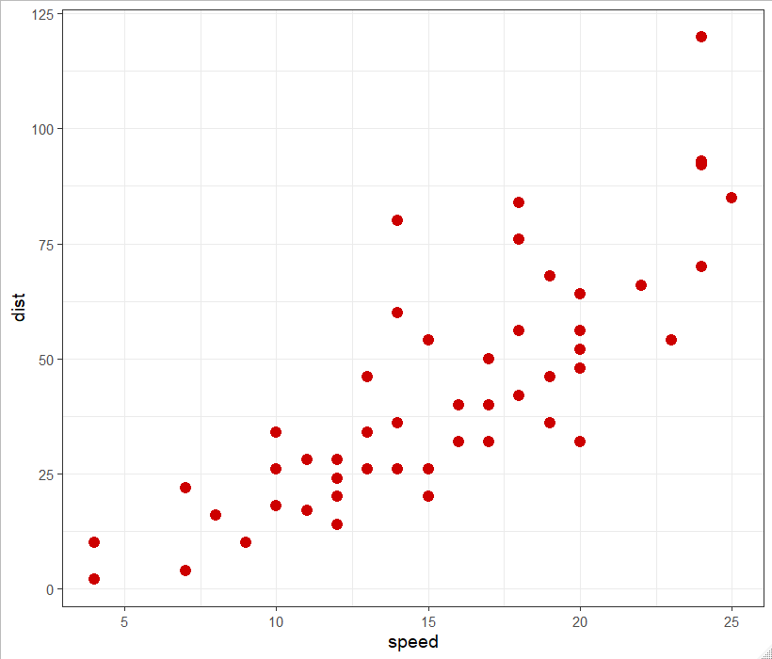
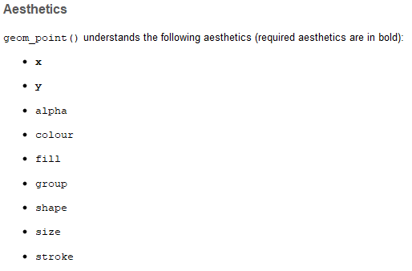
Aesthetics for geom_point()

Slide 62
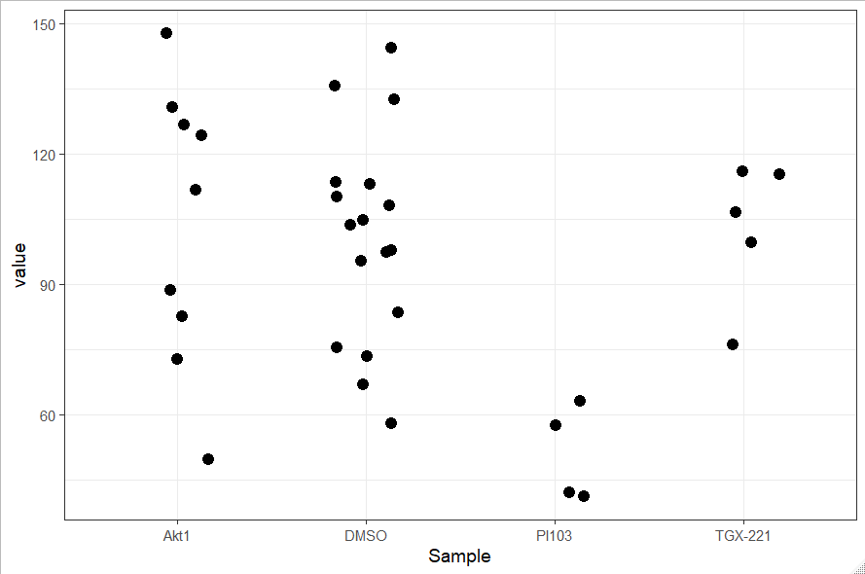
Mappings can be quantitative or categorical

Slide 63
How do you define aesthetics
Fixed values
  Colour all points red
  Make the points size 4
Encoded from your data – called an aesthetic mapping
  Colour according to genotype
  Size based on the number of observations
Aesthetic mappings are set using the aes() function, normally as an argument to the ggplot function
  data %>% ggplot(aes(x=weight, y=height, colour=genotype))

Slide 64
Putting things together
Identify the tibble with the data you want to plot
Decide on the geometry (plot type) you want to use
Decide which columns will modify which aesthetic
Call ggplot(aes(...))
Add a geom_xxx function call

Slide 65
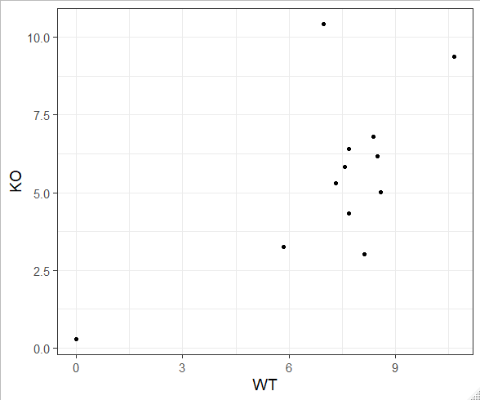
Our first plot…
ggplot( )
expression
, aes(x=WT, y=KO)
+ geom_point()
> expression
# A tibble: 12 x 4
Gene WT KO pValue
<chr> <dbl> <dbl> <dbl>
1 Mia1 5.83 3.24 0.1
2 Snrpa 8.59 5.02 0.001
3 Itpkc 8.49 6.16 0.04
4 Adck4 7.69 6.41 0.2
5 Numbl 8.37 6.81 0.1
6 Ltbp4 6.96 10.4 0.001
7 Shkbp1 7.57 5.83 0.1
8 Spnb4 10.7 9.38 0.2
9 Blvrb 7.32 5.29 0.05
10 Pgam1 0 0.285 0.5
11 Sertad3 8.13 3.02 0.0001
12 Sertad1 7.69 4.34 0.01
Identify the tibble with the data you want to plot
Decide on the geometry (plot type) you want to use
Decide which columns will modify which aesthetic
Call ggplot(aes(...))
Add a geom_xxx function call

Slide 66
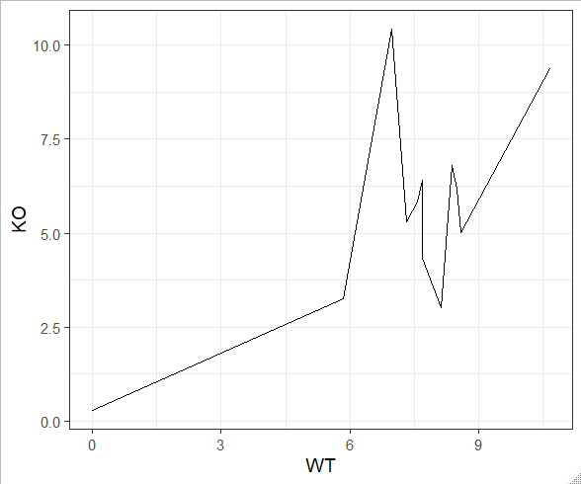
Our second plot…
ggplot( )
expression
, aes(x=WT, y=KO)
+ geom_line()
> expression
# A tibble: 12 x 4
Gene WT KO pValue
<chr> <dbl> <dbl> <dbl>
1 Mia1 5.83 3.24 0.1
2 Snrpa 8.59 5.02 0.001
3 Itpkc 8.49 6.16 0.04
4 Adck4 7.69 6.41 0.2
5 Numbl 8.37 6.81 0.1
6 Ltbp4 6.96 10.4 0.001
7 Shkbp1 7.57 5.83 0.1
8 Spnb4 10.7 9.38 0.2
9 Blvrb 7.32 5.29 0.05
10 Pgam1 0 0.285 0.5
11 Sertad3 8.13 3.02 0.0001
12 Sertad1 7.69 4.34 0.01

Slide 67
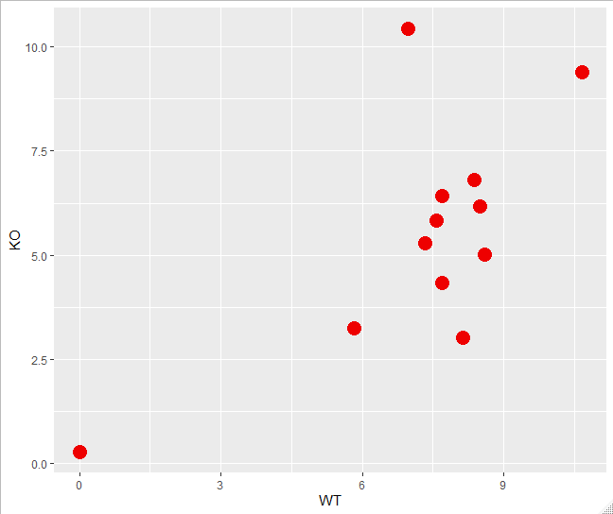
Our third plot…
expression %>%
ggplot (aes(x=WT, y=KO)) +
geom_point(color="red2", size=5)

Slide 68
Colour recap
Encoded from your data – called an aesthetic mapping, set using the aes() function
  data %>%
  ggplot(aes(x=weight, y=height, colour=genotype)) +
  geom_point()
Fixed values – all points the same colour
  data %>%
  ggplot(aes(x=weight, y=height)) +
  geom_point(colour="blue2")

Slide 69
Exercise 6

Slide 70
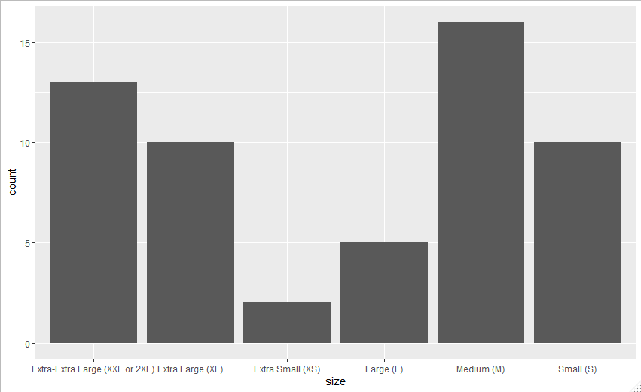
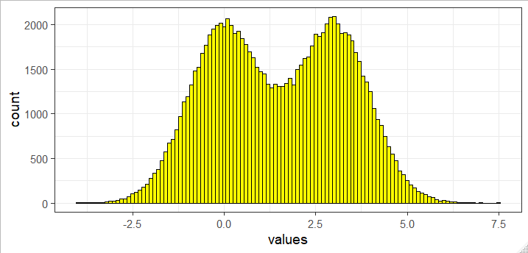
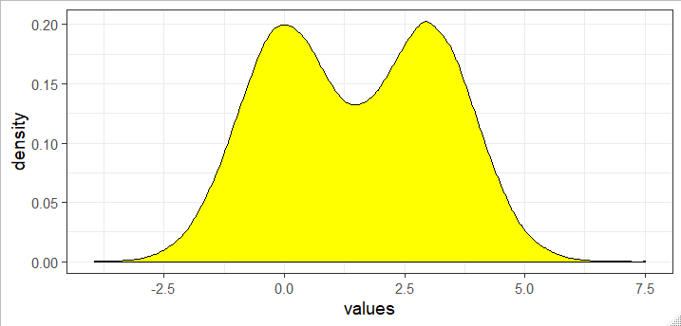
Other plot types
Barplots
  geom_bar
  geom_col
Distribution Plots
  geom_histogram
  geom_density

Slide 71
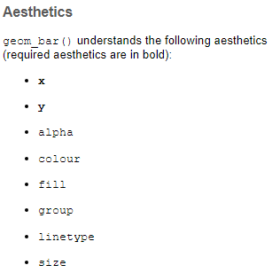
Drawing a barplot (geom_col())
Plot the expression values for the WT samples for all genes
What is your X?
What is your Y?
> expression
# A tibble: 12 x 4
Gene WT KO pValue
<chr> <dbl> <dbl> <dbl>
1 Mia1 5.83 3.24 0.1
2 Snrpa 8.59 5.02 0.001

Slide 72
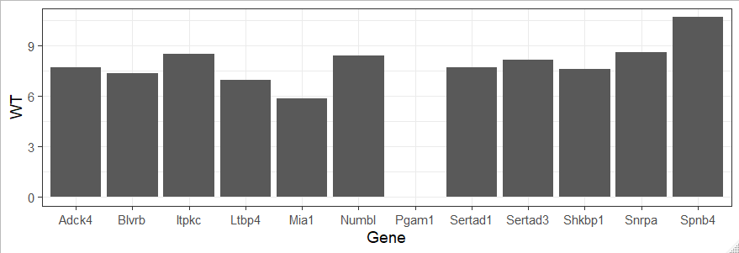
Our bar plot…
expression %>%
ggplot(aes(x=Gene, y=WT)) +
geom_col()

Slide 73
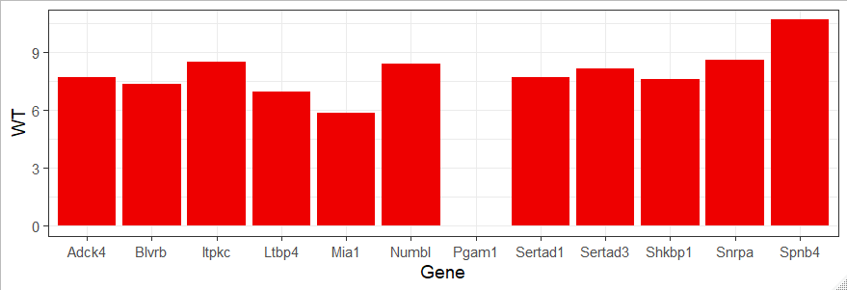
Our bar plot…
expression %>%
ggplot(aes(x=Gene, y=WT)) +
geom_col(fill="red2")

Slide 74
Counting bar plot…
dogs %>%
ggplot(aes(x=size)) +
geom_bar()
> dogs
# A tibble: 56 x 2
size breed
<chr> <chr>
1 Extra Large (XL) Airedale Terrier
2 Extra-Extra Large (XXL or 2XL) Akita
3 Extra Large (XL) American Foxhound
4 Extra Large (XL) Australian Shepherd
5 Extra Large (XL) Bassett Hound
6 Medium (M) Beagle
7 Extra-Extra Large (XXL or 2XL) Bernese Mountain Dog
8 Medium (M) Bichon Frise
9 Small (S) Boston Terrier
10 Medium (M) Boston Terrier
# ... with 46 more rows

Slide 75
Plotting distributions - histograms
> many.values
# A tibble: 100,000 x 2
values genotype
<dbl> <chr>
1 1.90 KO
2 2.39 WT
3 4.32 KO
4 2.94 KO
5 0.728 WT
6 -0.280 WT
7 0.337 WT
8 -1.31 WT
9 1.55 WT
10 1.86 KO
many.values %>%
ggplot(aes(values)) +
geom_histogram(binwidth = 0.1, fill="yellow", colour="black")

Slide 76
Plotting distributions - density
> many.values
# A tibble: 100,000 x 2
values genotype
<dbl> <chr>
1 1.90 KO
2 2.39 WT
3 4.32 KO
4 2.94 KO
5 0.728 WT
6 -0.280 WT
7 0.337 WT
8 -1.31 WT
9 1.55 WT
10 1.86 KO
many.values %>%
ggplot(aes(values)) +
geom_density(fill="yellow", colour="black")

Slide 77
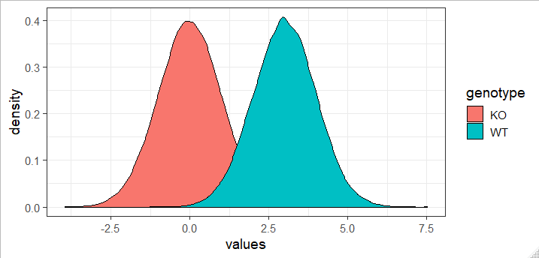
Plotting distributions - density
> many.values
# A tibble: 100,000 x 2
values genotype
<dbl> <chr>
1 1.90 KO
2 2.39 WT
3 4.32 KO
4 2.94 KO
5 0.728 WT
6 -0.280 WT
7 0.337 WT
8 -1.31 WT
9 1.55 WT
10 1.86 KO
many.values %>%
ggplot(aes(x=values, fill=genotype)) +
geom_density(colour="black")

Slide 78
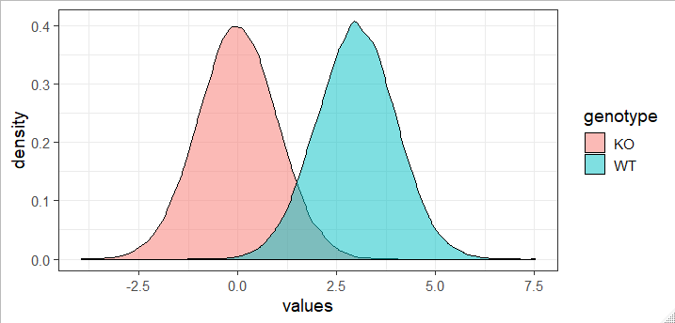
Plotting distributions - density
> many.values
# A tibble: 100,000 x 2
values genotype
<dbl> <chr>
1 1.90 KO
2 2.39 WT
3 4.32 KO
4 2.94 KO
5 0.728 WT
6 -0.280 WT
7 0.337 WT
8 -1.31 WT
9 1.55 WT
10 1.86 KO
many.values %>%
ggplot(aes(x=values, fill=genotype)) +
geom_density(colour="black", alpha=0.5)

Slide 79
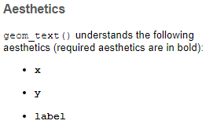
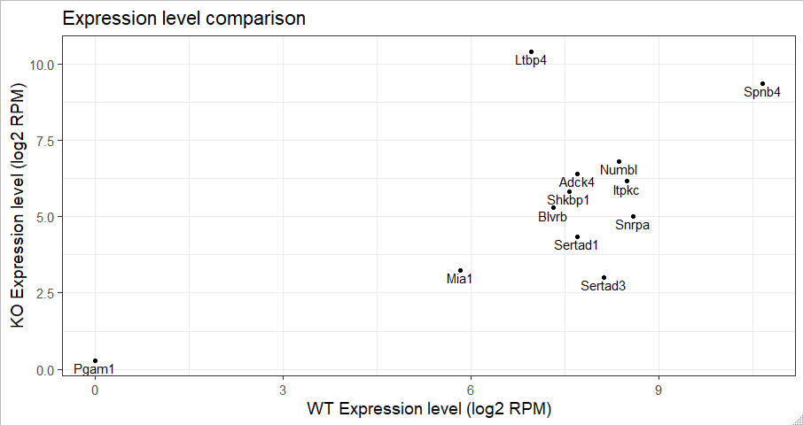
Other annotation geometries
expression %>%
ggplot(aes(x=WT, y=KO, label=Gene)) +
geom_point() +
ggtitle("Expression level comparison") +
xlab("WT Expression level (log2 RPM)") +
ylab("KO Expression level (log2 RPM)") +
geom_text(vjust=1.2)

Slide 80
Exercise 7

Slide 81
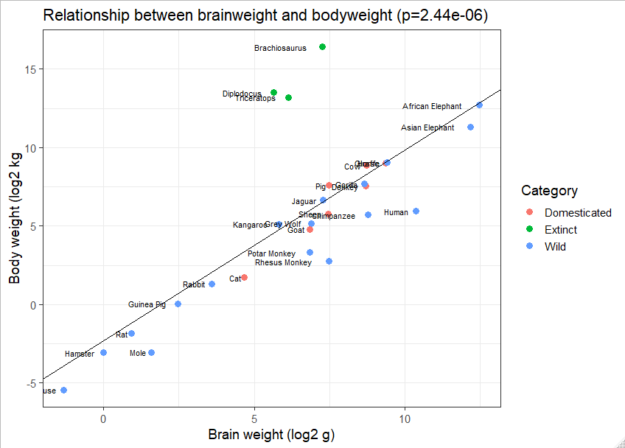

Slide 82
Viewing large variables
In the console
  head(data)
  tail(data, n=10)
Graphically
  View(data) ^{[Note capital V!]}
  Click in Environment tab

