Slide 1


An Introduction to Unix
Sarah Inglesfield, Simon Andrews
v2024-08

Slide 2
Terminology and Distributions

Slide 3









Admin tools
Bundled Software
Support duration / cost

Slide 4


Types of Linux installation
Bare Metal | Physical hardware CD / DVD / USB / Network installation Can be physically accessible (desktop) or remote (server / cluster)
Virtual Machine | Runs within another operating system Portable / disposable Install from ISO / Network
Cloud | Virtual machine on someone else's hardware Amazon / Google are the main providers Range of available hardware

Slide 5
Connecting to Linux Installations

Slide 6


Local vs Remote Connections
Remote Linux Machine
User 1’s
Machine
User 2’s
Machine
username:
password:
Local Linux Machine
username:
password:
?
Local Machine
e.g. working on clusters

Slide 7
Connecting to a remote Linux installation
Remote Linux Machine
What?
Encrypted connection Text based interface
Username + Password + 2FA
or
Username + SSH key + 2FA
How?
OSX or Linux | Use the terminal program which comes with the OS
Windows | Git Bash (https://gitforwindows.org/) PuTTY (https://www.putty.org/)
SSH
"Secure shell"
Local Machine

Slide 8
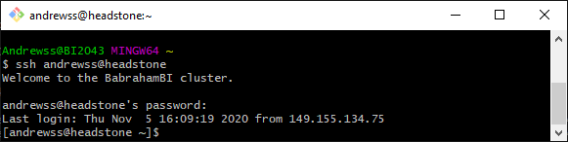
SSH + Password connection
ssh username@server.address
[Will be promoted for password]

Slide 9
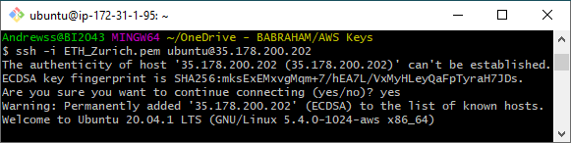
SSH + Key connection
ssh -i [key_file.pem] username@server.address

Slide 10
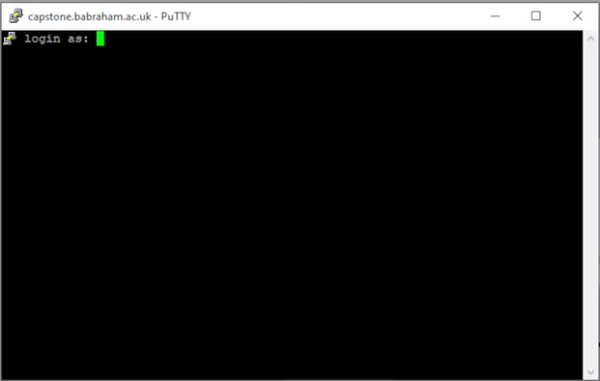
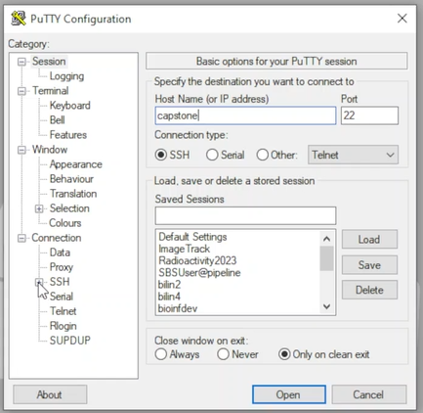
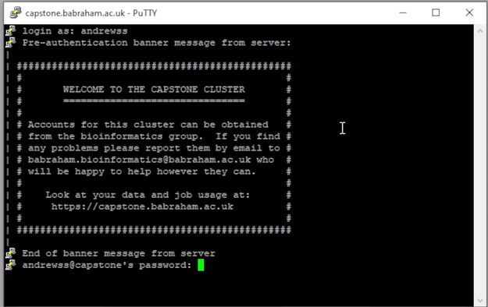
SHH Using PuTTY

Slide 11


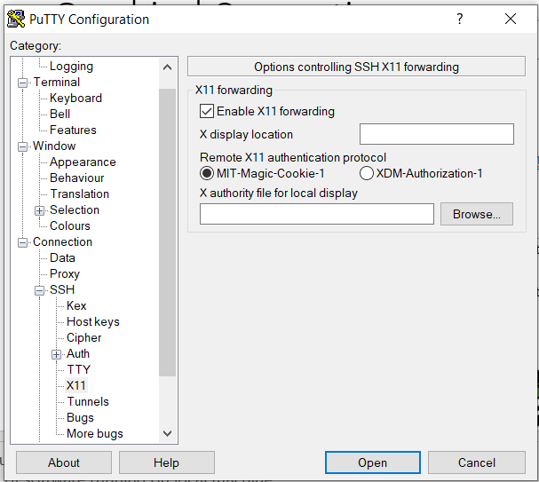


SHH with Graphical Connections
Single application windows
Remote Linux Machine
X11
Sits on top of SSH
https://www.xquartz.org/
https://sourceforge.net/projects/vcxsrv/
SHH
= Just Text
SHH+ X11
ssh -YC -i [key_file.pem] username@server.address
& Text
Virtual Desktop
VNC
Stand alone application or
Browser based desktop

Slide 12
Exercise 1

Slide 13

Running programs in the BASH shell

Slide 14


Launching programs in Linux
Two major methods:
 | Graphical | Command Line
Requires? | Full Graphical Environment e.g. virtual desktop | Command Line Linux Environment
How to Launch a program? | Click an icon | Type commands into an interpreter
Works for: Graphical Programs Non-Graphical Programs
Most data processing and remote access will be command line based
For this we need an interpreter….

Slide 15




Shells
A shell is a command line interpreter, used to launch software in Linux
Text commands are used to launch programs
$
$
</>
Many different shells available:
Largely similar in how they launch programs
Differ in some of their automation/ other clever functions
We will use the most popular shell:
BASH

Slide 16








What Does a Shell Provide?
Command line editing and construction tools
History
Automation
  Scripting language
  Variables, functions etc
$
Job control

Slide 17
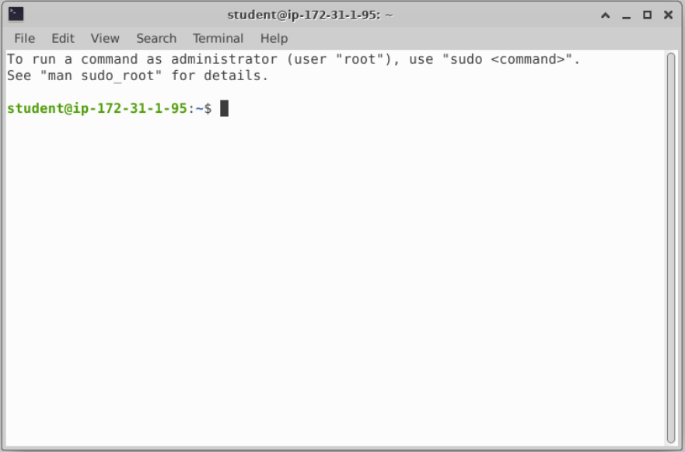

What does a Shell look like?
We will be using a graphical terminal running BASH

Slide 18
Running programs
Type the name of the program you want to run
Add on any options the program needs
Press return - the program will run
When the program ends control will return to the shell
Run the next program!

Slide 19
Running programs
student@ip1-2-3-4:~$ ls
Desktop Documents Downloads examples.desktop Music Pictures Public Templates Videos
student@ip1-2-3-4:~$
Command prompt - you can't enter a command unless you can see this
The command we're going to run (ls in this case, to list files)
The output of the command - just text in this case

Slide 20

Running graphical programs
student@ip1-2-3-4:~$ xeyes
student@ip1-2-3-4:~$
Note that you can't enter another command
until you close the program you launched

Slide 21
The structure of a unix command
ls -ltd --reverse Downloads/ Desktop/ Documents/
Program
name
Switches
Data
(normally files)
Each option or section is separated by spaces. Options or files with spaces in must be put in quotes.

Slide 22
Command line switches
To change the behaviour of the program must write the appropriate switch
Different options are represented by short and/or long forms (usually both)
Short Form | Long Form
Minus plus single letter . -x -c –z . Can be combined -xcz | Two minuses plus a word . --extract --gzip . Can’t be combined
Switches can be binary (on/off) or take an additional value
Binary (on/off) | + Additional Value
Switch alone specifies the behaviour --gzip | An additional value is provided after the switch . -f somfile.txt (specify a filename) --width=30 (specify a value) . Use a [space] or = to separate

Slide 23
Figuring Out Options…
Programmes usually come with documentation for their options and usage
Core Programs | Non-Core Programs
Included with the install | Additional installs e.g analysis tools
Manual page (always) | Help Page (usually)
man [program] | [program] --help (or -h)
These pages all follow a very similar structure…

Slide 24
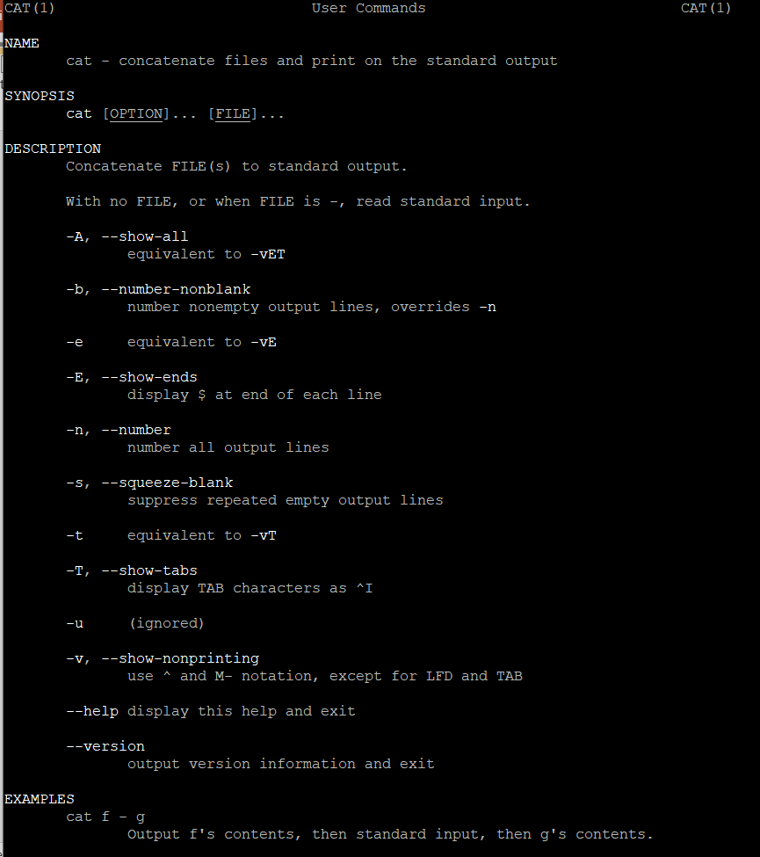
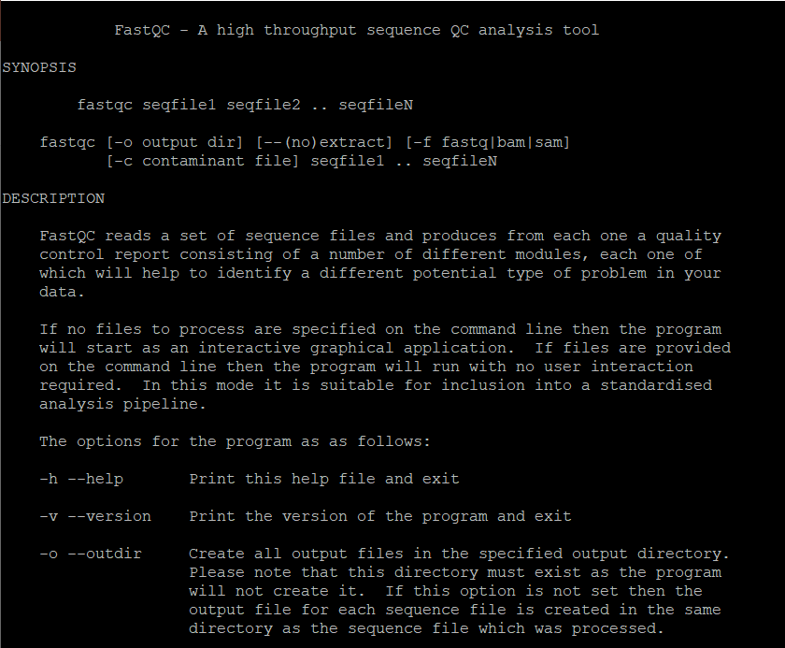
Manual Pages
vs
Help Pages
Name
Synopsis
Description
Examples

Slide 25
Exercise 2

Slide 26
Understanding Unix File Systems

Slide 27
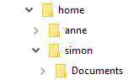
Unix File Systems vs Other File Systems
A Familiar Picture…
Standard OS File System
Hierarchical Directories
Each Directory can contain files
Use drive Letters
Need file extensions e.g. .txt
Same in Unix?

Slide 28


A Simple Unix Filesystem
= Root Directory = Always the top of the file system
= Directory containing all users home directories
= Directory containing all users home directories
= A Directory – note names are case sensitive
= A text file we want to work with
= A USB stick added to the system
How do we write this in our shell?
= Path
$ ls /home/simon/Documents/test.txt

Slide 29
Navigating The File System
Every Unix session has a ‘working directory’
  This is a folder where the shell looks for file paths
Your initial working directory will normally be your home directory (eg /home/user)
There are some useful commands to help navigate the system:
Task | Command
What is my current working directory? | pwd
I want to make a new directory | mkdir [name of directory to make]
I want to move into a different directory | cd [location to move to]
I want to go home | cd

Slide 30
Navigating The File System – An Example
[andrewss@server ~]$ pwd
/home/andrewss
[andrewss@server ~]$ mkdir Simon
[andrewss@server ~]$ cd Simon
[andrewss@server Simon]$ pwd
/home/andrewss/Simon
[andrewss@server Simon]$ cd
[andrewss@server ~]$ pwd
/home/andrewss

Slide 31
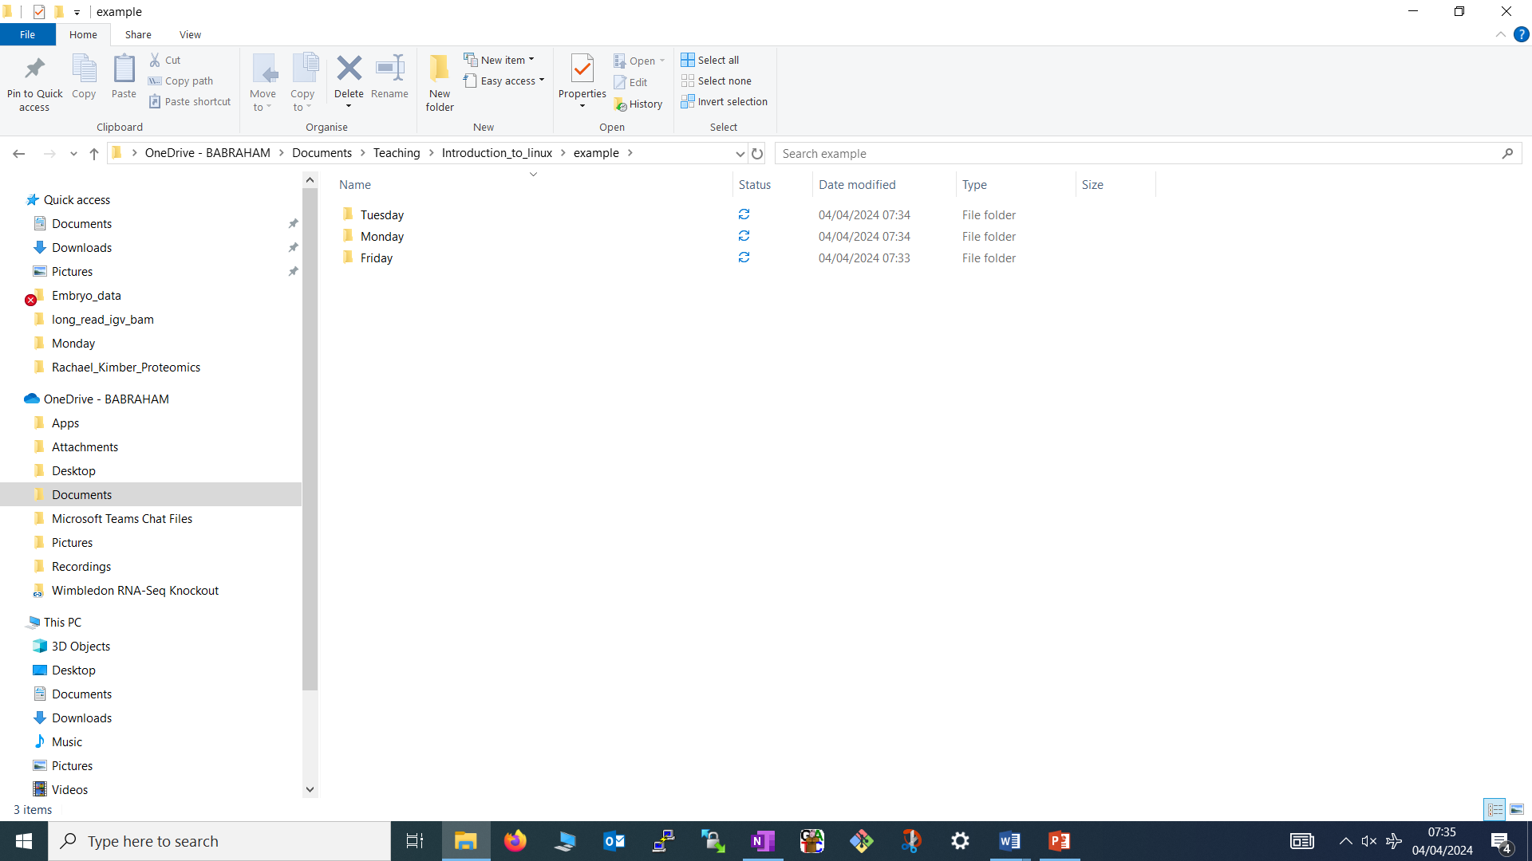
Specifying File Paths
Options:
1. Absolute paths from the top of the file system e.g.
/home/simon/Documents/Course/some_file.txt
2. Relative paths from your current directory e.g.
if we are in Course = some_file.txt
if we are in Documents = Course/some_file.txt
3. Paths using typing shortcuts
/
home
Simon
Documents
Another_Course
Course
some_file.txt
How can we refer to this file?

Slide 32

Specifying file paths - Shortcuts
Some Useful Shortcuts:
~ | The current user's home directory
. | The current directory
. . | The directory immediately above the current directory
/
home
Simon
Documents
Another_Course
If we were in Another_Course
Course
~/Documents/Course/some_file.txt
some_file.txt
../Course/some_file.txt

Slide 33
Specifying File Paths – Question:
/
home
Which Path (or Paths!) will specify my “Fun_ideas.txt”?
sarah
You are here
A
/home/sarah/teaching/multiomics/Fun_ideas.txt
Teaching
B
~/Teaching/multiomics/Fun_ideas.txt
linux
C
QC
multiomics/Fun_ideas.txt
multiomics
Fun_ideas.txt
It’s easy to make mistakes when typing paths

Slide 34

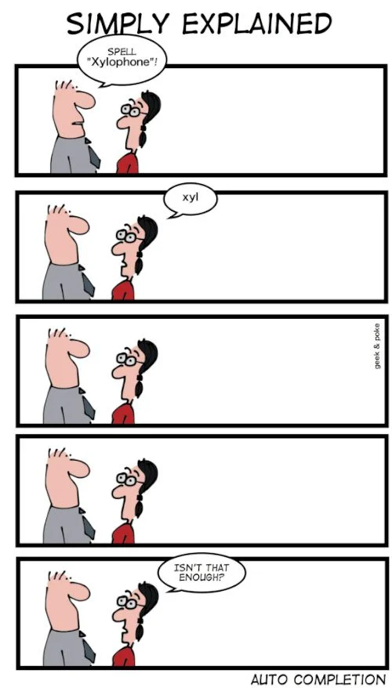
Command line completion…
…Is Basically the shell's version of Autocomplete
Most errors in commands are typing errors in either program names or file paths
Shells (ie BASH) can help by completing paths for us
How?
Type a partial path then press the TAB key
Hooray for the TAB Key!
https://www.datamation.com/trends/tech-comics-is-auto-complete-enough/

Slide 35
Command line completion- Examples
inglesf
You are here
Documents
How Tab Complete Will Work:
T [TAB] → Templates
Downloads
Do-re-me.txt
P [TAB] → Publi
Mi-so-la.txt
Do [TAB] → [beep] . Do [TAB] [TAB] → Documents Downloads Do-re-me.txt . Doc [TAB] → Documents
Music
Public
Published
Templates
You should ALWAYS use TAB completion to fill in paths for
locations which exist so you can't make typing mistakes
(so it won't work for output files!)

Slide 36
Command line completion- Question
inglesf
You are here
Documents
Downloads
Which Is the Shortest Way to Specify Mi-so-la.txt?
Do-re-me.txt
Mi-so-la.txt
A
M[TAB]
Music
B
Mi [TAB]
Public
C
Mi-so-la [TAB]
Published
Templates

Slide 37
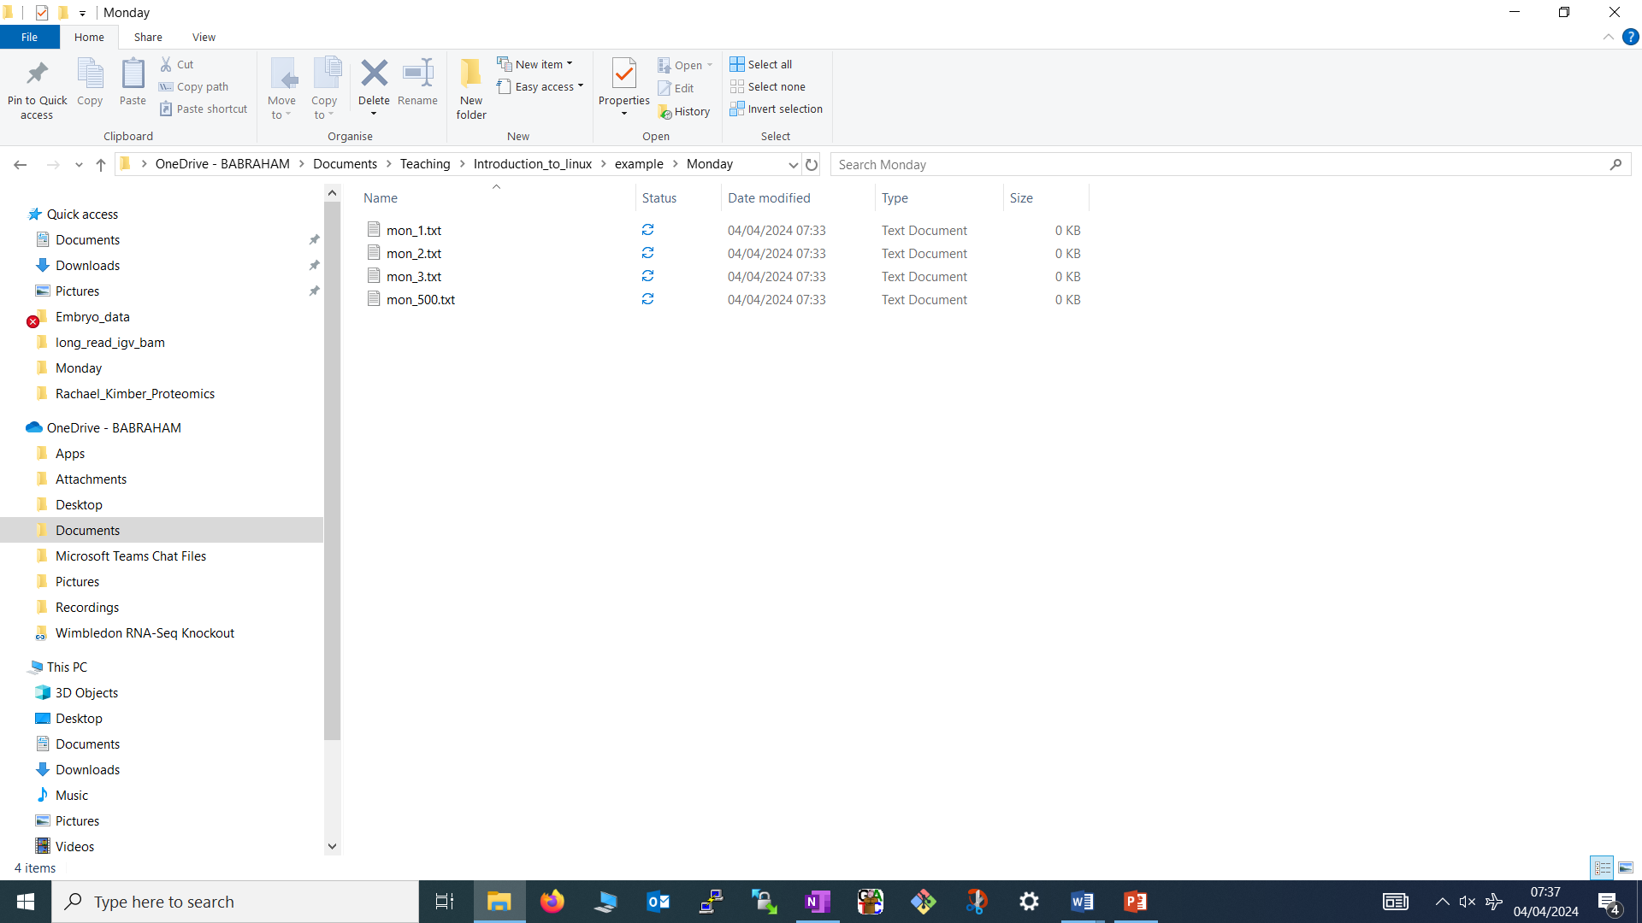
Specifying Multiple File Paths – Wildcards
Sometimes we want to refer to more than one file / location
Common part of name
Unique part of name
2024_report.txt
2023_report.txt
2019_report.txt
2024_report.txt
2023_report.txt
2019_report.txt
Use Wild cards to substitute for unique parts of related file paths
Shell will expand them before passing them on to the program
Wildcard | Meaning | Example
? | One of Any character | 202?_report.txt
* | Any number of Any characters | 20*_report.txt
Could be more ambiguous here e.g. 20* , *.txt or even *
But it depends what else this path would capture!

Slide 38
Using Wildcards
How do we use them:
At any point in the path
Multiple wildcards can be in the same path
Do make sure expression captures files of interest specifically!
Command line completion won't work after the first wildcard
D*
ls -ltd --reverse Downloads/ Desktop/ Documents/
Program
name
Switches
Data
(normally files)

Slide 39
Using Wildcards - Questions
My Working Directory:
Monday
mon_1.txt
mon_2.txt
mon_3.txt
mon_500.txt
Tuesday
tue_1.txt
tue_2.txt
tue_3.csv
How can I list only text files from Tuesday?
A
ls Tuesday/*
B
ls Tuesday/?.txt
C
ls Tuesday/*txt

Slide 40
Using Wildcards - Questions
My Working Directory:
Monday
mon_1.txt
mon_2.txt
mon_3.txt
mon_500.txt
Tuesday
tue_1.txt
tue_2.txt
tue_3.csv
What files will “ls Monday/mon_?.txt” return?
A
mon_1.txt
mon_2.txt
mon_3.txt
B
mon_1.txt
mon_2.txt
mon_3.txt
mon_500.txt
C
tue_1.txt
tue_2.txt
tue_3.csv

Slide 41
Using Wildcards - Questions
My Working Directory:
Monday
mon_1.txt
mon_2.txt
mon_3.txt
mon_500.txt
Tuesday
tue_1.txt
tue_2.txt
tue_3.csv
How can I list all the text files in both Monday and Tuesday?
A
ls ?day/*
B
ls *
C
ls */*txt

Slide 42






Manipulating files
Moving or renaming files
Copying files
Editing text files
Deleting files
Viewing files
(normally text files)
$
Finding files
You will spend a lot of time managing files on a Linux system

Slide 43
Viewing Files
Simplest solution
cat [file] | Sends the entire contents of a file (or multiple files) to the screen.
Quick look
head -[number] [file] tail -[number] [file] | Look at the first X lines of the file Look at the last X lines of the file
More scalable solution
less [file] | A 'pager' program, sends output to the screen one page at a time
–S | A useful switch that stops line wrapping
Navigation inside less: | Return / j = move down one line k = move up one line Space = move down one page b = go back one page /[term] = search for [term] in the file q = quit back to the command prompt

Slide 44
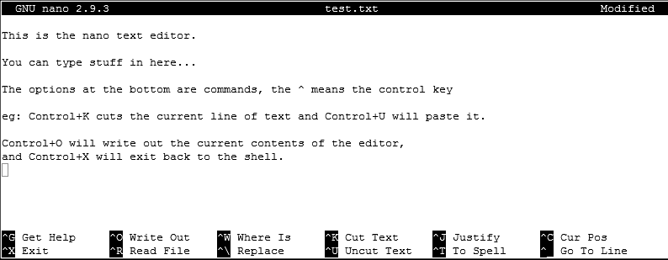
Editing files
Lots of text editors exist, both graphical and command line
Many have special functionality for specific content (C, HTML etc)
nano is a simple command line editor which is always present
nano [filename] | edits if file exists, creates if it doesn't

Slide 45
Moving / Renaming files
Use mv command for both (renaming = moving from one name to another)
mv [existing file or directory] [new name/location]
Good to Know….
  If “location” is a existing directory, the file is moved there with its existing name
  Moving a directory moves all of its contents as well
  Shortcuts can help to form the path of where you want to move files to/from
The return of useful shortcuts!
. | The current directory | Useful for “pull” moves
. . | The directory immediately above the current directory | Useful for “push” moves

Slide 46
Moving / Renaming files – “Push”
Start
Command | Outcome
mv old.txt new.txt
my_dir
new.txt
You are here
mv old.txt ../Saved/
my_dir
my_dir
old.txt
Saved
Saved
old.txt
mv old.txt ../Saved/new.txt
my_dir
Saved
new.txt

Slide 47
Moving / Renaming files – “Pull”
Start | Command | Outcome
 | mv ../my_dir/old.txt .
my_dir
my_dir
old.txt
Saved
You are here
Saved
old.txt

Slide 48
Copying a file
Use cp command on a single file
cp [existing file] [new name/location]
Start | Command | Outcome
 | cp old.txt new.txt
my_dir
my_dir
old.txt
old.txt
new.txt

Slide 49
Copying Directories with recursive copy
cp -r [existing directory] [new name/location]
Start | Command | Outcome
 | cp -r ../Saved NewDir
 | cp -r ../Saved ExistingDir/ (only if ExistingDir exists)
my_dir
my_dir
Saved
NewDir
test.txt
test.txt
my_dir
my_dir
ExistingDir
ExistingDir
Saved
Saved
test.txt
test.txt
*remember the original “Saved” directory will also still exist

Slide 50
Copying files: Match the Command with the Desired Action
my_dir
old.txt
Saved
Command
A) cp old.txt ../Saved/new.txt
B) cp ../Saved/old.txt .
C) cp old.txt ../Saved/
Working Directory | Action
my_dir | 1) Copy old.txt to Saved
my_dir | 2) Copy old.txt to Saved and call it new.txt
Saved | 3) Copy old.txt to Saved

Slide 51





Linking rather than copying
Location A
Location B
Copy duplicates the data in a file
  Can be a problem with big data files
Links are a way to do 'virtual' copies
Two types of link, hard links and soft (or symbolic) links
  We will always use soft links as they're more flexible
Same file
ln -s [from] [to]
Start | Command | Outcome
 | ln -s test.txt test2.txt
mydir
mydir
test.txt
test.txt
test2.txt

Slide 52
Working with symbolic links
When you list a link you can see where it points…
$ ls -l test2.txt
lrwxrwxrwx 1 babraham babraham 8 Sep 11 16:27 test2.txt -> test.txt
…but you can use it like a file
$ cat test.txt This is a test file | $ cat test2.txt This is a test file
=

Slide 53
Finding Things with find
find | [starting point] | [global options] | [other arguments]
Location to start from
modify the behaviour of find
Tests of what to look for
How to handle symbolic links
  -H, -L, -P
  .
How to handle how deep to search in the filesystem
  -maxdepth -mindepth
Find a given file name
  -name [filename]
Find matches belonging to a user
  -user [username]
Find matches of a certain type
  - d –f
mydir
Example:
file1.txt
file3.txt
find .–maxdepth 1 –name ‘*.txt’
file2.txt
file4.csv
mysubdir
yet_another_file.txt

Slide 54

Deleting files
Linux has no undo.
Deleting files has no recycle bin.
Linux will not ask you "are you sure"
Use the rm command to delete files and directories (and all of their contents)
rm [name(s) of file to delete]
rm –r [name(s) of directory to delete]
Examples
  rm test_file.txt test_file2.txt
  rm -r Old_directory/

Slide 55

Deleting files – With Wildcards
You can use the wildcard shortcuts to delete multiple files or directories
rm *.txt
be VERY careful using wildcards
rm * .txt
Accidental space
Always run ls first to see what will go

Slide 56
Exercise 3

Slide 57

More advanced BASH usage

Slide 58
What we know already
How to run programs
  How to modify the options for a program using switches
  How to supply data to programs using file paths and wildcards
How Can we Usefully Build on this?

Slide 59




What else can we do…
Check for errors in programs which are running
Link programs together into small pipelines
Record the output of programs
Automate the running of programs over batches of files
$
All possible with a bit more knowledge of the BASH Shell

Slide 60


Communicating with Programs
Three data streams exist for all Linux programs:
STDOUT
Standard Output
a way to send expected data out of the program
Standard Input
STDIN
program
STDERR
Standard Error
a way to send data into the program
a way to send errors/warnings out of the program
By default STDOUT and STDERR are connected to your shell
so when you see text coming from a program it's from these streams

Slide 61
Communicating with Programs
Redirecting standard streams to files
Redirecting standard streams to other programs

Slide 62
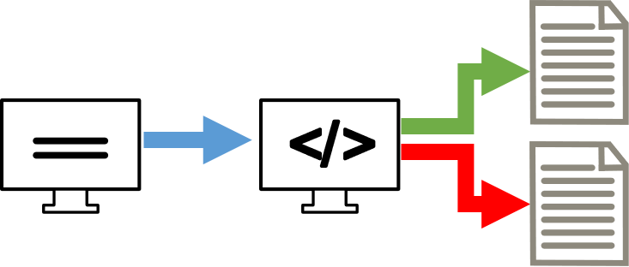
Redirecting standard streams
You can redirect using arrows at the end of your command
> [file] | Redirects STDOUT
2> [file] | Redirects STDERR
> [file] 2>&1 | Sends STDERR into STDOUT
< [file] | Redirects STDIN
$ find . -print > file_list.txt 2> errors.txt
$ ls
Data Desktop Documents Downloads errors.txt examples.desktop file_list.txt Music Pictures Public Templates Videos
$ head file_list.txt
.
./Downloads
./Pictures
./Public
./Music

Slide 63

Throwing stuff away
Sometimes you want to be able to hide output
  STDOUT - I just want to test whether something worked
  STDERR - I want to hide progress / error messages
Linux defines a special file /dev/null
Which just discards all data sent to it
Throw away the STDOUT | program > /dev/null
Throw away the STDERR | program 2> /dev/null

Slide 64

Linking programs together with pipes
UNIX was designed to have lots of small programs doing specific jobs
Which could be linked together to perform more advanced tasks
ect.
Do this by connecting STDOUT from one program to STDIN on another
This is done with Pipes |
$ ls | head -2
Data
Desktop

Slide 65
Useful programs for pipes
You can theoretically use pipes to link any programs
But there are some which are particularly useful, like:
wc | to do word and line counting
grep | to do pattern searching
sort | to sort things
Uniq | to deduplicate things
less | to read large amounts of output
zcat/gunzip/gzip | to do decompression or compression

Slide 66
Small example pipeline
Take a compressed fastq sequence file, extract from it all of the entries containing the telomere repeat sequence (TTAGGG) and count them
Decompress the fastq file
Find the pattern
Count the matches
zcat file.fq.gz
| grep TTAGGGTTAGGG
| wc -l
$ zcat file.fq.gz | wc -l
179536960
$ zcat file.fq.gz | grep TTAGGGTTAGGG | wc -l
3925

Slide 67

Iterating over files
When processing data often need to re-run the same command multiple times for different input/output files.
X
*.txt
*.txt
Some programs support being provided with multiple input files i.e. wildcards!
BUT MANY DON’T!
Instead we use the automation features of the BASH shell to automate running these programs

Slide 68

The BASH for loop
What?
How?
Use Simple looping construct
Start with a set of files (or values)
Temporary
Environment
Variable
ect.
command
Loop over these to do some function for each in turn
Write commands using a special variable
Takes on the value of each item in turn

Slide 69
Example of BASH for loops
for file in *txt
do
echo $file
grep .sam $file | wc -l
done

Slide 70

Job Control
By default you run one job at a time in a shell
Shells support multiple running jobs
jobs | lists the jobs in this shell
States of job:
Running - foreground | shell has the attention of the job
Running - background | output goes to the shell but other jobs can run
Suspended | job exists but is paused, consumes no CPU
Running - disconnected | output is no longer attached to the shell

Slide 71
Job Control
Working Directory
prog_to_run | starts in foreground
prog_to_run & | starts in background
Control + Z | suspends the current job
bg fg | Send a job to the background
 | Bring a job to the foreground
nohup prog_to_run nohup prog_to_run > log.txt & | disconnects, logs to nohup.out … or redirect to your choice of file Means it can’t be killed when terminal exits

Slide 72
More Extended Job Control on Clusters
Control on a single machine
vs
Control on a Cluster
User 1’s
Machine
User 2’s
Machine
Same for small jobs we can run on the Head Node
  e.g. nohup, fg, bg
Need a bit more control for bigger jobs
  Workload managers
  Workflow managers

Slide 73


Workload managers – Cluster Queues
Job 1
Compute
Node
Compute
Node
Head Node
Job 2
Compute
Node
Compute
Node
Job 1
Job 3
…
Job 3
Job 2
Compute
Node
Compute
Node

Slide 74
Workload managers – Cluster Queues
Submitting a job directly
Submitting a job to a workload manager
fastqc data.fq.gz
ssub
-o f.log
--cores=2
--mem=5G
fastqc data.fq.gz

Slide 75





Workflow Mangers – Beyond 1 job…
Imagine you have generated RNAseq data for 4 samples…
QC reports
QC reports
QC
QC
Multi-QC
Summary report
Fastq files
Trim
Map
Trimmed
Fastq files
Bam files
…A lot to coordinate!

Slide 76


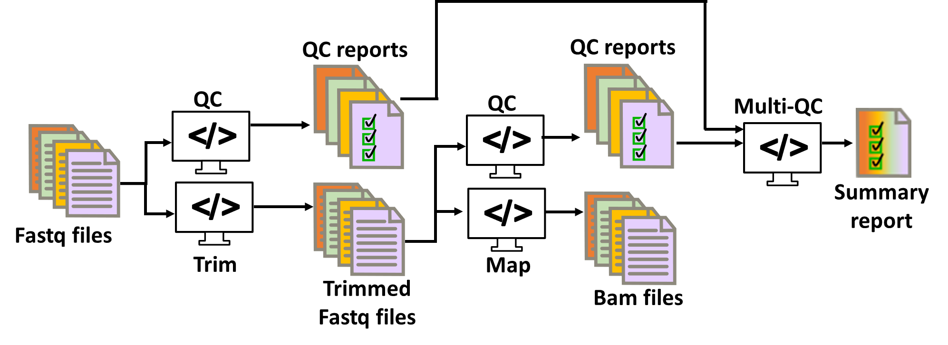
Workflow Mangers
Larger Scale Automation
Multiple Programs
Multiple Files
Integrates with Clusters
Turn this…
…Into this!
nf_rnaseq --genome GRCh38 *fastq.gz

Slide 77
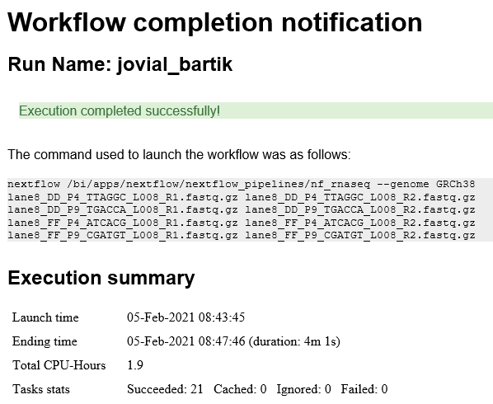
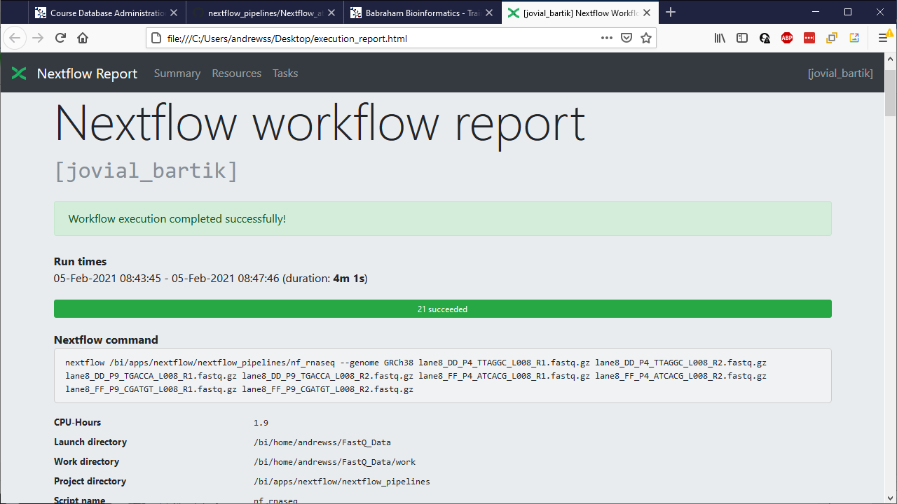
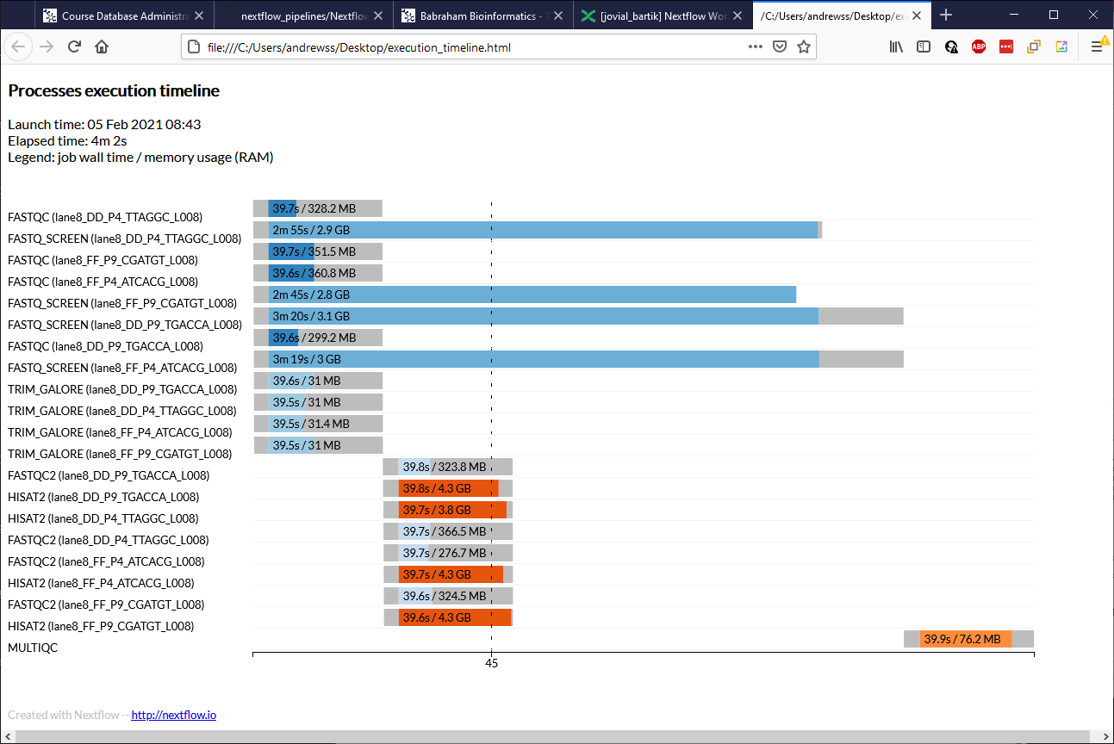
executor > slurm (21)
[15/929bd5] process > FASTQC (lane8_DD_P9_TGACCA_L008) [100%] 4 of 4 ✔
[b9/674ced] process > FASTQ_SCREEN (lane8_FF_P4_ATCACG_L008) [100%] 4 of 4 ✔
[ca/b39d14] process > TRIM_GALORE (lane8_FF_P9_CGATGT_L008) [100%] 4 of 4 ✔
[c0/4dcaf9] process > FASTQC2 (lane8_FF_P9_CGATGT_L008) [100%] 4 of 4 ✔
[58/879cf5] process > HISAT2 (lane8_FF_P9_CGATGT_L008) [100%] 4 of 4 ✔
[c4/cfe1f1] process > MULTIQC [100%] 1 of 1 ✔
Completed at: 05-Feb-2021 08:47:47
Duration : 4m 2s
CPU hours : 1.9
Succeeded : 21

Slide 78
Exercise 4

